Slide 1
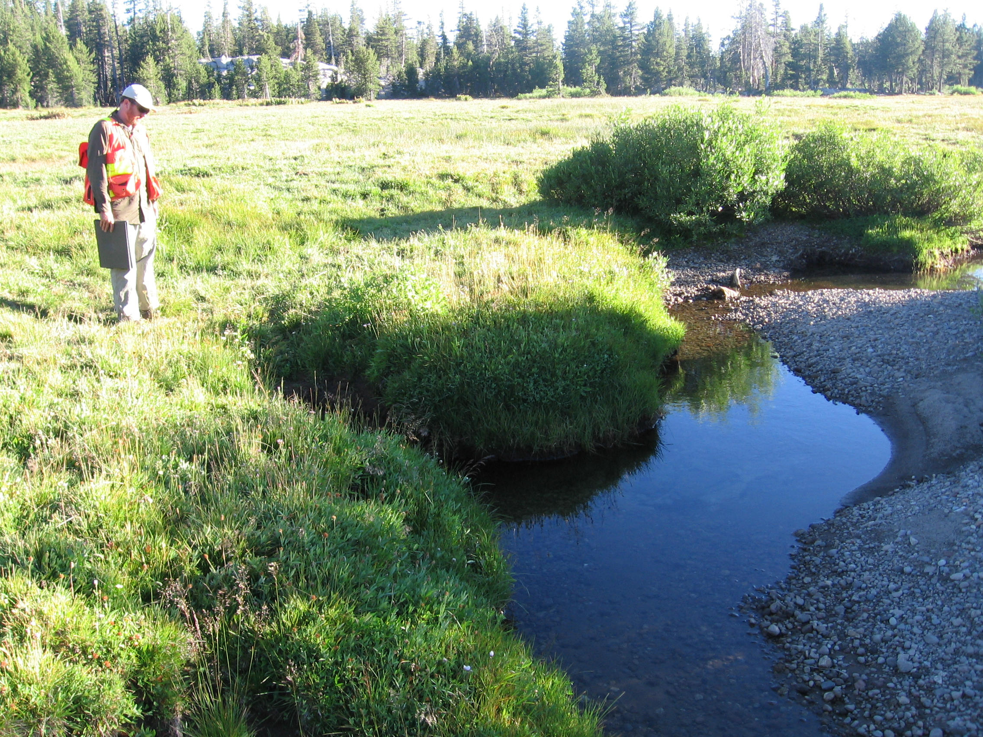
Sierra Meadow Wetland and Riparian Area Monitoring Plan
SM-WRAMP

Slide 2
Sierra Meadow Wetland and Riparian Area Monitoring Plan
SM-WRAMP
What is our GOAL?
Sierra-Wide Monitoring Program
Robust
Replicable
Cost-efficient
What will be Gained?
Steer SMP 30,000 ac goal - Program Tracking
Increase Support - Demonstrate Benefits of Restoring/Protecting Meadows
Do a Better Job per Meadow - Adaptive Management
Do Better for Meadows - Learn as We Go for best results
Increase Resilience to Climate Change – better understanding = more
effective actions

Slide 3
Sierra Meadow Wetland and Riparian Area Monitoring Plan
SM-WRAMP
Estimated Completion Dates | Task Name
On –going | Establish and Coordinate the SM-WAC
Summer 2019 | Draft Protocols
Winter 2019 | Develop Guidelines for Protocols
Fall 2020 | Pilot, and Finalize Protocols
Summer 2019-2021 | Engage Agencies
Winter 2019 | Develop Guidance on Protocol Management
Spring 2021 | Training
Winter 2020 | Database

Slide 4
SM-WRAMP Plan
Level 1: Inventory: cost per acre, restoration type, photo’s
Level 2: Assessment
Level 3: Monitoring when the goal of restoration has been identified – select the appropriate monitoring

Slide 5
Goals of Restoration (aka Desired Conditions)
Desired Conditions – Current Conditions =
Needs (Goals) → Smart Objectives

Slide 6
Goals of Restoration
Site Appropriate
Floodplain connectivity
Elevated groundwater table
Increased Biodiversity
Grazing Management
Reduced Invasive Species
Sediment inputs and outputs
Maintain/Increase Soil Carbon
Improved water quality
Resilience to climatic perturbations
Watershed Linkages/Forest Health
Cultural Values
Complexity at different scales
Sustainability (beaver, natural processes)

