Slide 1

Butte Creek House Ecological Reserve Meadow Restoration

Slide 2
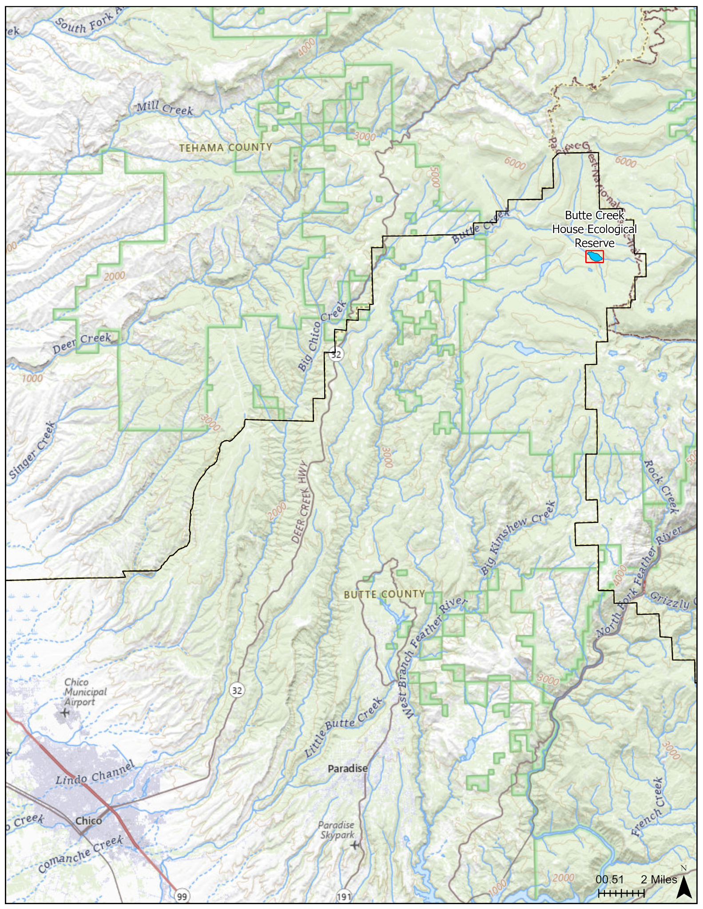
Project Location & Site History
Headwaters of Butte Creek
Northern corner of Butte County, east of Butte Meadows
100 acre wet meadow habitat
Historic overgrazing and logging activities
Acquired by CDFW in 1987
In 2021 the Dixie Fire burned most of the watershed at high severity

Slide 3
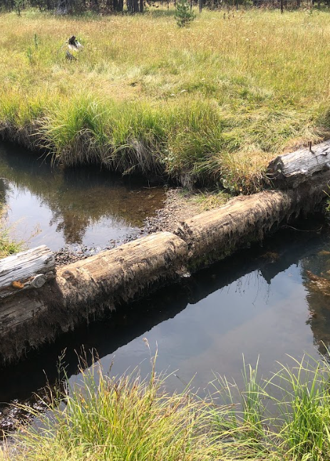
Current Conditions
Headcutting
Lack of continuity between the riffles and floodplain
Main channel is oversized
Incised channel located outside of valley low
Check dams installed in 1990 have slowed degradation but have reached their life span

Slide 4
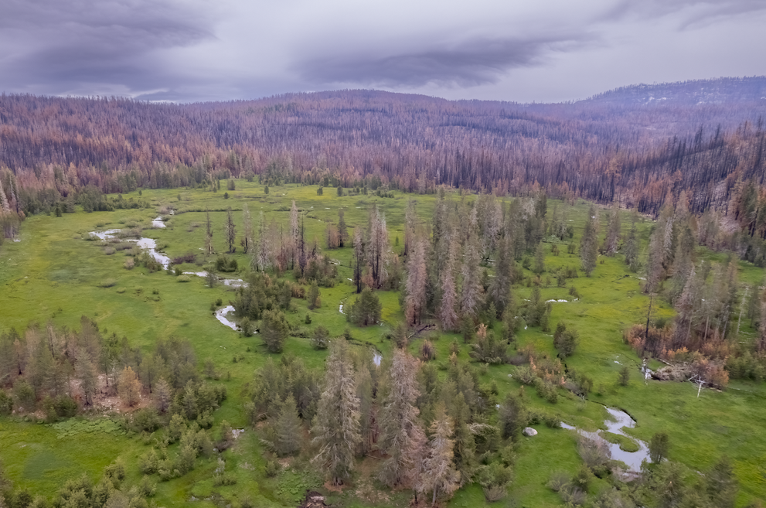
Post-Dixie Fire
Notes:
320 acre property, 100 ac wet meadow

Slide 5
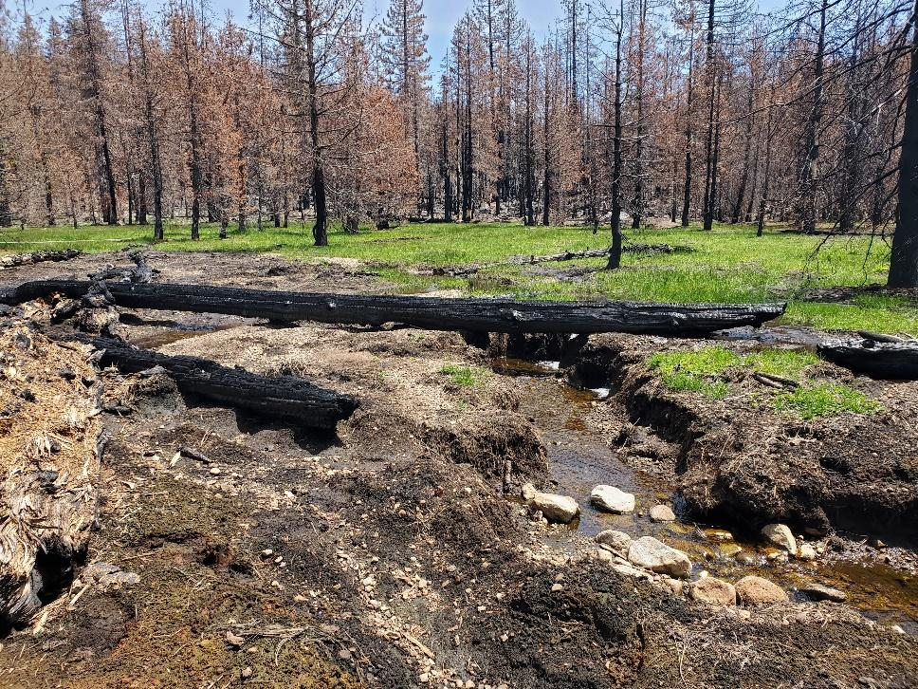
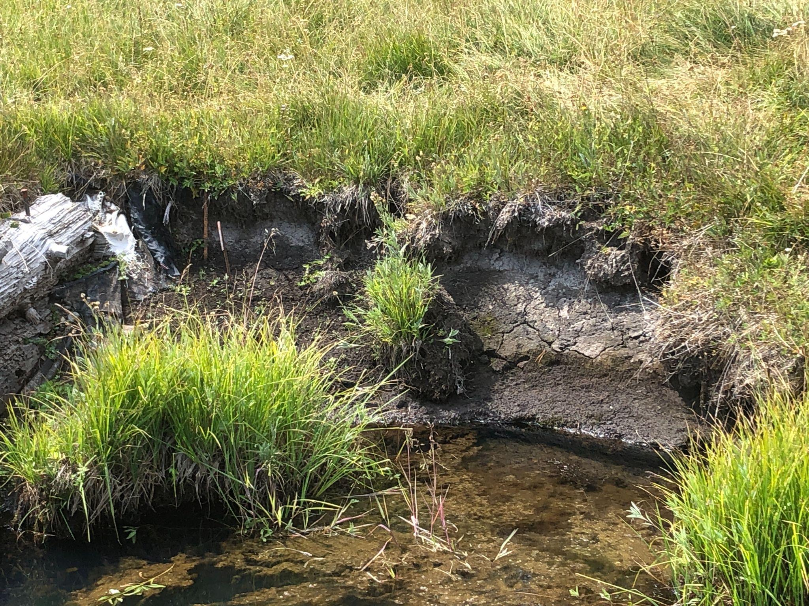
Headcut within upper meadow
Bank erosion

Slide 6
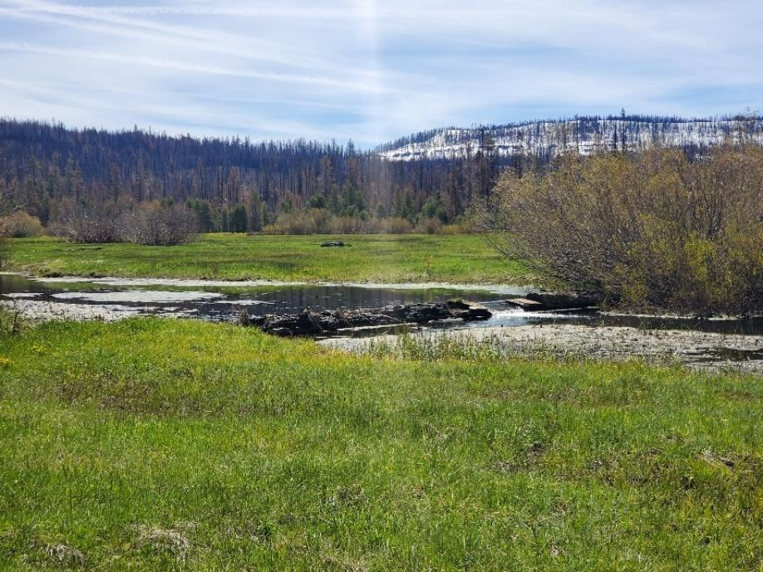
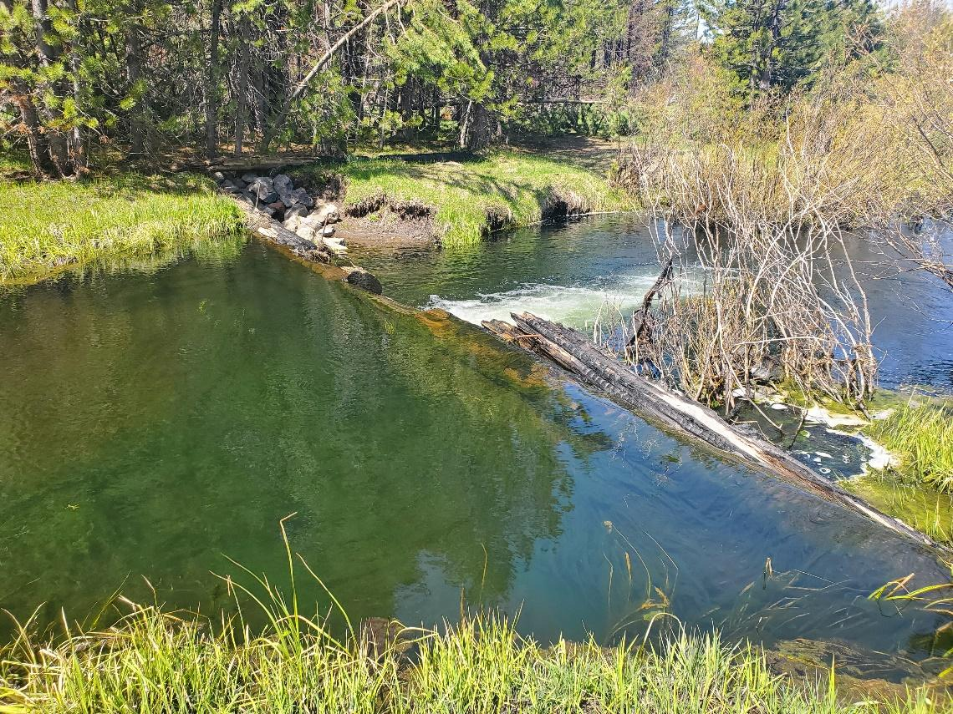
Existing log weir with water impounded at or near meadow’s surface
Log weir showing signs of degradation, scour (downstream left bank) and lack of upstream aggradation

Slide 7
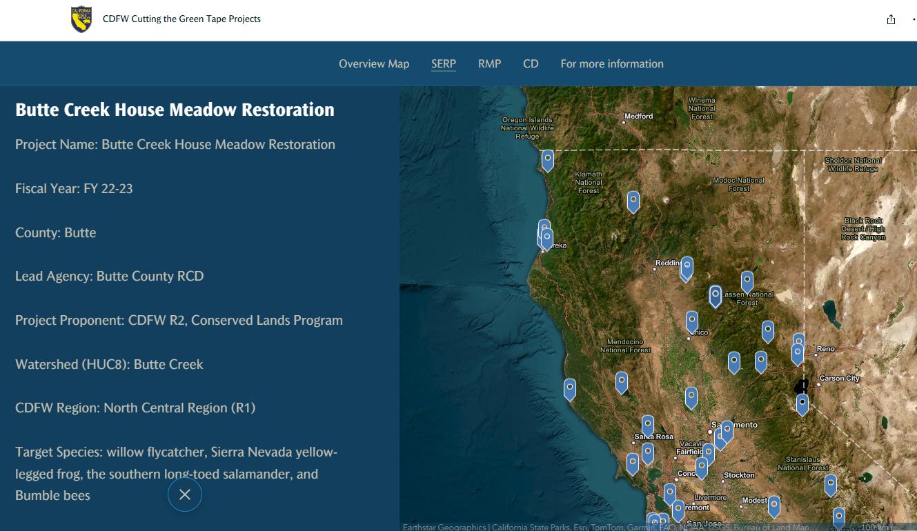
Statutory Exemption for Restoration Projects
“Cutting the Green Tape”
For projects that protect, restore, conserve or assist in recovery of native spp. and their habitat
CDFW pre-consultation & application support
< 1 year
9 page application + supporting materials
NOD $50 filing fee
401, 404, 1602 permits still required
https://storymaps.arcgis.com/stories/f2ff115a6add4732bcd128cc59009ca

Slide 8
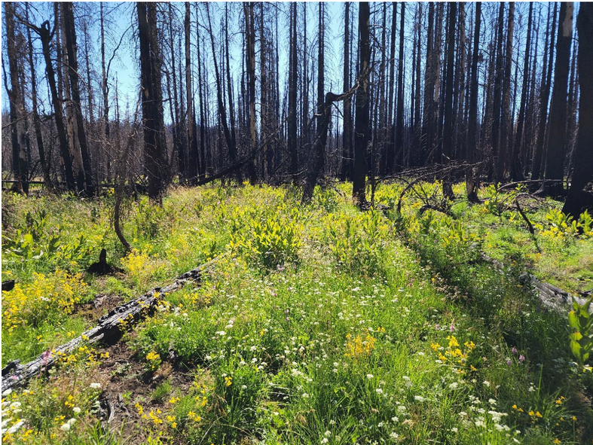
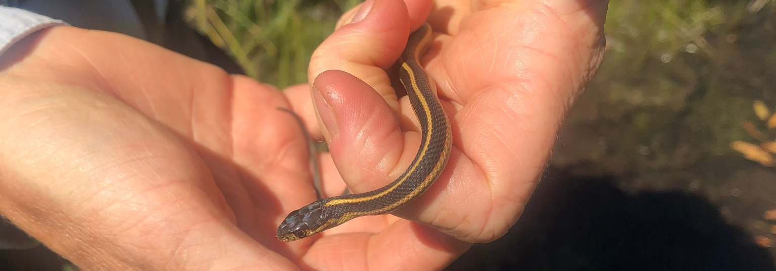
Upcoming Implementation
Restoration Outcomes: restore hydrological function and structural complexity to increase habitat diversity and resilience to climate change.
2024 Field Season
PALS/BDAs, timber falling, rock riffles, headcut treatment, heavy equipment first entry.
2025-2026 Adaptive Management
Willow and native wetland spp. planting in 2025, PALS/BDA maintenance until 2026…. beavers to maintain after?

Slide 9
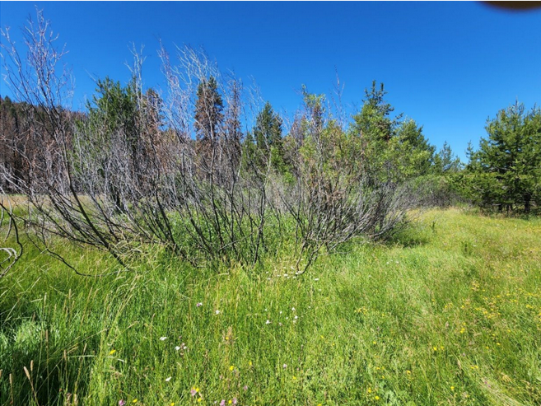
Possible Beaver Reintroduction
Surrounded by LNF
Closest community (Jonesville) is 7 mi. away
CDFW shared interest
Ranked highest restoration potential for translocating and low effort required to establish beaver dams on the landscape (Beaver Restoration Assessment Tool AKA BRAT)
Improve redundancy and maintenance of dam structures
Burned and resprouting Lemmon’s willow

Slide 10
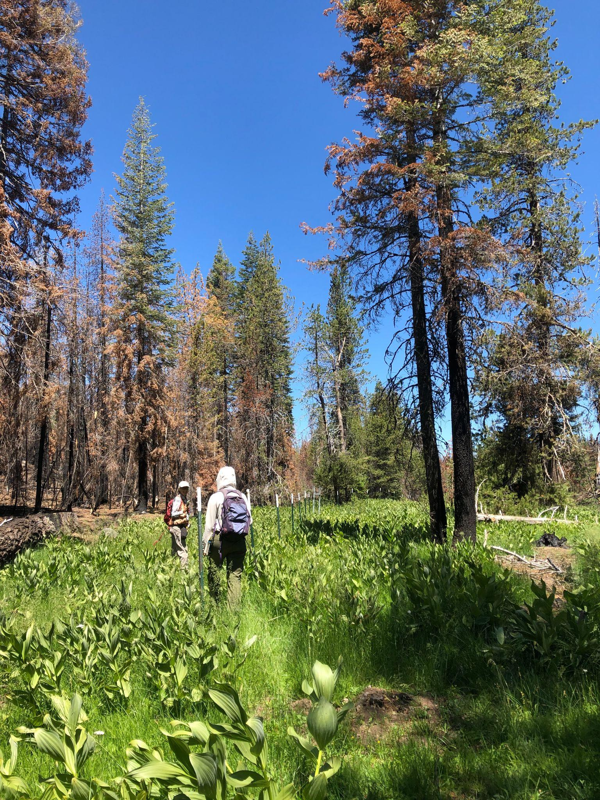
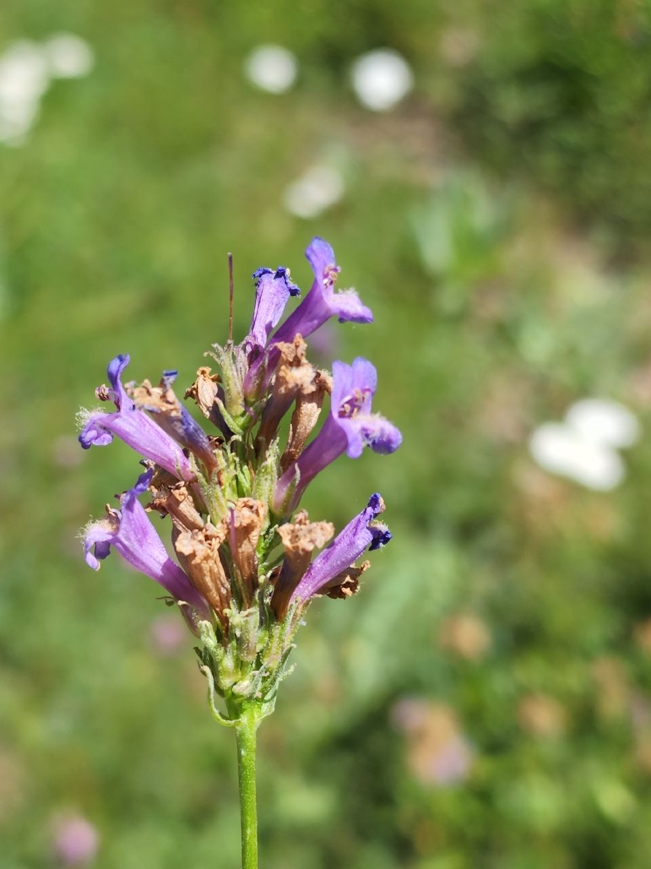
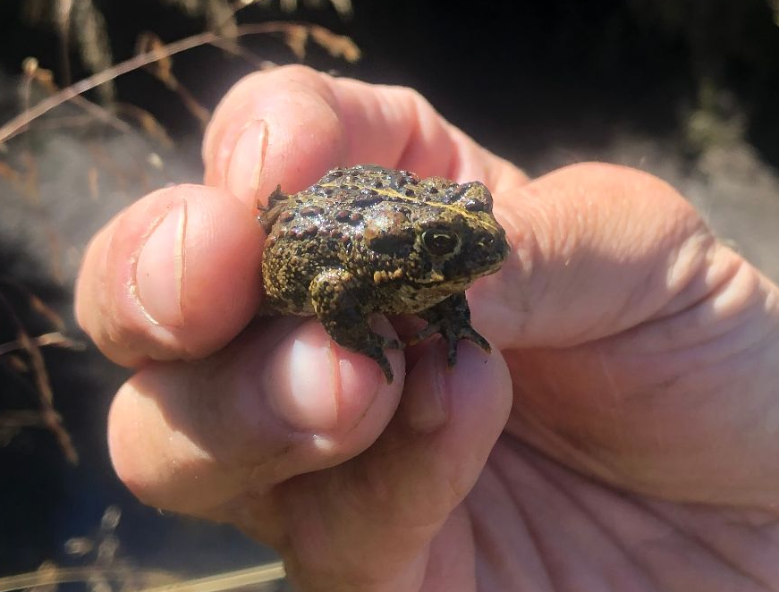
Thanks for listening and to SMP for making this project possible!

