Slide 1
Proposition 1 DFW-Funded Cap and Trade Projects
Progress and Updates
Sierra Meadows Workshop III
February 7-10, 2017

Slide 2
Osa Complex-Where We Are

Slide 3
Osa Meadows Context
Before - After Control - Impact (BACI) Design
Primary response variables
•CO2, N2O, CH4 flux
•Net ecosystem carbon storage
Hypothesized Co-variates
•Soil temperature
•Soil water content
•Air temperature
•Vegetation biomass
•Vegetation wetland status
•Soil texture
•Groundwater level
Sample Size: 3 Meadows
1 Impact- Osa Meadow
1 Control- Partnership Meadow
1 Reference- Bonita Meadow
Notes:
Hydrologically degraded meadow to the left with a groundwater table below the rooting zone during the growing season, supporting plant community with overall low productivity. Most of litter is rapidly decomposed, leaving little soil organic material (SOM). Small amounts of litter is mineralized, supporting low rates of nitrification and no or small N₂O emissions as an intermediate by product of nitrification. (b) Restoration raises growing season water table to support much more productive plant community; saturated soils support very slow anaerobic decomposition, leading to rapid buildup of soil organic material (SOM), and potentially supporting reductive processes of denitrification and methanogensis.

Slide 4
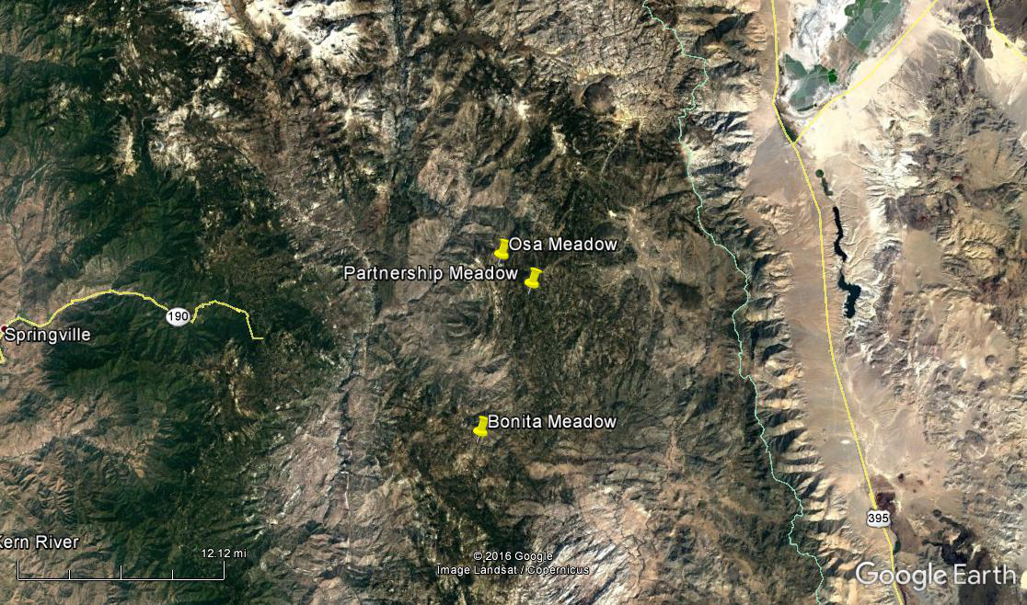
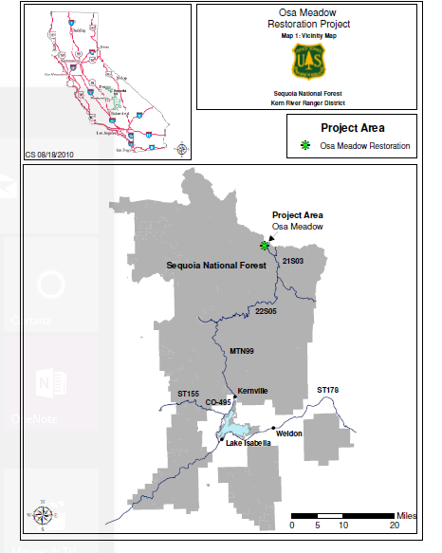
Osa Meadow Complex Overview
California Trout
Grantee, Principle Investigator
Stillwater Sciences- Amy Merrill and Nate Lawrence
Principle Scientists and team lead
NFWF
Grantor/Planning and Permitting
US Forest Service
Lead agency for NEPA, Land manager
UC Merced- Steve Hart and Abby D.
Scientist, TAC Member, Lab work.
Plumas Corporation
Plan Design, Permitting, GHG project sampling
Todd Sloat Consulting
Plans and Designs
UNR/TU/Sabra Purdy and Erin Smith
Pre-restoration Habitat assessment
CDFW
Grantor for research and restoration
Ben Sullivan, UNR
TAC Member
Notes:
All Riparian HGM type

Slide 5
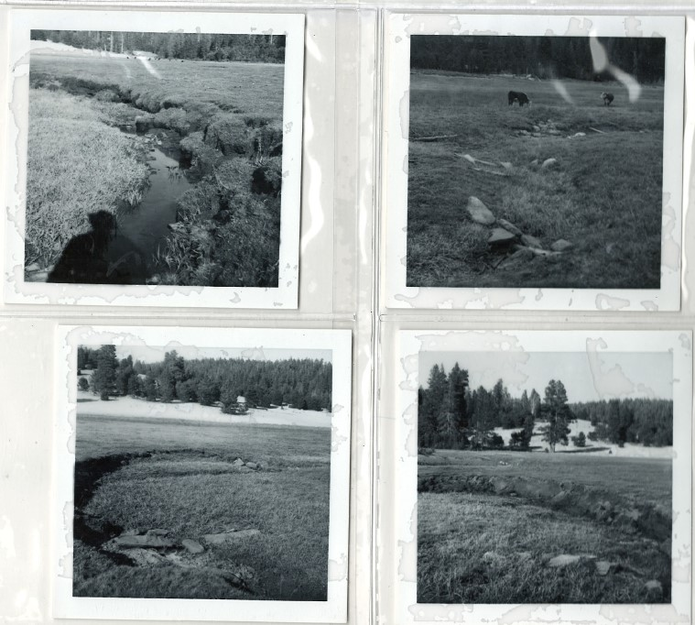
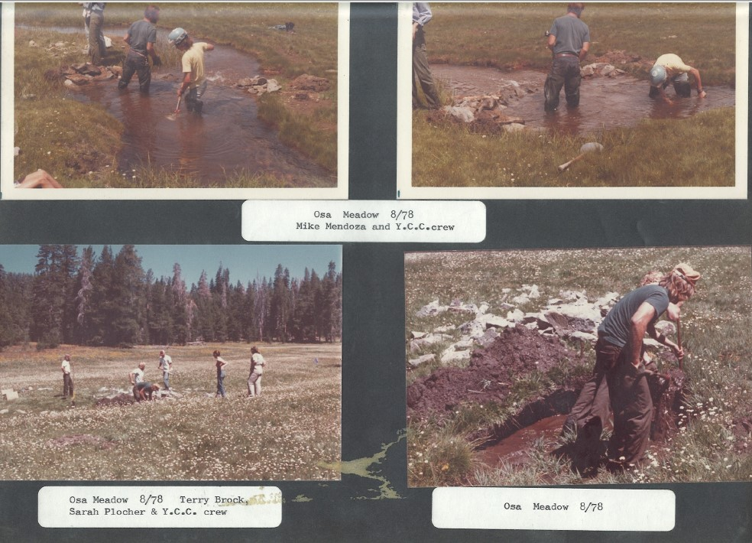
Land-use History
Grazing
+ Fire
+ Precipitation
= Severe Downcutting! → De-watering!
History of restoration and research
- Check Dams, WIFL counts, rock dams, willow planting.

Slide 6
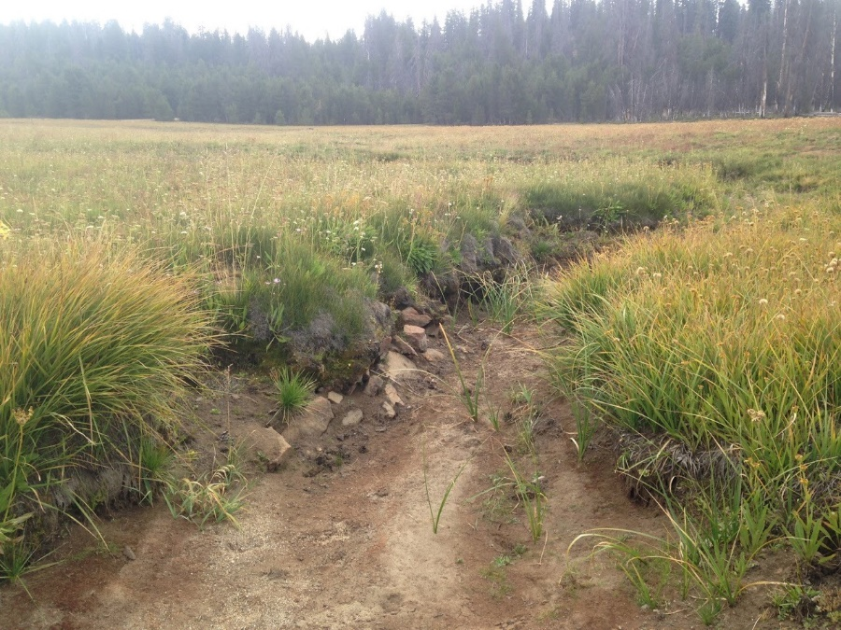
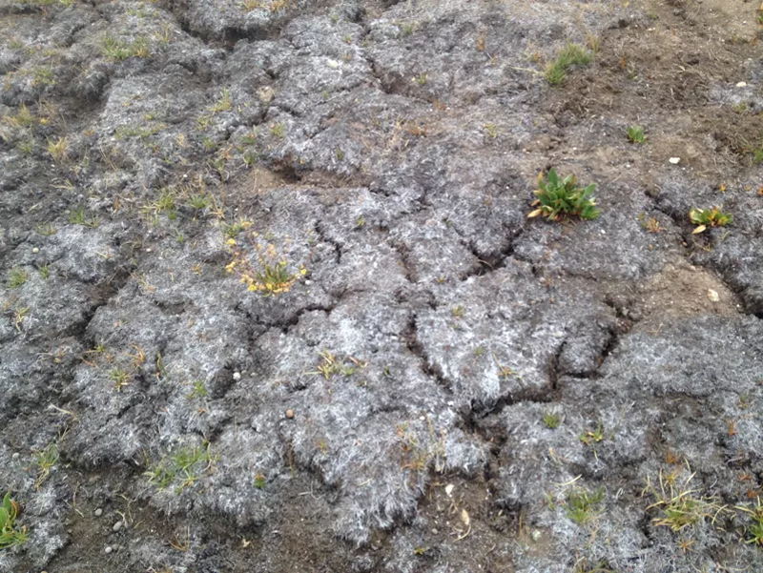
Pre-Restoration meadow conditions
Biological:
Kern River Rainbow Trout resident downstream
Potential MYLF habitat- Federal Listing of Endangered
Conifer Encroachment
Bare ground and forbes dominate
Hydrologic:
High width-depth ratio
Low water table
Moderately incised in the lower 2/3rd, Upper 1/3rd still functional, but at risk from incision
Notes:
oder

Slide 7
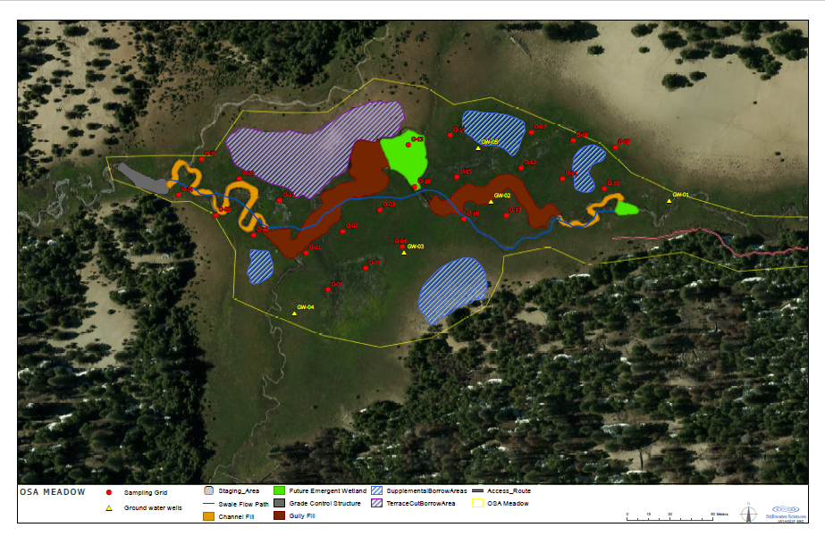
OSA Field Map- RESTORED
Notes:
55 Acres total, 19 acres→ 30-40 acres to be restored.

Slide 8
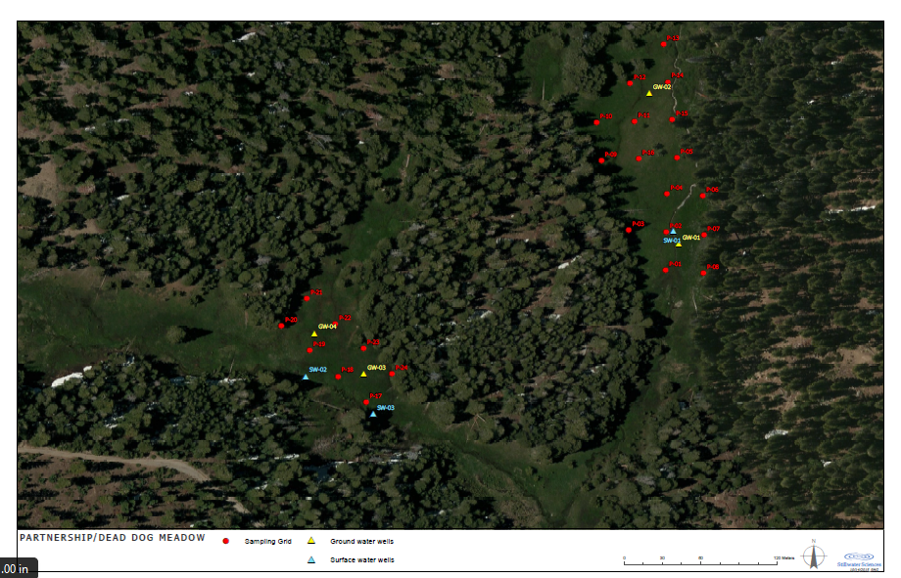
Partnership Field Map- Control
Notes:
Control

Slide 9
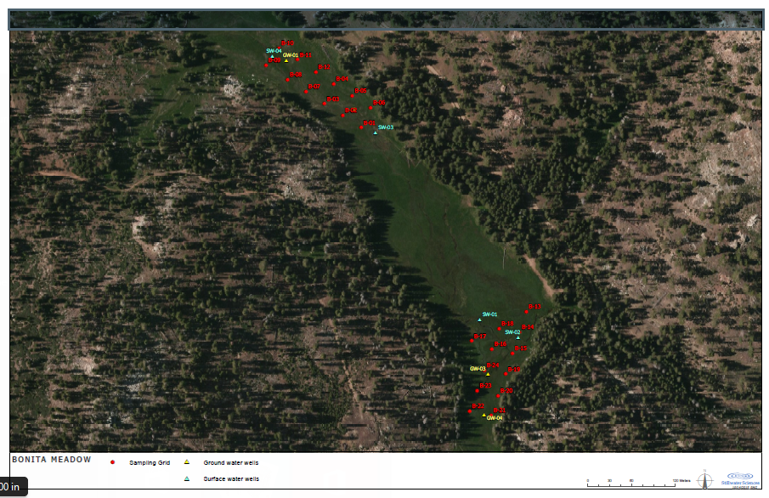
Bonita Field Map- Reference
Notes:
Reference-

Slide 10
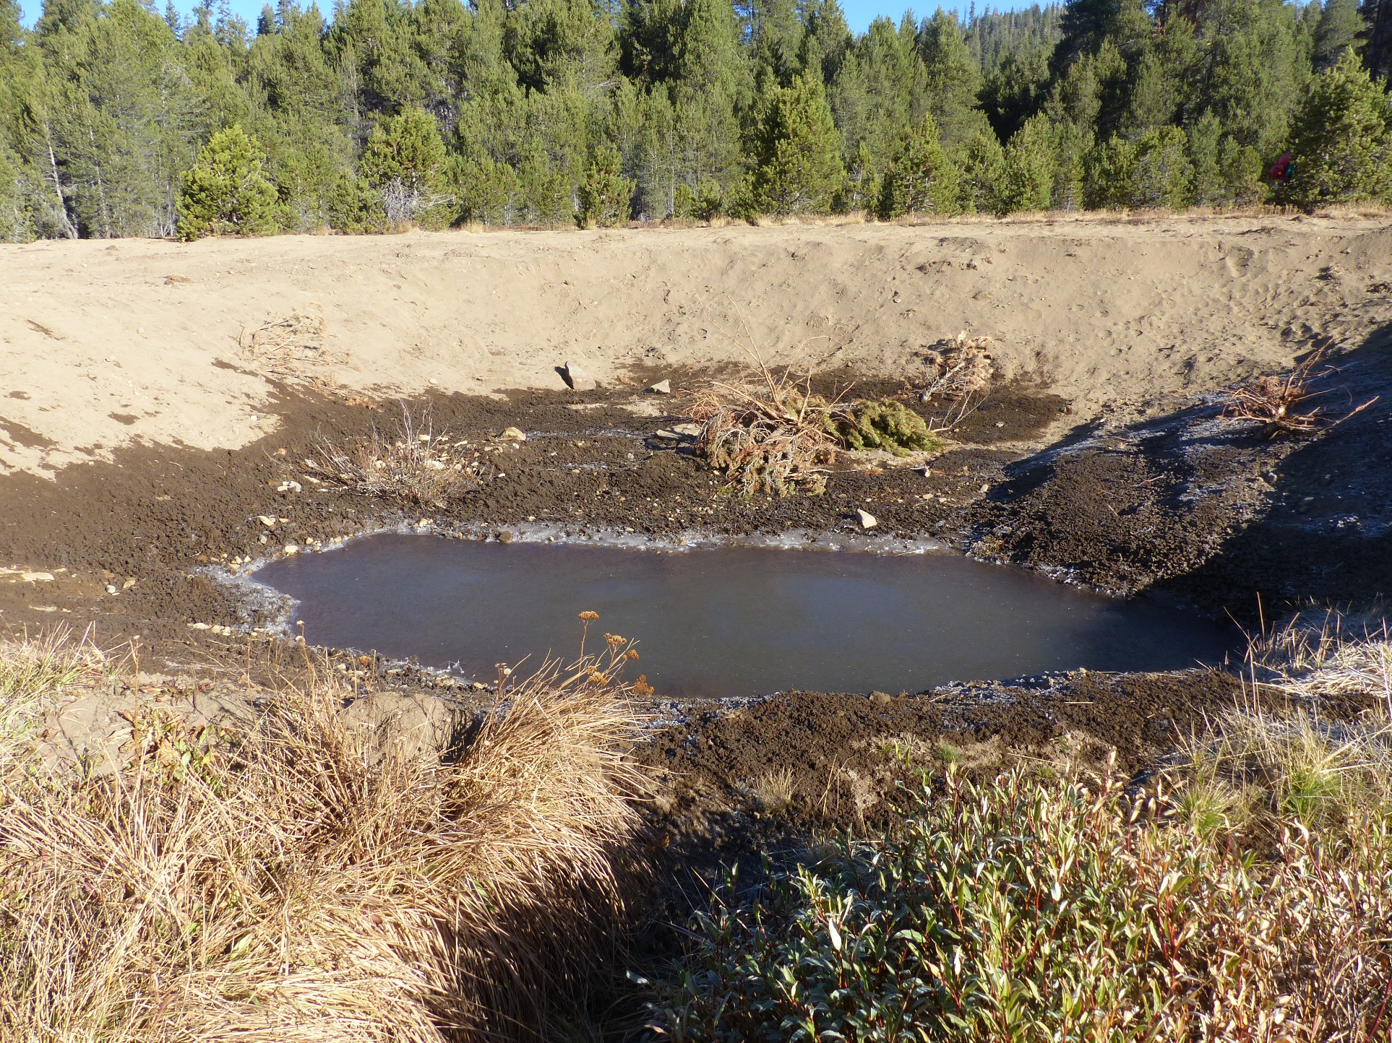
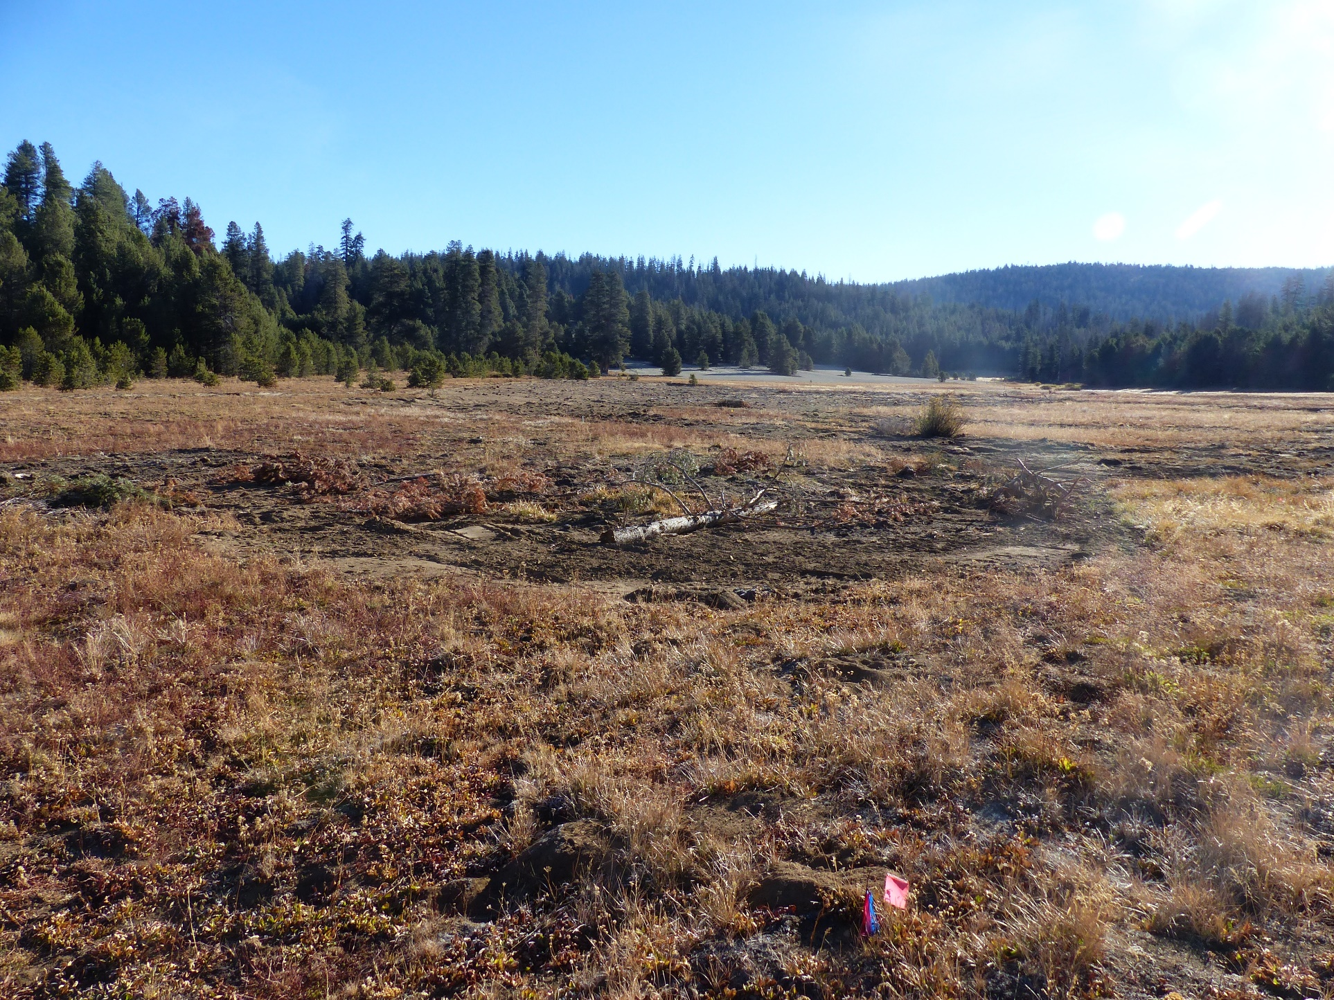
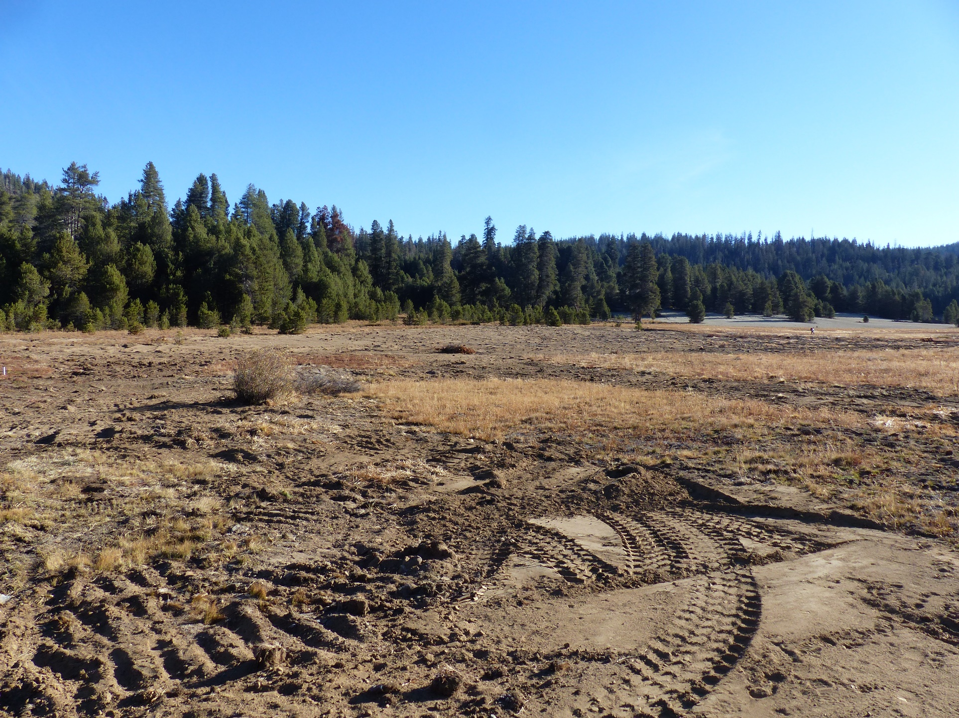
Successes:
No rock imported
Restoration was less expensive then planned
Challenges:
Machinery to remote location
Conifer encroachment
Re-vegetation timing
Notes:
Successes and Challenges?

Slide 11
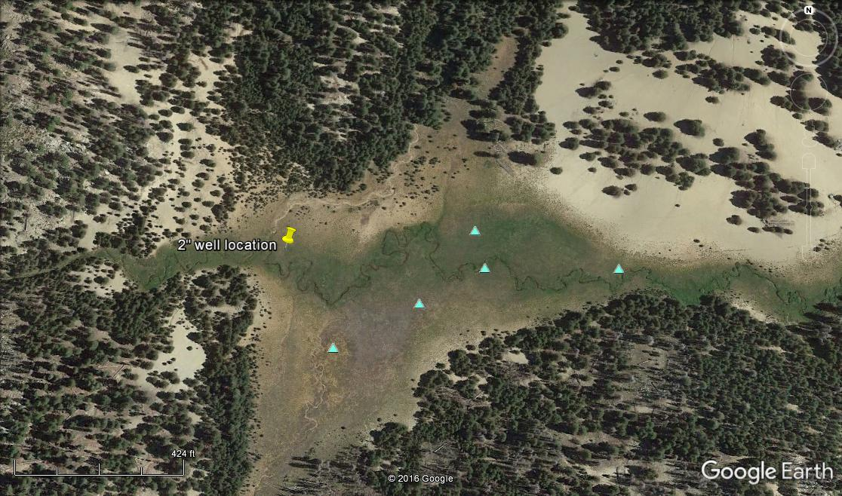
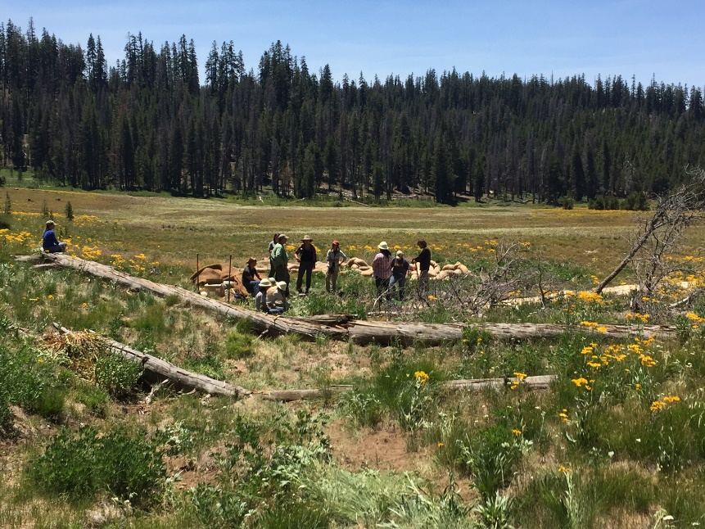
Next Steps
Post-restoration monitoring:
No “rest” period
Continue GHG sampling when accessible every 3 weeks.
Soil moisture, GW wells, photo points, Hobo stream temp loggers…..
Adaptive monitoring
Re-Vegetation
Willows
Native seeds
Native plant starts
Notes:
Post-restoration monitoring plan

Slide 12
Questions?

