Slide 1
First Year Results from an Experimental Study of Beaver and Beaver Dam Analogue Restoration Techniques in Childs Meadow
Center for Watershed Sciences, UC Davis
The Nature Conservancy
USFS Pacific Southwest Research Station
Point Blue Conservancy

Slide 2
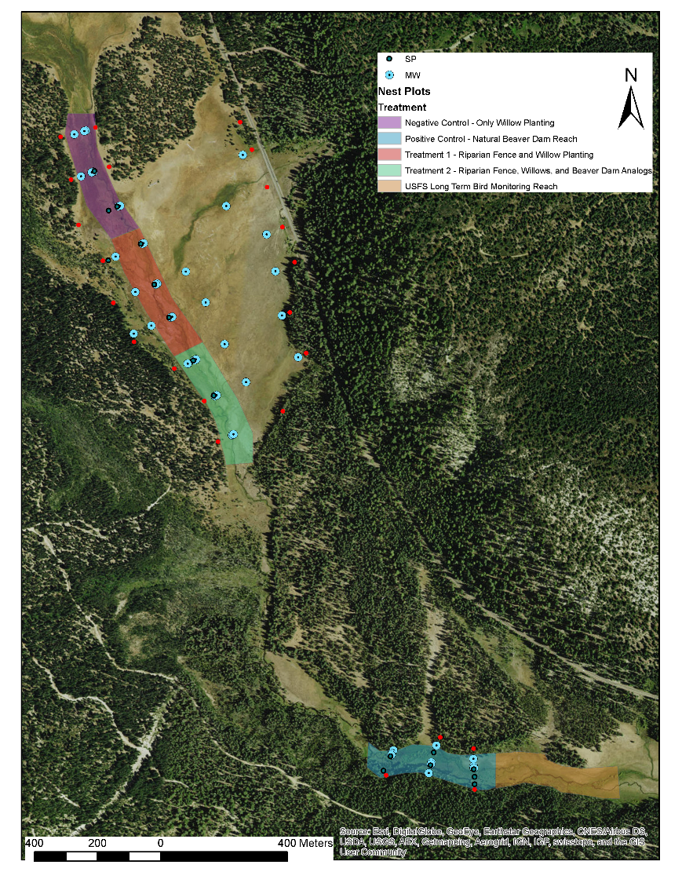
Study Design
BACI Design:
2 treatments
2 controls
Monitoring:
Above and below-ground carbon
Hydrogeomorphic conditions
Response of targeted wildlife species:
  Willow flycatcher
  Cascades frog
Notes:
Test two different restoration techniques using a modified BACI study design with a positive and negative control.
Goal of increasing carbon storage above ground (willows) and below ground (sediment retention, increased GW levels); increasing groundwater levels and extent of surface water; increasing habitat for sensitive meadow species.

Slide 3
Hydrogeomorphology
Pre-treatment Reaches Natural Beaver Reach

Slide 4
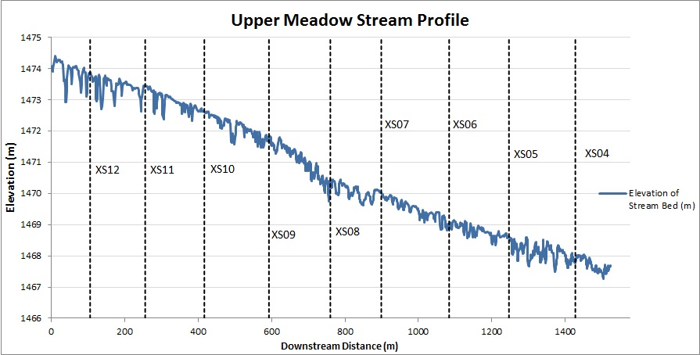
Hydrogeomorphology –
Stream Channel Profile
Pre-treatment Reaches

Slide 5
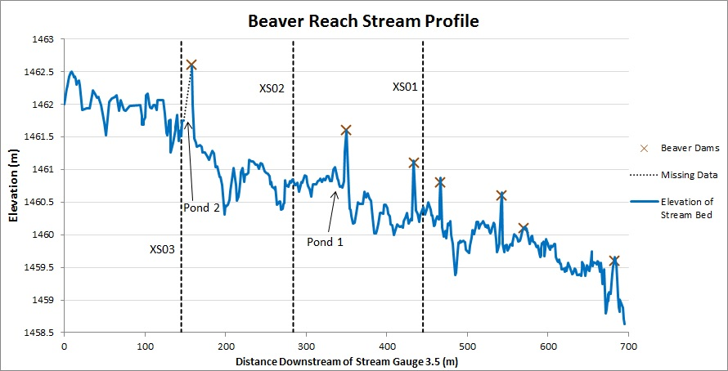
Hydrogeomorphology –
Stream Channel Profile
Natural Beaver Reach
Notes:
The beaver reach exhibits more heterogeneity in morphology and topography than the pre-treated grazed meadow reaches. Beaver dams increase pool area and depth, and subsequently store more sediment.

Slide 6
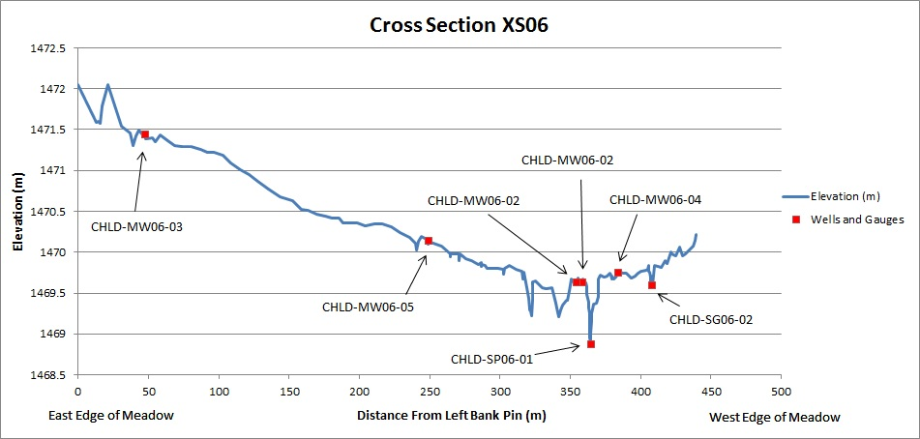
Hydrogeomorphology –
Meadow Cross-sections
Pre-treatment Reaches

Slide 7
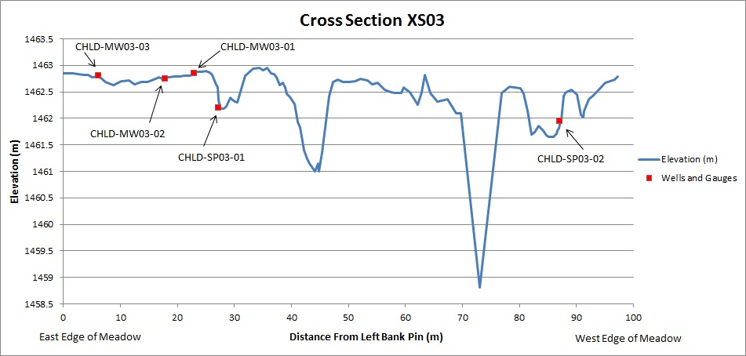
Hydrogeomorphology –
Meadow Cross-sections
Natural Beaver Reach
Notes:
The beaver reach exhibits more heterogeneity in morphology and topography than the pre-treated grazed meadow reaches. Beaver dams increase pool area and depth, and subsequently store more sediment.

Slide 8
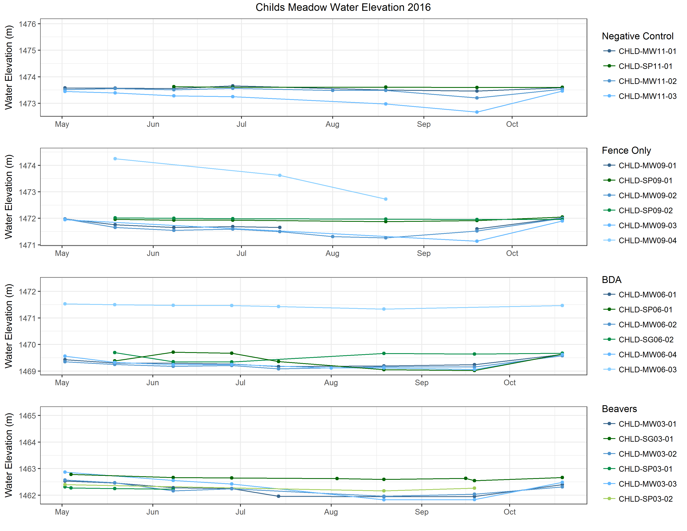
Hydrogeomorphology –
Groundwater Levels
Notes:
Groundwater levels indicate losing stream conditions in the upper treatment reaches year-round, with a switch to gaining conditions in the lower BDA treatment reach in late summer. The data indicate gaining conditions in the beaver reach in spring and losing conditions in late summer as the ponds contribute to groundwater. Stream flows indicate sustained baseflows at the downstream end of the treatment reaches and the beaver reach.

Slide 9
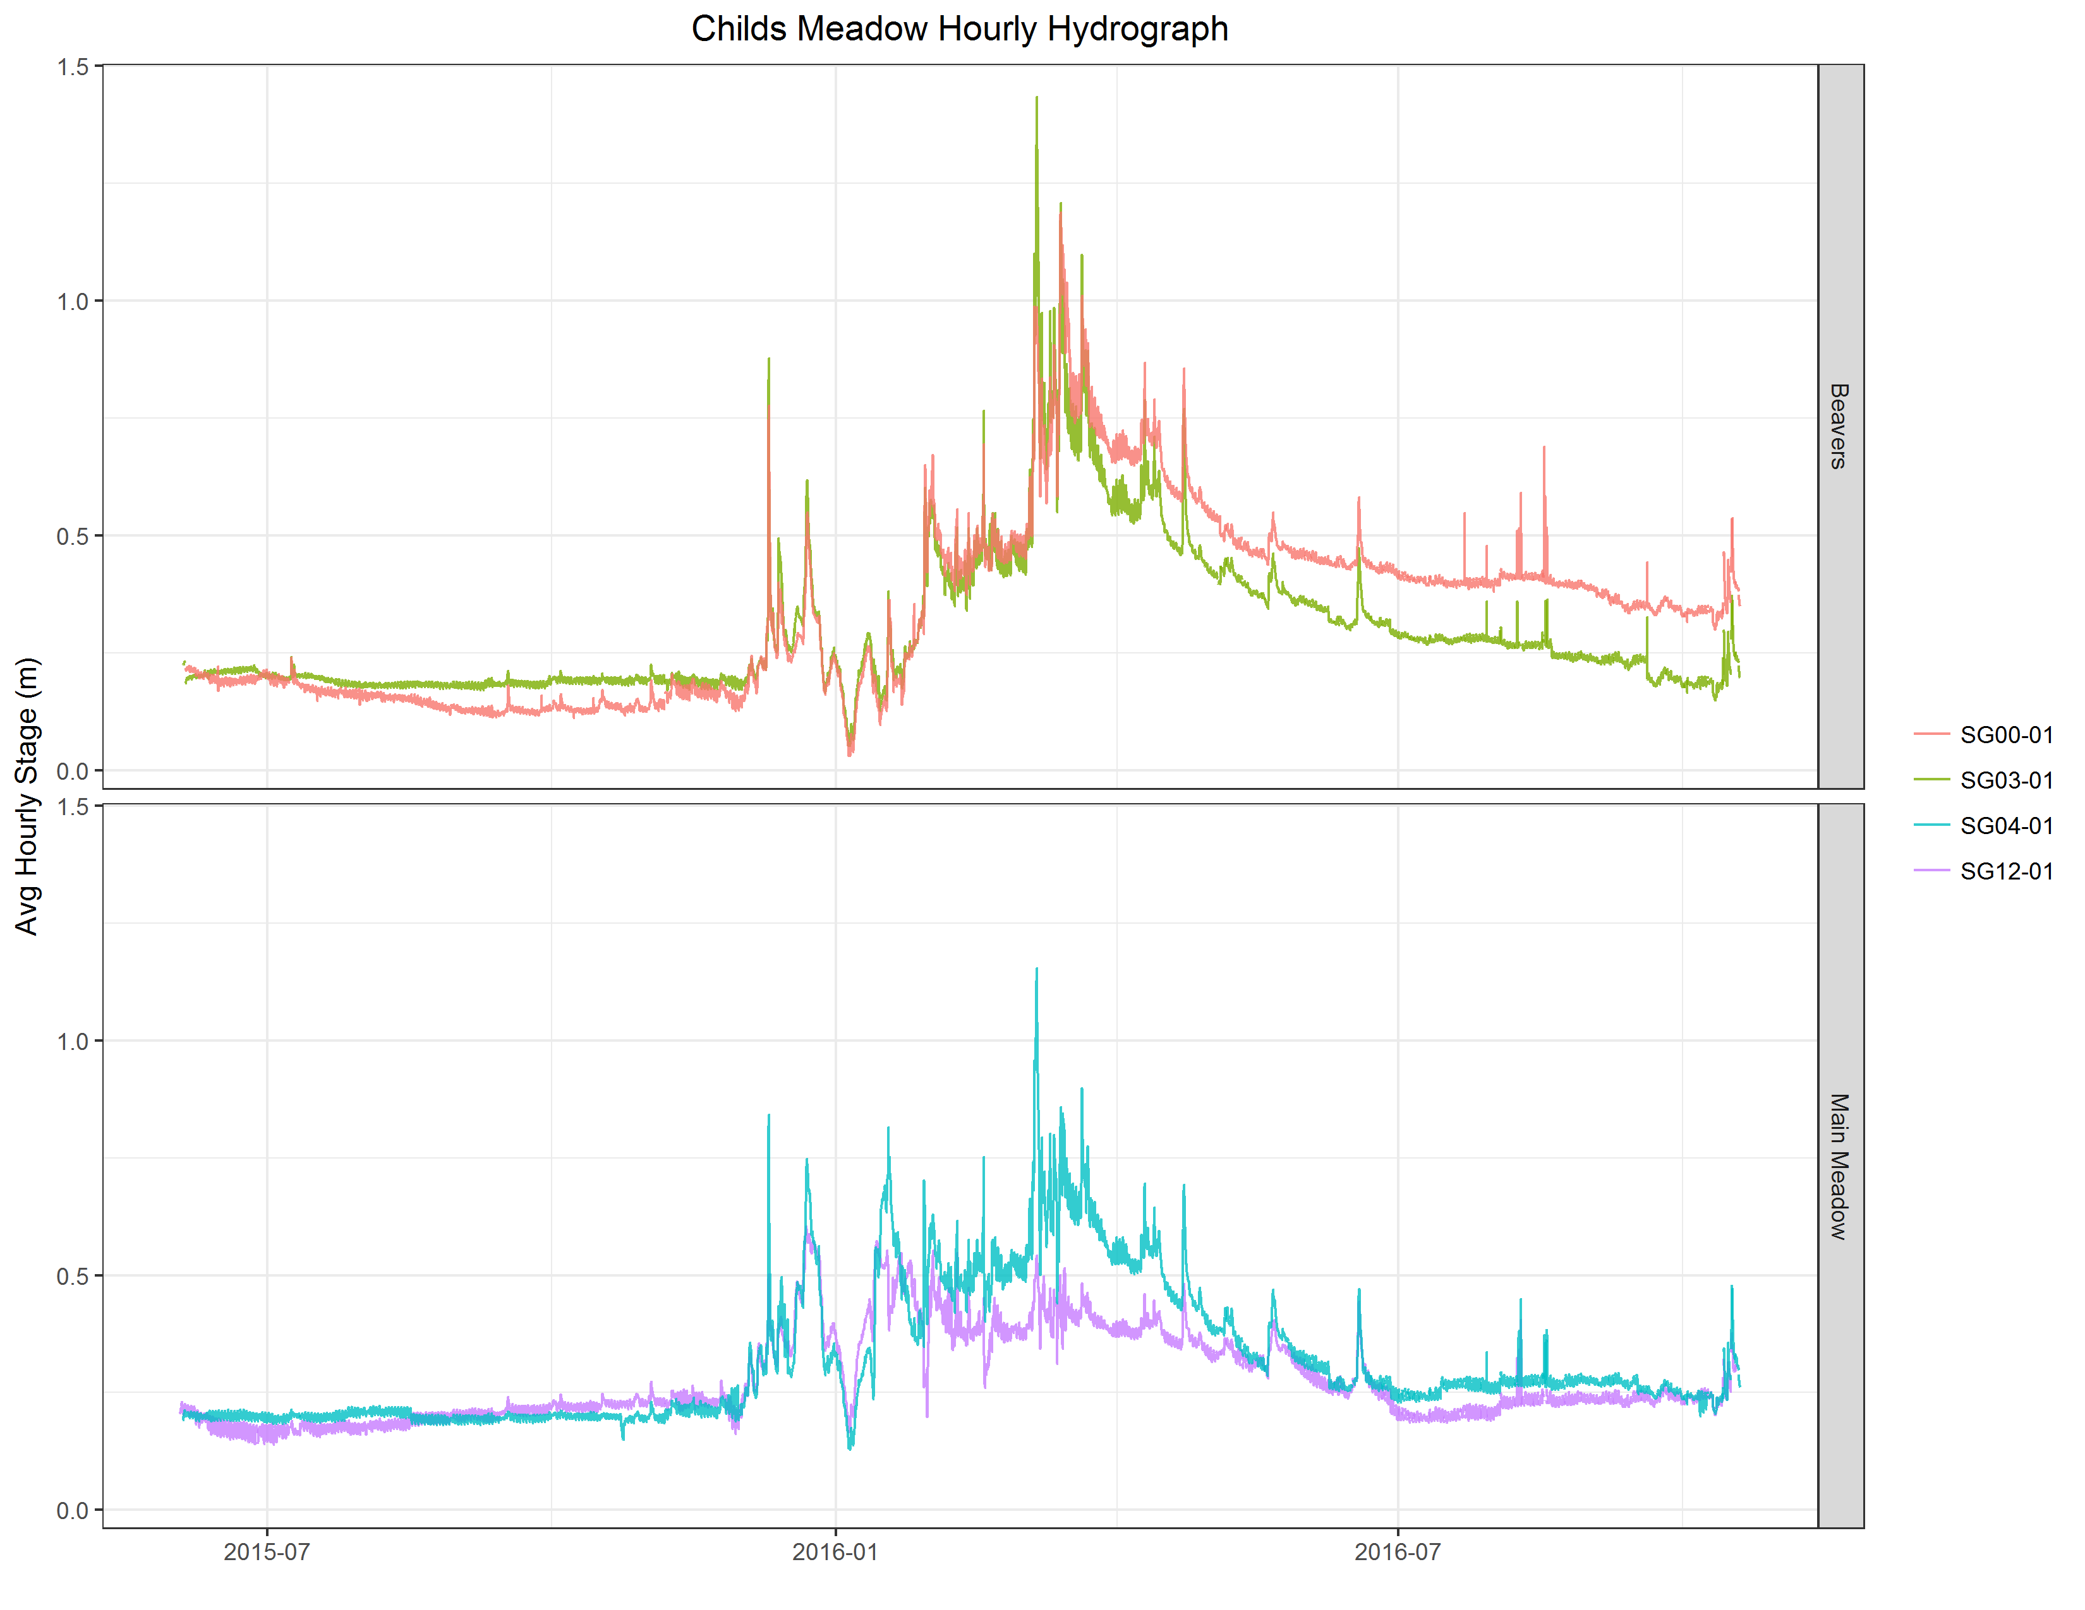
Hydrogeomorphology –
Surface Water Levels
Notes:
Groundwater levels indicate losing stream conditions in the upper treatment reaches year-round, with a switch to gaining conditions in the lower BDA treatment reach in late summer. The data indicate gaining conditions in the beaver reach in spring and losing conditions in late summer as the ponds contribute to groundwater. Stream flows indicate sustained baseflows at the downstream end of the treatment reaches and the beaver reach.

Slide 10
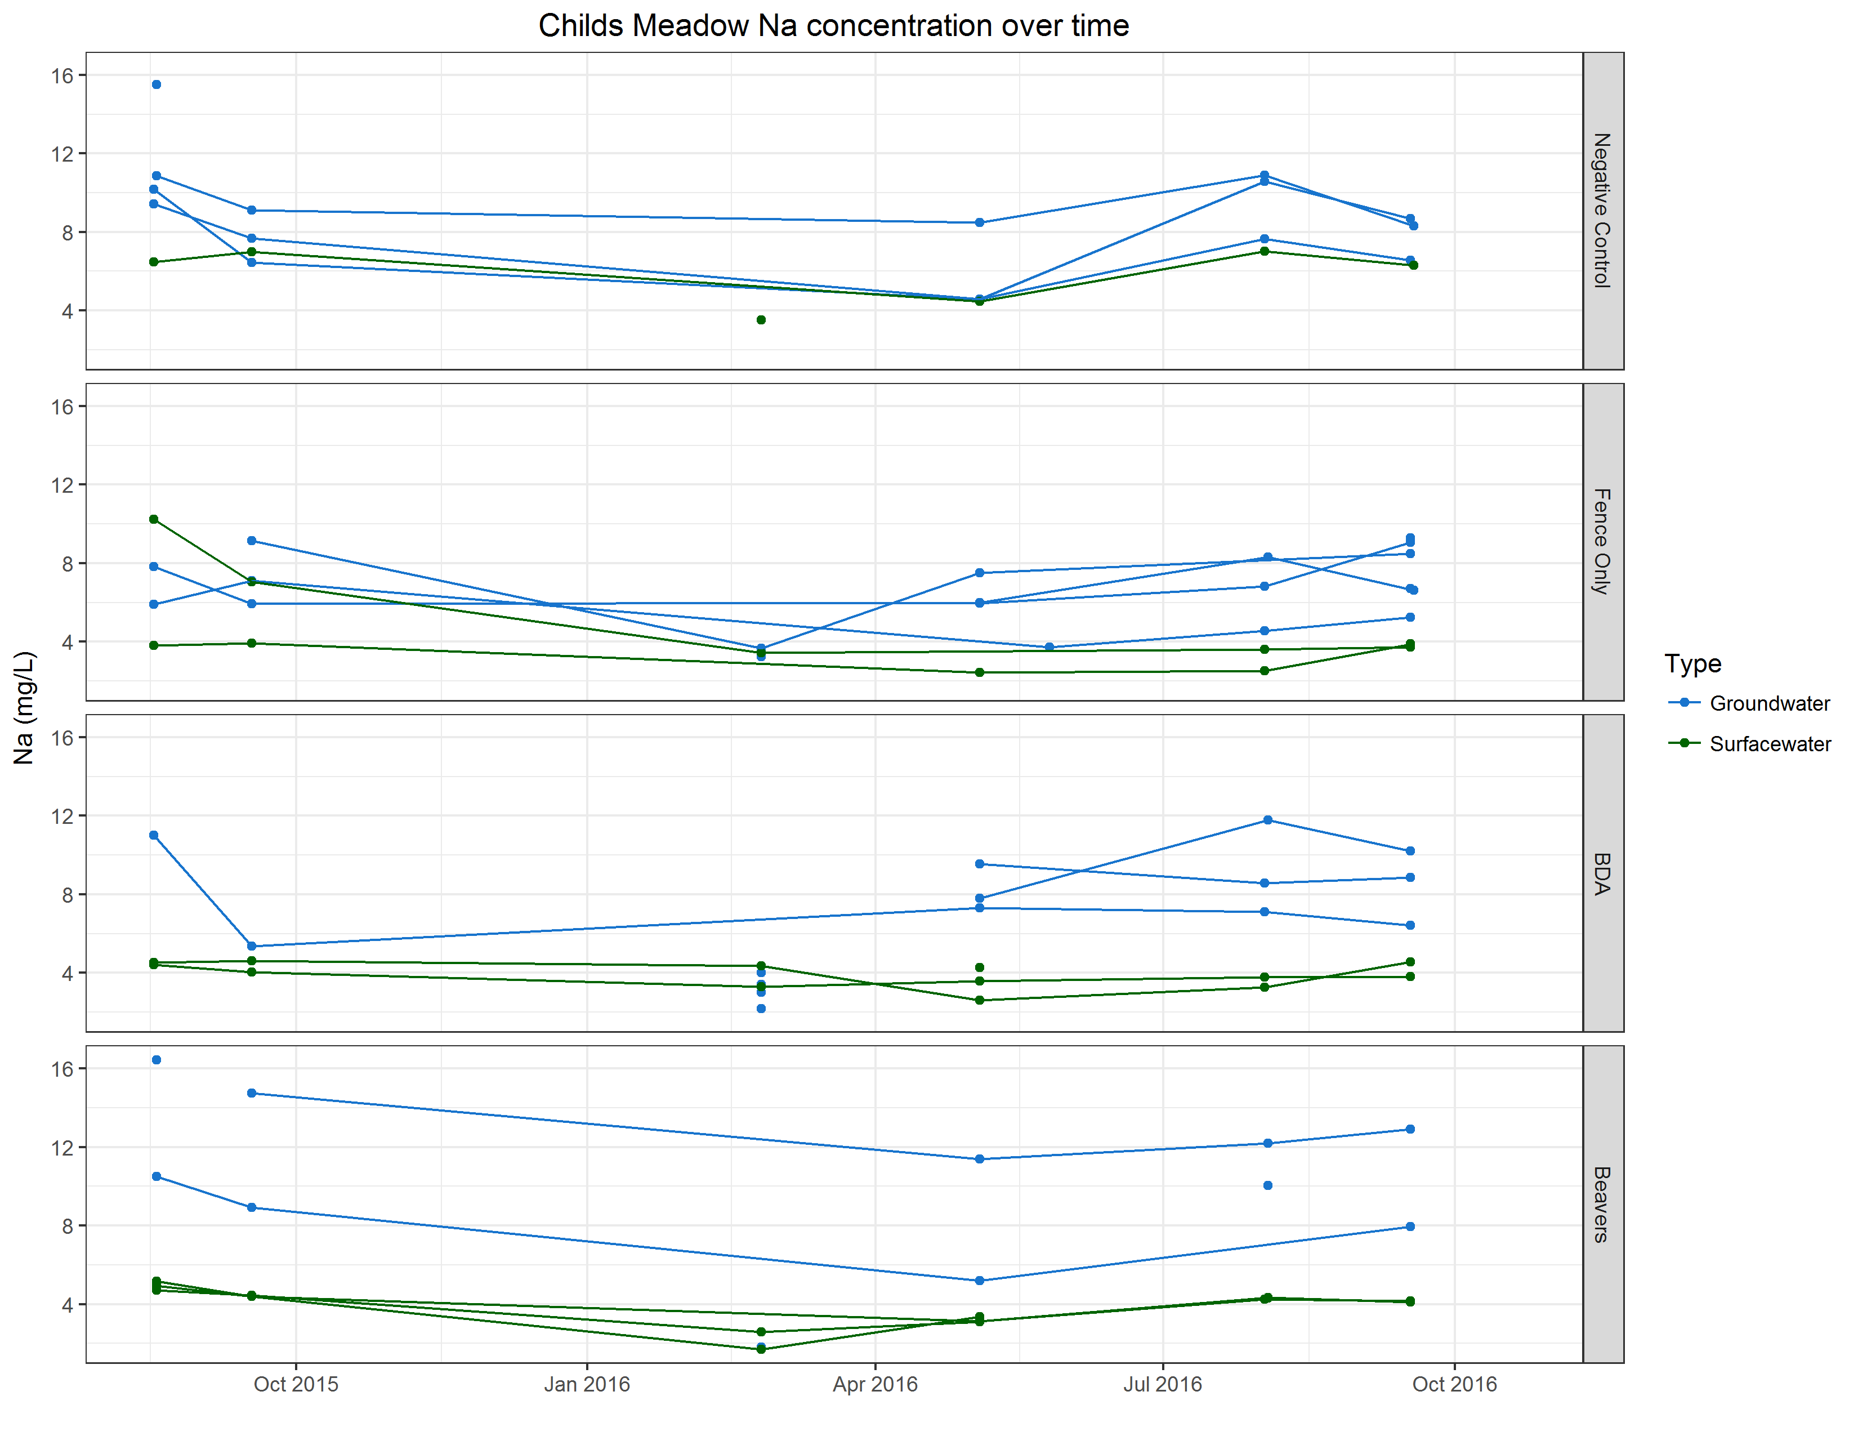
Hydrogeomorphology –
Water Quality
Notes:
EC and cation concentrations show stream water becomes chemically less similar to groundwater as it progresses downstream year-round, indicating significant surface water or fast-moving shallow groundwater sources.

Slide 11
Carbon Sequestration – Soil Cores
0-10cm
Neg Cntrl
10-20cm
Neg Cntrl
0-10cm
Fence Only
10-20cm
Fence Only
0-10cm
BDA
10-20cm
BDA
0-10cm
Beaver
10-20cm
Beaver
Beaver Ponds
Stream Riffles
Notes:
Soil cores from the natural beaver ponds show similar percent carbon retention to deeper meadow soil (>10cm), and significantly more than instream channels. Shallow meadow soils retain the highest levels of carbon.

Slide 12
Carbon Sequestration
Notes:
This chart shows the respiration, photosynthesis, and net (white diamonds) CO2 exchange readings for 2016, converted to daily values. Positive values indicate loss of CO2 to the atmosphere, negative values indicate CO2 added to the plant-soil system. The fencing, and fencing & BDA treatments result in more net-storage of CO2 compared to the grazing control condition.

Slide 13
Carbon Sequestration
Notes:
This chart shows the total GHG budget for the four plots types. CO2 is by far the most significant GHG measured to date. There is minor methane production in the grazed plot and minor nitrous oxide from the beaver plots (likely a result of the breached dam and lowered water table exposing the organic soil to oxidation). The net difference between the two treatment plots (fence and fence & BDA) and the grazing control is a net storage of ~16 Mg of C. Total soil C stocks are shown at the bottom for each plot. 16 Mg is a very small proportion of the existing carbon stored within the top 20cm of soil in our plots, but the Fence & BDA treatment is showing a shift to net storage, away from loss in the grazing plot.

Slide 14
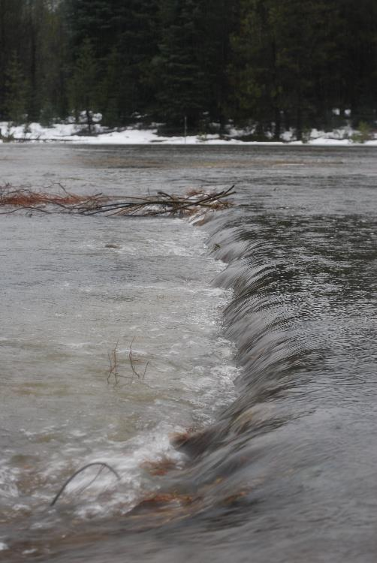
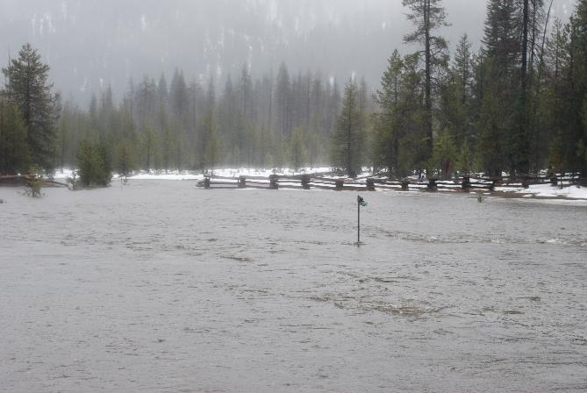
Post-Treatment Monitoring
3 seasons: 2017-2019
Continued hydrogeomorphology, GHG monitoring, and amphibian and avian ecology
BDA maintenance if needed
Dec 15 2016 Flood

