Slide 2
EcoRegion
Landscape context +
physical & functional attributes
Meadow Type
(Weixelman et al.)

Slide 3
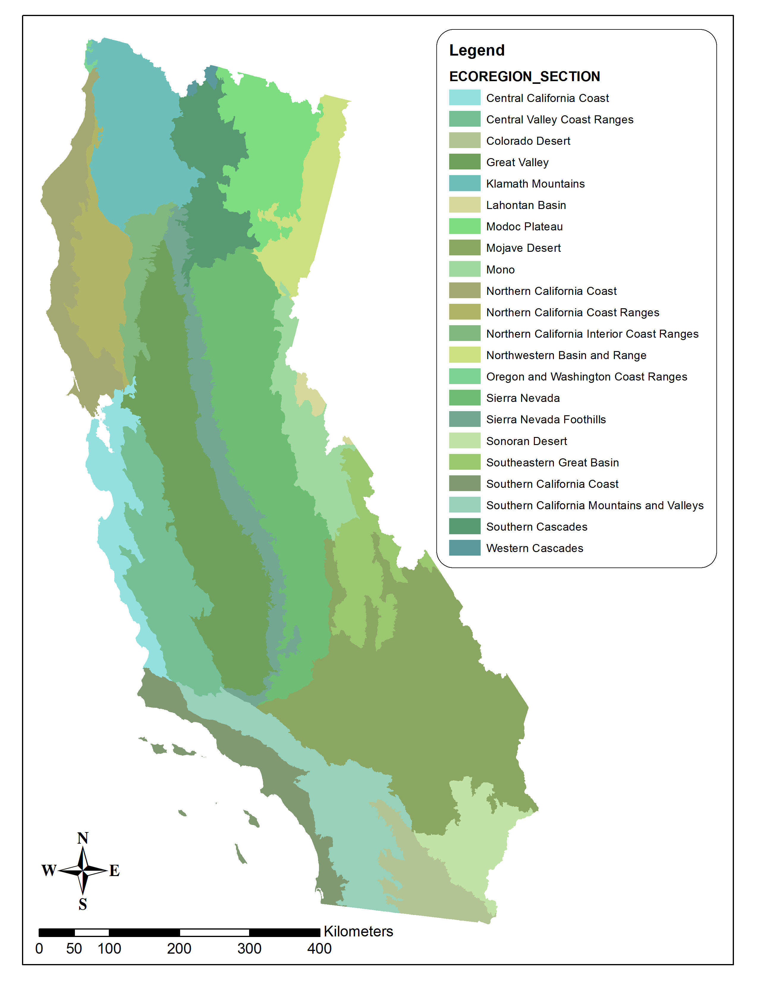
Ecoregion Sections:
(e.g., EPA, USFS)

Slide 4
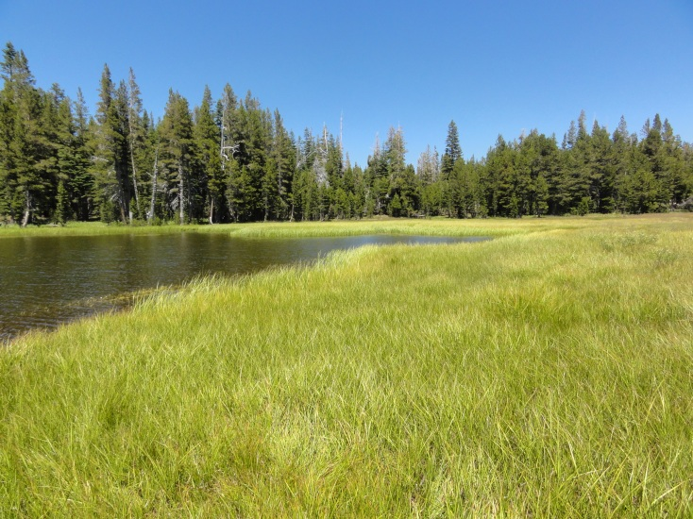
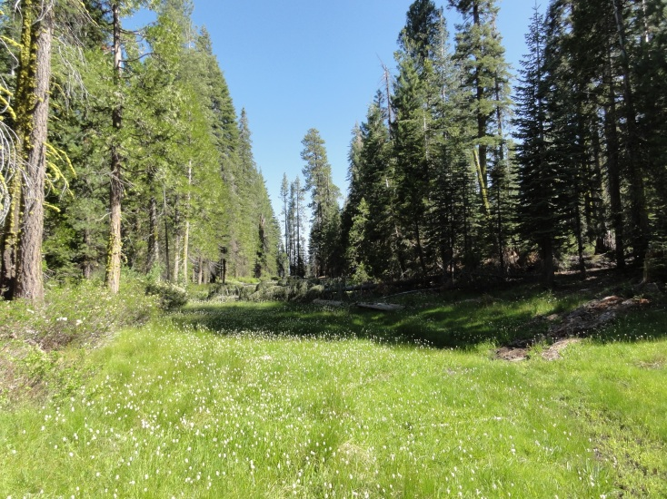
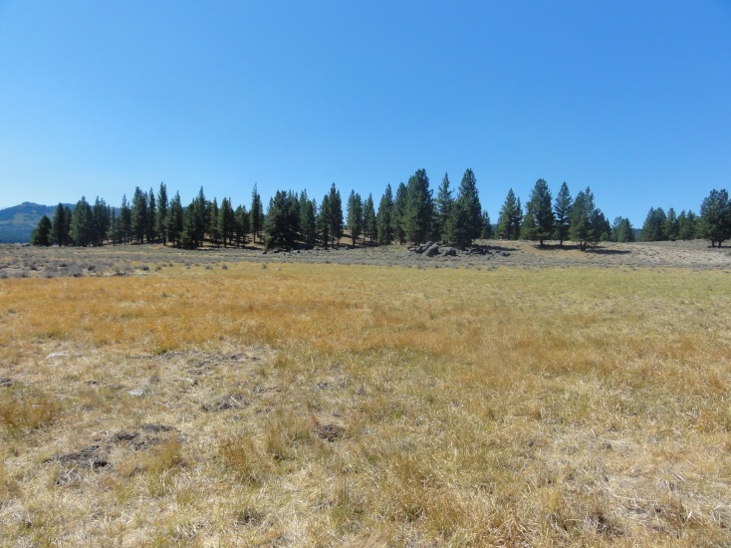
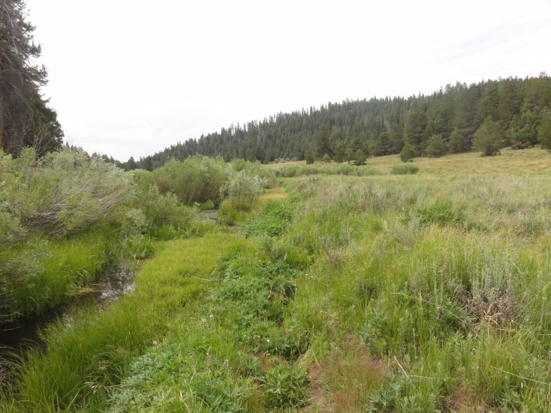
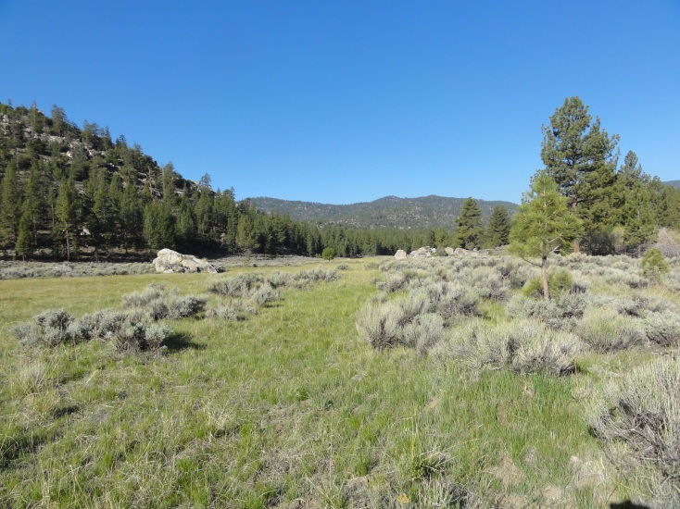
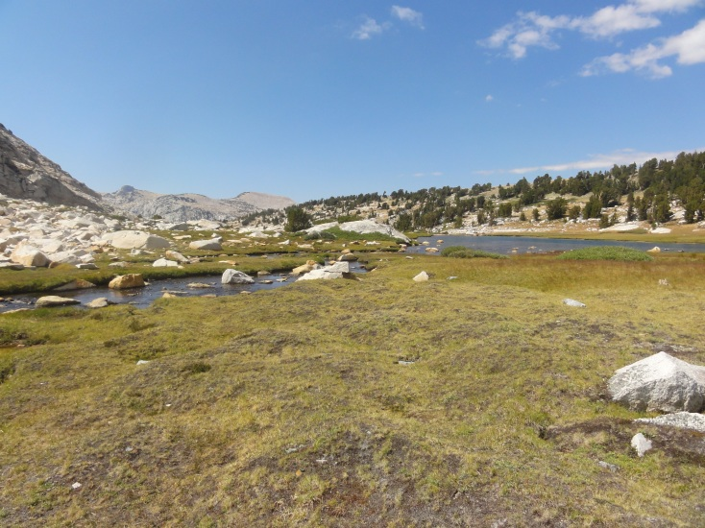
Meadow Types
Meadows typically contain more than one hydrogeomorphic type
Classification depends on landform features, water sources, and water flow directions

Slide 5
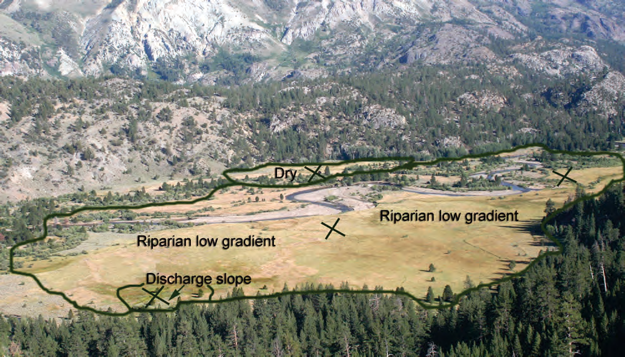

Slide 6
EcoRegion
Landscape context +
physical & functional attributes
Meadow Type
(Weixelman et al.) and ??
Desired Condition
Meadow function and resiliency
Target-specific desired outcomes
Goals and Benefits
with defined metrics
Existing Condition
Landscape-scale and site-specific measures of same metrics used to define desired conditions
Focal meadows’ current functional state and resiliency
Objectives
Targeted actions to achieve desired conditions on focal meadows or across a meadow system
Can include objectives at multiple scales

Slide 7
Core Functional Metrics
Ecoregional Metrics
Species-specific Metrics
Meadow-type Metrics

