Slide 1
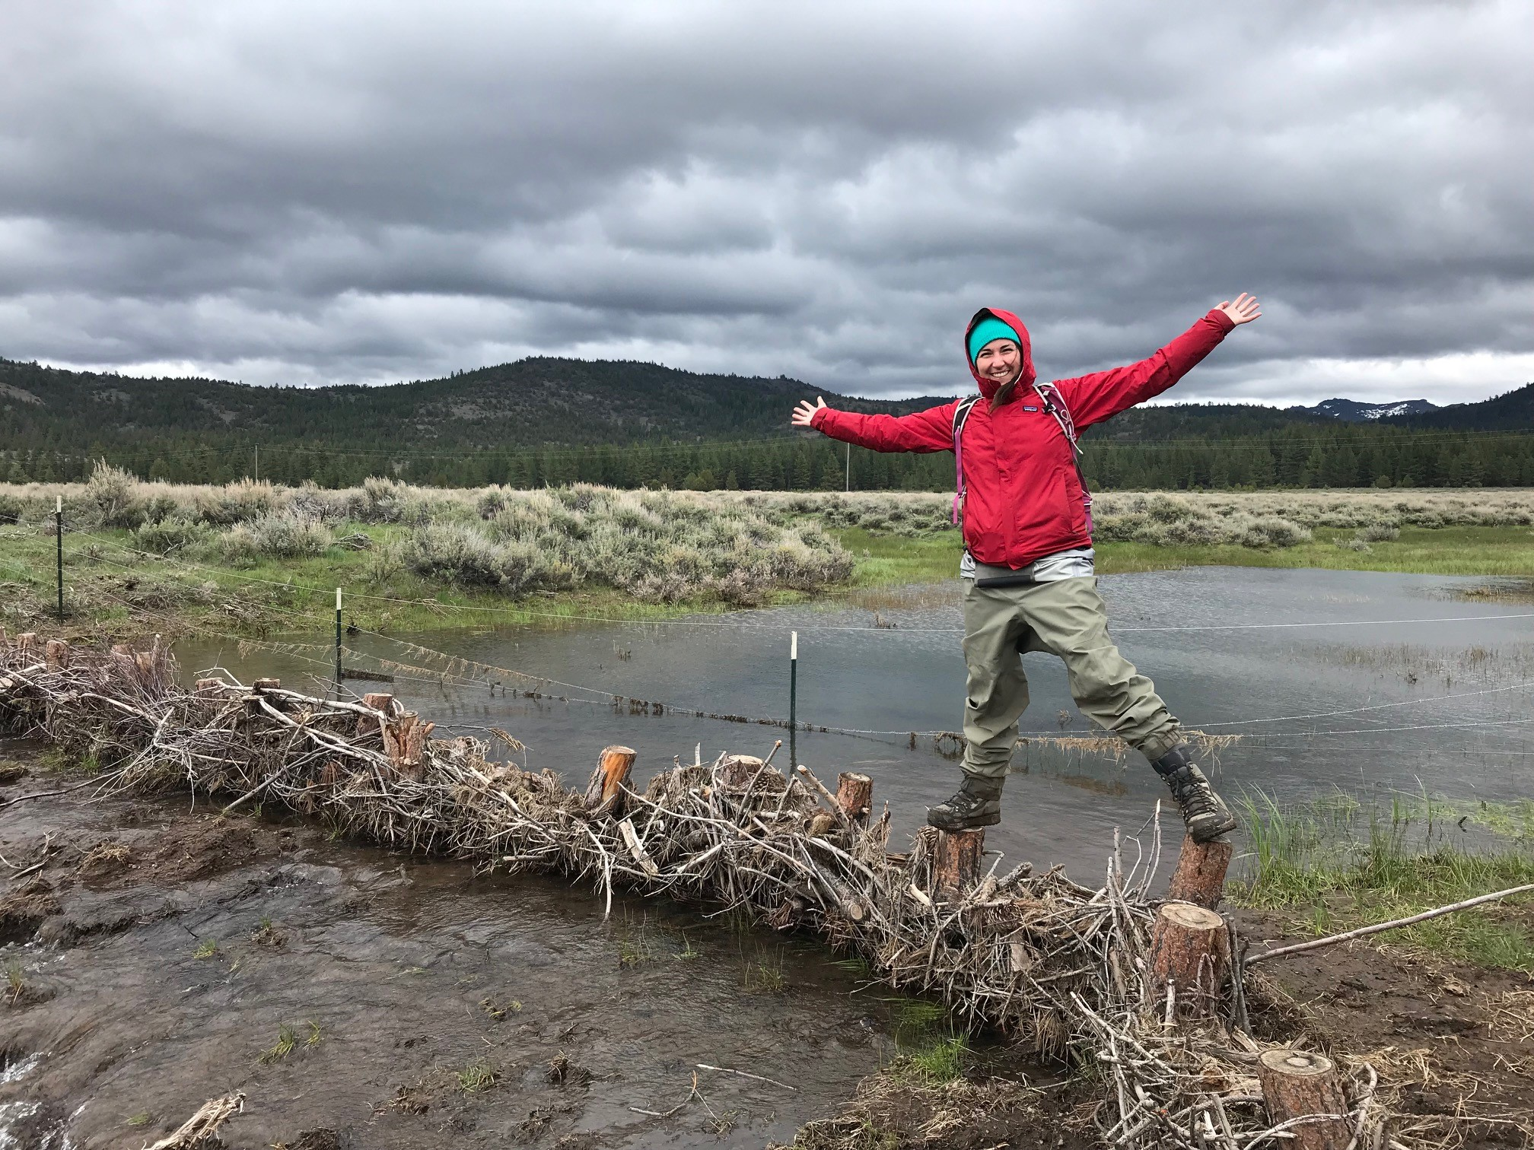
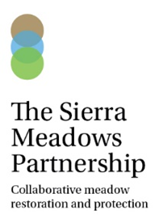
Sierra Meadows Partnership Annual Meeting May 2019 Regulatory Work Group Meeting
Julie Fair, American Rivers – jfair@americanrivers.org
Sheli Wingo, US Fish and Wildlife Service – sheli_wingo@fws.gov

Slide 2
Regulatory Workgroup
Purpose: to address the need to improve the permitting processes for meadow restoration in order to increase the pace and scale of restoration to meet the targets of the Sierra Meadows Partnership
Supports the SMP Strategy Approach 2: “Enhance regulatory and institutional funding capacity and coordination”
Approach: 3-fold
provide improved guidance on existing permitting and environmental compliance pathways
engage permitting agencies to foster support for meadow restoration and to provide technical support
work to identify and implement opportunities to streamline* permitting and environmental compliance processes
*Streamline: to make (an organization or system) more efficient and effective by employing faster or simpler working methods.

Slide 3
Work Group Participants
Co-leads
Julie Fair, American Rivers
Sheli Wingo, US Fish and Wildlife Service
NGO participants
Jessica Strickland, Trout Unlimited
Gia Martin/Leslie Mink, Plumas Corporation (advisory)
Vincent Rogers, Feather River Land Trust
Other
Sustainable Conservation
Conservation Strategies Group
Agency Participants
Diana Craig/Lisa Fong, USFS Region 5
Rick Kuyper, US Fish and Wildlife Service
Jesse Stovall, US Army Corps of Engineers (CA South Section
Ben Letton/Mary Fiore-Wagner/Laurie Scribe, Lahontan Regional Board
Bryan Smith, Central Valley Regional Board
Jessica Nadolski, State Water Board
Sean Hoobler/James Croft, CA Dept Fish and Wildlife
Tribal Liasons – USFWS, SNC (informal)
Notes:
Discuss Sustainable Cons and Cons Strat Grp – SB45 bond lang
Beth Christman – former/advisory
Melissa Odell – May meeting
Mike Berry – DWR – May meeting
Joe Pepi – CA Tahoe Conservancy
Sus Con – Erika Lovejoy
CSG – Sam Uden, Matteo Crow

Slide 4
Work Plan Summary
Task | Description
1 | Finalize permitting and compliance guidebook
2 | Establish agency contacts and regulatory advisory group
3 | Develop permitting and environmental compliance reference materials
4 | Organize meadow restoration permitting and environmental compliance training
5 | Develop regulatory challenges and solutions white paper
6 | Establish CEQA pathway for meadow restoration projects
7 | Evaluate options to streamline NEPA with US Forest Service
8 | Implement novel regulatory approaches and pilot project

Slide 5
Work To-Date
Completed meadow-specific permitting/compliance guidance document (Version I)
Co-leading permitting/engineering subcommittee with CDFW as part of ad-hoc work group focused on improving CDFW’s grant programs
Developed set of recommendations related to CEQA/permitting and CDFW’s engineering requirements/review processes in Dec 2018
CDFW developing response
Established additional contacts for outstanding agencies to participate in Regulatory Work Group
Also connected with other groups in CA working to improve permit/compliance (Sustainable Conservation, Conservation Strategies Group)

Slide 6
Work To-Date (cont.)
Conducted survey of meadow restoration practitioners to
Identify most common regulatory challenges
Gauge desire for permitting/compliance resources
Solicit example permits/compliance documents under various scenarios
Summarized results of survey and shared with agency participants
Conversations with Sus Con about
ensuring new permit works for meadows
will be acceptable for other agencies involved (eg. CDFW)
Potentially high level conversations between State Water Board and CDFW about determining a consistent CEQA pathway

Slide 7
Constraints
Lack of dedicated funding
In practice, one person currently developing materials
Unique group structure due to agency participants

Slide 8
Next Steps
Collect example permit/compliance documents and make available via SMP website
Agency advisors provide review and feedback? Additional examples?
Update permitting and compliance document
Including additional agency review where needed
Continue to work with CDFW to implement recommendations
Develop white paper about regulatory challenges and potential improvements
Use regulatory survey results as basis for challenges
Work with agency staff and others to identify and evaluate possible improvements
Use survey results to inform development of additional permitting/compliance guidance materials
Notes:
CDFW recs – clear CEQA path

Slide 9
Next Steps (cont.)
Continue to engage agencies to communicate with one another and develop potential improvements like
Clear permitting pathways under various funding/landownership scenarios
Programmatic approaches
Restoration-specific pathways
Secure funding to continue to implement workplan
Other items resulting from today’s meeting?
Notes:
CDFW recs – clear CEQA path

Slide 10
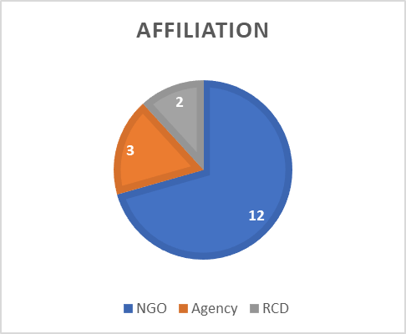
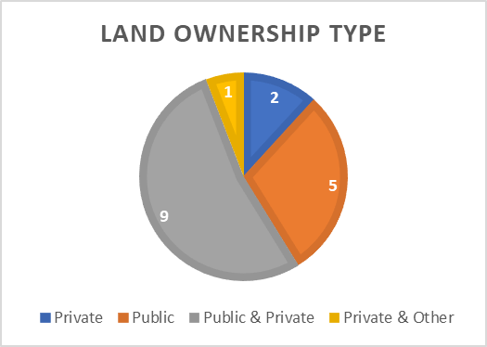
Summary of Survey Results
May 2018 – April 2019
17 participants affiliated with SMP (meadow restoration practitioners)
3 Sections: 1) Regulatory Challenges, 2) Desire for Regulatory Resources, 3) Example Permits
Land ownership where participants primarily work.
“Other” specified as tribal and municipal.
Notes:
CDFW recs – clear CEQA path

Slide 11
Regulatory Challenges – Common Themes
What two aspects of the permitting/environmental compliance process have caused the most disruption for your meadow restoration projects (or that you have generally found the most challenging)?
General
Slow agency processes/long agency review times (4 participants)
Inconsistencies in requirements/interpretation between offices/staff of the same agency (3 participants)
Incompatibility of permitting timelines (eg. long permit review timelines) and funding timelines (eg. inflexible grant timelines/end dates) (2 participants)
Cost (2 participants)
CEQA
Generally completing CEQA compliance (2 participants)
Determining CEQA lead agency (2 participants)
Notes:
CDFW recs – clear CEQA path

Slide 12
Regulatory Challenges – Common Themes
NEPA
Length of time to complete/delays completing NEPA (4 participants)
Delays specific to when USFS is lead (2 participants)
CA Dept of Fish and Wildlife
Unclear and inconsistent about CEQA lead (3 participants)
Unclear about 1600 requirement on federal land
Notes:
CDFW recs – clear CEQA path

Slide 13
Regulatory Challenges – Common Themes
What would you most like the Regulatory Working Group to address in the context of improving/streamlining permitting and environmental compliance for meadow restoration projects? Or generally any points you would like to make in this context?
Programmatic permits (3 participants)
Clear CEQA pathway (2 participants)
Need clear guidance about when a 1600 permit is required on USFS (or other federal?) land. At present, it is not clear if is only triggered by CDFW funds or all state funds or how the CDFW-USFS MOU is being applied (2 participants).
Clarify, possibly through the updating the MOU, that a 1600 is not required on USFS land (2 participants).
Notes:
CDFW recs – clear CEQA path

Slide 14
Regulatory Challenges – Common Themes
Explore and evaluate opportunities to batch CEQA/NEPA for projects (2 participants)
Better integration of permit applications to submit same information in same format (2 participants)
Clarify with the RWQCB that meadow restoration projects where all project components, including upland activities, are included in the Area of Potential Effects (APE) for Corps 404 permit/401 Water Quality Certification do not require a SWPPP (2 participants).
Notes:
CDFW recs – clear CEQA path

Slide 15
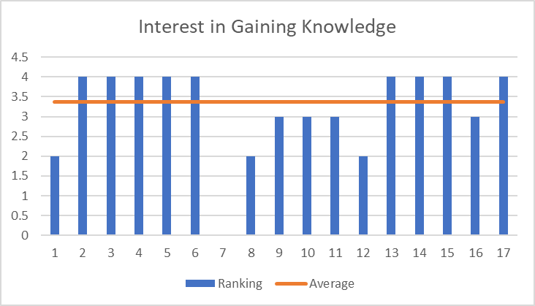
Desire for Permitting/Compliance Resources
For the following questions, participants were asked to rank their interest from 1-4, where 4 = highly interested, and 0 = no interest.
How interested are you in gaining more knowledge about completing permitting/regulatory compliance?
16 out of 17 participants
responded
Average ranking: 3.38
Notes:
CDFW recs – clear CEQA path

Slide 16
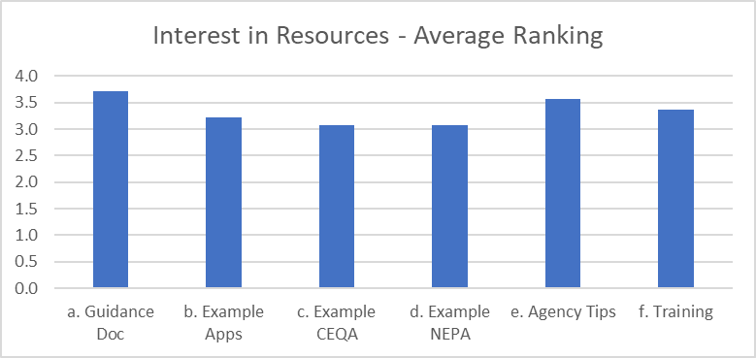
Desire for Permitting/Compliance Resources
Please indicate how interested you would be in the following permitting/compliance resources?
14 out of 17 participants responded
Notes:
CDFW recs – clear CEQA path

Slide 17
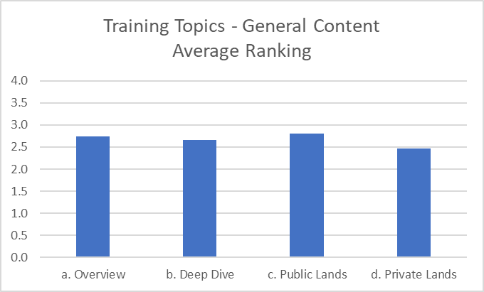
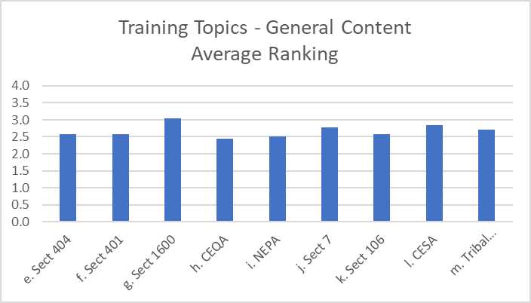
Desire for Permitting/Compliance Resources
If you are interested in the meadow-specific permitting/compliance training, please indicate how interested you would be in the following topics?
15 out of 17 participants responded
Notes:
CDFW recs – clear CEQA path

Slide 18
Example Permit Applications
Would you be willing to share a permit application or CEQA/NEPA compliance document that could be used as an example for other meadow restoration practitioners?
9 participants responded that they would be willing to share example documents.
Best Catch Phrase
“STREAMLINE THE STREAM WORK!”
-Gordon Long, Amador/Calaveras RCD
Notes:
CDFW recs – clear CEQA path

