Slide 1
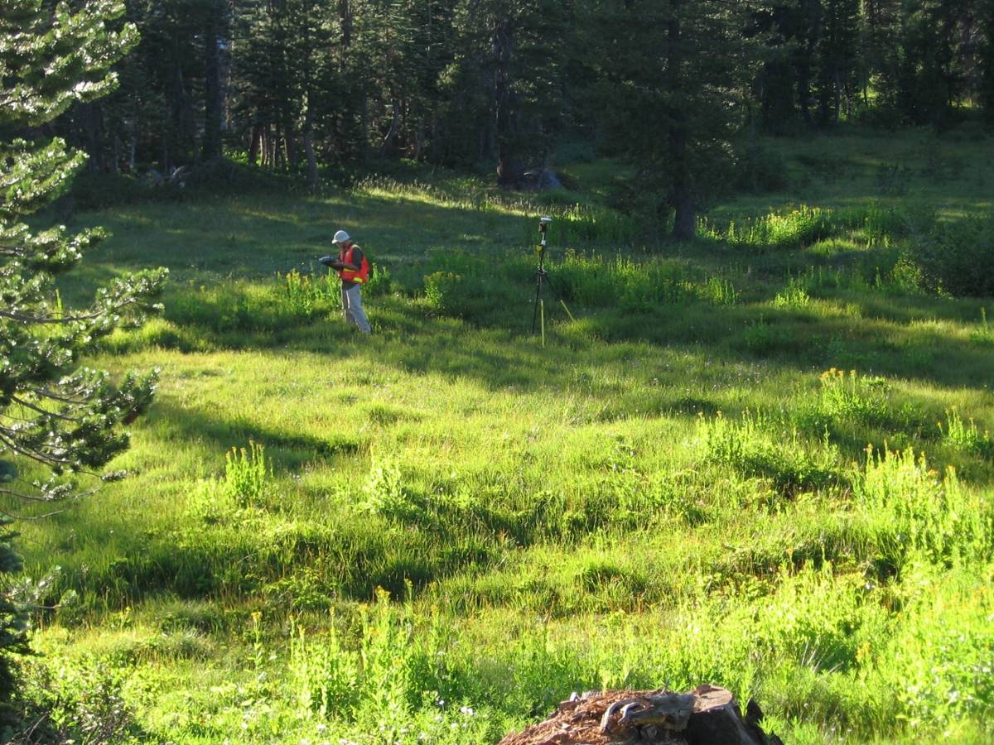
Monitoring Meadow Vegetation
Photopoints

Slide 2
Monitoring Vegetation
WHY?
Sensitive plants spp.
Meadow resilience (e.g. bank stability)
Condition (stressor increase /decrease?)
Indicators of Benefits
Habitat (# capacity)
Hydrology returned
Sequester C
Capture sediment
What?
Rare plant surveys
Population tracking
Green line surveys
Functional groups
Rooting density and depth
Volume and rates
Veg quality (forage)
Structure
Recruitment – succession processes
When?
Once
Annual
Pre, post action
Different pushes (cattle on/off)
Event - based
Scale?
Populations
Meadow complex
Watershed (sub)
Other landscape strata
LINK WITH PROCESS CONTROLS, RESPONSES, VARIABILITY e.g. HYDROLOGY, GEOMORPHOLOGY, MANAGEMENT, LEGACIES
TIE TO DESIRED CONDITIONS (USFS) and ENVIRONMENTAL BENEFITS

Slide 3
Data Quality and Management
Tractable field data records
Record: Name, Date, Methods, GPS points
Confidence qualifier
Notes
Account for Staff turn over
Spatial consistency
Link to physical control indicators
Accessible field protocols (UCD db)

Slide 4
Hydrogeomorphic Classification

Slide 5
Hydrogeomorphic Meadow Types
Basin Peatland,
Mound peatland,
Discharge slope peatland,
Depressional seasonal, perennial
Lacustrine Fringe,
Dry
Discharge slope
  Riparian low medium and high gradient
  Subsurface low medium and high gradient

Slide 6
Dichotomous Key
20 cm organic soil / not
  Edge of lake or pond
  Hillslope position (base of slope, toeslope, alluvial fan, valley bottom)
Not 20 cm organic soil
  Topographic depression (with/not standing water)
  Along a lake or reservoir
  Dominated by dryland grasses, sedges
    (FACU, UPL) – gw below 1 m during growing season
  Dominated by wet species
    OBL, FACW, FAC) – gw at or within 1 m all/part of growing season
  Water source –
    at/near meadow surface – springs, seeps
    surface water (channel)
  Channel gradient (<2%, 2-4%, >4%)

Slide 7
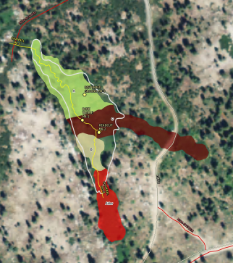
Vegetation Type Maps as a Foundation
Change of Extent and Composition

Slide 8
  What additional work do we have before us to meet the monitoring/ restoration goal stated in the NFWF Business Plan, namely to validate environmental benefits of restoration? Which ones need it the most? Can we do it with reasonable effort?
  What watershed to landscape scale questions do you think are of most concern as we head into the future? (e.g. scaling up monitoring info )
  How can we perform this monitoring and manage data to address key watershed and landscape scale questions?
  Are there institutional opportunities that could speed up ‘uptake’ of proper monitoring and reporting, data sharing, and communicating?

