Slide 1
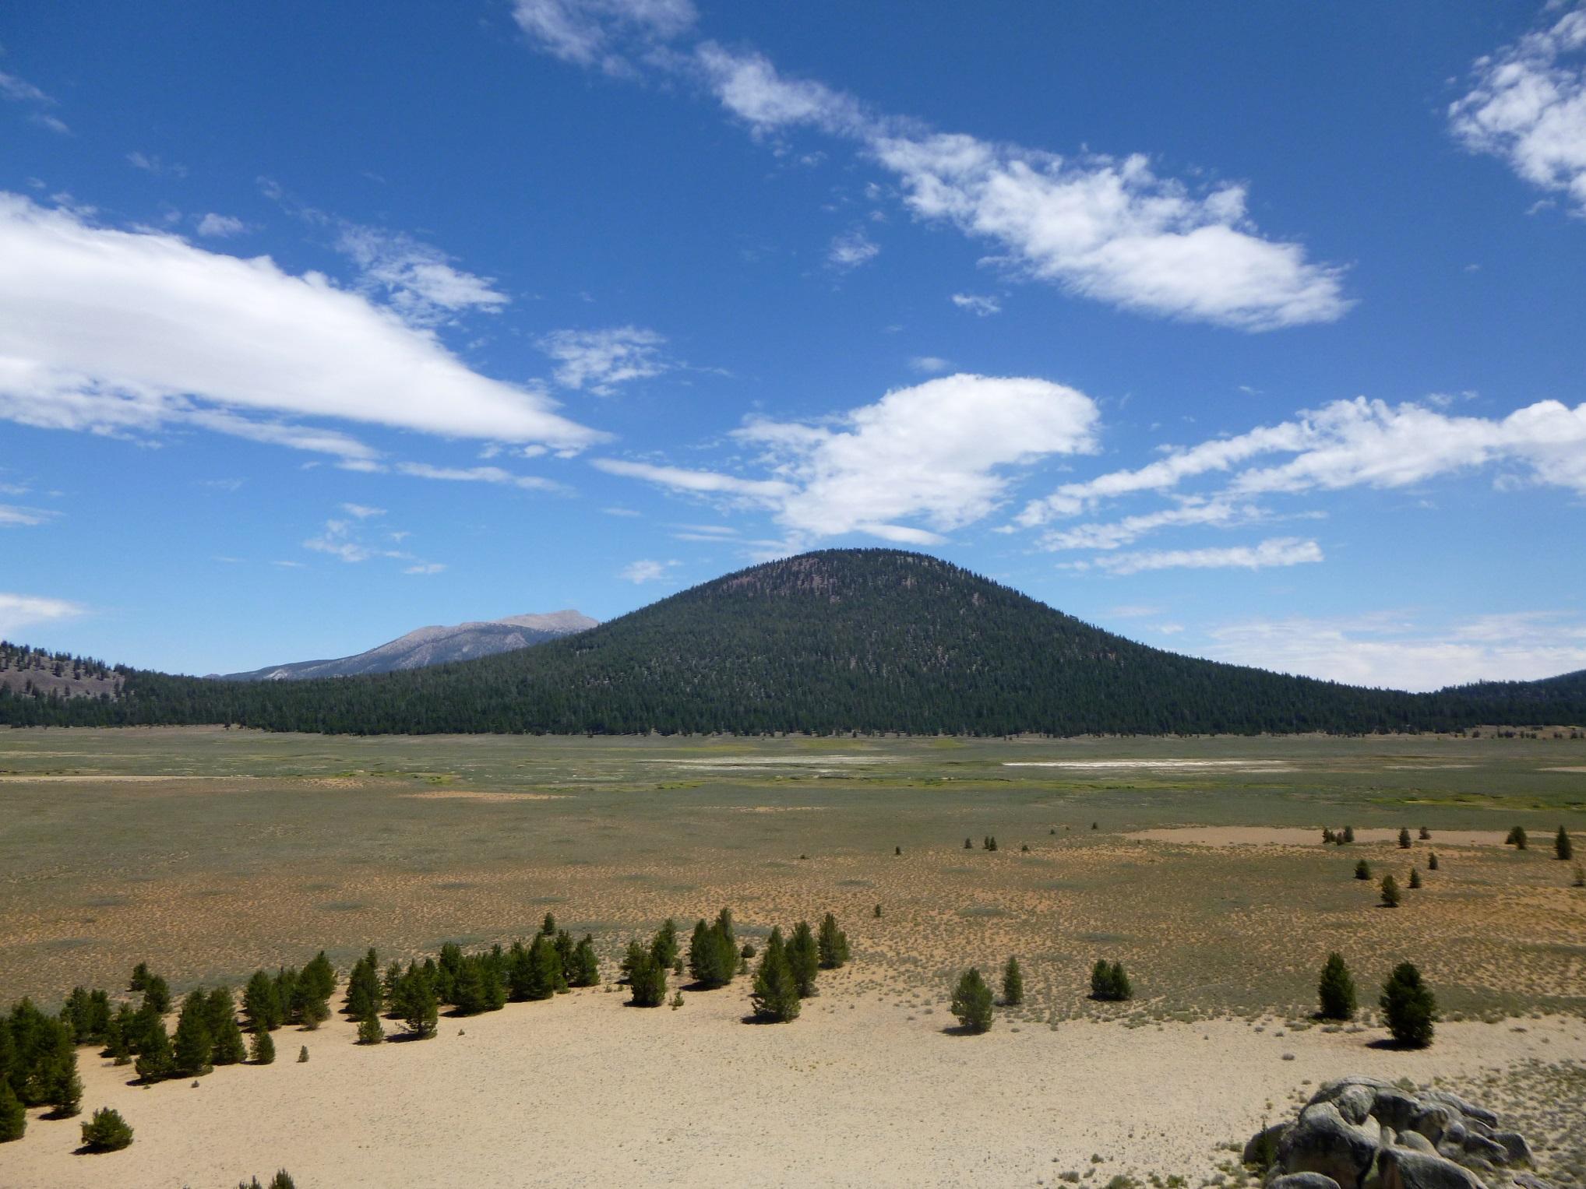
Templeton Meadow: Golden Trout Wilderness

Slide 2

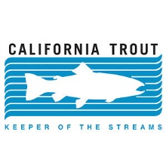
NFWF Meadows Survey Results
Andrew Skaggs
California Trout
Watershed and Outreach Coordinator

Slide 3
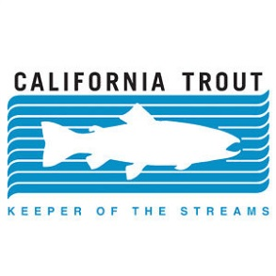
NFWF Meadows Survey
Developed by California Trout in 2013 for NFWF and SNC funded meadows projects.
The survey was created to gather important information about meadow restoration efforts and synthesize data regarding…
1. General Information: Location, Size, Goals, Key Partners
2. Project Type: Monitoring vs. Restoration, Methodologies
3. Land Use Practices: Grazing, Roads, Trails, Development
4. Focal Species: Assess Focal Birds, Fish, and Amphibians
5. NFWF Business Plan: Identify Conservation Strategies
6. Metrics: Identify Critical Important Habitat Metrics
7. Conclusion: Challenges of Meadow Restoration

Slide 4
Project Locations
Counties: Lassen, Inyo, Mono, El Dorado, Alpine, Amador, Modoc, Plumas, Placer, Tuolumne, Mariposa, Shasta, Tulare, Mariposa, Nevada, Siskiyou, Sierra.
National Forests: Modoc, Stanislaus, El Dorado, Yosemite, Klamath, Tahoe, Sierra, Sequoia, Humboldt-Toiyabe.

Slide 5
General Information
Total Meadow Area Within Project (N=31)
  Total Acres: 50,249.92 Acres
  Smallest Project: 3.6 Acres
  Largest Project: 10,000 Acres
  Mean Project Size: 2,094 Acres
Total Stream Miles Within Project Area (N=31)
  Total Acres: 55,836 Stream Miles
  Smallest Project: 0.6 Stream Miles
  Largest Project: 33,069.82 Stream Miles
  Mean Project Size: 2,147.57 Stream Miles

Slide 6
Monitoring and Restoration
Figure 1. Overview of monitoring and restoration project types (N=31).

Slide 7
Land Use Practices
How is your meadow project impacted by the following land use practices?

Slide 8
How is your meadow project impacted by the following land use practices?

Slide 9
How is your meadow project impacted by the following land use practices?

Slide 10
How is your meadow project impacted by the following land use practices?

Slide 11
Other Land-Use Practices
OHV Trail Use
Golf Courses
Airports
Mining
Urbanization
Irrigation
Levee Construction
Vegetation Removal

Slide 12
NFWF Proposed
Focal Species
Amphibians
  Yosemite Toad: 7 Projects
  Cascades Frog: 5 Projects
  Mountain Yellow Legged Frog: 14 Projects
  Sierra Yellow Legged Frog: 14 Projects
Birds
  Willow Flycatcher: 22 Projects
  Greater Sandhill Crane: 7 Projects
  Great Gray Owl: 13 Projects
  Yellow Warbler: 14 Projects
Fish
  Eagle Lake Rainbow Trout: 1 Project
  Lahontan Cutthroat Trout: 5 Projects
  McCloud River Redband Trout: 2 Projects
  Little Kern Golden Trout: 3 Projects
  California Golden Trout: 5 Projects

Slide 13
Additional Focal Species
Proposed for NFWF
1. Benthic Macroinvertebrates
2. Beavers
3. Lahontan Redside
4. Speckled Dace
5. Tahoe Sucker
6. Mountain Sucker
7. Paiute Sculpin
8. Moutain Whitefish
9. Moonworts
10. Camas
11. Swainson's Thrush
12. Virginia Rail
13. Sora Spotted Sandpiper
14. Wilson's Snipe
15. Red-Breasted Sapsucker
16. Warbling Vireo
17. Yellow Warbler
18. MacGillivray's Warbler
19. Common Yellowthroat
20. Wilson's Warbler
21. Yellow Breasted Chat
22. Song Sparrow
23. Lincoln's Sparrow
24. White Crowned Sparrow

Slide 14
Meadow Habitat Metrics
Commonly Used Metrics
-Vegetation Composition (74%)
-Change in Vegetation Extent (71%)
-Vegetation Structure Extent (65%)
-Presence of Invasive Species (65%)
-Depth to Water Table (58%)
Uncommon Metrics
-Conifer Encroachment (48%)
-Vegetation Biomass (35%)
-Invertebrate Abundance/Density (26%)
-Small Mammal Distribution (10%)
-Total Groundwater Monthly Volume (10%)
-Current Groundwater Temperature (6%)
-Mean Annual Groundwater Temperature (3%)
-Mean Daily Groundwater Temperature (3%)

Slide 15
Channel Habitat Metrics
Commonly Used Metrics
-Water Quality Measurements (92%)
-Stream Miles (77%)
-Stream Flow (68%)
-Presence of Invasive Species (65%)
-Depth to Water Table (58%)
Uncommon Metrics
-Mean Daily Temp. During Low Flow (45%)
-Mean Annual Stream Temp. (39%)
-Annual High Temp. (32%)
-Total Annual Flow Discharge (32%)
-Monthly Flow Discharge (29%)
-Entrenchment Ratio (29%)
-Seasonal % of Total Flow (23%)
-Desirable Substrate Area (23%)

Slide 16
Bank Habitat Metrics
Commonly Used Metrics
-Extent of Bare Eroding Bank (74%)
-Total Extent Reduced Bare Eroding Bank (61%)
-Total Vegetation Extent (58%)
-Total Number of Headcuts (58%)
Uncommon Metrics
-Change in Vegetation Extent (48%)
-% Headcuts Repaired (39%)
-Extent of Undercut Bank Habitat (35%)
-Extent of Target Taxa Vegetation (35%)
-Headcut Jump Height Measurements (32%)
-Change in Extent of Target Taxa (29%)

Slide 17
Floodplain Habitat Metrics
Commonly Used Metrics
-Total Extent of Vegetation (58%)
-Vegetation Composition (52%)
Uncommon Metrics
-Total Area Surface Flow (48%)
-Wetted meters Squared Days/Year (23%)
-Volume of Surface Flow (19%)
-Invertebrate Distribution and Density (16%)
-Wetted Meters Squared/ Days/ Critical Period (6%)

Slide 18
Additional Metrics for
Meadows
Channel Geometry
Substrate
Shade/Cover
Measurements of Stream Banks
Sediment Deposition
Historical Flow Data
Bank Full Wetted Width
Flood return Interval
Frequency of Inundation

Slide 19
Conclusion
What is the most significant challenge to conducting meadow restoration projects?

Slide 20
Conclusion
Further refinement of the survey.
More in depth statistical analyses of results.
Obtain a sample size of at least 50 Sierra Nevada and Cascades meadow projects for research paper.
Sharing of data with the UC Davis Meadows Clearing House

Slide 21
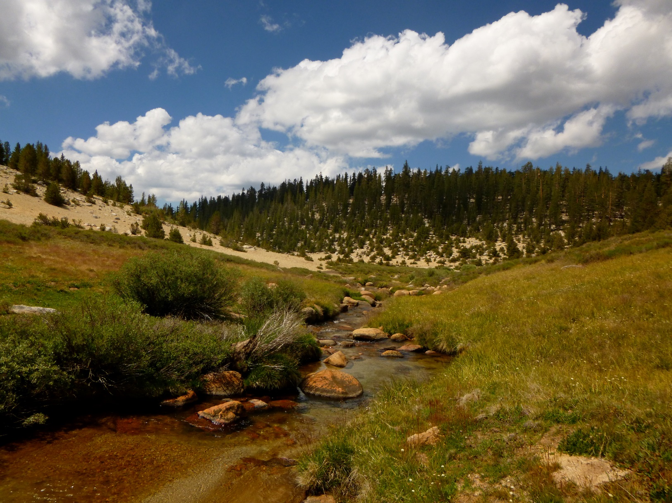
Questions / Comments?

