Slide 1
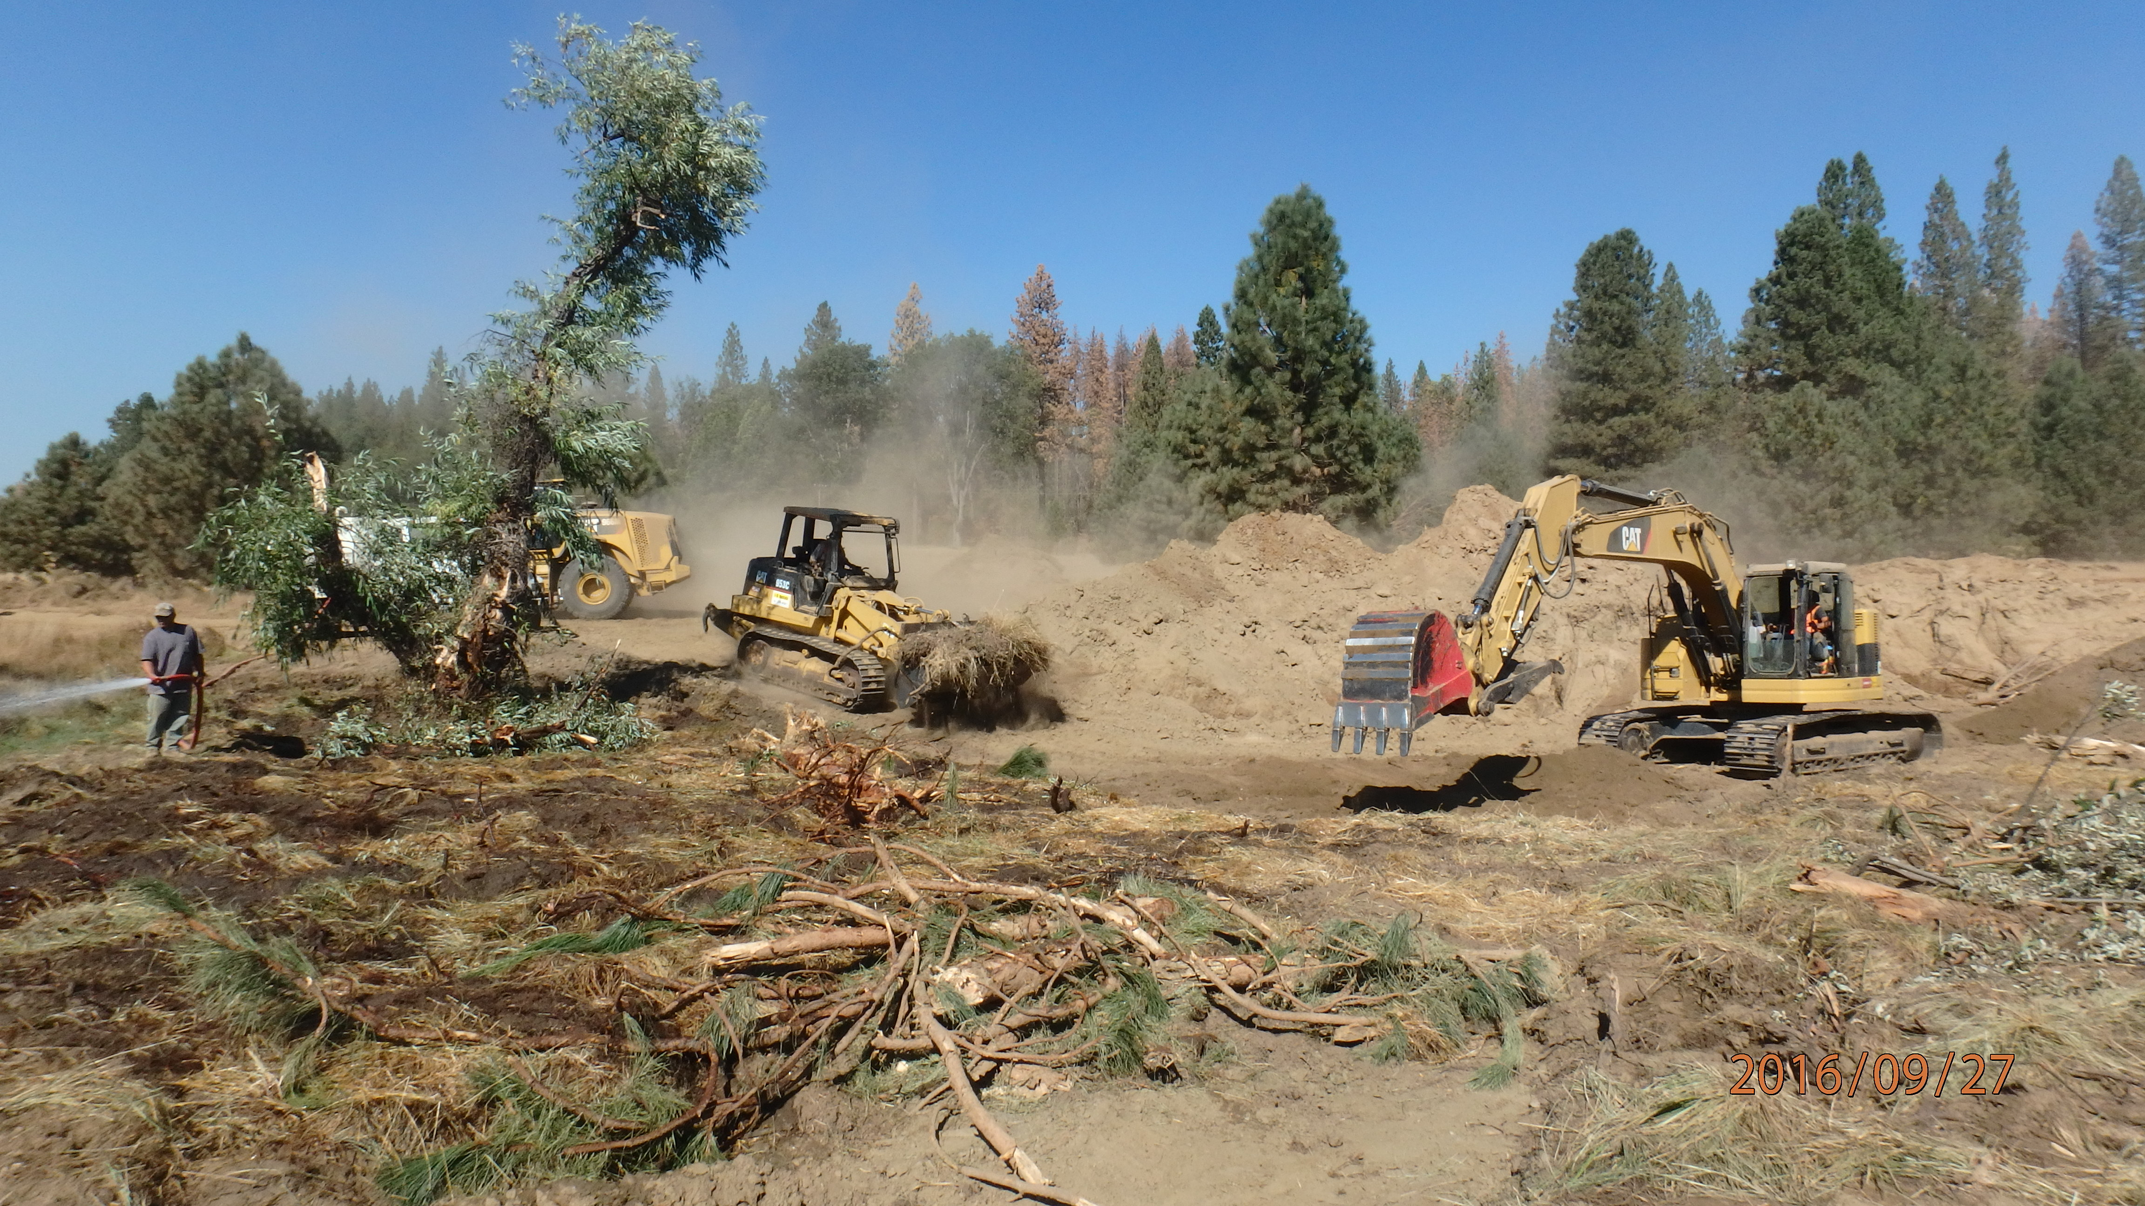
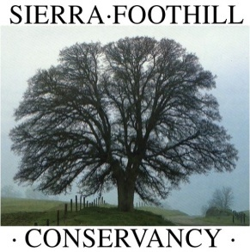
Bean Creek Preserve
Meadow Restoration
Proposition 1 DFW-Funded Cap and Trade Projects
Progress and Updates

Slide 2










Funding and Partners

Slide 3
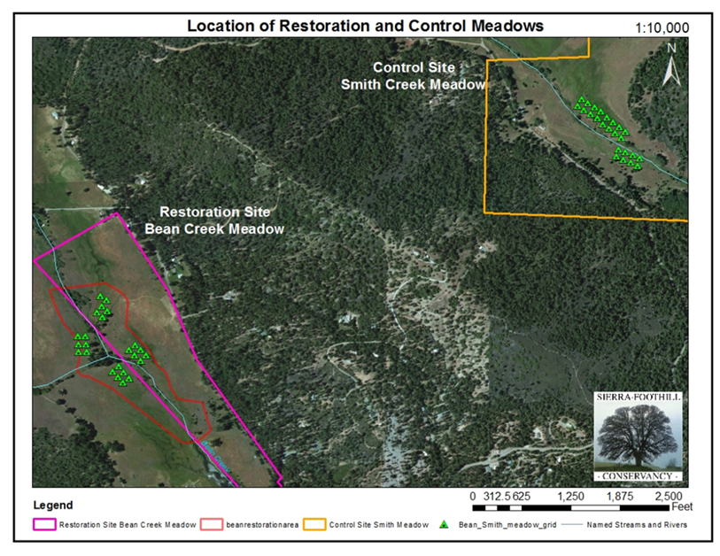
Restored and Control Site Locations

Slide 4
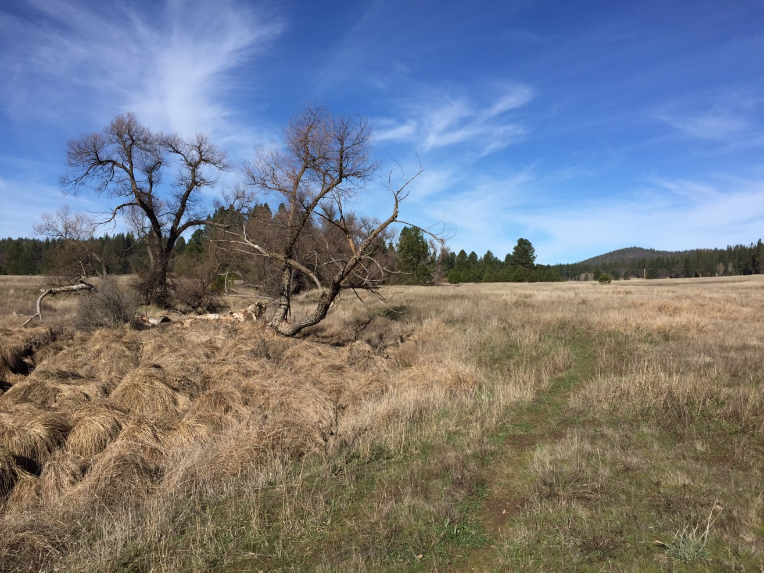
Meadow Type
Bean is an unusually low elevation meadow and the lowest lying meadow of the SMRRP at only 3,200 ft. elevation.
As with most Sierran meadows, Bean Meadow appears to be a Holocene (last 10,000 years) feature (Wilcox 2012).

Slide 5
Meadow Conditions Pre - restoration
Hydrologic status - 39 acre project area could be delineated into two distinct morphological reaches, separated by an alluvial fan associated with the west tributary and a colluvial fan extending into the meadow from the east that constrict the meadow floodplain. The meadow again becomes constricted, topographically, at the downstream end as flow enters the reservoir.
The upstream portion of the property is more complex with several apparent remnant channel swales across the meadow separated by subtle high features. The interaction between the alluvial fans confined the upstream channels into a single thread with a relatively narrow effective floodplain width.
The portion of the meadow downstream of the fan features maintains a definite slope to the east side of the meadow. This also appears to have kept the remnant channel as a single thread through the remainder of the meadow. The interaction of the fans also introduce variation in the channel/floodplain gradients.
Wilcox (2012)

Slide 6
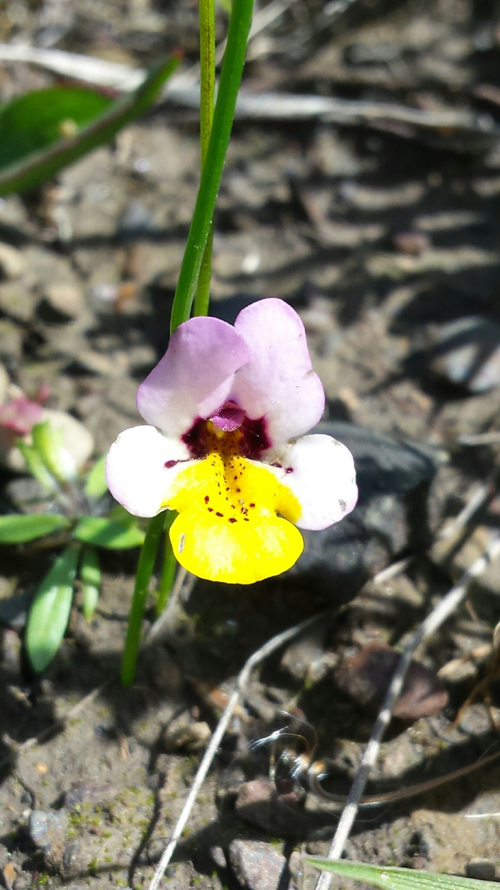
Critical Species
Known Species On Site: Western Pond Turtle, Great Gray Owl, Yellow Lip Pansy Monkeyflower
Possible Species: Golden Eagle, Willow Flycatcher and Spotted Owl
Common Species: Mule Deer, Black Bear, Coyote, Bobcat and abundant waterfowl.

Slide 7


Slide 8
Historic Land Use
Currently owned by SFC and neighbor Steve Dunckel
Previously owned by two prominent ranching families in the 1900’s and before
Likely causes of degradation: irrigation - particularly for “Timothy Hay,” historic grazing, building of reservoirs and dams
Co-managed by SFC and neighboring landowner and rancher, Steve Dunckel. Currently developing a grazing plan and implementing NRCS EQIP contract for proper fencing and water infrastructure to manage the grazing and restoration cohesively.

Slide 9
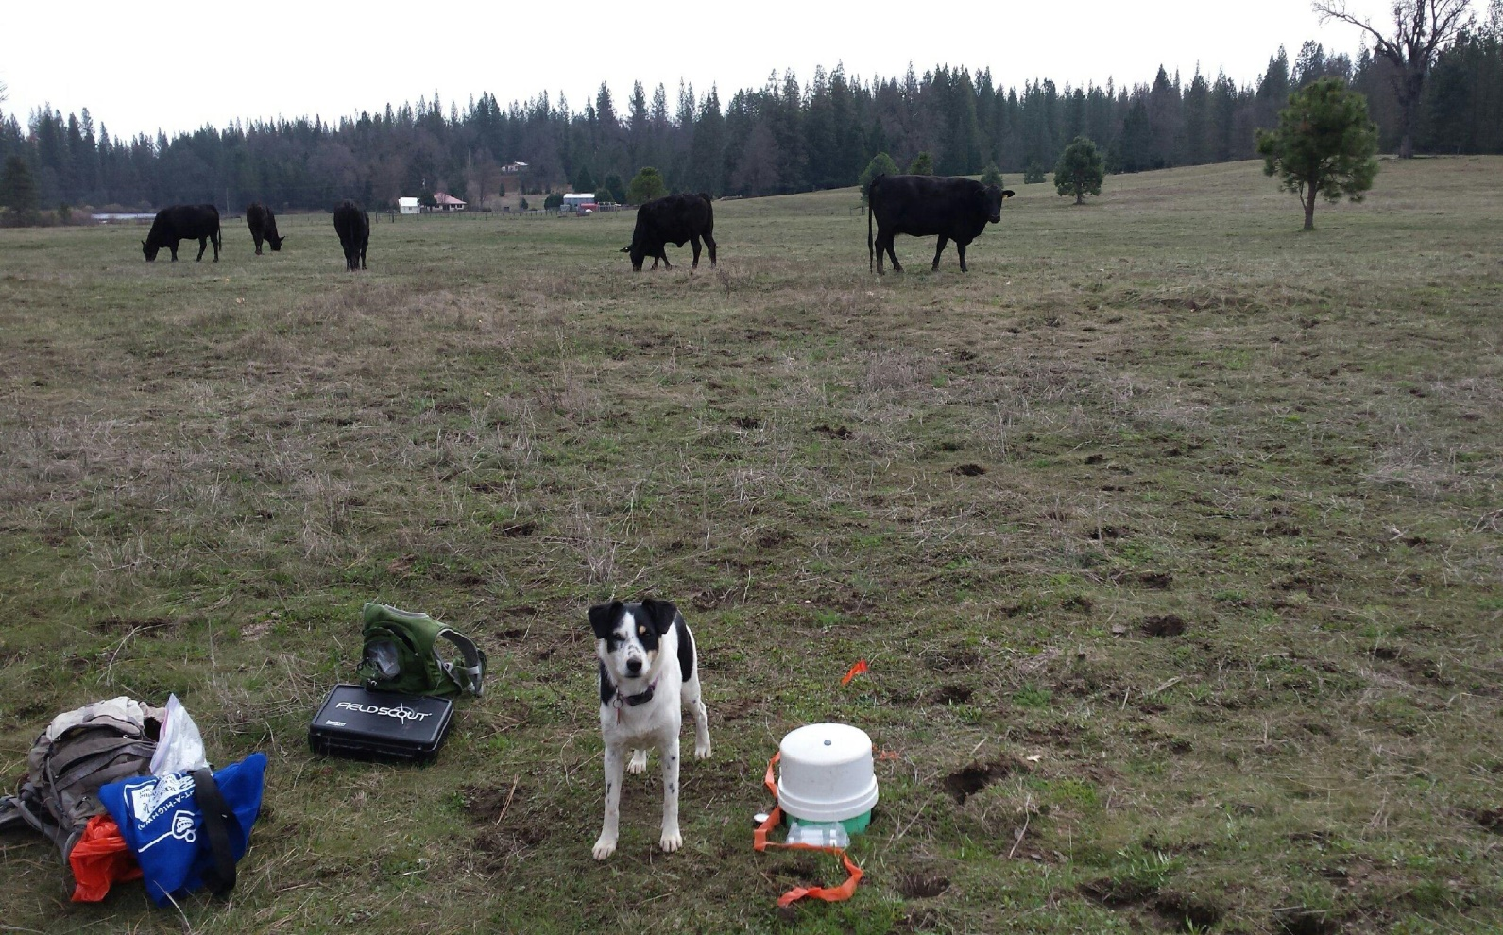
GHG Research
To date SFC has completed 15 of 15 pre-restoration GHG monitoring visits, from September 2015 to September 2016.
Due weather, repair will occur next fall, post-restoration monitoring will begin in September 2018 and continue through September 2019.

Slide 10
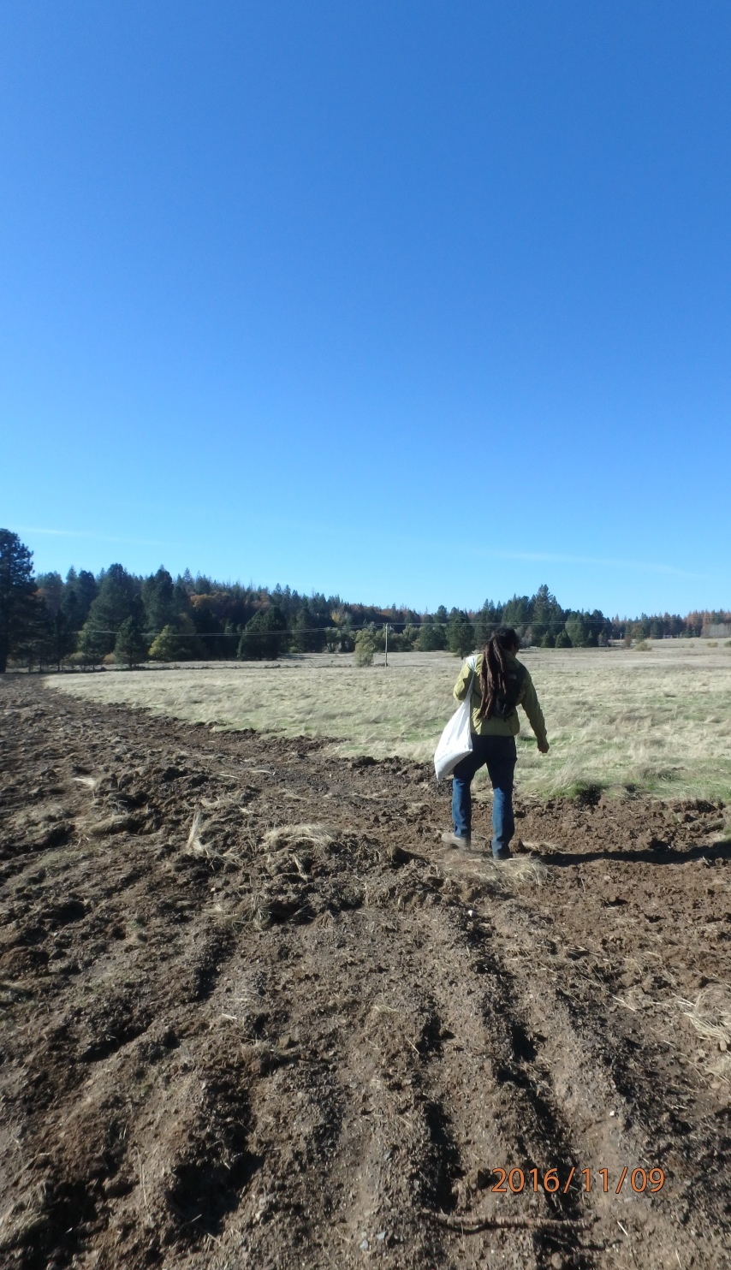
Restoration Goals
Increased Health and Function of Meadow Ecosystem
Increased Groundwater Storage
Increased Carbon Storage
Decreased Greenhouse Gas
Increased Native Species and Diversity (plant and animal)
Sustainability of Cattle Grazing in meadow ecosystems
Increased Awareness of the public benefit of meadow restoration
Increased Awareness of the need for meadow restoration on private and publically owned land

Slide 11
Restoration Design
In order to restore the hydrologic function of the channel/floodplain system and its attendant ecosystem benefits the restoration design would eliminate the seven active headcuts on the mainstream, tributary and remnant channels. The most cost effective technique to accomplish this goal is a pond and plug treatment.
The borrow ponds principal function are to provide native fill material for plug construction. Since the ponds will fill with groundwater and maintain ponded water year-round, habitat features and diversity are incorporated into the construction. These include varying water depths, islands, pennisulas, basking logs, etc., which are determined as fill needs are met. Topsoil is removed and stockpiled adjacent to the plug fill zone to top dress the completed plug.

Slide 12
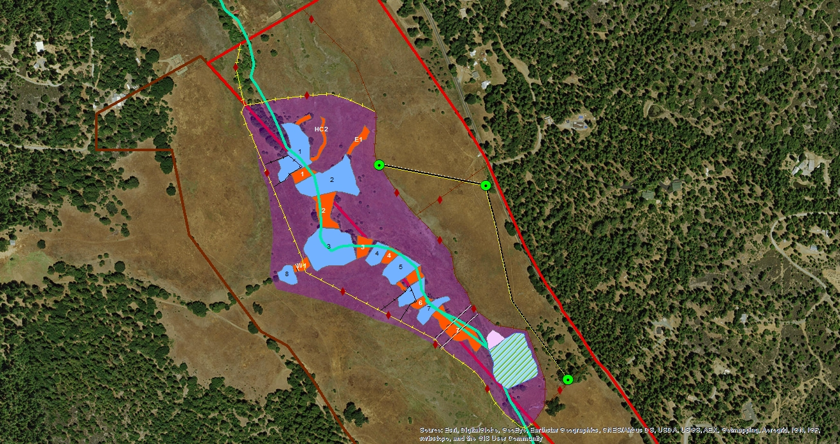
Restoration Plan
Pond and plug design as well as riparian pasture fencing and upland water infrastructure are all shown above.

Slide 13
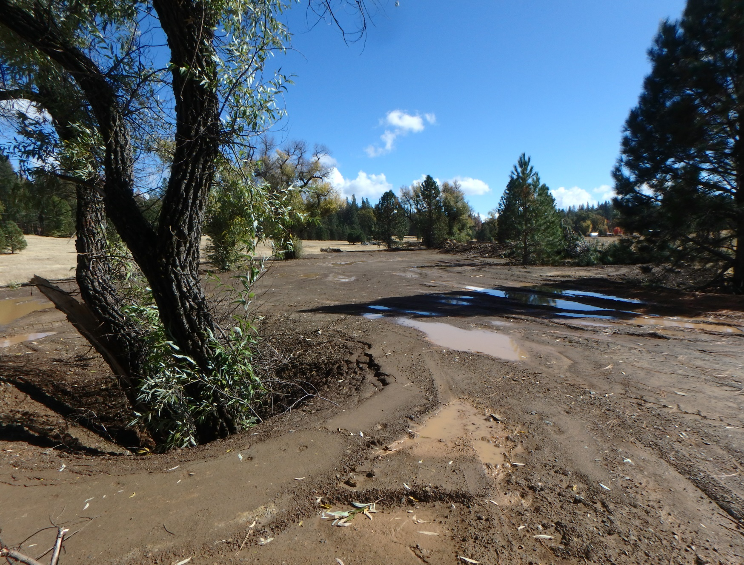
Implementation
Implementation occurred between early September and October 31st 2016.

Slide 14
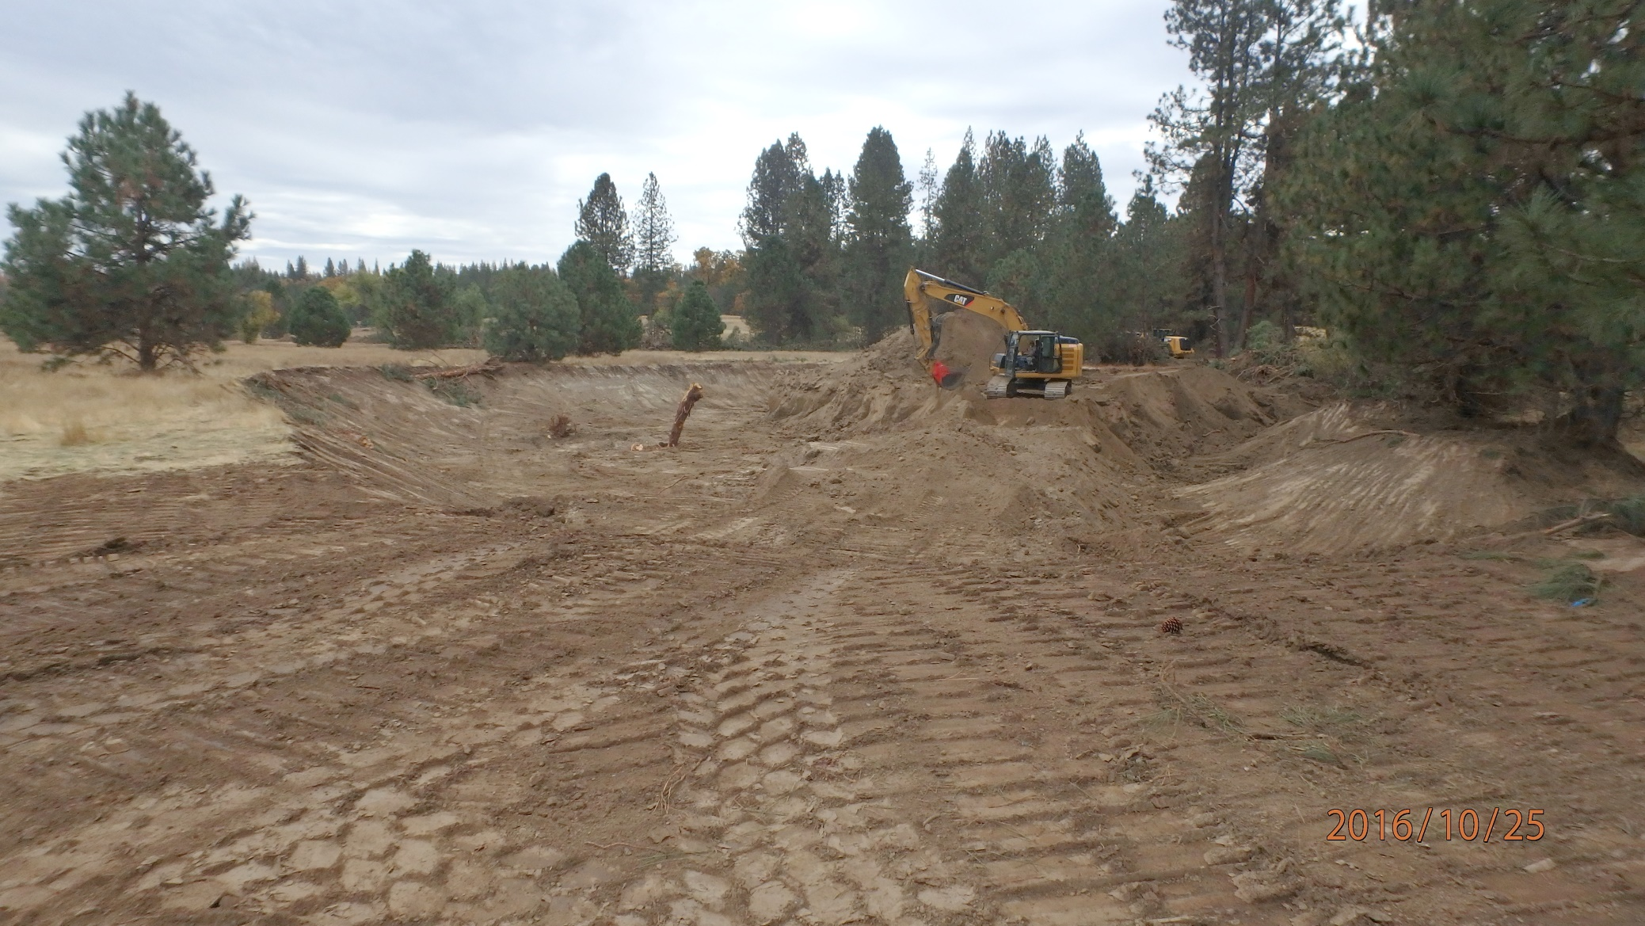
An excavator digs out a pond, gathering soil that will be used as fill for a plug upstream.

Slide 15
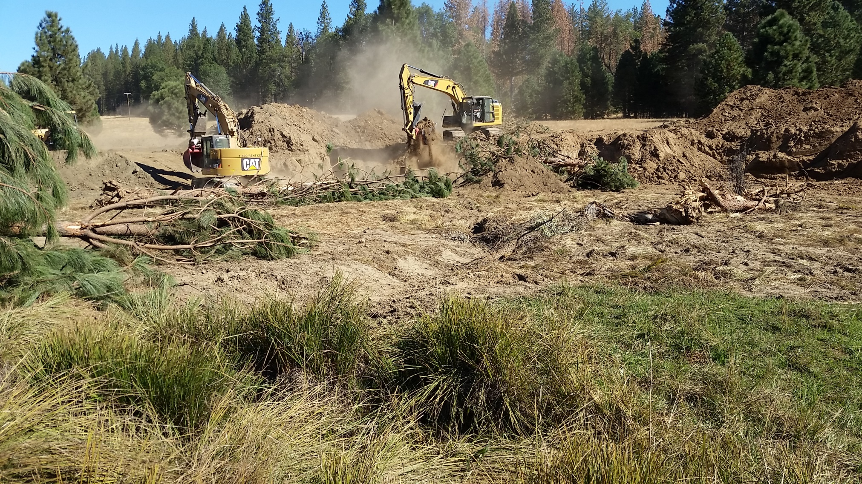
Excavators work in unison to remove soil and create a 1.1 acre wetland. The fill from the created wetland provided almost all soil needed for the terminal plug.

Slide 16
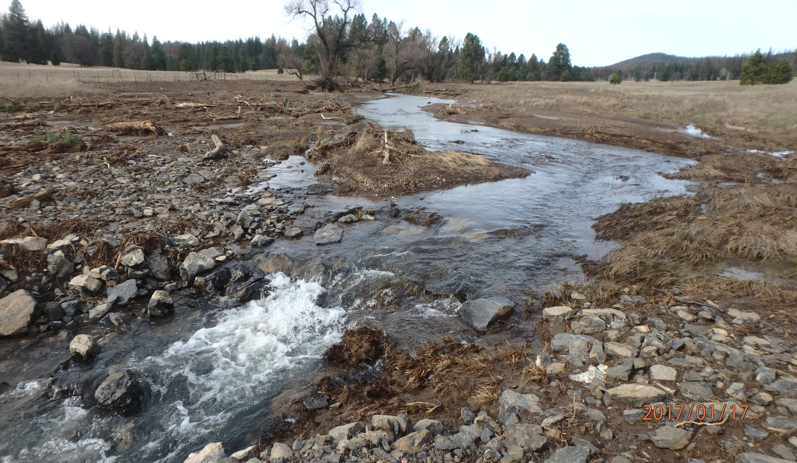
Post Restoration
The valley grade structure, constructed with shot rock from local quarry, withstands intense winter rains.

Slide 17
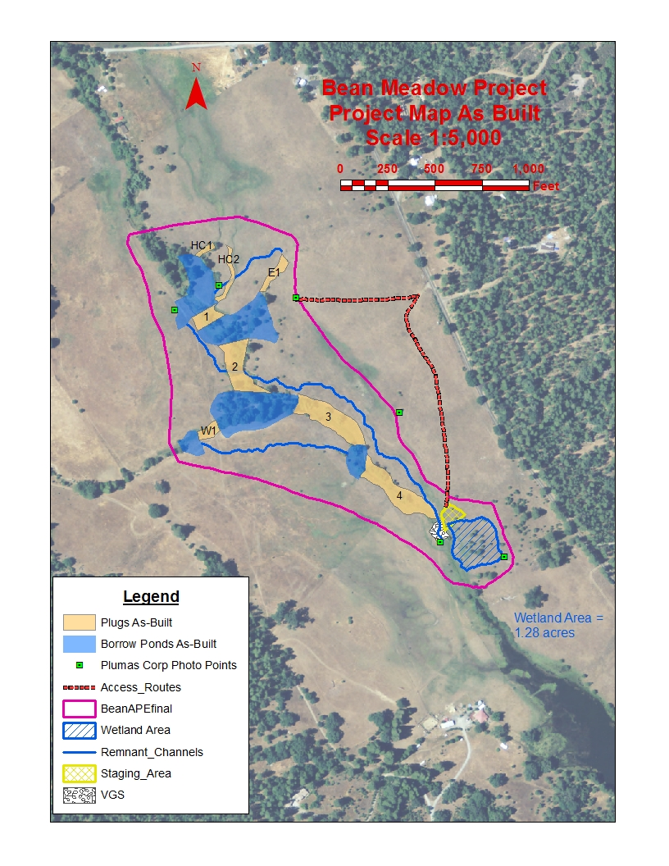
Design
As - Built
Due to the extra fill yielded from the created wetland, the amount of ponds originally needed for the design was no longer necessary. As built the plugs were much larger.
Map Credit: Plumas Corps.

Slide 18
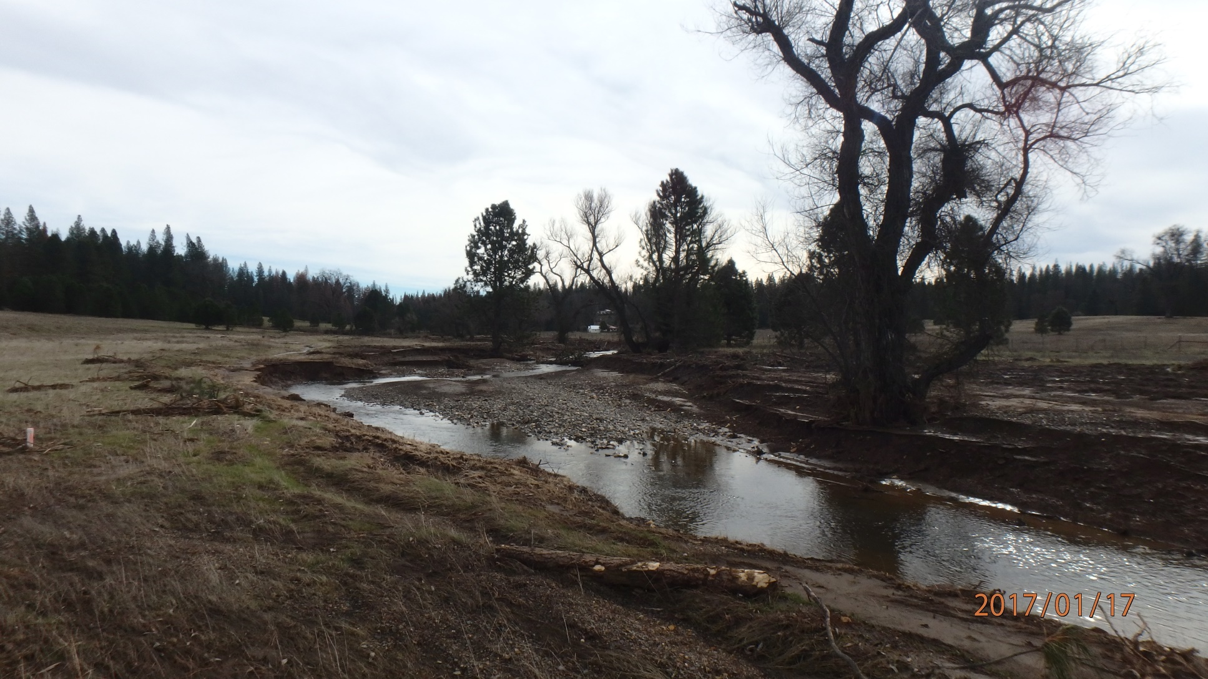
Mature willows retained for habitat requirement per 1600 permit and community, created tree wells that acted as weak point in which water infiltrated, swirled and traveled upstream degrading surfaces of plugs.

Slide 19
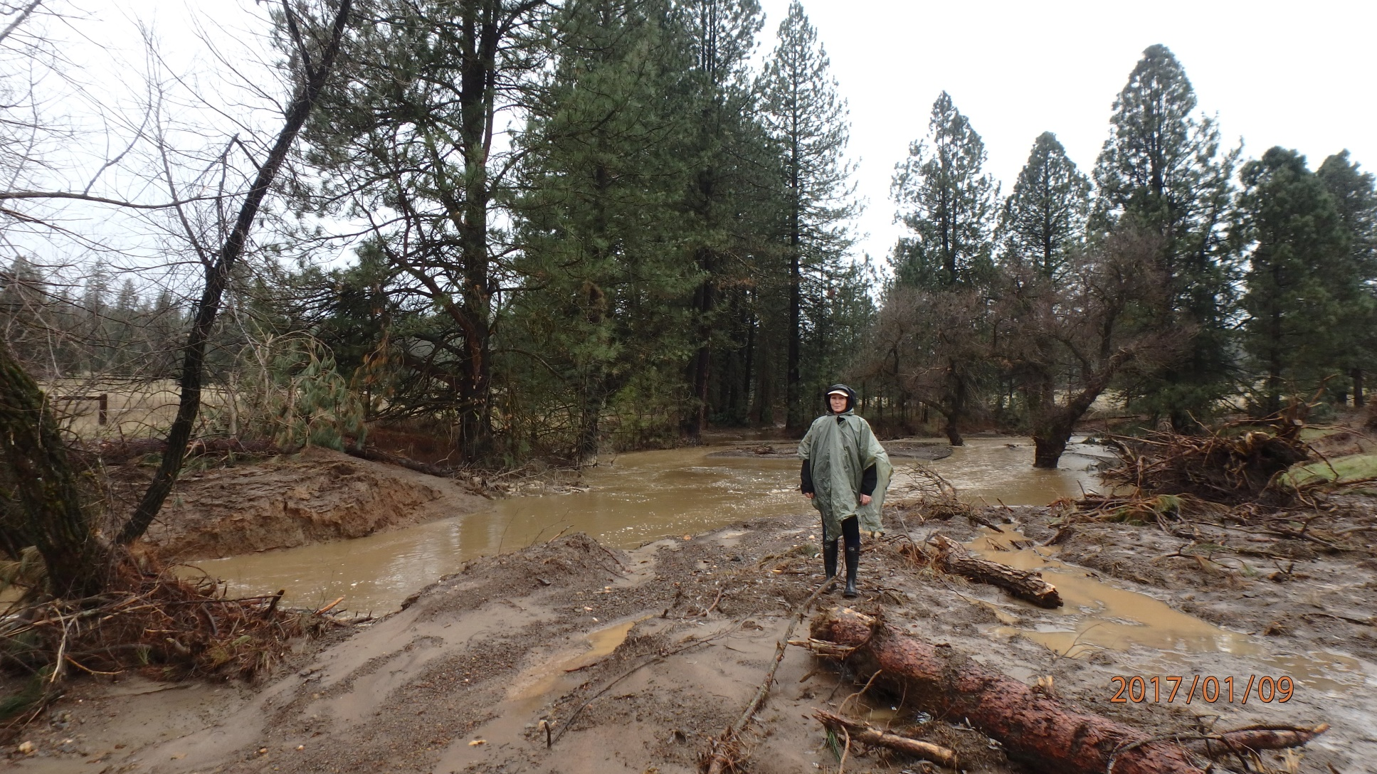
Bridget Fithian, Executive Director of SFC stands on plug, where heavy rains have caused erosion, that lead stream water into gully channel, instead of remnant channel as planned.

Slide 20
Next Steps
TASK | ESTIMATED DATE
Extend, amend, renew permits (401, 404, 1600 and CEQA) | February 2017 – July 2017
Mobilize, Implement Repair and Demobilize | August 2017 – September 2017
Complete native seeding and herbaceous cover | November 2017
Monthly monitoring of water wells and photo points Annual Point Blue avian survey | Life of project
Annual PSC and RDM monitoring | Spring and Fall life of project
GHG, Carbon and Veg | August 2018 to August 2019
Reintroduce cattle and implement riparian grazing | Spring 2020 (or when ready)

Slide 21
Repair Design
The repair focus would be on both effectively blocking the cuts as well as slightly raising plug elevations and lowering some flow exit points to reduce the likelihood of floodflows accessing vulnerable points on the plugs. The principal area of elevation adjustment would be the interface between plug #3 and plug #2. Dependent on soil moisture there are several options, one of which includes vinyl sheetpile (Wilcox 2017).
SFC is working with permitting agencies and Plumas Corps. and will asses and choose from there. Additionally rains continue to fall in record amounts, leaving the project vulnerable to further movement.

Slide 22
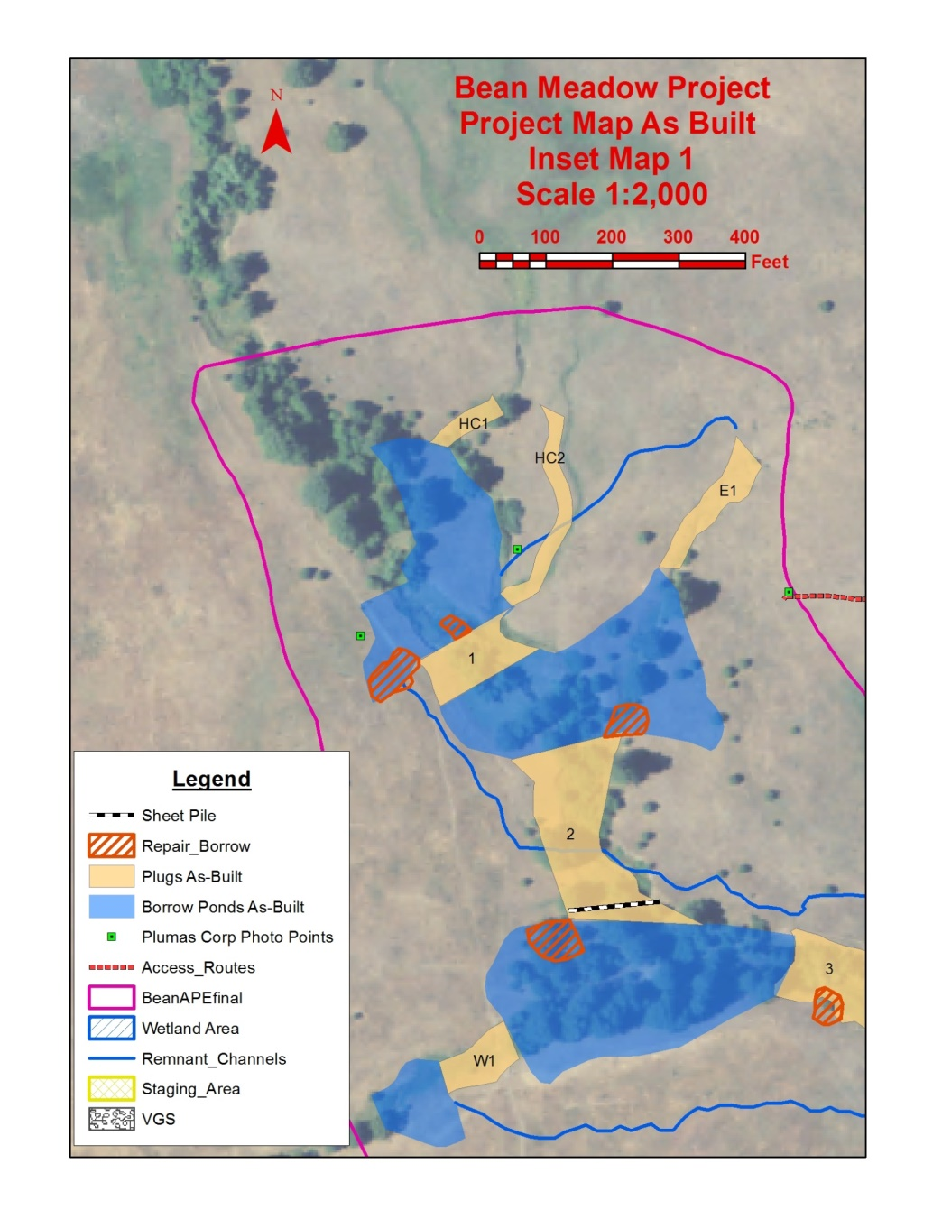
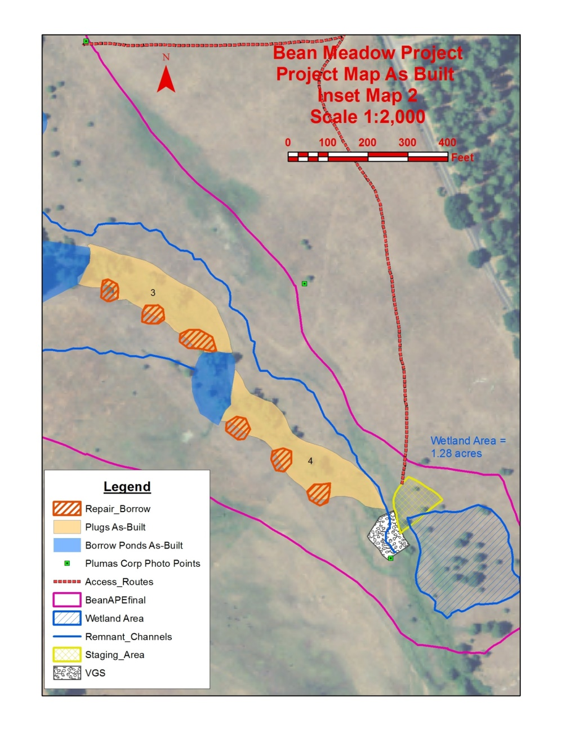
Repair Design

Slide 23
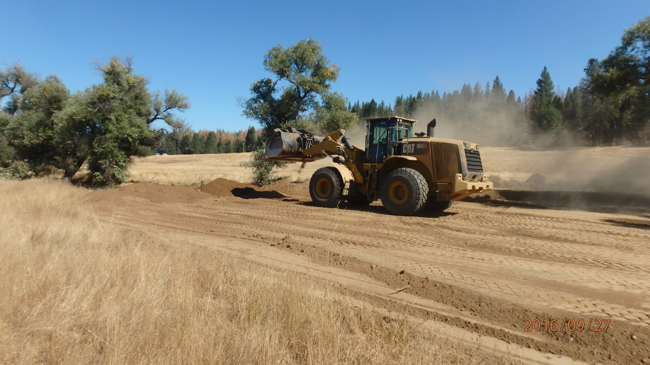
Questions?

