Slide 1
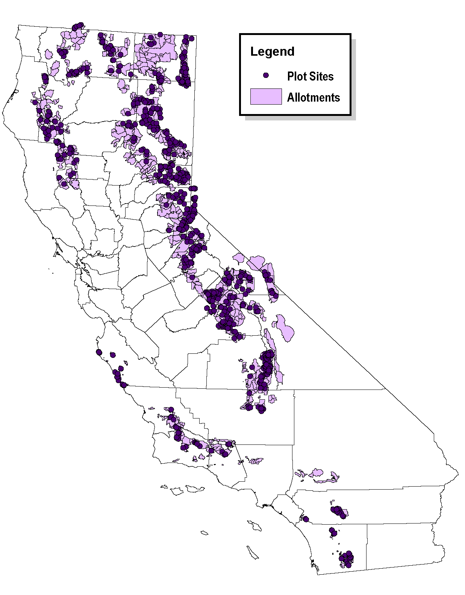
Meadow Condition Monitoring,1999 - 2013 1999-2012
850 Permanent plots
  Read every 5 years
  Over 270 with 10 years of data
Plant species composition
  Diversity
  Richness
  CIR – Range Condition
Current data analysis
  Current Condition
  Trends in Condition
  Initial Condition x Weather x Site Type x Management

Slide 2
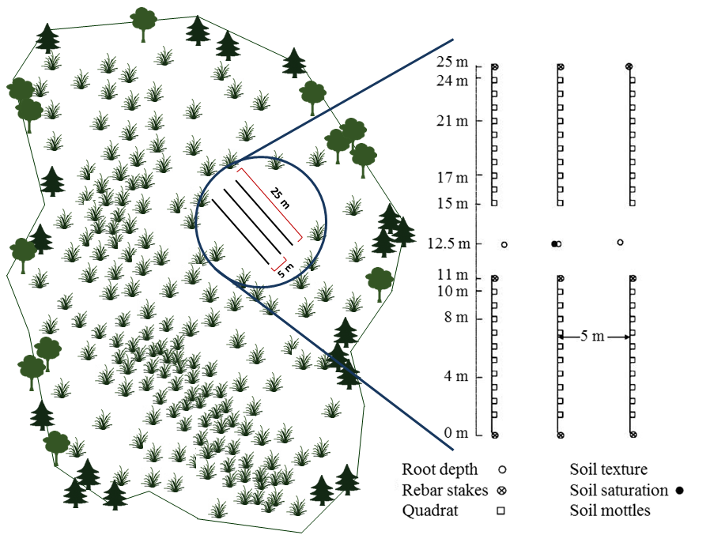
Plant Community Composition Monitoring
plant rooted frequency
soil characteristics
site characteristics
grazing management
weather
climate change scenarios

Slide 3
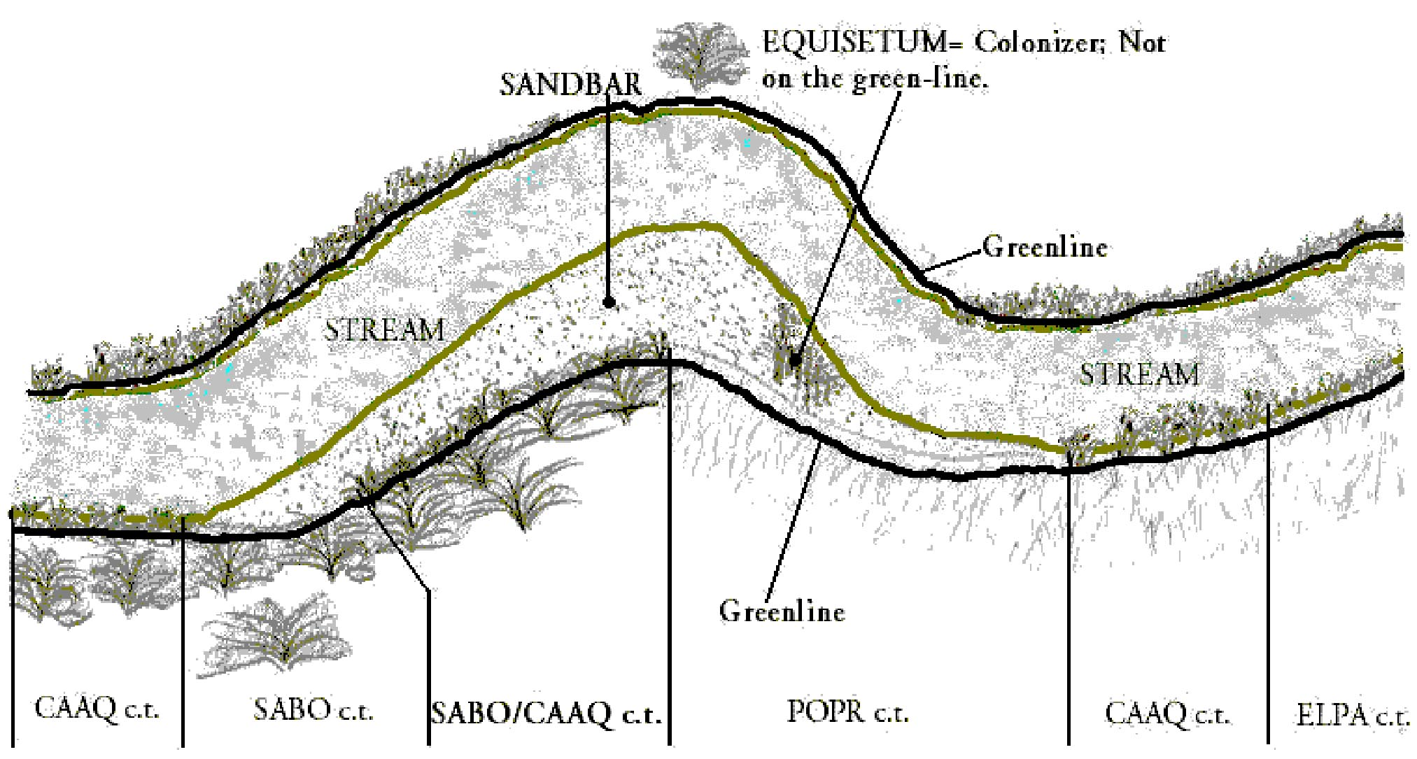
Monitoring Methods
greenline, woody regeneration

Slide 4
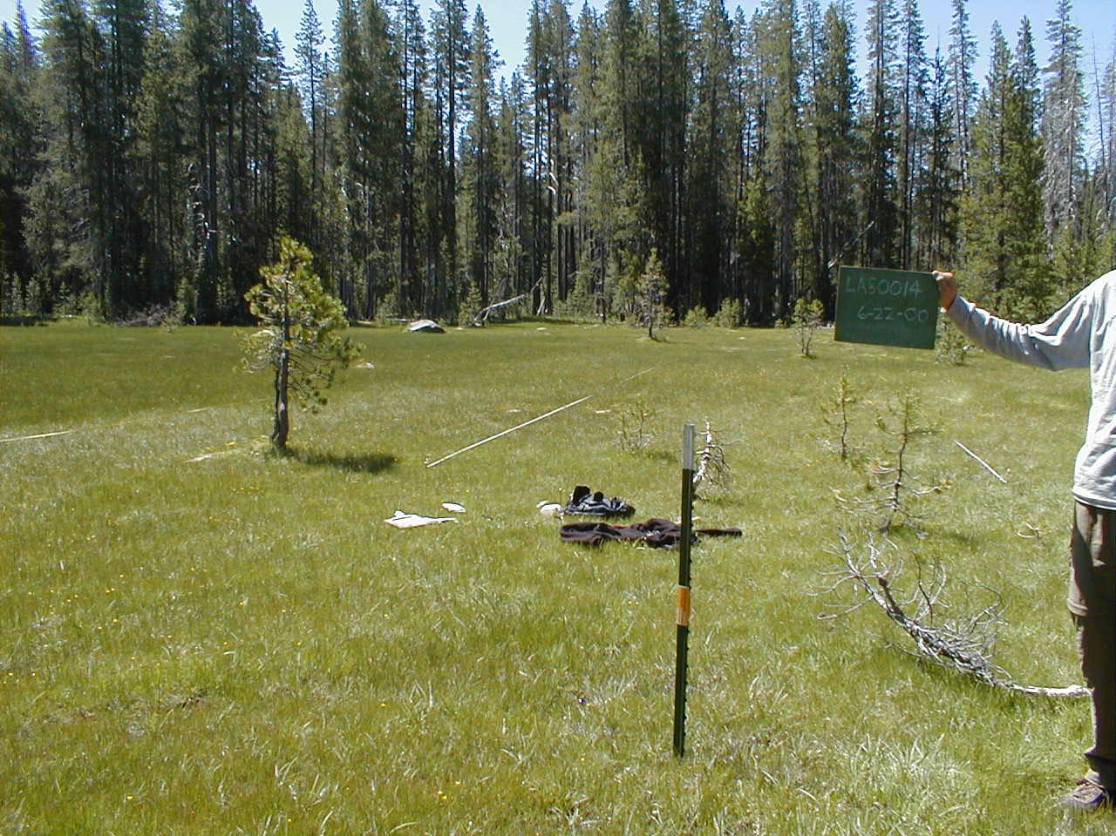
All Monitoring plots are permanently marked

Slide 5
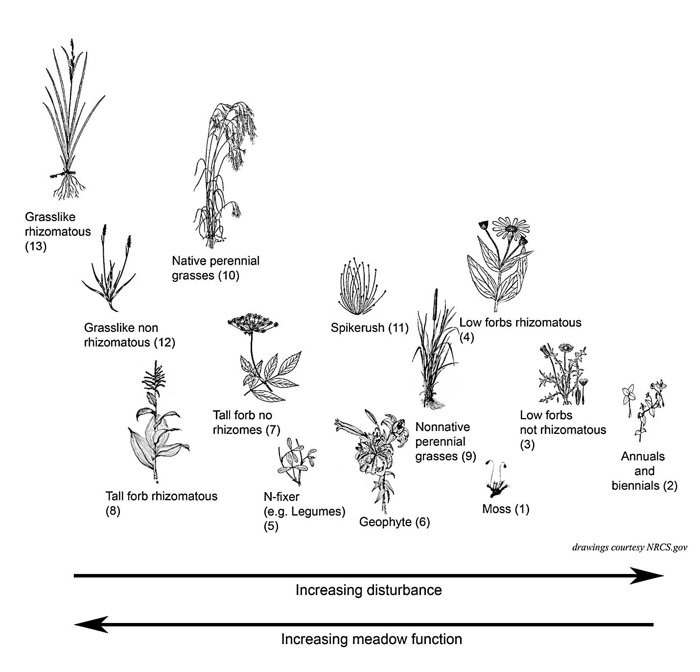
Plant Functional Groups

Slide 6
Plant Functional Groups
Competitor
Intermediate
Ruderal

Slide 7
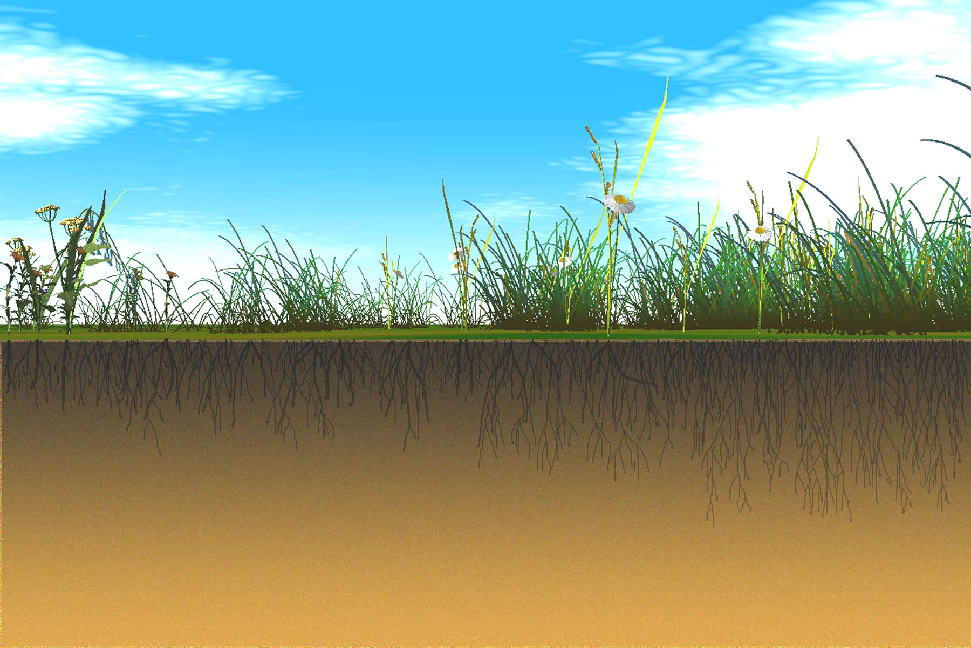

Slide 8
Condition
Poor Condition
Excellent Condition

Slide 9
Trend for relative amounts of functional groups

Slide 11
Desired Conditions
Sierra Nevada Framework, 2004
Streambank trampling
Vegetation Seral stage
Browsing on woody plants
Special habitats (fens, springs)

Slide 12
Head of Livestock on National Forest Grazing Allotments, 1906 - 2012
Meadow Conditions on National Forest Grazing Allotments
Since 2000, 27% reduction in authorized AUMs

