Slide 1
Ecosystem Services Panel Discussion: USFS perspective
Calistoga III
Jason Ko
Ecosystem Services and Climate Change Program Lead
U.S. Forest Service, Region 5
State and Private Forestry

Slide 2
Outline
How does USFS define Ecosystem Service?
What is FS doing with Ecosystem Services?
  National, Regional and Forest examples
  Pilots
  Mechanisms
  Challenges
What does the future look like for Ecosystem Services?

Slide 3
What are Ecosystem Services?
Provisioning
Food, timber/wood products, fresh water
Regulating
Air quality, water regulation, climate regulation (carbon), disease and pest regulation, erosion, pollination
Cultural
Recreation, spiritual, solitude, aesthetic values
Nutrient cycling, soil formation, primary production
Supporting
Helping to provide and protect goods and services outside of forests
Direct use or extraction
Opportunities to experience or explore
Creating the necessary conditions to enable the delivery of the three other services
Enabling delivery of provisioning and cultural

Slide 4
Why Ecosystem Services?
Strengthen connection to public
  Meaningful outcomes to complement targets
  More and different stakeholders to the table
Value benefits that are not traditionally monetized or valued
  Eg: scenery, solitude, biodiversity
Encourages all lands and cross-resource management
  What affects water quality?
Leverage resources and investment
  Carbon and water markets

Slide 5
Moving from Outputs to outcomes

Slide 6
2012 Planning Rule
CFR Text
Plans “will guide management of (forests) so that they have the capacity to provide people and communities with ecosystem services and multiple uses that provide a range of social, economic, and ecological benefits. (36 CFR 219.1(c))
Establish a foundation for discussing how benefits are derived from forests and grasslands
FS EMC Suggested Steps
(Assessment)
The responsible official shall identify and evaluate existing information relevant to the plan areas for … social, cultural, and economic conditions … benefits people obtain from the NFS planning area (ecosystem services) … and multiple uses. (36 CFR 219.6)
Identify a preliminary list of beneficiaries and associated forest goods and services
Focus the list of forest goods and services and beneficiaries for assessment (i.e. “key” goods and services)
Identify available information for characterizing key forest goods, services, and beneficiaries
Summarize key Forest goods and services in the assessment document

Slide 7
NATIONAL Ecosystem Services Strategy Team
Focus Areas
Planning: Consider the full suite of services in analysis, decision-making and priority setting;
Articulate the relevance of ecosystem services to fulfilling the Forest Service mission.
Draft Five Year Objectives (2020)
Performance: Quantify and communicate the value of resources and impacts of management actions in terms of benefits to people through measurement and reporting;
Partnerships: Connect providers and beneficiaries of ecosystem services through partnerships and shared investments.
Identify and implement models to support understanding and analyzing trade-offs from management decisions.
Design inventory methodologies and data management solutions to improve reporting of ecosystem service flows, benefits, and –where appropriate – values.
Promote an enabling framework of formal policy and informal guidance to incorporate ecosystem services into the management of our nation’s forests and grasslands.
Build capacity, infrastructure, and learning across Forest Service Deputy Areas and with partners for sustained ecosystem services benefits and improved outcomes from forest and grassland management.
Support payments, markets, and partnerships to leverage investments in shared benefits from sustainable forest and grasslands management across multiple ownerships.
Facilitate connections between non-traditional stakeholders across the urban to rural continuum and our nation’s forests and grasslands.

Slide 8
R5 Ecosystem Services DRAFT Framework
Integrate Ecosystem Services into Decision-Making, Analysis, and Priority Setting Processes
  Regional Program Priority Setting
  Land Management Planning
  Project Level NEPA
  State Initiatives/Programs
Quantify and Communicate the Value of Resources and Impacts of Management Actions in Terms of Benefits to People
  Establish Standardized Methodologies, Baselines, Trends and Projections
  Create Communication Tools
Connect Providers and Beneficiaries of Ecosystem Services
  Collaborative Frameworks and Authorities
  Pilot Projects

Slide 9
Pilot projects
Water Partnerships
Denver Water & Eugene (OR) Water
Carbon (Voluntary and other)
Angeles NF – NFF partnership (also San Juan NF in CO)
R2-NFF Agreement on Western Range (Colorado) + Francis Marion/Sumpter NFs (South Carolina)
Compensatory Mitigation (CWA +ESA)
Placer County: Avoided Fire
R5 MOU with Army Corps and CalTrans
Pilot projects on Tahoe, Inyo, Shasta T, Sequoia
GGRF, Forest Carbon Plan, and other State initiatives
TBD, AB-2087: Regional conservation investment strategies
Mokelumne Watershed Avoided Cost Analysis
Indian Meadow and Arundo Removal Projects (CocaCola)
Meadows…..
WO forest carbon analyses – baseline and historic “what ifs”, CEQ Guidance
Pacific Islands Interest
Eldorado/Stanislaus NFs– Upper Mokelumne Watershed Authority

Slide 10
Mechanisms
Stewardship Authority
10 year duration
Challenge Cost Shares
Cooperatively developed, planned, and implemented
Good Neighbor Agreements
Agreements or Contracts
Stewardship or other authorities
5 year duration
Participating Agreements
Goods for Services
Cooperative Funds, Wyden and other authorities
10 year duration
Tribal Forest Protection Act
No Cost Share required
Cost-share required
Reimbursement only
Cost-share
5 year duration
With State Agencies Only

Slide 11

Challenges
Integration and Prioritization
Shifting culture and ways of thinking about resource management, results, outputs, and outcomes
Communication
Translating “Ecosystem Services” to something digestible.
How are ecosystem services measured at different scales? Outputs to Outcomes.
Standardization, Measuring, and Monitoring
What is important for region, forest, and project? To whom?
How to reconcile different tools, programs and landscapes in CA?
How to define who to connect with on what, and when?
What existing data can be used and/or compiled?
How to connect to people and communities without adding extra data collection and onerous reporting?
Implementation
How to scale? Across ownerships?
FS cannot trade/sell carbon credits
Capacity (financial and human) constraints
Balancing Criteria
Permanence

Slide 12
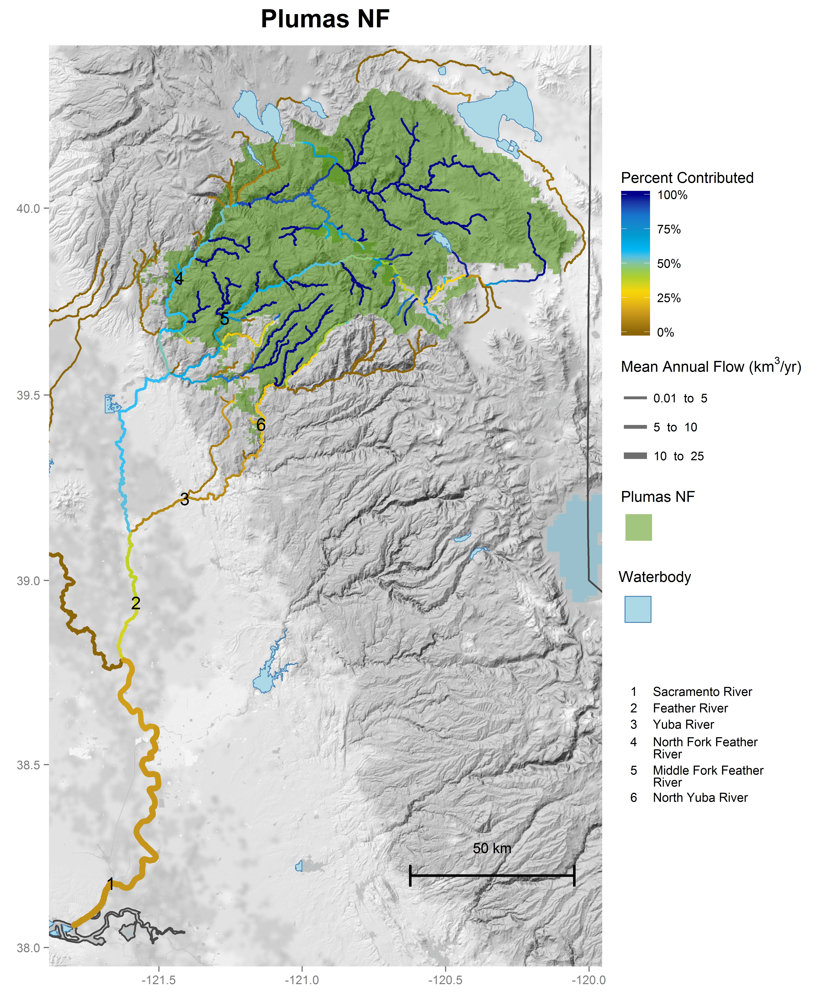
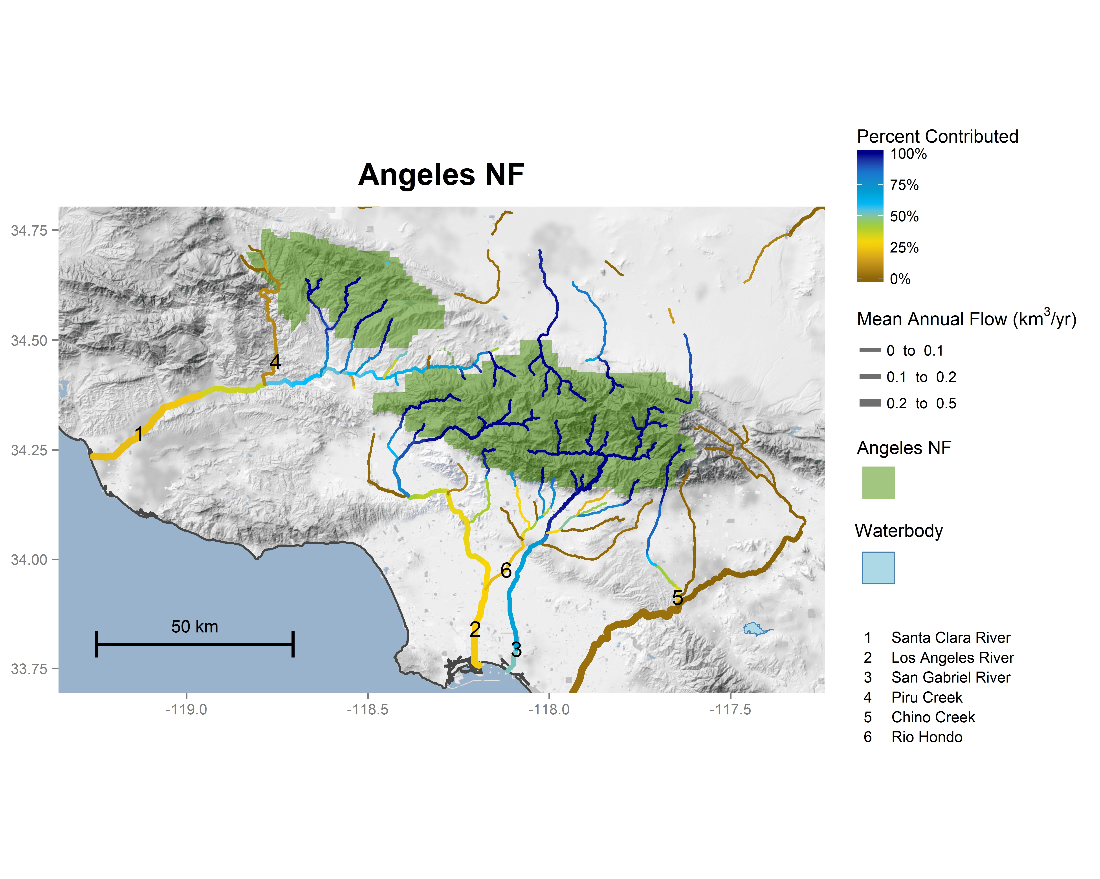
% Stream flow from FS National Forests
https://www.fs.fed.us/rmrs/national-forest-contributions-streamflow-pacific-southwest-region-region-5

Slide 13

Future
Forest Plan Revision
How to identify Key Ecosystem Services in plan assessments (NWFP)
Measuring and Monitoring - Research
Quantification methodologies (Mokelumne, Carbon baselines, FIA)
Investing and Innovating - Pilot Projects
Compare effects of alternatives on key services
Investment and finance partnerships (private finance, AB 2480, corporate social responsibility)
Working with CA State Agencies (WKRP, CFLRPs, WIP, CA Headwaters, Forest Carbon Plan, Tree Mortality)
Modeling of future scenarios and benefit outcomes (SoCal study, water)
Environmental markets – Carbon (Voluntary Carbon Protocols, other ecosystem benefit markets, compensatory mitigation scaling, AB 2087)
Collaborating – Landscape Perspectives
Valuation of benefits when possible
FS National Ecosystem Services Strategy Team - NESST (cross-deputy)
Engaging new partners – Utilities, Army Corps, CalTrans, private sector
Tiering of project level to forest plan to regional monitoring
GGRF → CEQ → Plan revision → Region 5 Forest Carbon → 1504 reports → CA Forest Carbon Plan
Meadows as multi- benefit pilots

Slide 14
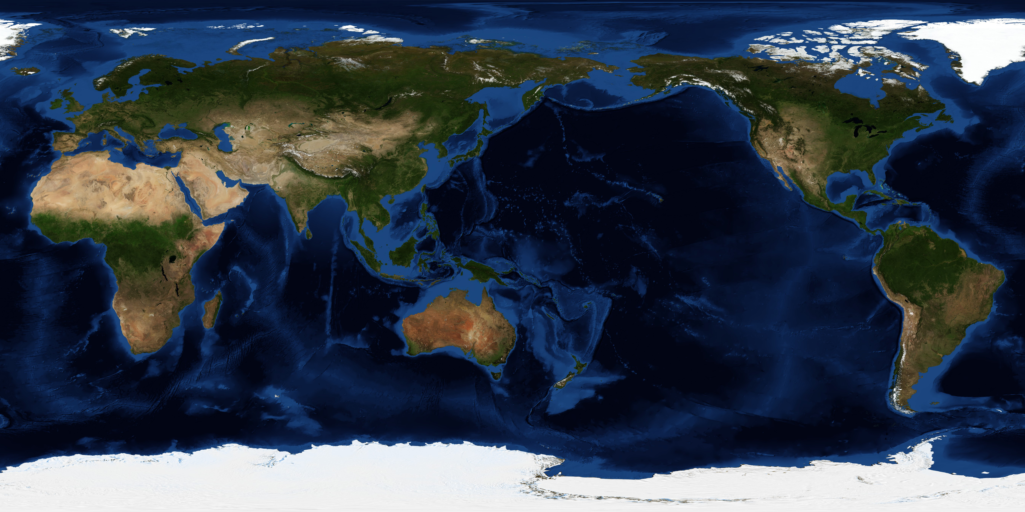
Questions?
Calistoga III

