Slide 1
Standards for Unlocking Carbon and Ecosystem Finance to Support Land Conservation Projects
Toby Janson-Smith

Slide 2
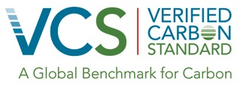
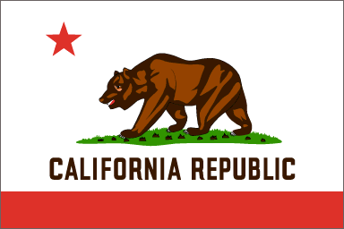
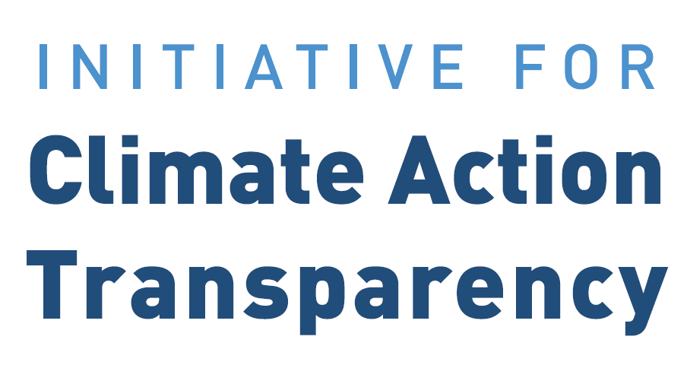
Organizational overview - VCS
Non-profit organization
Founded in 2007, incorporated in 2009
Headquartered in Washington, DC, staff in Peru and Switzerland
Develop, manage and evolve standards frameworks
Key strengths
Industry leading standards portfolio
Ability to convene diverse range of stakeholders and generate workable frameworks
Innovation

Slide 3
Presentation outline
Role of standards in international carbon markets & other conservation investments
Standards frameworks managed by the VCS
Verified Carbon Standard
The Climate, Community & Biodiversity (CCB) Program
Sustainable Development Verified Impact Standard (SD VISta)

Slide 4
International Carbon Markets and Investments in Conservation

Slide 5
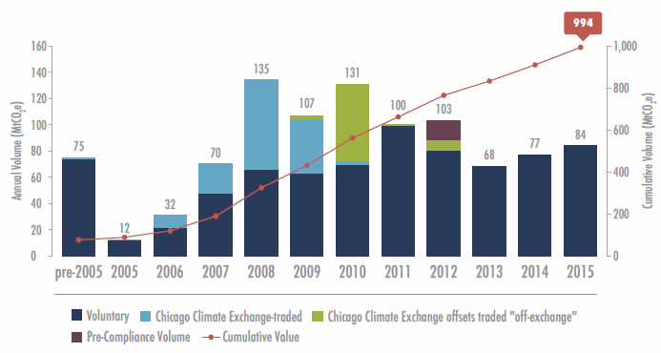
Voluntary carbon offset transactions
Source: Forest Trends’ Ecosystem Marketplace. State of the Voluntary Carbon Market 2016

Slide 6
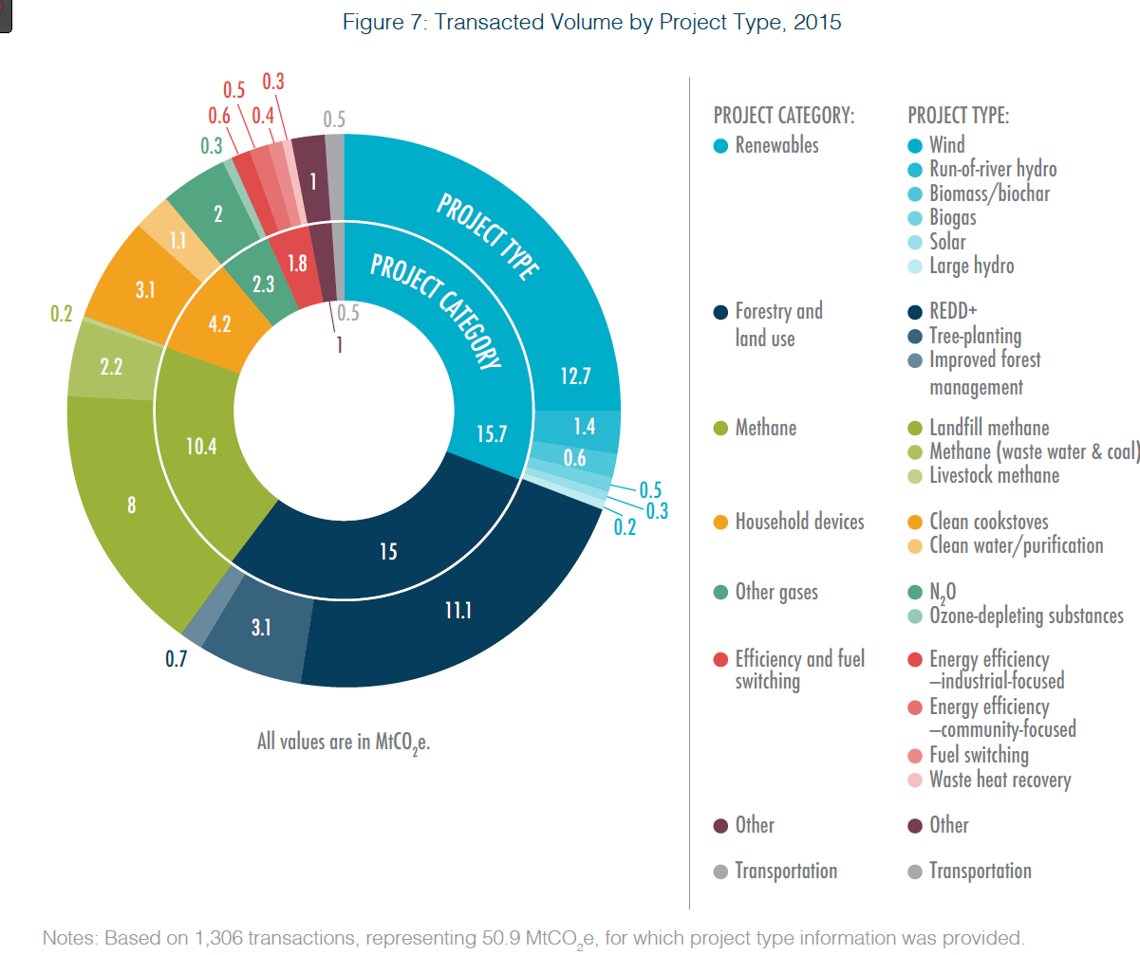
Transacted volume & average price (2015)
Source: Forest Trends’ Ecosystem Marketplace. State of the Voluntary Carbon Market 2016
Notes:
VCM

Slide 7
Source: Forest Trends’ Ecosystem Marketplace. State of the Voluntary Carbon Market 2016
Notes:
VCM 2016
End buyer breakdown by profit status, sector, type, experience and motivation

Slide 8
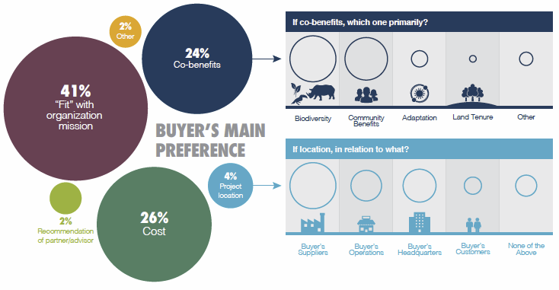
Buyer breakdown by main concern
Source: Forest Trends’ Ecosystem Marketplace. State of the Voluntary Carbon Market 2016
According to one recent Ecosystem Marketplace report, “nearly half of all respondents claimed that co-benefits had a “major influence” on their buyer(s), saying their buyer(s) engaged in the forest carbon market primarily because of the beyond-carbon impact of their dollars.” (State of Forest Carbon Finance 2016)
Notes:
VCM

Slide 9
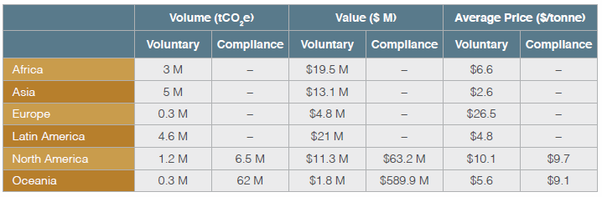
Demand for forest carbon credits by activity location
Source: Forest Trends’ Ecosystem Marketplace. State of Forest Carbon Finance 2016
Notes:
2015

Slide 10
California compliance buyers
Source: Forest Trends’ Ecosystem Marketplace. State of Forest Carbon Finance 2016

Slide 11
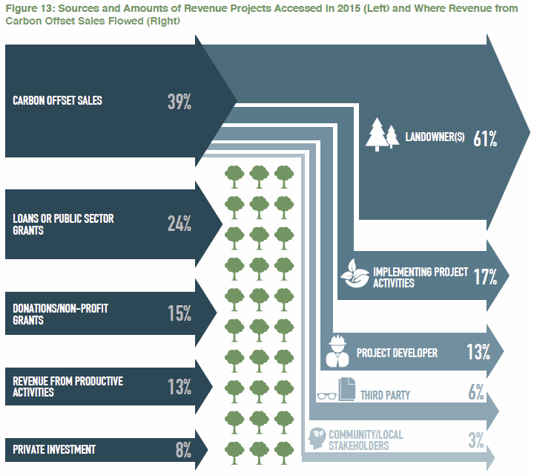
Funding accessed by projects and flows of credit sale revenue
Source: Forest Trends’ Ecosystem Marketplace. State of Forest Carbon Finance 2016

Slide 12
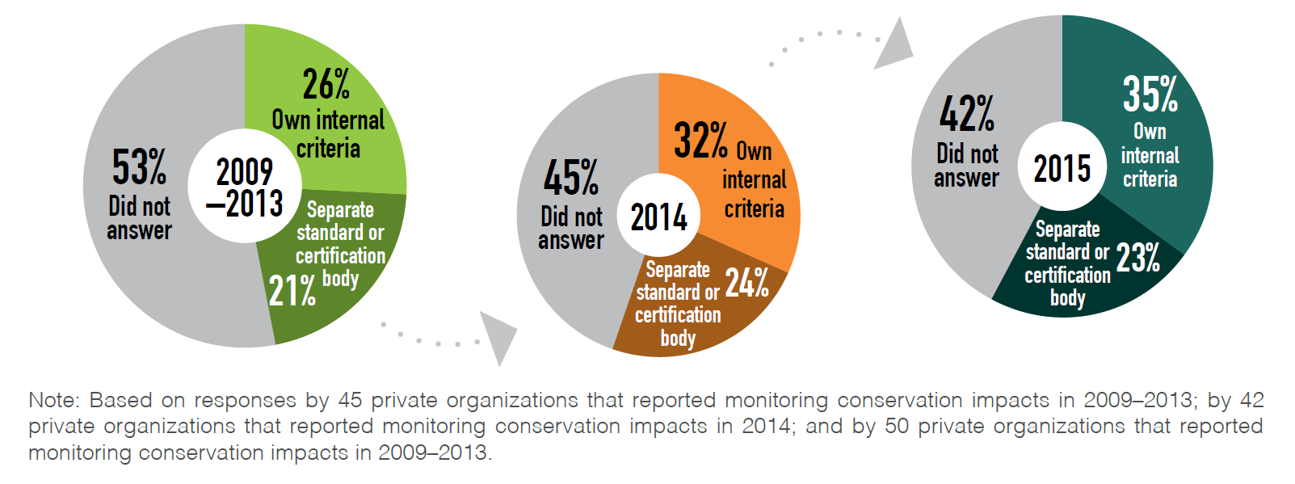
More organizations are monitoring & reporting conservation impacts
Source: Forest Trends’ Ecosystem Marketplace. State of Private Investment in Conservation 2016.
The majority of those who use a third-party standard use VCS and/or CCB Standards
Notes:
From 2009 to 2015, there has been a trend towards increased monitoring and reporting of the intended conservation impacts of investments, both using internal criteria as well as a third-party standard or certification body. In 2015, respondents reported the highest use of monitoring and reporting, with 35% using internal criteria and 23% using a third-party certification or standard (Figure 34).
The majority of respondents using a third-party standard cited a carbon offset standard. Typically, they mentioned voluntary carbon standards (mostly the Voluntary Carbon Standard; Voluntary Carbon Standard and Climate, Community and Biodiversity Alliance; Climate Action Reserve; American Carbon Registry; and Gold Standard) but a few also listed the California market compliance standard and the UN Clean Development Mechanism. Some respondents also reported using FSC certification — sometimes in addition to carbon standards, other times as a stand-alone certification.

Slide 13
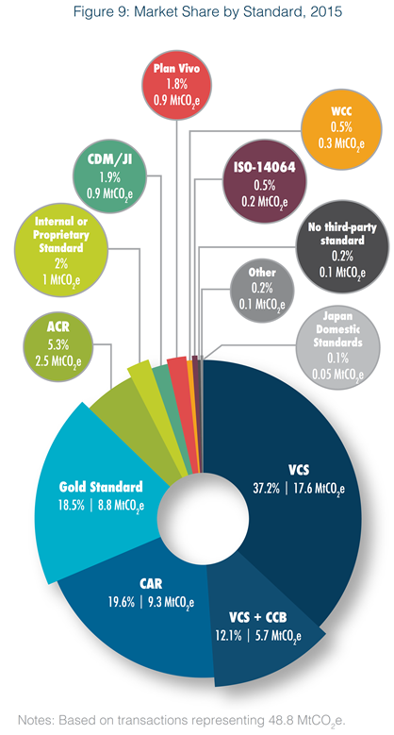
Market share by standard
Source: Forest Trends’ Ecosystem Marketplace. State of the Voluntary Carbon Market 2016

Slide 14
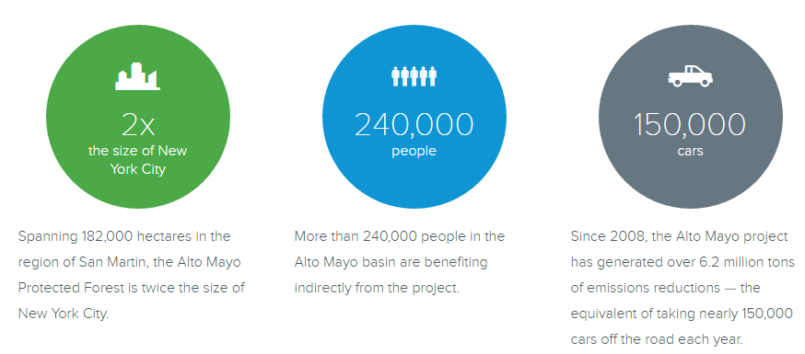
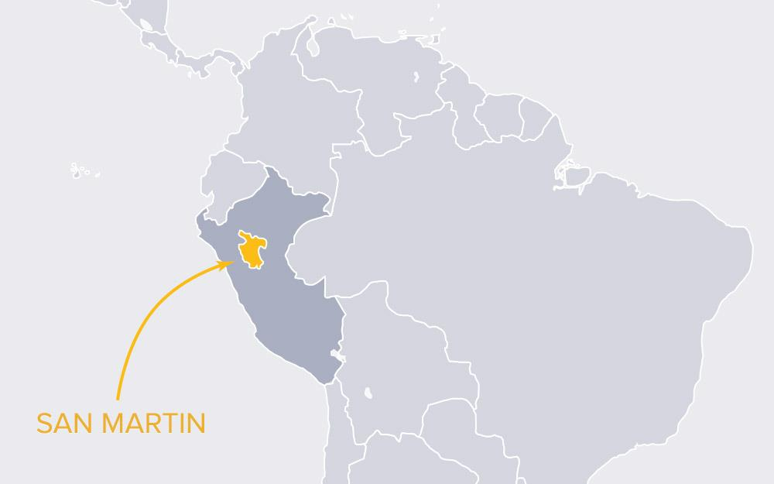
Corporate interest: Disney’s investment in Peru
Notes:
Project started June 2008. Through June 2016, the project has avoided the emissions of over 1.3 million tonnes more carbon
Habitat conserved: The integrity and connectivity of the 132,842 ha of forest was maintained and or improved with the restoration of almost 1,000 ha;
Awareness increased: The project maintained a conservation program at schools and promoted nearly 80 environmental education events, with the attendance of over 3,300 participants. As a result, 97% of the AMPF population recognizes the importance of the forest for their livelihood and well-being;
Alto Mayo Protection Forest (AMPF) governance strengthened: The AMPF staff has grown from 10 in 2008 to 103, of which 90 are paid for by the project. In addition to the construction of a new office in Rioja and the improvement of the control check points, the project has strengthened the governance by providing technical and management training, which resulted in a more effective and accountable operation;
Sustainable production promoted: Coffee is still the major driver of deforestation in the protected area; however, through the conservation agreements, the settlers are changing their agricultural practices to a sustainable production aligned with the conservation objectives of the AMPF. Currently, 848 settlers have signed the conservation agreements, an increase of 117 agreements since 2014. This figure represents approximately 60% of the total population settled in the AMPF. More subscribers are also reinvesting their revenues in organic production (65% in 2016 compared to 19% in 2014), showing initial trends of financial sustainability;
Organic coffee certified: Aiming to increase economic incentives and link production to specialty markets, a coffee cooperative, COOPBAM, was created. In the first year of operation, the cooperative exported a total of 325 qq (or 15,000 kg) of organic coffee to buyers in Denmark. This was a groundbreaking moment for two reasons: the selling and certification of this coffee had the approval and endorsement from SERNANP, and this was the first certified coffee produced in a protected area;
Living conditions improved: During the monitoring period, a positive impact in the generation of economic alternatives is noticeable. Nearly 1,900 wages were generated for conducting primate monitoring activities and nursery and reforestation work, totaling approximately US $11,000 and benefiting 358 people. Up to date, 187 fuel-efficient cook stoves were delivered and access to education and health care has been enhanced significantly;
Social management supported: A strategy was created to work cross sectorially and promote social management and support conflict resolution. Outcomes included the formation of four women’s committee within the COOPBAM; the implementation of 10 medical campaigns; the implementation of solar panels; and the establishment of an education complex through integrated management with the local population.
The project is opting for Exceptional Biodiversity Benefits: AMPF has been identified in many conservation priority analyses as being of exceptional importance for the protection of global biodiversity. Over 1,200 species of plants distributed over 118 family and 378 genera have been identified in the Alto Mayo forests. This number includes 59 species of orchids, among them is the endemic Alto Mayo orchid (Phragmipedium peruvianum). The project area is also habitat of 25 species categorized by the International Union for Conservation of Nature (IUCN) as Critically Endangered (CR) and Endangered (EN), and other 20 categorized as Vulnerable.

Slide 15
Ecosystem Marketplace survey respondents say…
Demand for carbon credits:
New climate commitments taken on by businesses may require them to look beyond emissions in their direct control and purchase offsets
Verification of co-benefits will become even more important due to the launch of the Sustainable Development Goals
Supply of carbon credits:
Supply will keep growing, with more than half coming from forest carbon
There is optimism that voluntary schemes could be included under emerging compliance markets
Source: Forest Trends’ Ecosystem Marketplace. State of the Voluntary Carbon Market 2016

Slide 16
Developments to watch re: forest carbon
The role of forest carbon in the aviation carbon market
Post-2020 constraints on international offsets
Rising interest in private forest and forest carbon investments
Better data on forests (and meadows!)
In 10 years, for PES markets expect…
Significant growth in demand for standards-verified, beyond-carbon, environmental benefits and assets
Public-private partnerships and investment models become widespread

Slide 17
Standards Managed by VCS

Slide 18
Leading land-use carbon standards
Credibility of GHG reductions
Social & environmental impacts
Additionality
Measurement & monitoring
Leakage
Permanence
Validation, verification, registration
Poverty alleviation & sustainable development
Biodiversity conservation
Watershed protection
Climate change adaptation

Slide 19
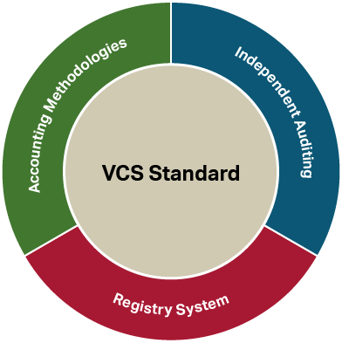
VCS Program
Notes:
The VCS Program draws from four key components:
The Standard establishes the core rules and requirements that must be met by every project.
2. Verification ensures that projects meet the standard. We establish processes for accrediting auditors and provide support and oversight over their performance.
3. Accounting methodologies set out the specific methods by which projects determine baselines, and measure and monitor their activities
4. Registry provides a secure and transparent platform on which projects and credits are listed, and connect to other programs.

Slide 20
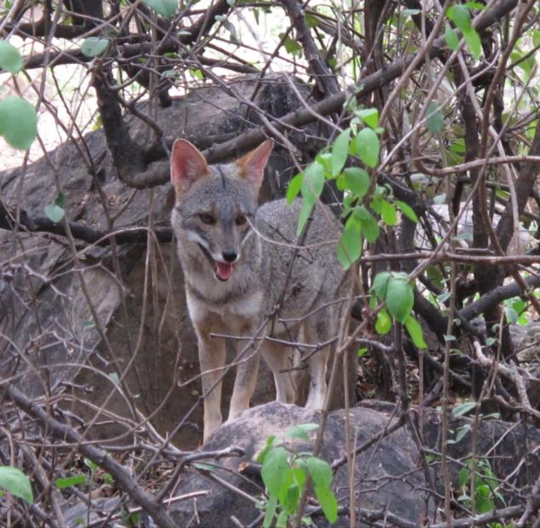
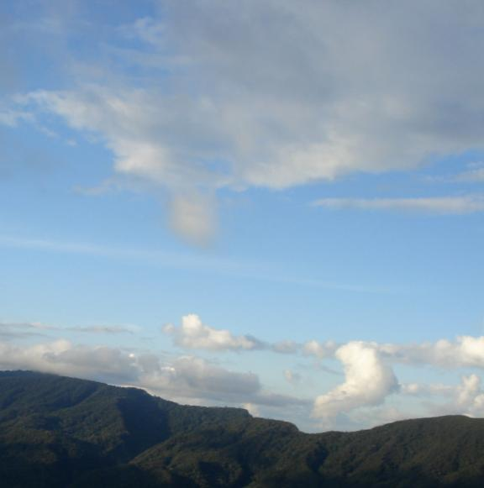
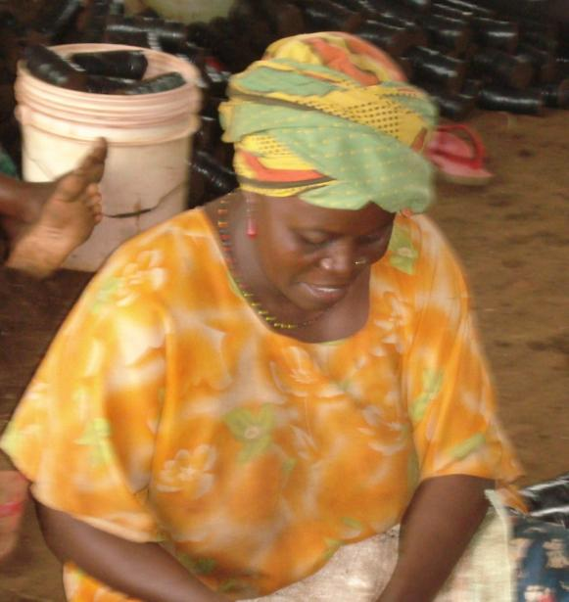
Climate, Community & Biodiversity Program
The CCB Program stimulates and promotes land management activities that credibly mitigate global climate change, improve the wellbeing and reduce the poverty of local communities, and conserve biodiversity.
Photos: J.Henman

Slide 21
CCB Program
Notes:
Compared to VCS prescribed methodologies, CCBS is a more flexible framework that allows projects to define their own methodology based

Slide 22
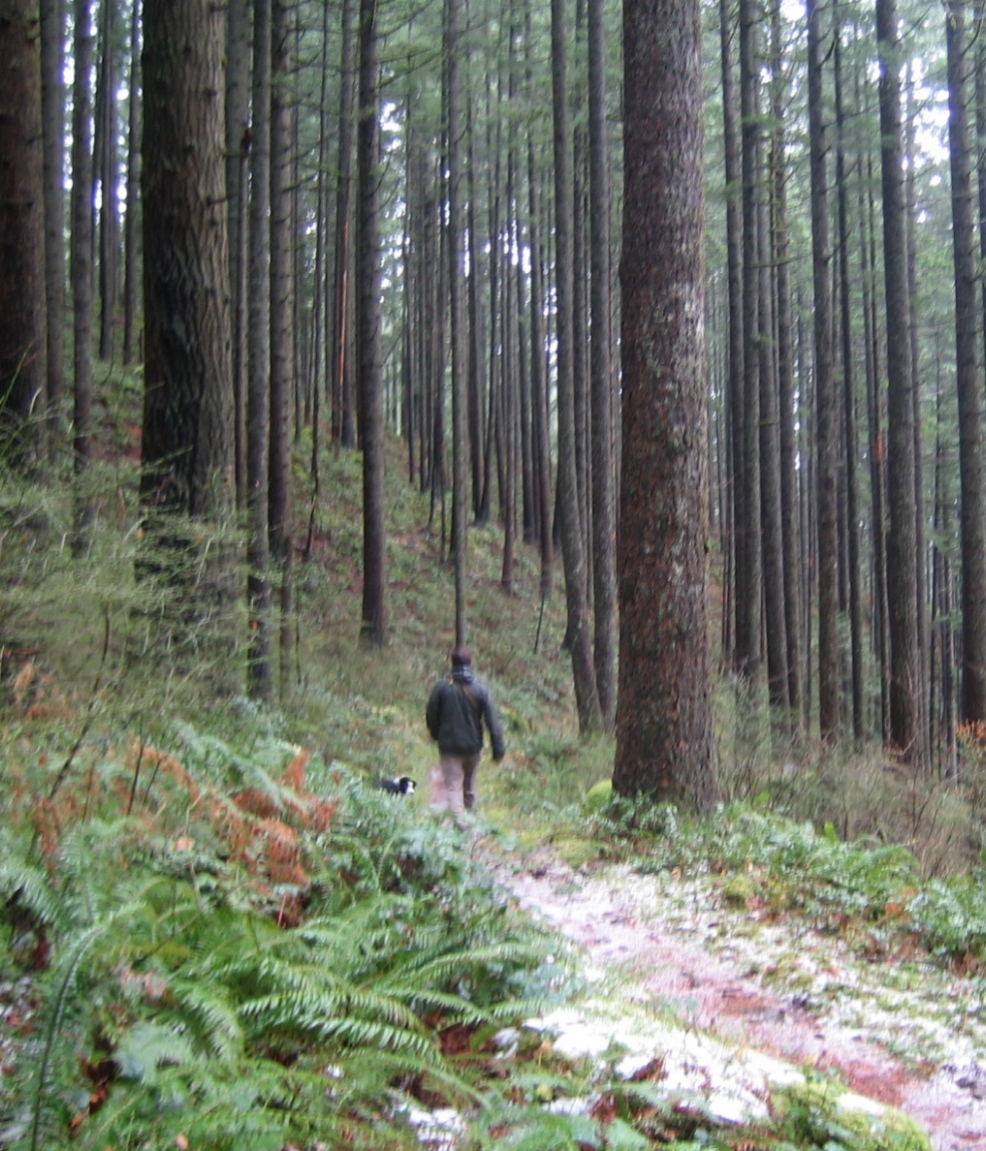
The wide scope of CCB
Allows a broad range of land-use project types
Project can be anywhere in the world
Projects can be any size and assessed on an individual or grouped basis
Projects can have any start date
Can be combined with GHG standards to issue carbon credits
Notes:
Agricultural Land Management
Agroforestry
Improved Forest Management
Reforestation
Avoided Deforestation

Slide 23
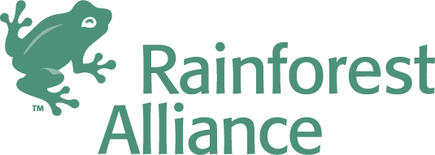
History of the Standards
Developed by the CCB Alliance
First edition released in 2005
Managed by VCS since November 2014
Program documents developed through multi-stakeholder processes
Notes:
First edition released May 2005
Second edition released December 2008
Third edition released December 2013
Current Rules for Use of the CCB Standards released December 2013

Slide 24
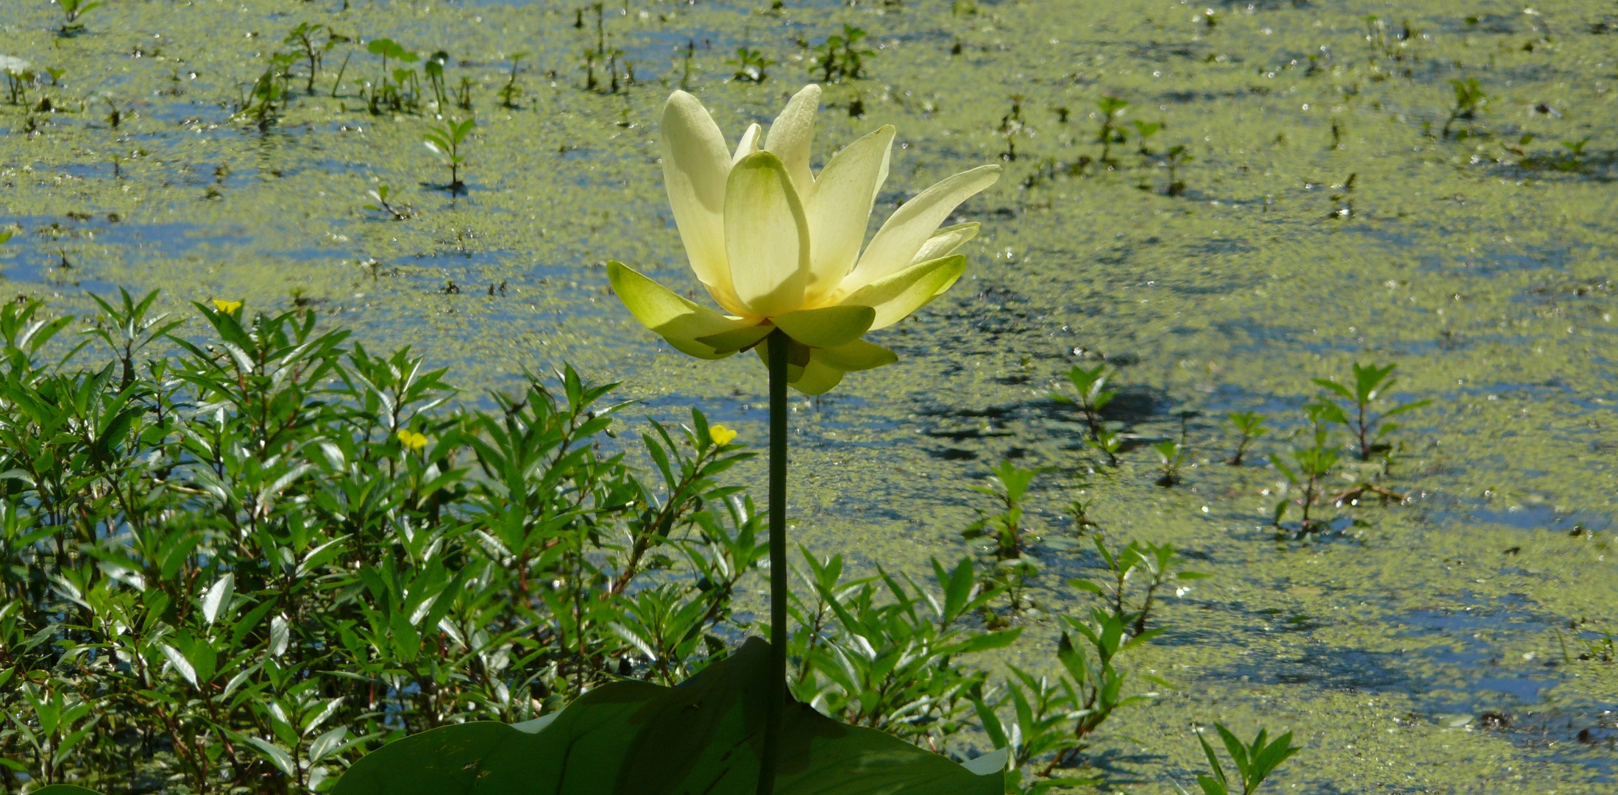
CCB Standards serve a dual role
Project design standard
Project implementation standard
Photo: Mingo National Wildlife Reserve via Flickr
Notes:
Project design standard: provide rules and guidance to encourage effective and integrated project design
Project implementation standard: applied through the life of a project to verify the adoption of best practices and the delivery of social and environmental benefits

Slide 25
Benefits of Using the CCB Program
To project developers and local communities
Guide development of projects that deliver a suite of environmental and community benefits
To land management agencies and regulators
Ensure that projects contribute to public good
Identify projects that satisfy regulatory objectives
Project investors and credit buyers
Lower project risks
Greater demand and higher price for CCB-labeled VCUs

Slide 26
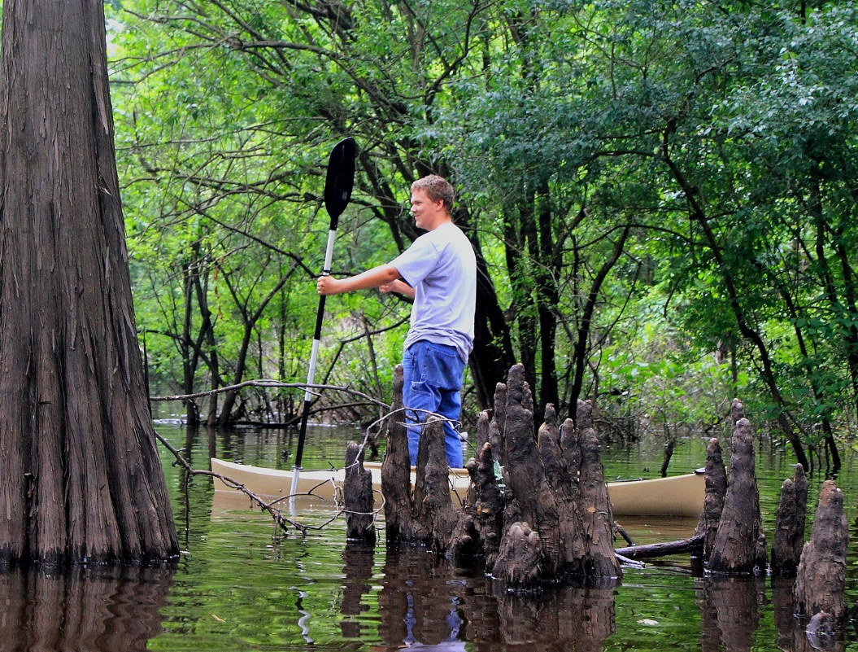
Stats on CCB projects
CCB validated projects: 104
Out of these, 52 have been verified so far
CCB projects in the US:
Restoring a legacy at Red River National Wildlife Refuge
Restoring a Forest Legacy at Marais des Cygnes National Wildlife Refuge
Restoring a Forest Legacy at Mingo National Wildlife Refuge
Grand Cote and Lake Ophelia National Wildlife Refuges Restoration Initiative
Restoring a Forest Legacy at Upper Ouachita National Wildlife Refuge
Tensas River Basin Project
Ducks Unlimited Avoided Grassland Conversion Project in the Prairie Pothole Region
Photo: Finch Lake, Upper Oauchita NWR via Flickr

Slide 27
Sustainable Development Verified Impact Standard (SD VISta)
Benefits to Poor and/or Disadvantaged Communities
Ecological Sustainability
Project Viability
(Without-project scenario, stakeholder engagement, legal status, etc.)
Climate Benefits
CCBS Climate Section: Claim
User-defined SD Claim(s)
Verified Carbon Unit
SD Asset
Other GHG Credit

Slide 28
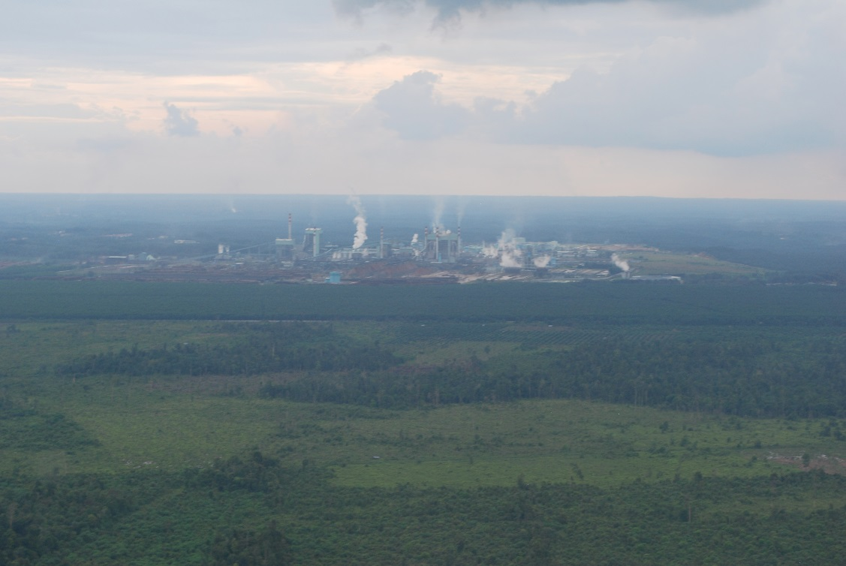
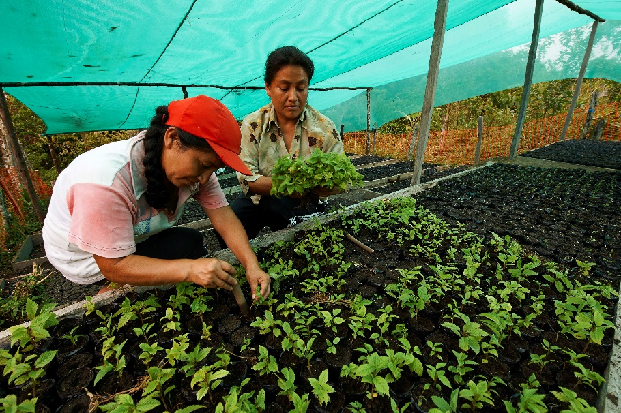
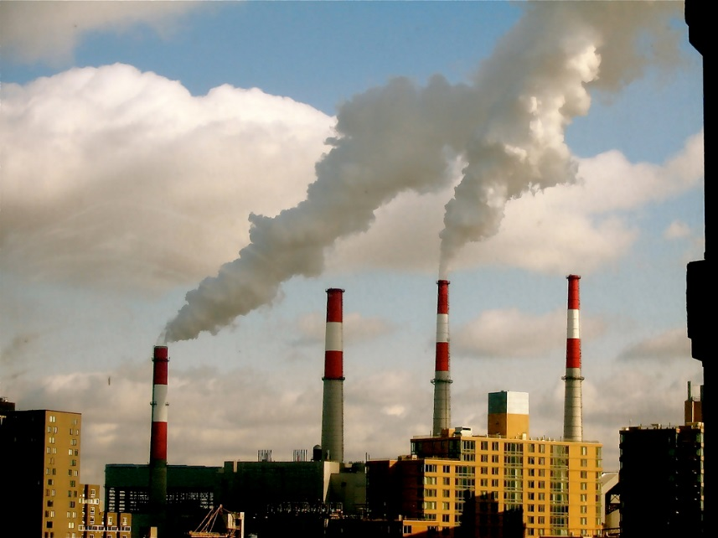
SD VISta value proposition
Flexible, robust, global standard to demonstrate how ecosystem conservation (and related) measures can deliver significant and measurable sustainable development benefits, and help connect these outcomes to donors, investors, credit buyers and other key stakeholders
Photos: Alto Mayo REDD+ project, Peru (source unknown); US smokestacks via Flickr; Indonesia (N. Swickard, VCS)
Notes:
Independent, credible, transparent means for companies to demonstrate achievement of their business and corporate social responsibility goals:
Net-zero deforestation commitments
Support for women and children
Improving livelihoods, health and access to water
Facilitate private-sector engagement and alignment of project actions and reporting with the Sustainable Development Goals (SDGs)

Slide 29
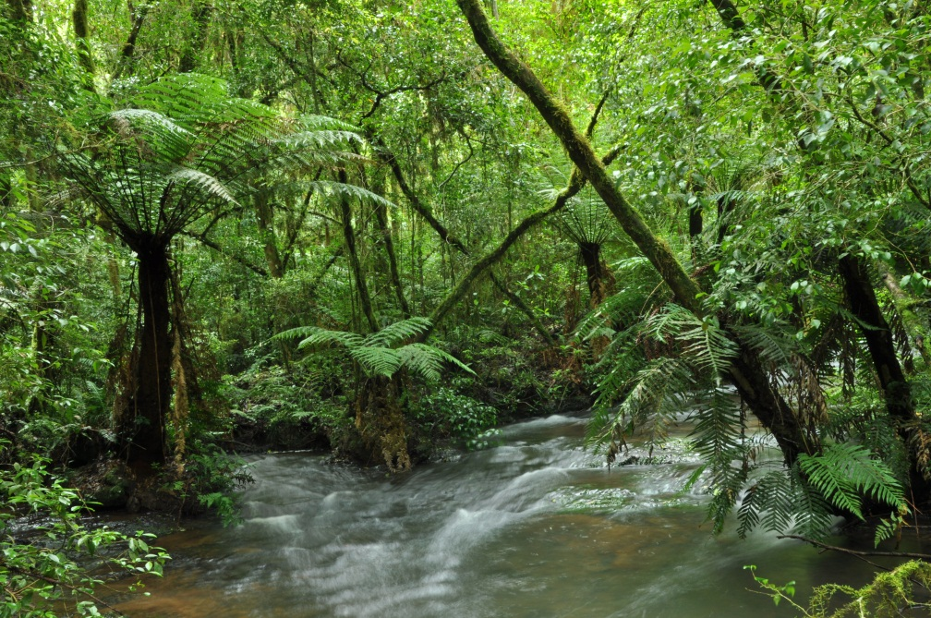
Questions?
Julianne Baroody
Climate, Community & Biodiversity Program Manager
jbaroody@v-c-s.org
Toby Janson-Smith
Chief Innovation Officer
tjanson@v-c-s.org
VCS Association
One Thomas Circle, NW
Suite 1050
Washington, DC 20005
www.v-c-s.org

