Slide 1

Decision support for meadow conservation and restoration in the Sierra Nevada Ecoregion: leveraging landscape-scale retrospective and near real-time data to enhance understanding of vulnerabilities and adaptation options under changing climate
Shana Gross, USFS
Christine Albano, UNR, CSP
Meredith McClure, CSP
Justin Huntington, DRI
Charles Morton, DRI
Britta Daudert, DRI
Wes Kitlasten, USGS

Slide 2
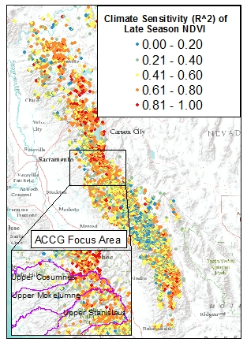
What is the relative importance of landscape variables on meadow responses to climate variability
Expanded suite of landscape variables(e.g.):
stream network statistics
geologic characteristics that indicate the potential importance of the groundwater system (e.g. fracture density and proximity to potential aquifers)
watershed characteristics that influence the timing and amount of precipitation (e.g. basin hypsometry, contributing area, watershed aspect).
Notes:
Climate sensitivity of meadows varies significantly across the project area.
Complement updated UC Davis meadow layer

Slide 3
Develop spatially-vulnerability assessment and decision framework to prioritize meadows for restoration
Overlay climate sensitivity, climate projections (exposure), and adaptive capacity (e.g., geomorphic characteristics, connectivity) datasets to develop a spatially-explicit vulnerability assessment.
Refined through visit a subset of meadows within the ACCG planning area
Evaluated with the American Rivers Meadow Scorecard
Notes:
structured around key characteristics of Climate-Smart Conservation
decision framework will be refined based on feedback from the ACCG and field testing

Slide 4
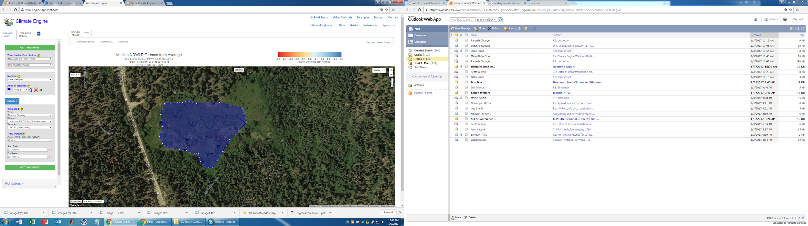
Develop a meadow and riparian monitoring tool that allows stakeholders to visualize near real-time vegetation conditions using climate and satellite image archives through Google Earth Engine
Notes:
Tailored to meet the needs of management partners
Ability to contol climate variables and time scale
Visualize map and time series results in a Google Maps environment.

Slide 5
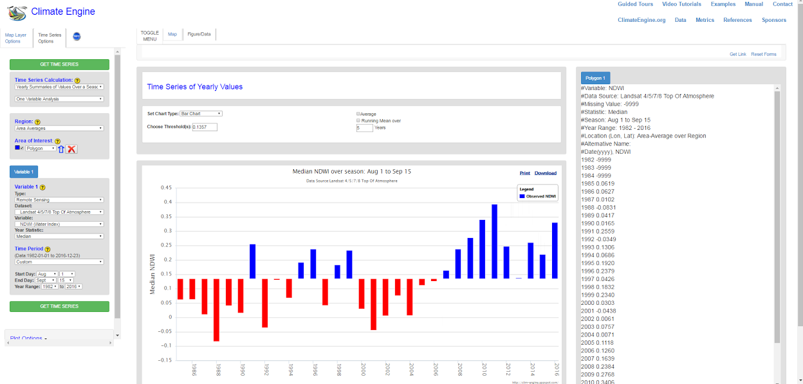
Annual time series of median Aug 1 - Sept 15 NDWI - restoration from 2005 - 2006 - http://bit.ly/2hOtpik

Slide 6
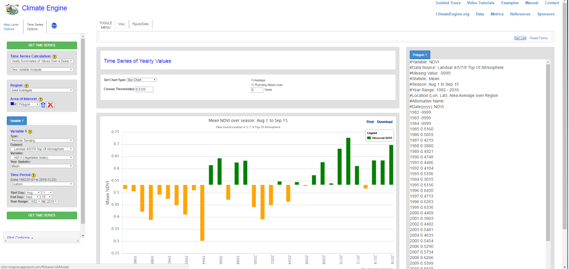
Annual time series of median Aug 1 - Sept 15 NDVI - restoration from 2005 - 2006 - http://bit.ly/2hOpCBP

Slide 7
