Slide 1


Middle Martis Creek Wetlands Restoration
Calistoga Meadows Conference
Feb. 10th, 2016
Beth Christman (TRWC) and Amy Merrill (Stillwater Sciences)

Slide 2
Middle Martis Project Partners
Landowners and Land Managers:
Caltrans
Northstar Community Services District
Truckee Donner Land Trust
Truckee Tahoe Airport District
Truckee River Watershed Council
U.S. Army Corps of Engineers
Vail Resorts
Notes:
Very complicated project! Beth had to align seven different organizations: state, federal, several special interest districts and private. All really cooperative

Slide 3
Middle Martis Project Partners
Funders:
US Army Corps of Engineers
American Rivers
Martis Fund
Tahoe Truckee Community Foundation
Tahoe Truckee Airport
Truckee River Fund
Vail Resorts
Northstar Community Services District
Lahontan Regional Water Quality Control Board
National Fish and Wildlife Foundation
California Department of Fish and Wildlife
Notes:
A lot of land owners/managers contributed

Slide 4
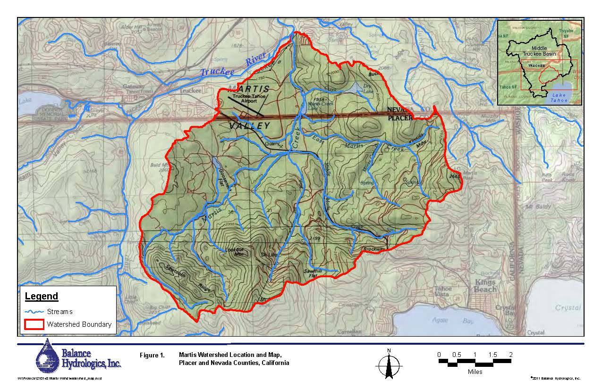
Location
Notes:
See about adding inset. Star is on highway 267. Insert better location map in upper corner. Ski resort north star …

Slide 5
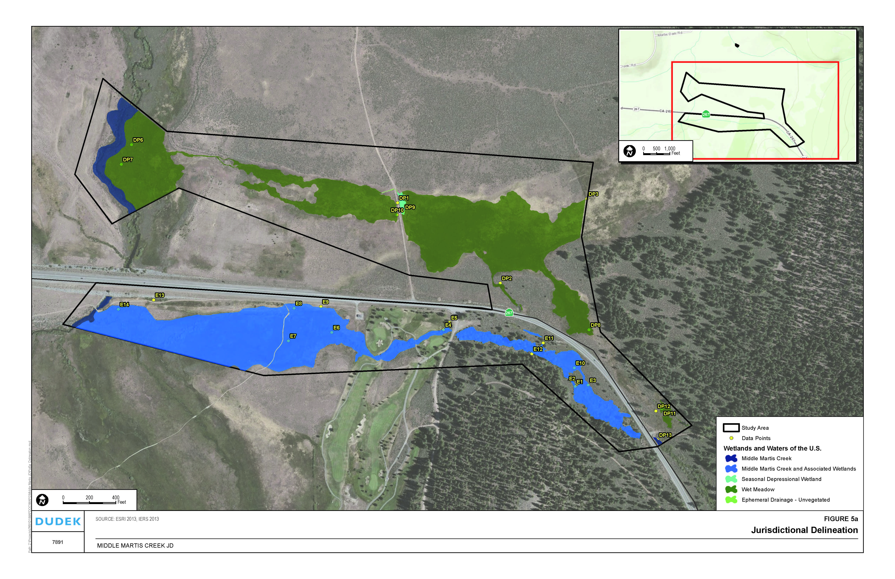
Meadow Types
Subsurface middle/low gradient
Subsurface middle/low gradient = control
Dry Meadow
Converted riparian middle gradient
Riparian low gradient and subsurface low gradient
Riparian low gradient
Notes:
Beth made estimates on meadow types using the wetland delineation – subsurface middle/low gradient on top might be riparian middle/low – check this out more closely ….. Ditch only rarely has water now….. Channel will be restored!

Slide 6
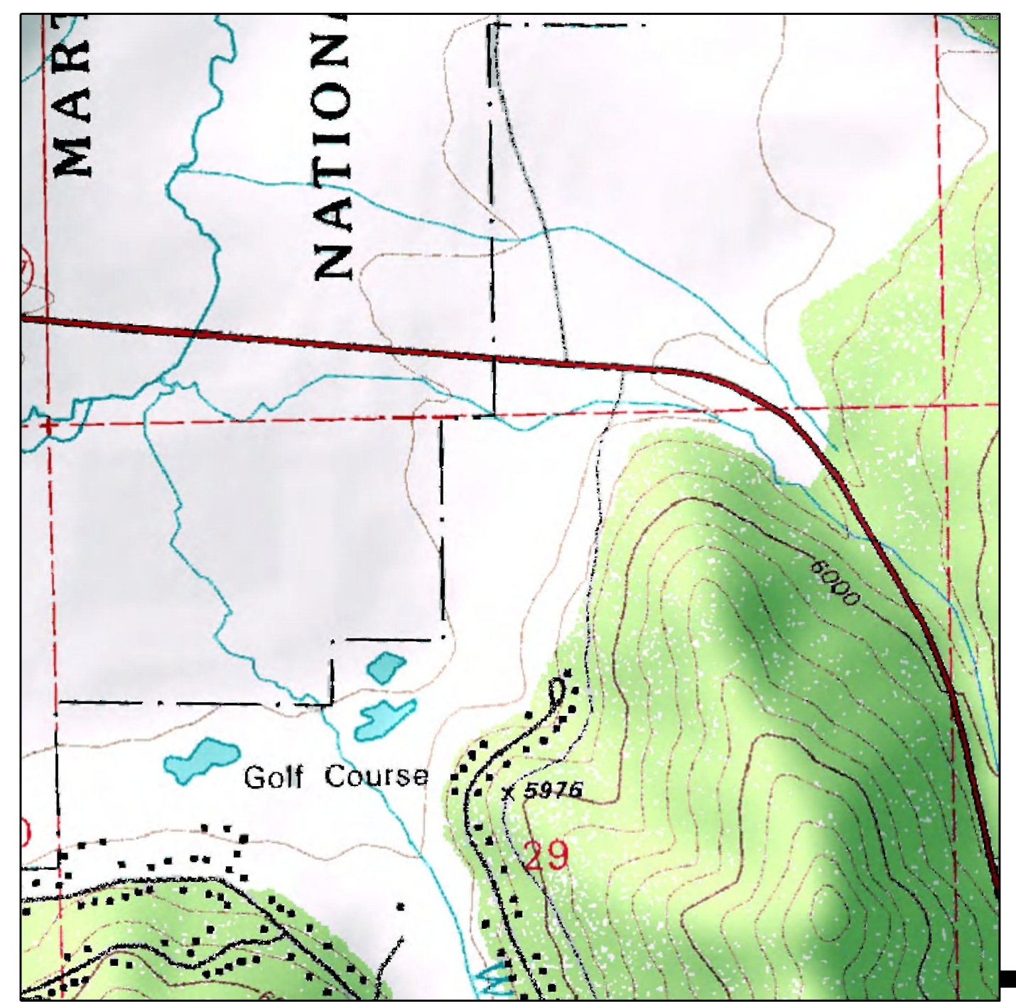
Land use – historic changes
Historic alluvial fan with multiple channels
1895 Map shows confinement to south side of road
Current USGS map shows channel on north side and south side
Notes:
Shows old Brockway road. As early as 1895, they had picked a side for the channel. Currently blue line is on both sides of the highway. Early 1940’s topo map had it on the north side.
Noses in btw show old channels are two on either sides.
Point is that the single channel is undersized for what comes down in spring. Causing erosion and flooding hwy and golf coarse road (where we parked). Army Corps owns recreational trail on other side of road (Martis Lake is flood control property and this is a mitigation area for creating the reservoir).

Slide 7
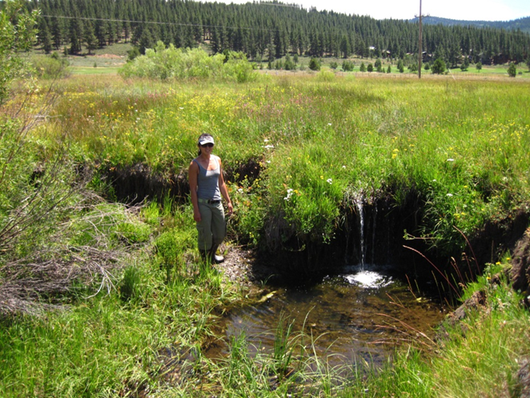
Current Conditions
Impacts due to confinement to single channel:
Channel undersized for moderate flows
Incision, erosion, and headcutting in Middle Martis Creek
Fish passage barriers
Meadow degradation
Infrastructure impacts
  Highway 267 flooding
  Trail and access road damage
One of a series of headcuts

Slide 8
Solution
Restore peak flows to north side of highway
Split flows at existing culvert
Maintain base flow to existing stream corridor on south side of Highway
Restore and enhance historic wetlands on north side
Eliminates extreme flows in current undersized channel
Notes:
Replicating alluvial fan function
Rewater wetland on north side
Important for landowners on south side to keep wetlands on south side (don’t want to be accused of destroying an
500 cfs comes through now, more comfortable to receive 5-50 cfs….

Slide 9
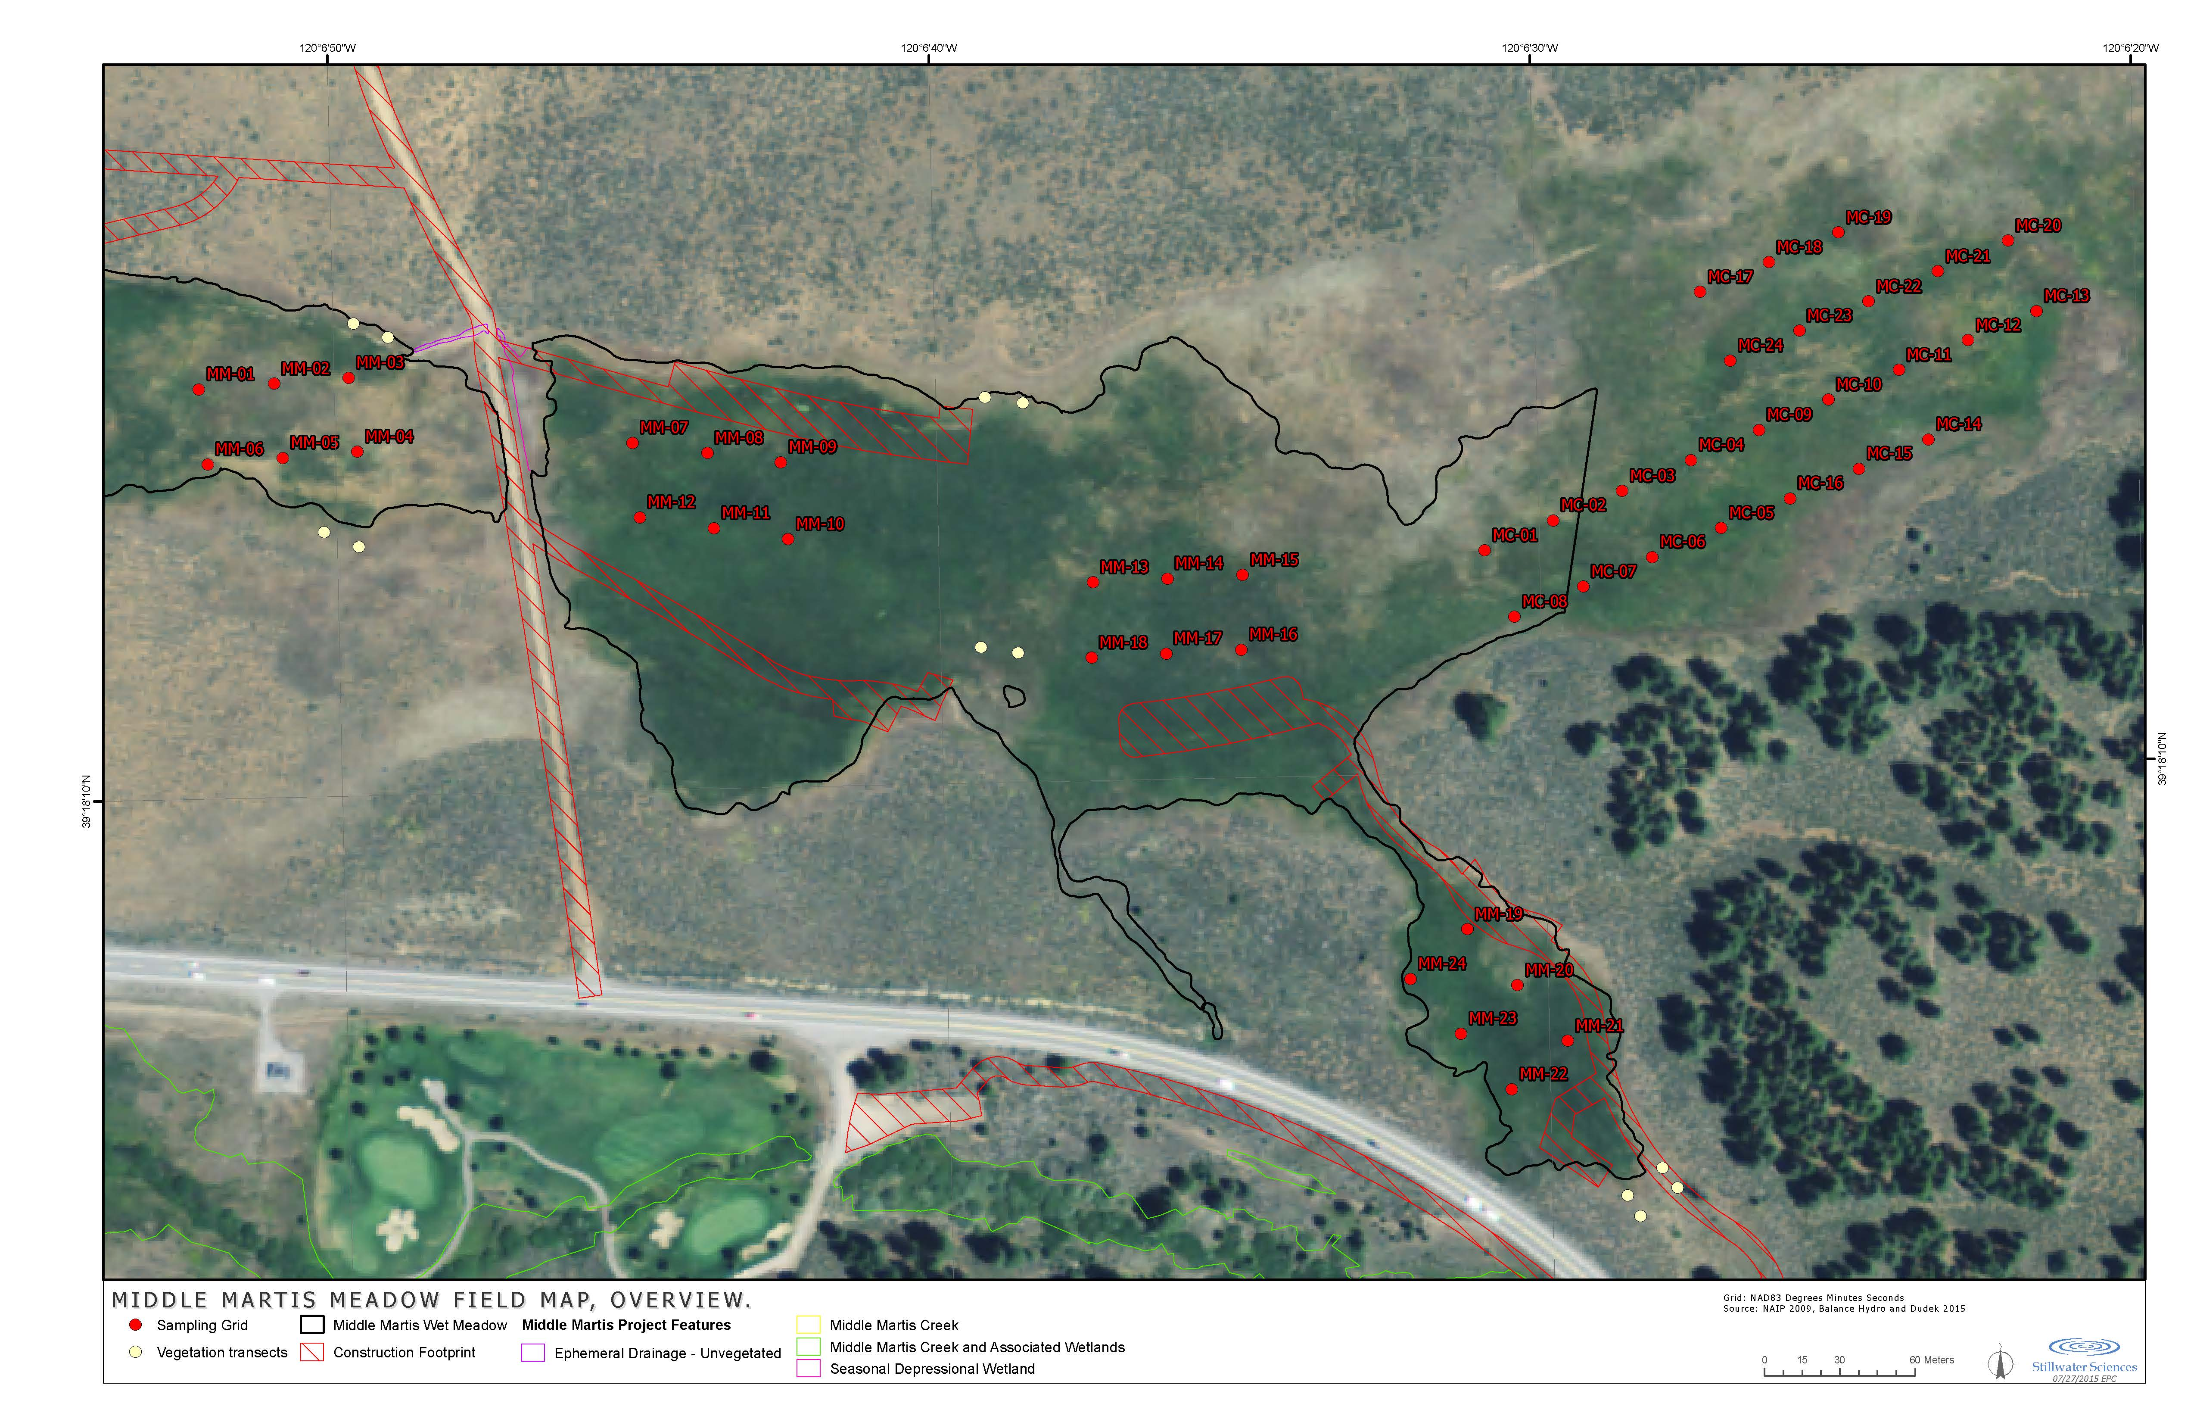
Pre-project Data – soil carbon and GHG plots
Notes:
Our map. Replace red with white and send cc to Beth! Veg plots here too. Move the projrect area line out of the control sites!

Slide 10
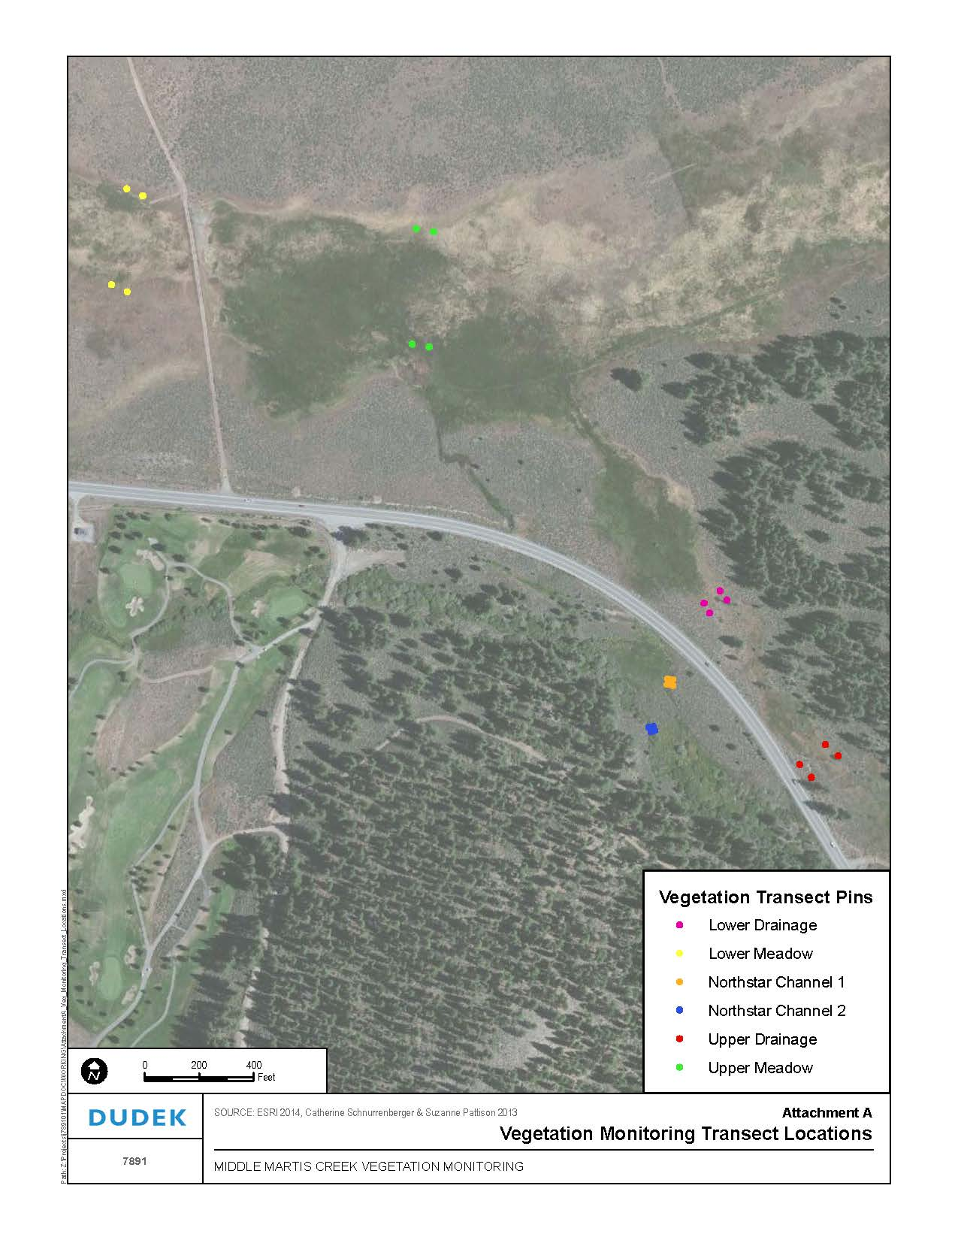
Pre-project data – vegetation plots

Slide 11
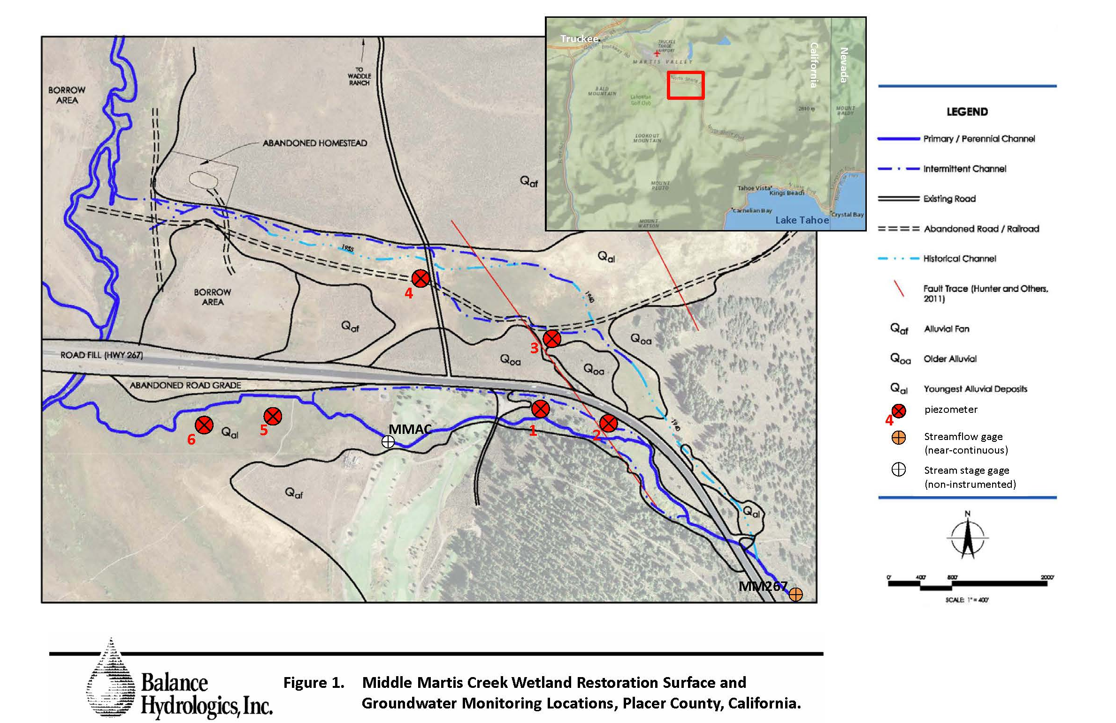
Pre-project data – Hydrologic stations
Notes:
Shallow gw wells and stream gages

Slide 12
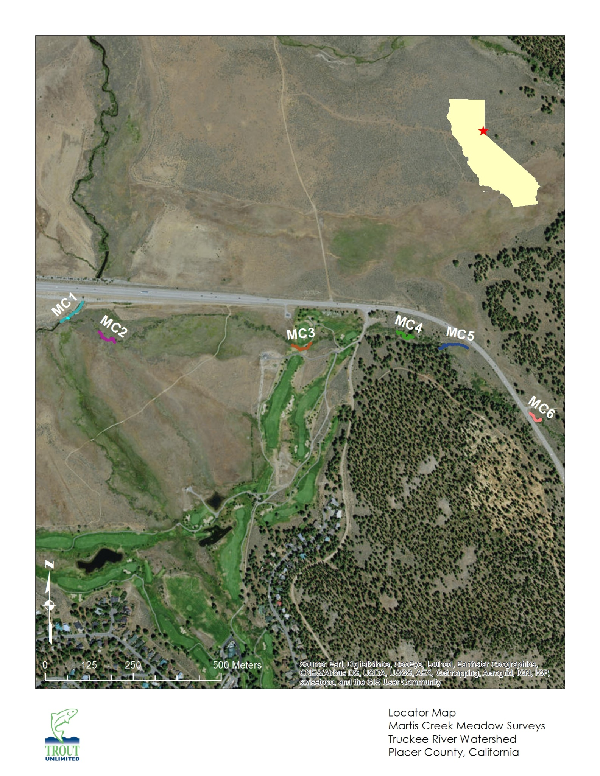
Pre-project data – Aquatic habitat
Notes:
Trout unlimited instream and aquatic sampling (invert collections and fish surveys – no fish in Middle Martis); looked at fish passage barriers – tons of fish are at MC1 but don’t come up Middle M. – head cuts that are 3-4 ft high now- restoration will fix these existing head cuts and the redirection of high flows will remove the source of the problem that created them (they id’d the stressor and will dispatch it!). (bank erosion, pool depth, pebble counts SCI probably). Not expected to create habitat above 267, but it is expected to improve passage by slowing erosion rates.

Slide 13
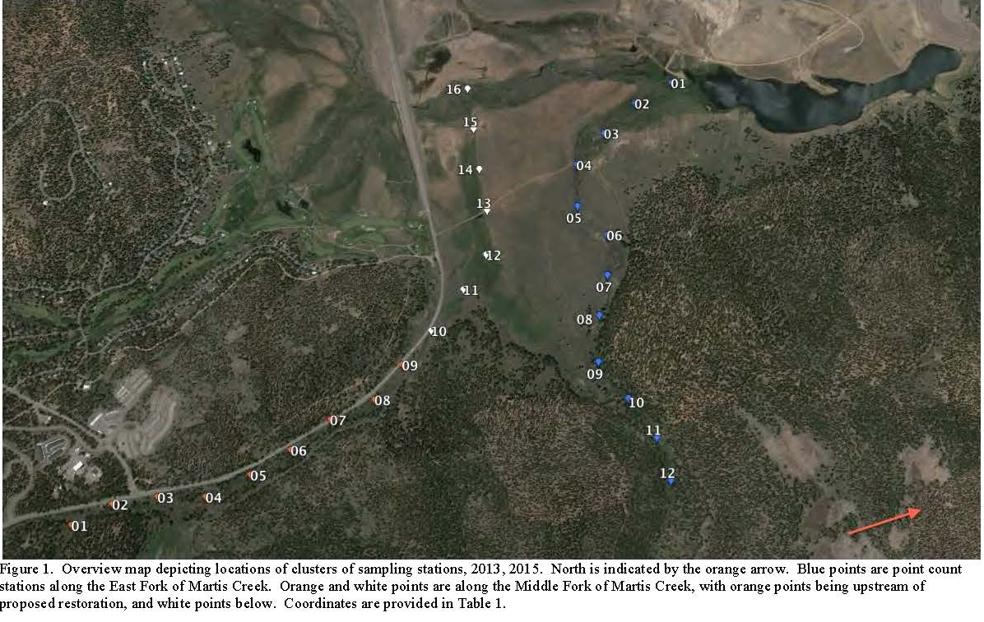
Pre-project data – avian point count stations
Notes:
Tahoe Institute for Natural Sciences, local non-profit in Truckee and Incline. These are the transects they set up series of transects and some controls on the east fork, where the diversity is higher than in the restoration area. East Martis creek has a lot of base flow in the summer (source might be fault?) cold water at 2 cfs….. Want to attract response from the bird community in wetland (there have been Willow Fly Catchers detected there)

Slide 14
Project Timeline
Task | Start Date | Completion Date
Watershed Assessment | January, 2011 | April, 2012
Project Design | June, 2012 | November, 2014
Permitting | June, 2014 | March, 2016
Pre-project monitoring | March, 2013 | July, 2016
Implementation | July, 2016 | October, 2016
Post-project monitoring | October, 2016 | December, 2019
Notes:
WS Assessment id’ed about 20 different projects, this by far the most complicated and everyone’s first choice.

Slide 15
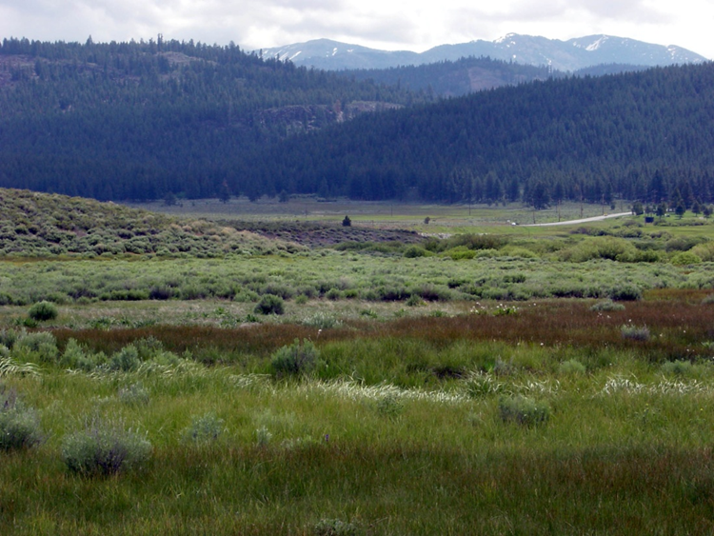
Questions?
Additional Information:
Beth Christman
Truckee River Watershed Council
bchristman@truckeeriverwc.org
530-550-8760 x1
PS - Thank you Amy!

