Slide 1
Hydroclimatic change and meadows Dave Herbst Sierra Nevada Aquatic Research Laboratory - UCSB & Sarah Yarnell Center for Watershed Sciences - UCD

Slide 2
Meadow ecological service values:
storage of water, flood attenuation, groundwater recharge
sustained release to streams during baseflow
maintain cooler water temperatures
water quality = filtering of sediments, uptake of nutrients
integrated connectivity of aquatic-riparian-meadow food web and wildlife habitat
biological diversity reservoirs
forage for wildlife and stock animals
recreation focal areas

Slide 3
A Changing Hydrograph:
Shift in the mountain snowmelt flow regime
Developing and anticipated changes with climate warming
rain-on-snow floods
wetter & more erratic
winter flows
earlier snowmelt
earlier & prolonged low summer flows
periodic drying of
perennial streams
Notes:
Classic snowmelt-driven hydrograph of spring melt and summer recession // so winter floods are one element of the changing hydrograph
Predicted warming of 4 C equivalent to a northward shift of 400 km in thermal regime
Stenothermic alpine taxa highly vulnerable to warming, and are at an ecological dead-end

Slide 4
Meadow conversion under climate change hydrology
Meadow
Vegetation
Hydric-Mesic
Meadow
Vegetation
Xeric
High water table:
gaining stream
Meadow streams are low
gradient, low power, so
accumulate sediments
Fallen water table:
losing stream,
becoming intermittent
Incised channel during winter floods,
summer drought, eroding banks,
sedimentation, floodplain disconnect

Slide 5
Less Snowpack Cover, More Precipitation as Rain
Reduced extent, amounts and duration of snowpack cover will lead to less potential for slow-melt recharge of groundwater aquifer
Rain comes off landscape more quickly, leaving less time for percolation and low residence time of flashy flows in streams
Meadows store less water, have lower water tables, altered vegetation with lower habitat value, and have less water to release
Warmer conditions over time convert more of the wet-cool vegetation of the mid-elevation and alpine regions to xeric drought-tolerant forms
Warmer atmosphere also promotes greater evapotranspiration rates
Loss of riparian cover may lead to warmer stream temperatures and evaporative losses, reduced organic matter subsidy to streams
Groundwater-dependent habitats such as mountain springs and discharge-slope meadow types also more likely to dry or become intermittent

Slide 6
Further stresses: soil permeability loss during drought
New research out of UC Merced (Chelsea Arnold, PhD student soil physics lab)
Soil cores taken in 2011-12-13 from wet meadows in Hall Natural Area, east of Yosemite, and used to study effects of drying and drought on hydraulic conductivity of meadow soils
Cores re-saturated in controlled laboratory setting and water movement down the soil columns measured
Soil drying and consolidation that had occurred in 2012 produced a 60-90% loss of hydraulic conductivity, suggesting that infiltration of snowmelt or precipitation into meadows declines substantially under drought conditions
Shows diminished potential for recharge recovery of groundwater after drought because pore structure of dried soils is altered
Studies underway on even drier 2013 cores, and reversibility of effects
Organic content of soils may play an important role in pore structure

Slide 7
Disruptions of meadow services and restoration
Eroded headwater meadow valley yielded rapid groundwater discharge of short duration (Barry Hill 1990): does restoration of incised channels (eg. head-cut control) benefit slower and sustained groundwater discharge?
Meadow soils (and vegetation, microbes) can take up nutrients and filter sediments to a greater extent than forest soils (Burcar 1994): is this ecosystem service altered in degraded meadows, and recoverable?
Sparsely vegetated or open burned areas form winter ice cover whereas areas with vegetation cover or organic litter layer form frost crystals under snow – while rain or snowmelt is rapid off ice surfaces, the frost promotes infiltration of water into soils (Haupt 1967): can litter or organic amendments enhance permeability of degraded meadows?
Slow snowmelt contributes to aquifer recharge but when warm conditions melt snowpack faster than hydraulic conductivity of soil/bedrock underlying meadows, water bypasses storage (Flint and Dettinger 2010): meadow restoration responses may be enhanced where melt is slower at northern solar aspects and higher elevations

Slide 8
Accounting for effects of climate change
on ecological integrity of aquatic ecosystems
that are sustained by meadow functionality:
sentinel stream network

Slide 9
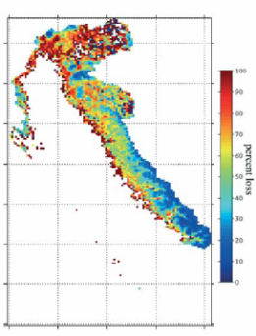
DESIGN
3rd-order size watersheds
of Sierra Nevada
Natural Resistance Filters: rank low to high
Northness Aspect (snowmelt timing, temp, vegetation)
Groundwater contributions (geology/springs)
Riparian cover and meadow area (water storage)
Reference selection filter using GIS:
mininimum roadedness or land use,
no reservoirs, all above 1000 m)
Reference
3rd-order watersheds
(local impacts minimal to none)
field reconnaissance
of best candidate sites
Low Risk
High Resistance
High Risk
High Resistance
Climate forecast filter:
VIC-hydrological model prediction of snowpack and stream flow
Low Risk
Low Resistance
High Risk
Low Resistance
3 watersheds each category
with differing exposures
and expectations for the
influence of climate change
Ranked list of watersheds
by quartiles of lowest
and highest climate risk
►Designed as a natural experiment
testing hypotheses of risk & resistance
Notes:
Important to distinguish the physical resistance or vulnerability of the catchments from the vulnerability of individual taxa that comprise the community: site selection based on physical environment features, while the vulnerability of the biological community and component taxa can only be assessed from the resident organisms found

Slide 10
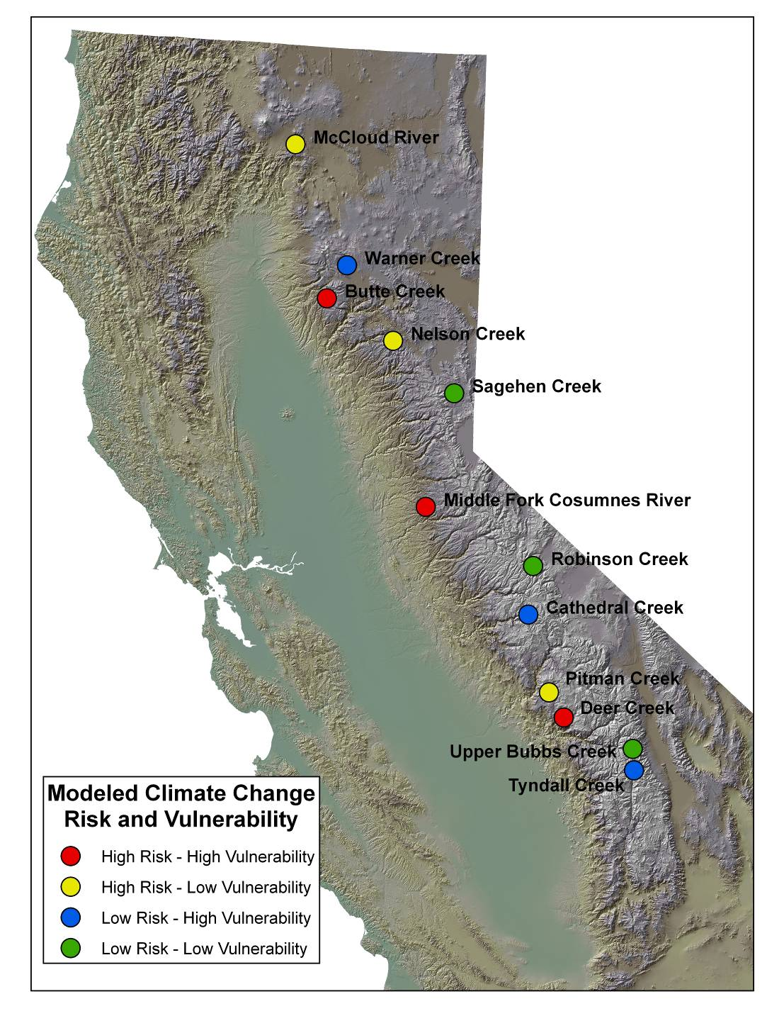
Monitoring climate variability effects on headwater stream ecosystems and hydrology in the context of risk to change and natural resistance
Resistance conferred in part by the potential role of meadows in sustaining flow and cool temperatures – and sentinel streams contain a range of meadow coverage from 0 to 33% of upstream riparian zone
This based on UCDavis meadows database; our ground-truthing observations suggest the type of meadow system and hydration state need to be considered in evaluating the potential role of these meadows in sustaining downstream flows
Suggest monitoring of intact (operational definition least-disturbed) reference meadows over time to provide a means, as with the sentinel streams, of evaluating climate change effects in the absence of other land use disturbances

