Slide 1
An Overview/Update on Carbon Offsets and Payments for Ecosystems Services: Methodologies and Markets 2017 Calistoga Sierra Meadows Workshop February 8, 2017
Robert J. Hrubes, Ph.D.
Executive Vice President Emeritus, SCS Global Services

Slide 2
About SCS Global Services
Founded in 1984
Chartered Benefit Corporation
Specializes in third-party environmental certification, auditing, testing, and standards development

Slide 3
SCS’ Greenhouse Gas Verification Program
In 2009, one of the first entities to achieve ISO 14065 accreditation for the validation and verification of carbon offset projects
The world's leading verifier of forest carbon offsets, known for technical expertise and quality
Verified >50 million tons of offsets (nearly 100 unique projects and methodologies)
Experience in both the voluntary and compliance carbon markets.

Slide 4
The Bigger Picture: Linking Environmental Restoration to Private Sector Financing—Conservation Finance
PES—Payment for Ecosystem Services
Linking non-market benefits to private capital
Building on stewardship certification programs such as the FSC
Carbon financing/markets are the most developed but not the only vehicle/mechanism
Derivative funding from carbon schemes—CA Cap & Trade GHG Reduction Fund (proceeds from allowance auctions)
Ecosystem credits
“Green premiums” on certified natural resource-based commodities
Charitable funding not tied to transactional exchanges of credits

Slide 5
Ecosystem Services
Ecosystem services are the benefits human communities enjoy as a result of natural processes and biological diversity.
These services include sequestering or storing carbon in trees/vegetation and soil, providing fish and wildlife habitat, filtering water, maintaining biodiversity and resilience, and reducing damages from natural disasters.
Not all ecosystem services are logically linked to climate change—but that doesn’t mean they are not important and valuable

Slide 6
Payments for Ecosystem Services
A transparent system for the additional provision of environmental services through conditional payments by voluntary actors (buyers/benefactors) to voluntary providers
What are the ecosystem benefits of healthy mountain meadows and, by extension, the restoration of degraded meadows? “Carbon” doesn’t capture the full suite of benefits; it may even be the most significant benefit
Exclusively focusing only on climate change benefits and associated carbon markets is myopic and yet to be confirmed as being financially viable for projects such as meadow restoration

Slide 7
State of PES Markets
Still early days in terms of fully structured, rigorous project registration/verification/trading platforms
CCB is most advanced in this arena
Forest Stewardship Council’s ForCES initiative is nearing completion but it remains to be seen the extent of uptake
But, when broadly defined, payments for ecosystem services are expanding through a multitude of pathways
Market-based mechanisms such as PES are likely to take on increased importance in the current/emerging political climate

Slide 8
Carbon 101
Why Carbon? Why Markets?
Key Terms, Concepts, and Entities
Carbon offset project methodology
Carbon offset project quantification
Carbon offset project verification
Anatomy of a Verification Audit

Slide 9
Carbon Offsets
Reduced GHG emissions or enhanced GHG removals
Enhanced GHG removals are generated by natural resource stewardship practices---thanks to photosynthesis
Co2e—the coin of the carbon realm, based on Global Warming Potential of different greenhouse gasses

Slide 10
Markets and Offsets
Voluntary vs. Regulatory Markets
In voluntary markets, offsets have value to companies, public entities, and individuals who want to mitigate their impacts
Cap and Trade (such as ARB 32) requires the heaviest polluters to cap their reported emissions and reduce them
Reduce the cost of climate change mitigation
In regulatory industries, buying offsets from project developers can be cheaper than meeting a mandated reductions requirement with internal emissions reductions; 8% of annual obligations can be met through the purchase of offsets

Slide 11
Key Terms
CRT/VCU/ARBOC/ER (a metric ton of emissions reduced or avoided, in Carbon Dioxide Equivalent (C02e), value of $2-20+ depending on qualities)
Global Warming Potential (CO2 vs. CH4 vs. N2O)
Baseline
Additionality
Permanence
Project Design and Validation
Monitoring/Reporting and Verification

Slide 12
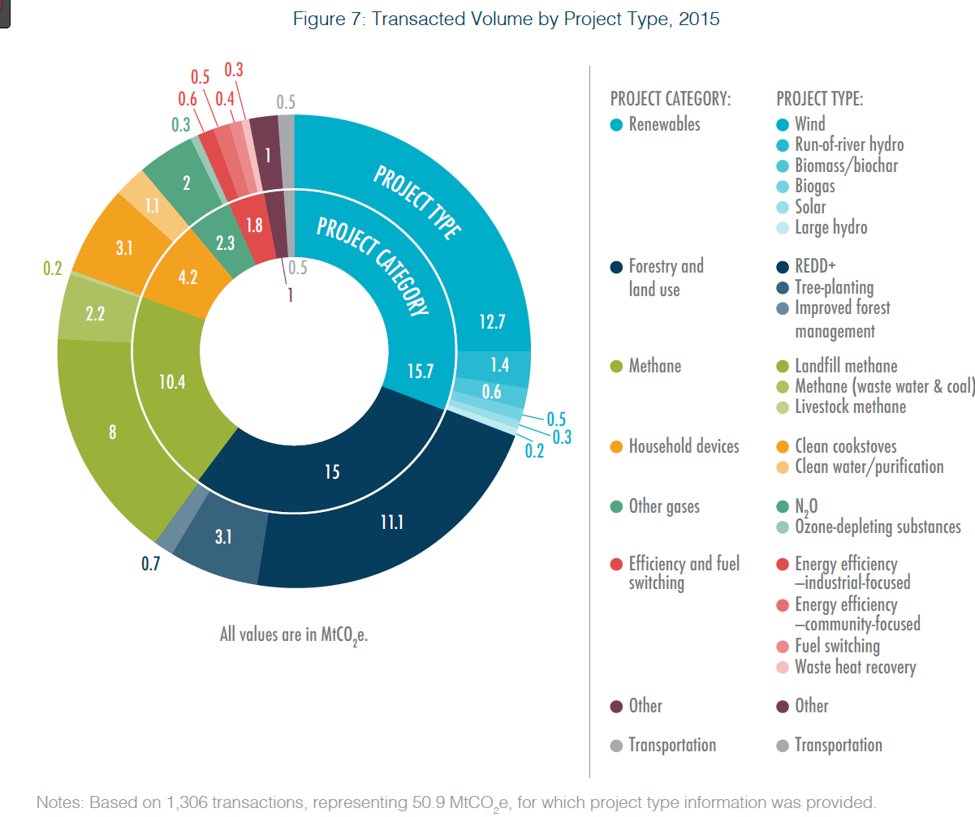
2015 Offset Transaction Volumes

Slide 13
2015 Transactional Values

Slide 14
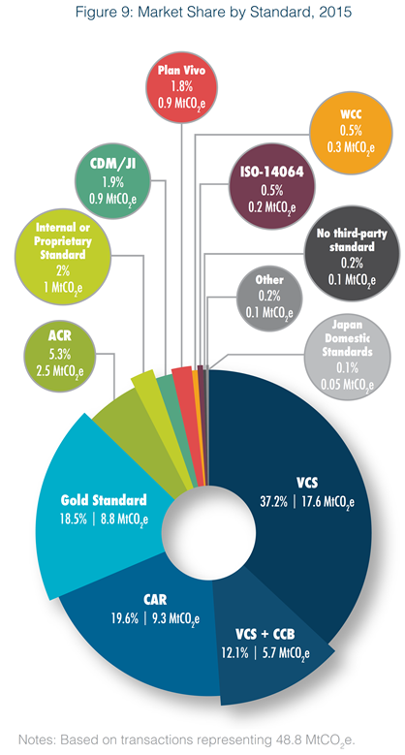
2015 Offset Projects by Standard

Slide 15
2016 Offset Prices
Prices in 2016 stabilized compared to greater volatility (downward trends) in 2014 and 2015
Typical forest carbon trading price in 2016 in the range of $5 to $8 per tonne
But, as has long been the case, price range is substantial with upper end exceeding $30 per tonne
Projects with charismatic characteristics or having consonance with buyer policies/agendas can fetch considerably higher prices
Compliance grade offsets fetch considerably higher prices
The future of California Cap & Trade (reauthorization) will have an uncertain but likely considerable impact on voluntary markets

Slide 16
GHG Schemes/Registries/Standards
Notes:
Standards around now – rainforest standard, womens’ standard, socialcarbon, plan vivo also upcoming

Slide 17
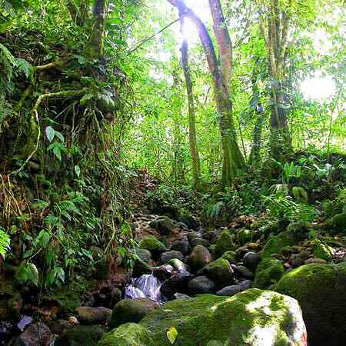
Offset Registries: For What Purpose?
Registration/Trading Platform
Validation
Verification
Corroboration
Confirmation
Assurance
Monitoring

Slide 18
Why?
To assure integrity of environmental claims
Because financial incentives create conflicts of interest with respect to uncorroborated claims made by directly involved parties such as forestland owners and/or project developers
Without credibility, offsets have little to no market value

Slide 19
Offset Project Methodologies
Methodologies comprise the procedure/protocol/process within which carbon offset projects are developed
Methodologies assure accuracy, completeness and credibility in project design and implementation so that real climate change mitigating benefits are, in fact being generated
There is a growing number of methodologies that have been promulgated under each of the major carbon registries
Project developers can employ existing methodologies and/or, for some registries, develop a new methodology suited for the intended project activities

Slide 20
Methodology Validations Completed by SCS
IFM and REDD
Soil and Agricultural Carbon
Peat Conservation / Rewetting
Wetlands Creation
Tools for Calculating Deforestation Rates
British Columbia FCOP
Fire Management

Slide 21
SCS GHG Program Background
Evolved from longstanding expertise in forest management certification (FSC)
Conducted first forest carbon audits in 2007
GHG Program formed in 2008
Accredited to ISO 14065 in 2009
Now operate on a global scale under one regulatory and numerous voluntary standards
Known globally as leading expert in forest carbon verification but we verify non-forest offset projects, as well
Service and technical expertise are our strengths

Slide 22
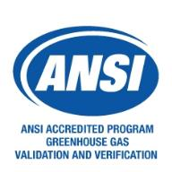
ISO Accreditation
Required for many forest carbon offset standards:
Climate Action Reserve
Verified Carbon Standard
American Carbon Registry
SCS is audited annually by ANSI
Office Visit
Witness Audits
All SCS verification audits are conducted in compliance
with our approved quality system.

Slide 23
Verification Overview
Rationale: to ensure consistency and credibility of GHG data and the offset-generating project
Goal: assess conformance to applicable standards and industry best practices
Process: audit consisting of desk and field assessment activities (risk based sampling approach)
Result: verifier will develop verification report and verification statement outlining results of audit and number of carbon credits to be issued.
Deliverables: Clear, transparent audit trail with evidence to support conclusions.
Note: verifiers cannot consult for the same project they verify (limited to generic advice and outlining of deficiencies)

Slide 24
Conducting the Audit: Collecting Evidence of Conformance
Saw it
“Witnessed during the visit of the Deer Ridge site.”
Heard it
“Confirmed by interviews with area forester and state biologists”
Read it
“Stated in PPD page 2.”

Slide 25
Stages of a Verification Audit
Kick-off meeting with client
Desk review: reviewing a PDD and associated documentation. Issuing findings
Opening meetings
Office audit- looking inside the black box
Site visit(s), inventory verification
Closing meeting(s)
Report writing

Slide 26
Verification Steps
Desk Review
Review project documentation
Identify fatal flaws
Public comment period, if applicable
Green light the site visit
Develop the audit plan for the site visit

Slide 27
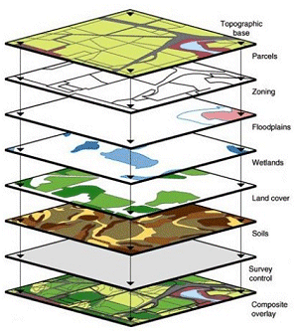
Verification Steps
Site Visit
Office Meeting
Discuss audit plan & scope
Interview relevant personnel
In-person review of maps, data management, carbon calculations & growth and yield model
Cracking open the “black box”

Slide 28
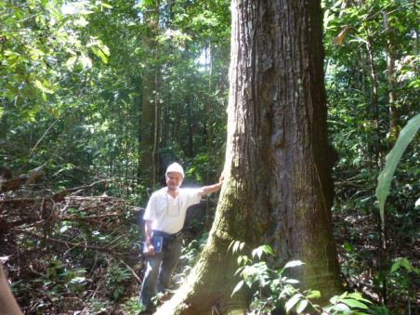
Verification Steps
Site Visit
“Verification cruise”- inventory plots installed or selected for re-measurement
Compare described inventory methodologies to field observations
Site reconnaissance
Interviews with local communities

Slide 29
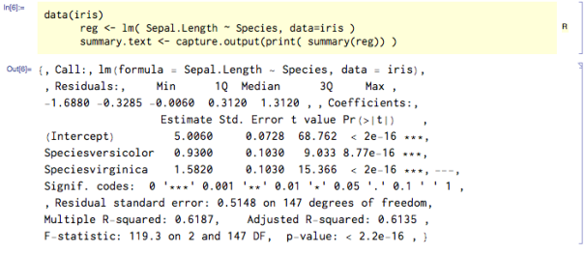
Verification Steps
Data Analysis
Confirming the precision/accuracy of GHG assertions
Baseline quantification
Project carbon stocks, over time, using growth & yield models
Issuing Findings and assessing adequacy of responses

Slide 30
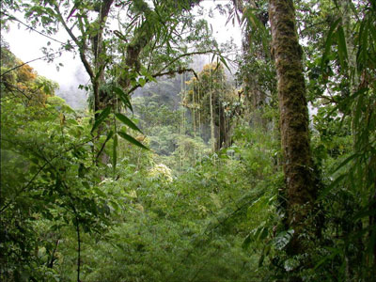
Verification Steps
Report Preparation and Issuing a Verification Statement
Resolution of Findings
Adherence to ARB requirements and past reviews
Extensive documentation and data trail
High stakes consequences of errors/omissions—failure to detect

Slide 31
Top 5 Problems and Shortcomings
Lack of preparedness, documentation, evidence or experience
Failure to budget adequately for validation/verification
Carrying out measurement/monitoring tasks to a lower standard of quality than is needed for carbon projects
Failure to obtain clear right of use or land title, or to consider GHG Program-specific rules pertaining to title
Failure to adequately engage local communities in project design/implementation
Notes:
Lack of preparedness, documentation and evidence (many first-time clients don’t realize the extent to which they will need to have documented evidence to support every claim in the project documents, that all calculations need to be fully traceable, and that we adopt an attitude of “professional skepticism” and won’t approve something unless it can be justified on the basis of sound theory or independent empirical evidence)
Failure to budget adequately for validation/verification (people sometimes think their job is done once they submit documentation to us, but in reality, we rely heavily on our clients to help us understand what they have done and present us with evidence and documentation to support the project documents, as well to make any changes that are required; this can mean that much more staff time, on the part of project personnel, is taken up than some of our clients anticipate)
Carrying out measurement/monitoring tasks to a lower standard of quality (GHG Programs only work when high-quality data are used in preparation of project documentation, but our clients sometimes run into trouble when taking approaches that work just fine for other purposes and then “porting” them to a forest carbon offset context; our favorite example is companies using “operational” forest inventory practices that result in data that are plenty good for general management planning purposes but don’t make the cut for GHG emission reductions/removals quantification)
Failure to obtain clear right of use or land title, or consider GHG Program-specific rules pertaining to title (the circumstances under which someone can be considered a “project proponent” vary from GHG Program to GHG Program, and sometimes the necessary legal framework is not in place to carry out a project, effectively making projects dead in the water; for example, projects with federal conservation easements on the land are not allowed under ARB, even though they are allowed under ACR and other programs)

Slide 32
Concluding Comments
There are no free lunches in the Carbon Offset or Payments for Ecosystems Services worlds
Methodology development and approval
Project design and development
Project validation and/or verification
All cost money, to develop, register and verify/certify
Financial viability of Carbon Offset and PES projects as Conservation Finance tools is the bottom line
Alternative pathways may be available if generating sufficient amounts of tradeable carbon offsets is not a good fit for monetizing the benefits of mountain meadow restoration

Slide 33
Questions or Comments?
Robert J. Hrubes
510-913-0696
rhrubes@scsglobalservices.com

