Slide 1
Osa Meadows Project Partners:
California Trout
Grantee, Principle Investigator
Stillwater Sciences- Amy Merrill and Nate Lawrence
Principle Scientists and team lead
NFWF
Grantor/Planning and Permitting
US Forest Service
Lead agency for NEPA, Land manager
UC Merced- Steve Hart and Abby D.
Scientist, TAC Member, Lab work.
Plumas Corporation
Plan Design, Permitting, GHG project sampling
Todd Sloat Consulting
Plans and Designs
UNR/TU/Sabra Purdy and Erin Smith
Pre-restoration Habitat assessment
CDFW
Grantor for research and restoration
Ben Sullivan, UNR
TAC Member

Slide 2
NFWF OSA Grant
Assessment and permitting
Baseline monitoring
Design and planning
field crew supervision
Creation of a plant bank for revegetation
A literature review of carbon dynamics in meadow systems

Slide 5
Land-use History
Grazing
+ Fire
+ Precipitation
= Severe Downcutting! → De-watering!
Past restoration attempts demonstrate potential, but have been objectively unsuccessful.

Slide 6
Pre-Restoration meadow conditions
Biological:
Kern River Rainbow Trout resident downstream
Potential MYLF habitat- Federal Listing of Endangered
Conifer Encroachment
Hydrologic:
High width-depth ratio]
Low water table
Moderately incised in the lower 2/3rd, Upper 1/3rd still functional, but at risk from incision
Notes:
oder

Slide 7
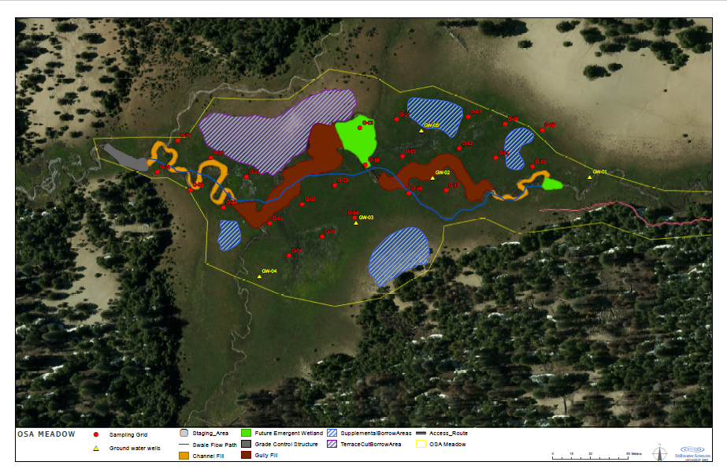
OSA Field Map
Notes:
55 Acres total, 19 acres→ 30-40 acres to be restored.

Slide 8
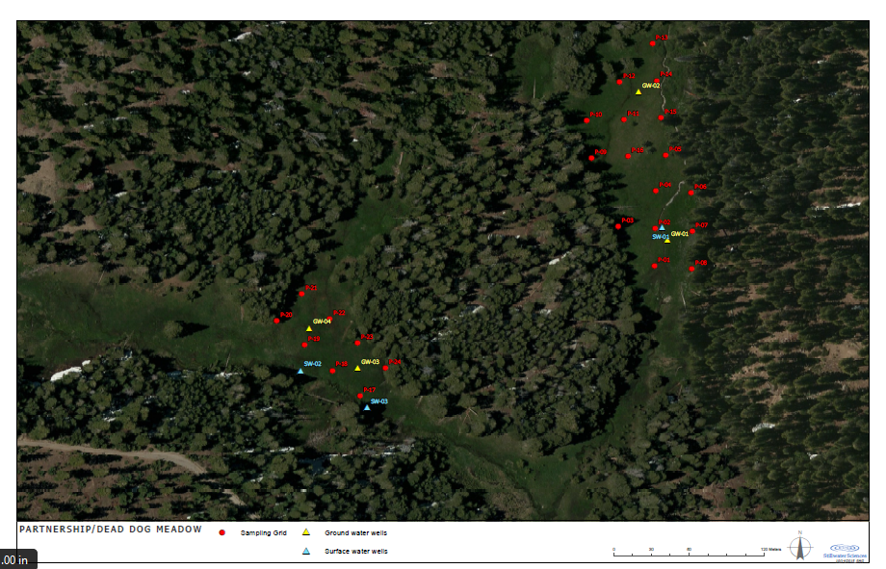
Partnership/Dead Dog Field Map
Notes:
Control

Slide 9
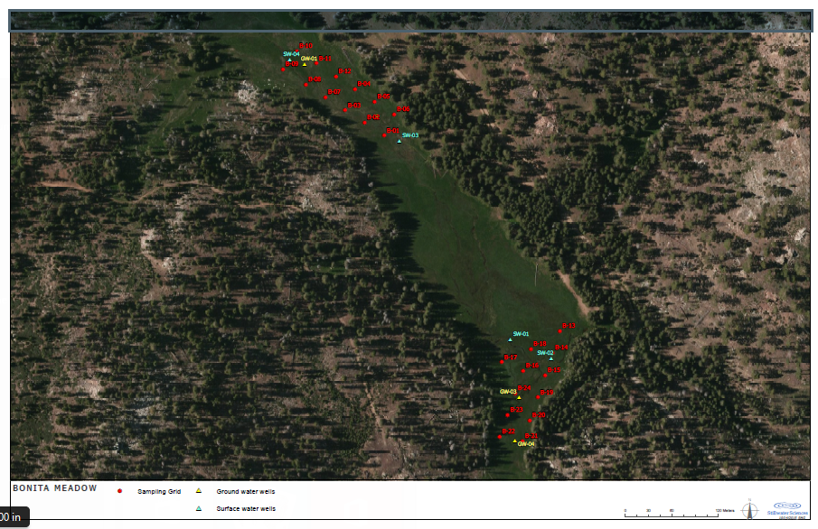
Bonita Field Map
Notes:
Reference-

Slide 10
Restoration Plans
Restore floodplain connectivity to the incised reaches of Osa Meadow
Near complete fill of the incised channel

Slide 12
Questions?
To allow time for questions

