Slide 1


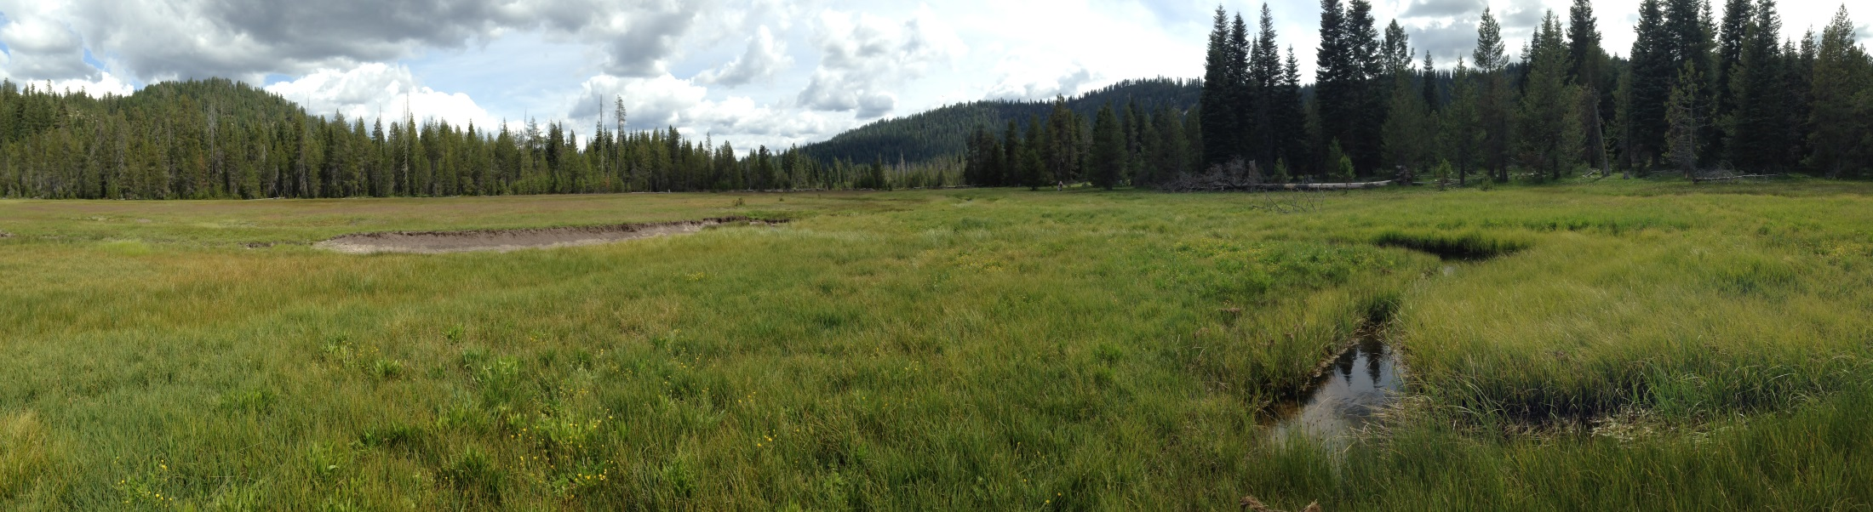
Considerations for Meadow Restoration within the Range of Rare Amphibians
¹Karen Pope, ²Sarah Yarnell, ³Cathy Brown
¹USDA Forest Service, Pacific Southwest Research Station
²UC Davis, Center for Watershed Sciences
³Stanislaus National Forest

Slide 2
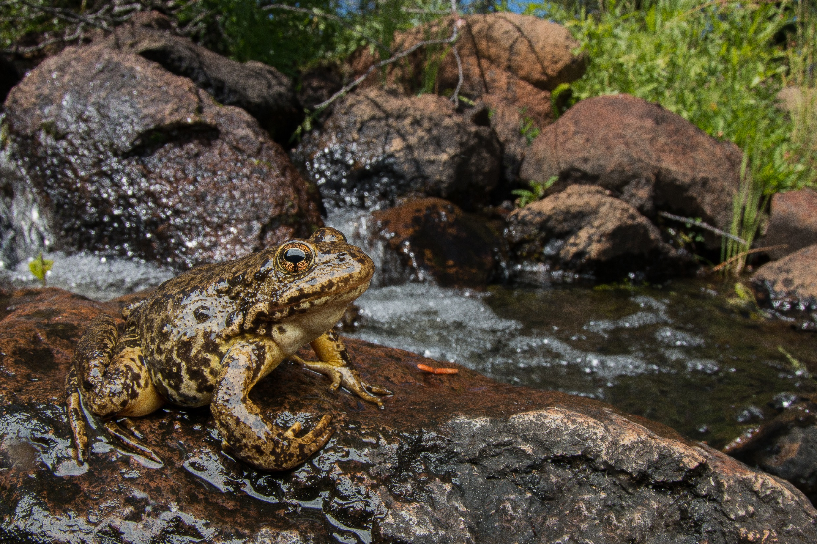
Outline
Why should we care about frogs when restoring mountain meadows?
What are the meadow conditions that support population persistence?
How are those conditions created and maintained?
How do we conduct restoration so that the processes that create and maintain suitable conditions are sustained?

Slide 3
1. Why should we care about frogs when restoring meadows?
Legal Nexus
  Sierra Nevada yellow-legged frog and mountain yellow-legged frog (Rana sierrae & R. muscosa) - state and federally listed as endangered
  Cascades frog (Rana cascadae) – under review for state listing as endangered
  Yosemite toad (Anaxyrus canorus)- federally listed as threatened
Evidence of increased reliance on meadow habitats
Complex life histories linked to meadow processes

Slide 4
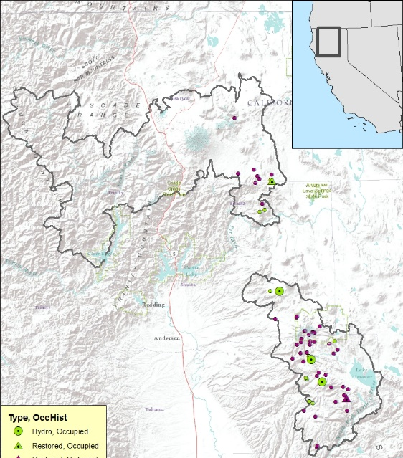
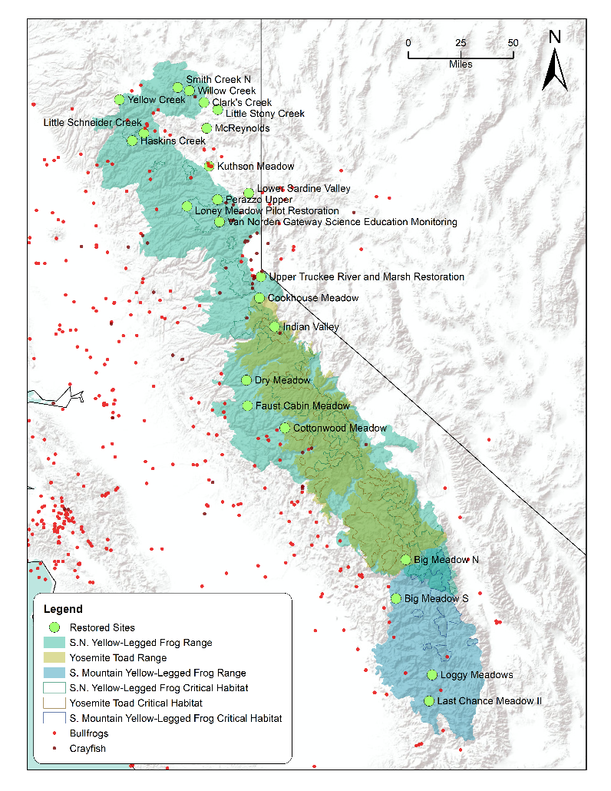
Ranges of California’s Sensitive Mountain Amphibians

Slide 5
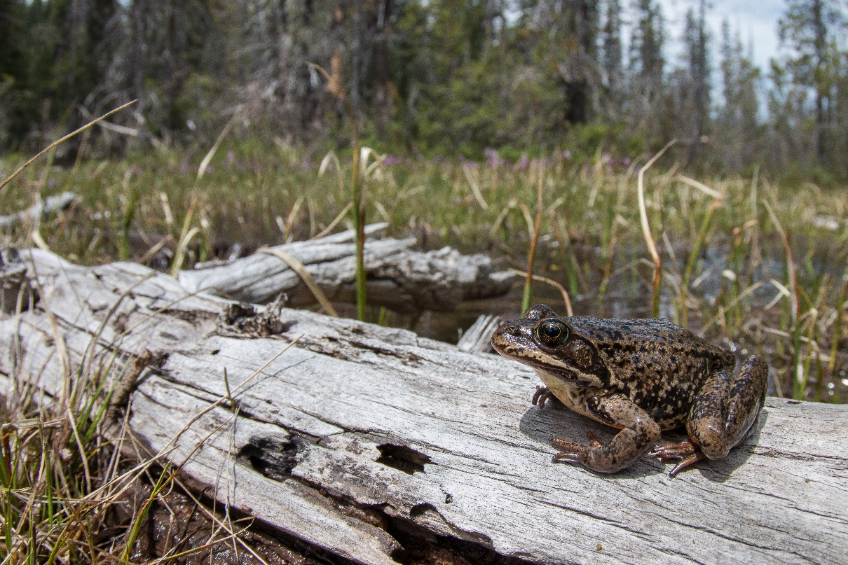
2. What are the meadow conditions that support population persistence (RASI, RAMU, RACA)?
Water throughout the year
  With specific conditions for breeding & overwintering
Ability to access food and refuge
Basking sites

Slide 6
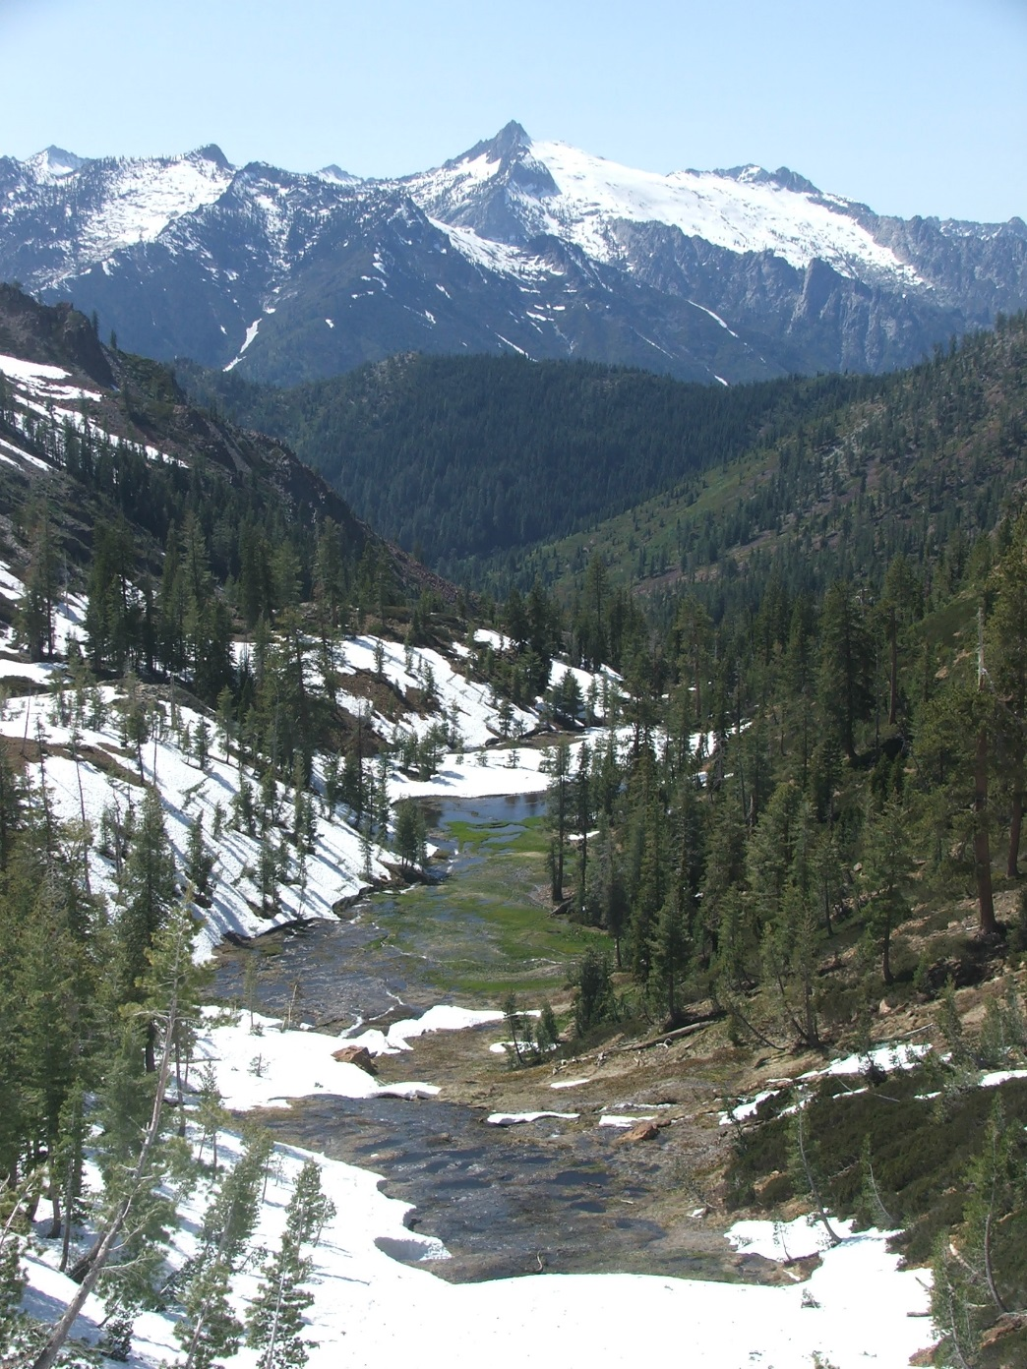
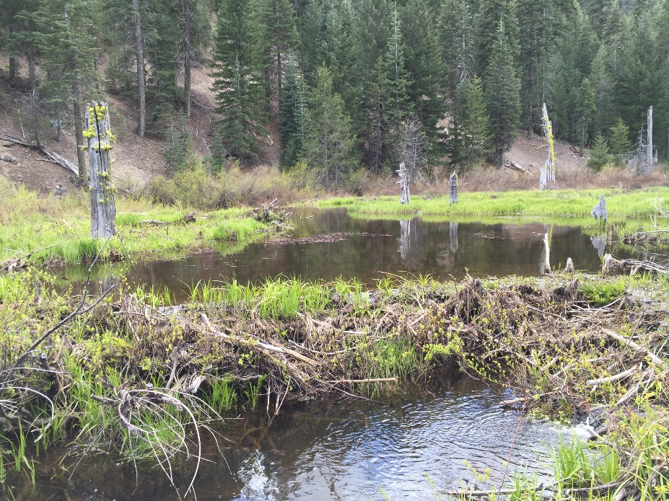
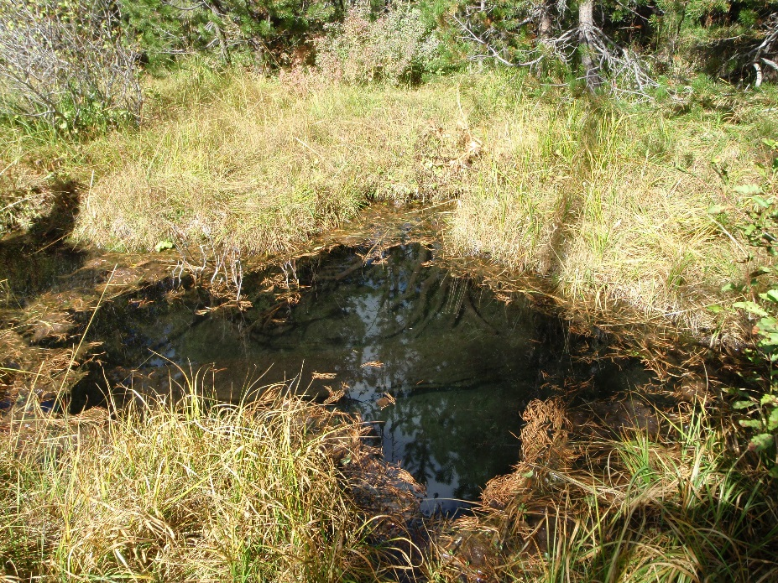
2a. Water throughout the year
Snow/ runoff
Beaver dams
Groundwater springs

Slide 7
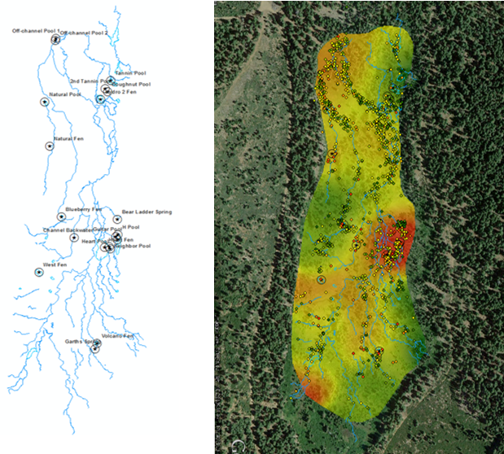
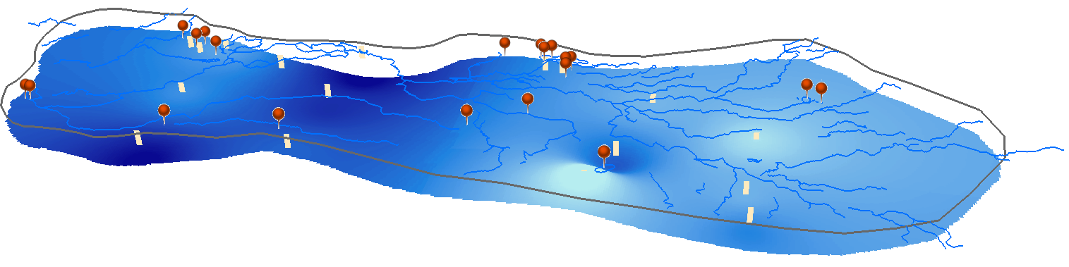
Meadow Hydrology and Frog Distribution
Stream flow and breeding sites
Water temperature and frog locations
Ground water and breeding sites

Slide 8
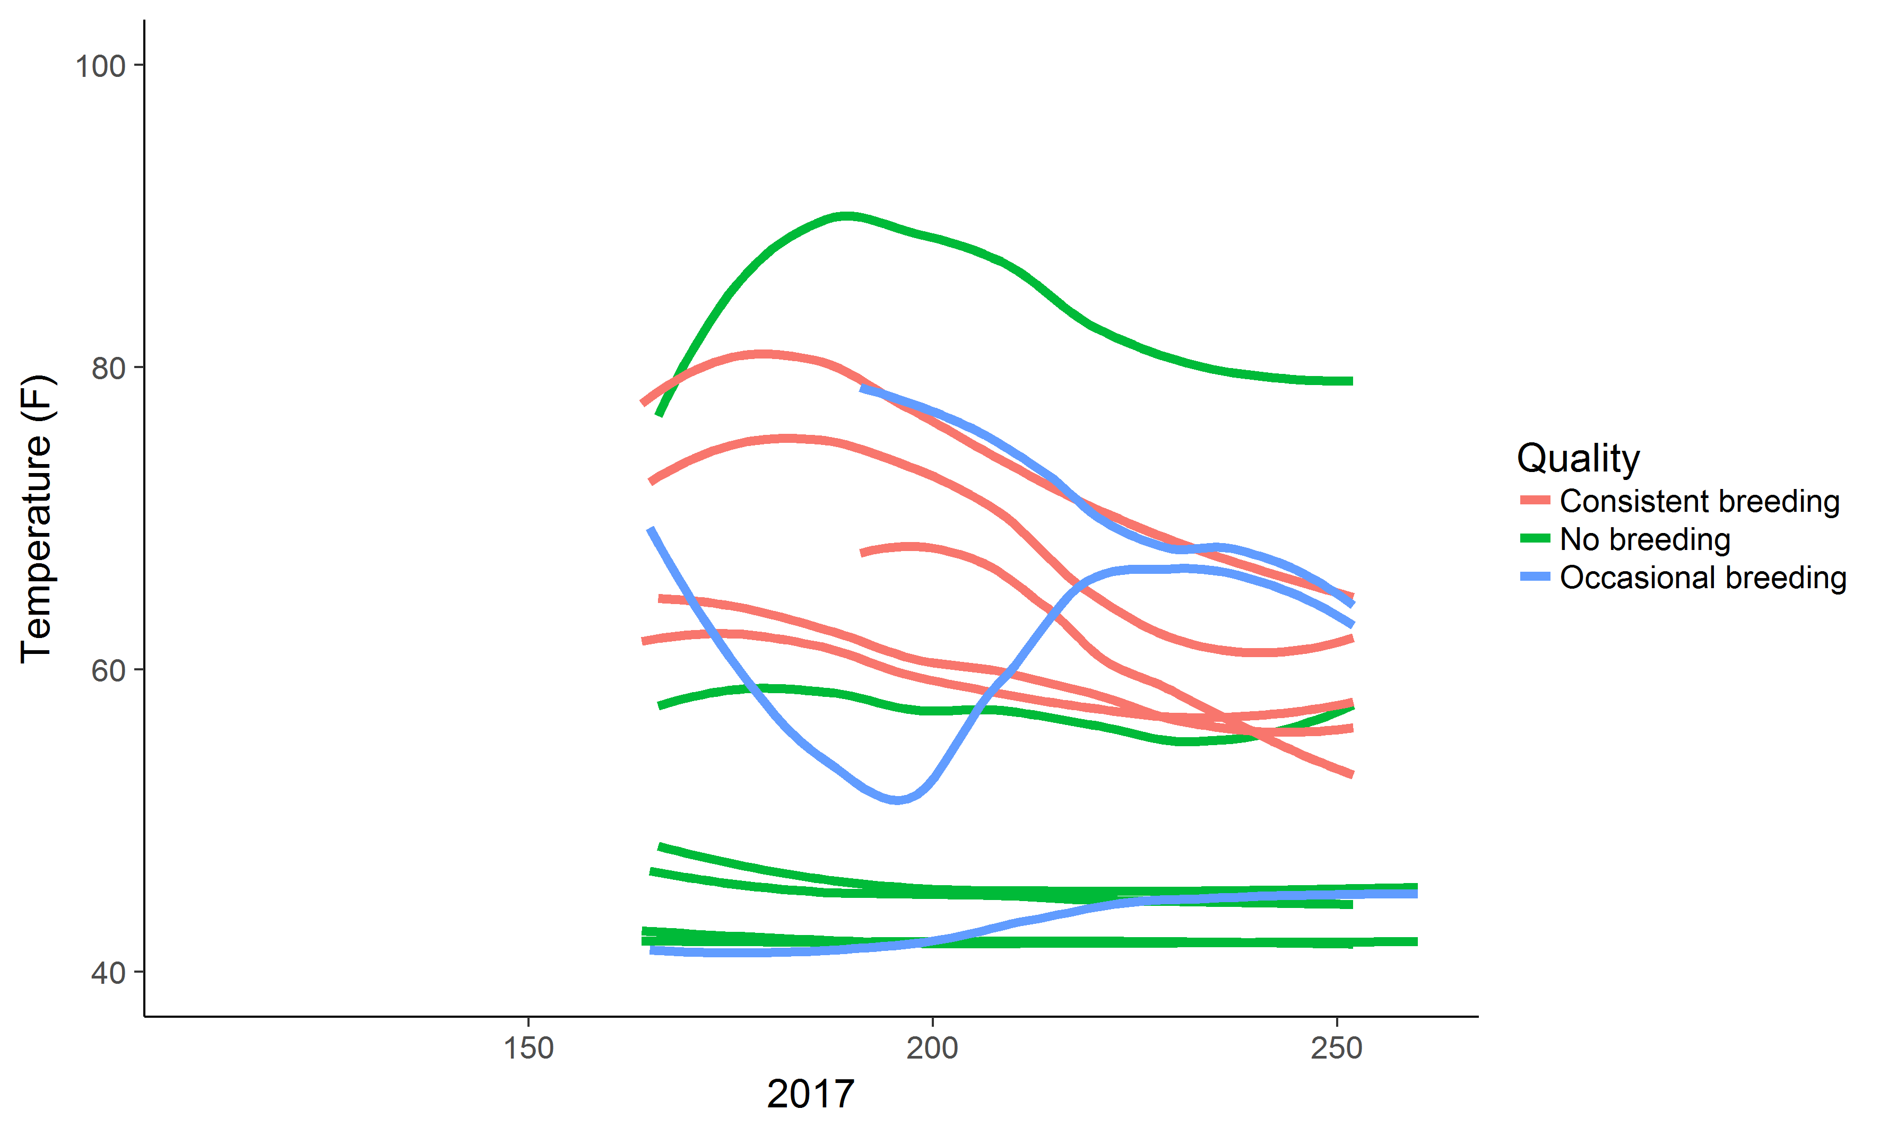
2a. Water throughout the year - breeding habitat
Warm surface flow
Goldilocks zone
Cold springs
Rana cascadae
Julian Day

Slide 9
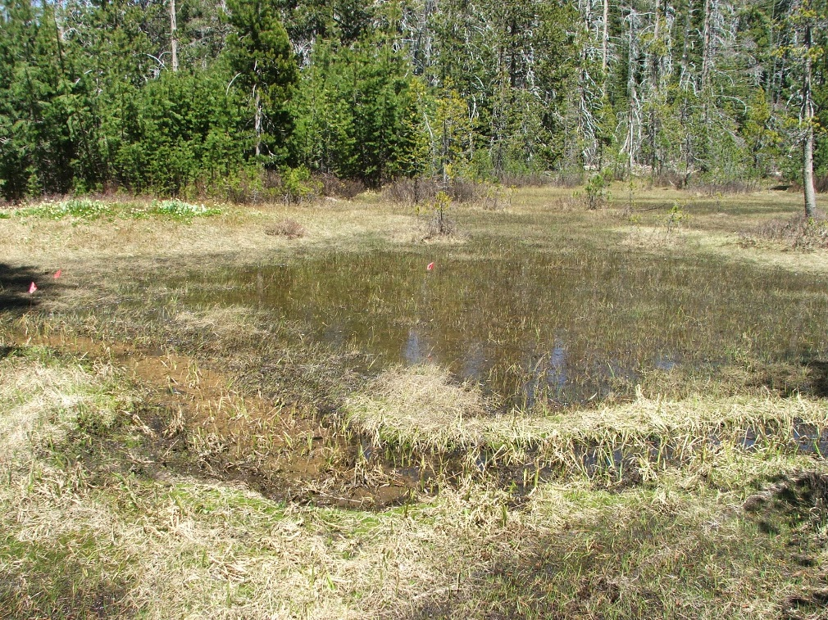
Breeding habitat (Cascades frog)

Slide 10
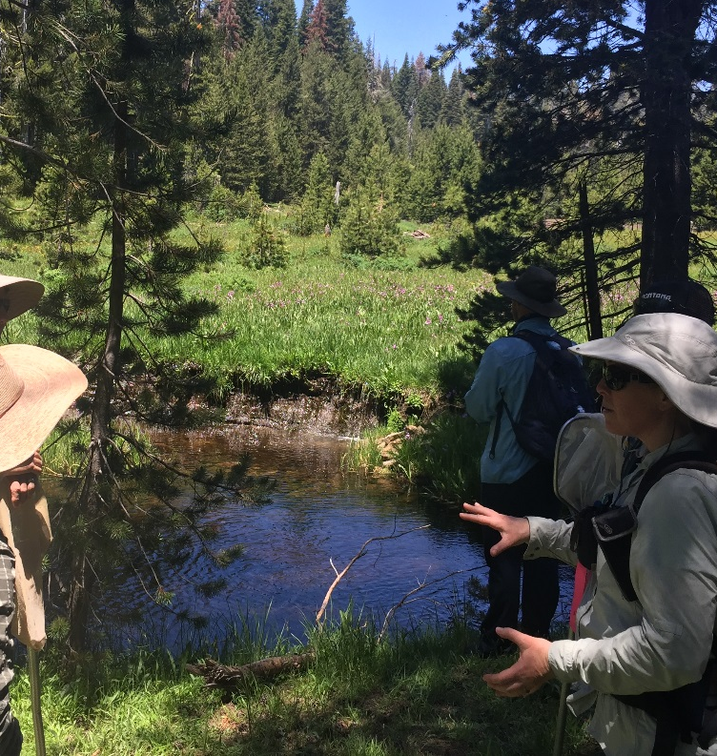
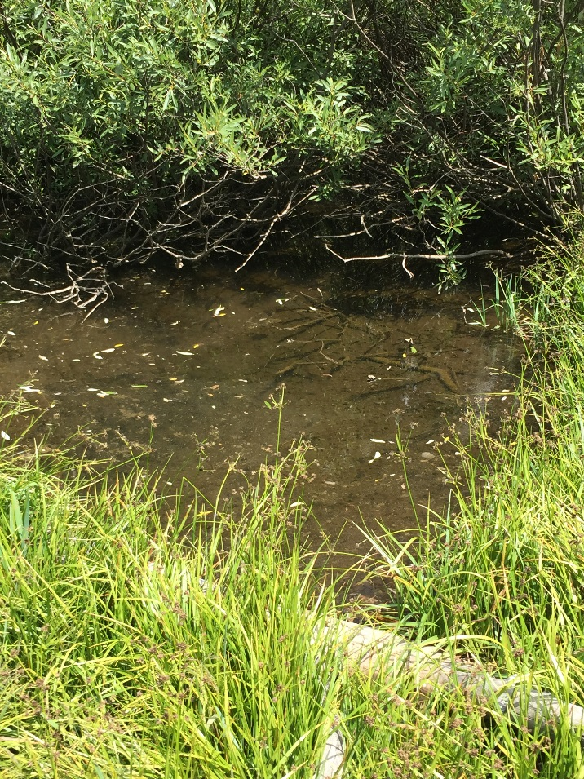
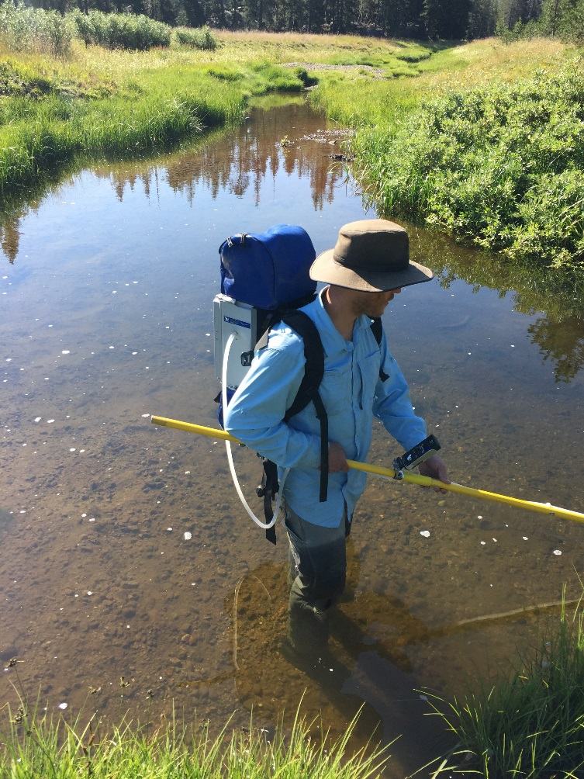
Breeding habitat (SNYLF)

Slide 11


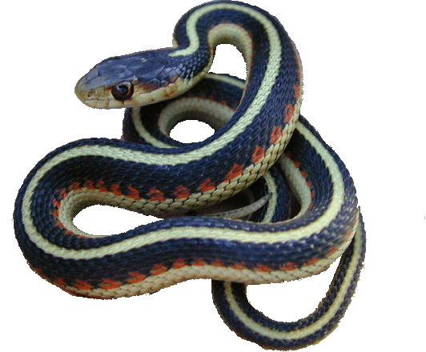
2b&c. Ability to access food, refuge, and sun

Slide 12
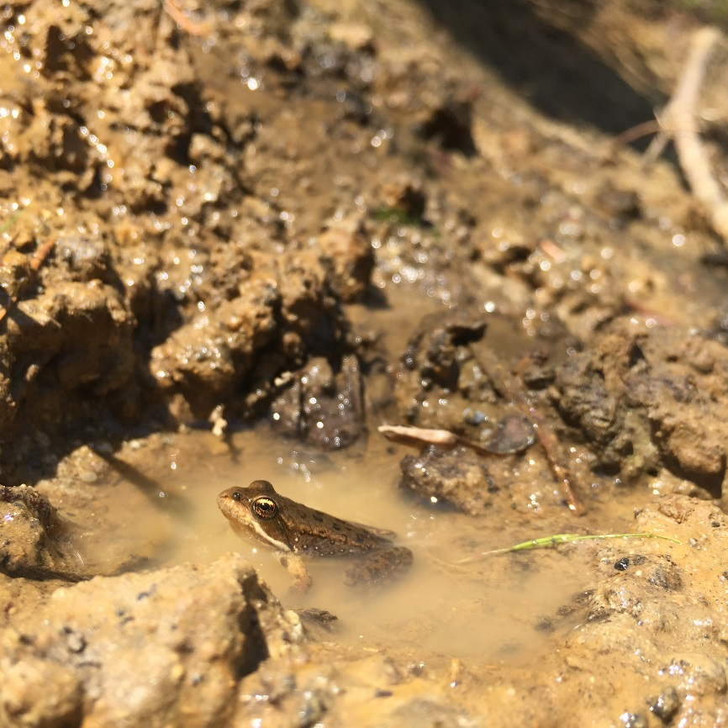
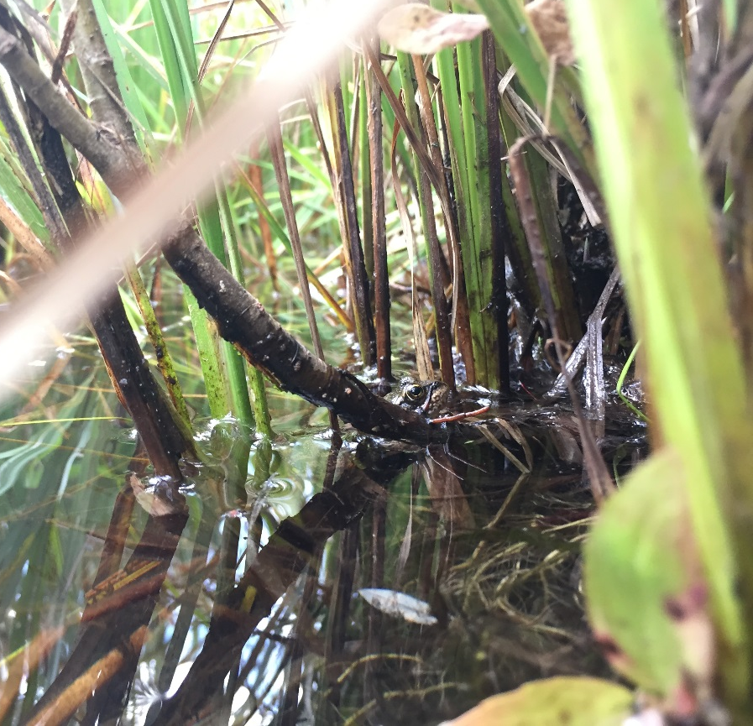
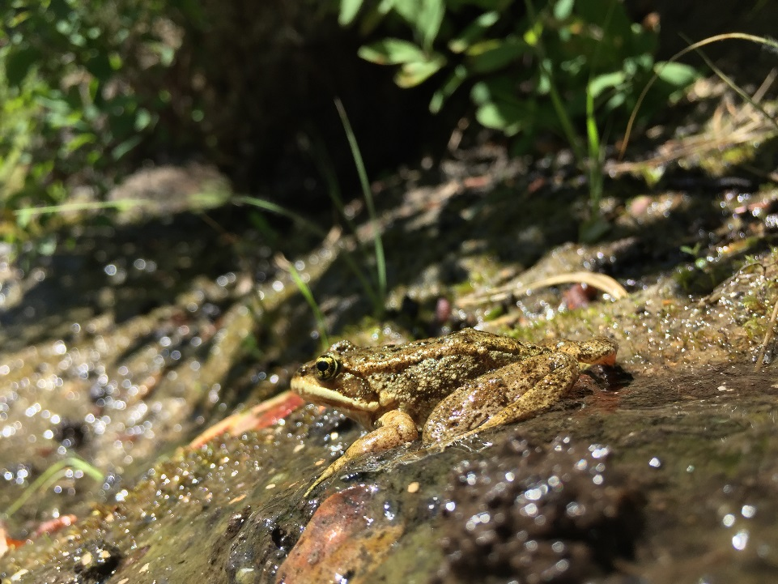
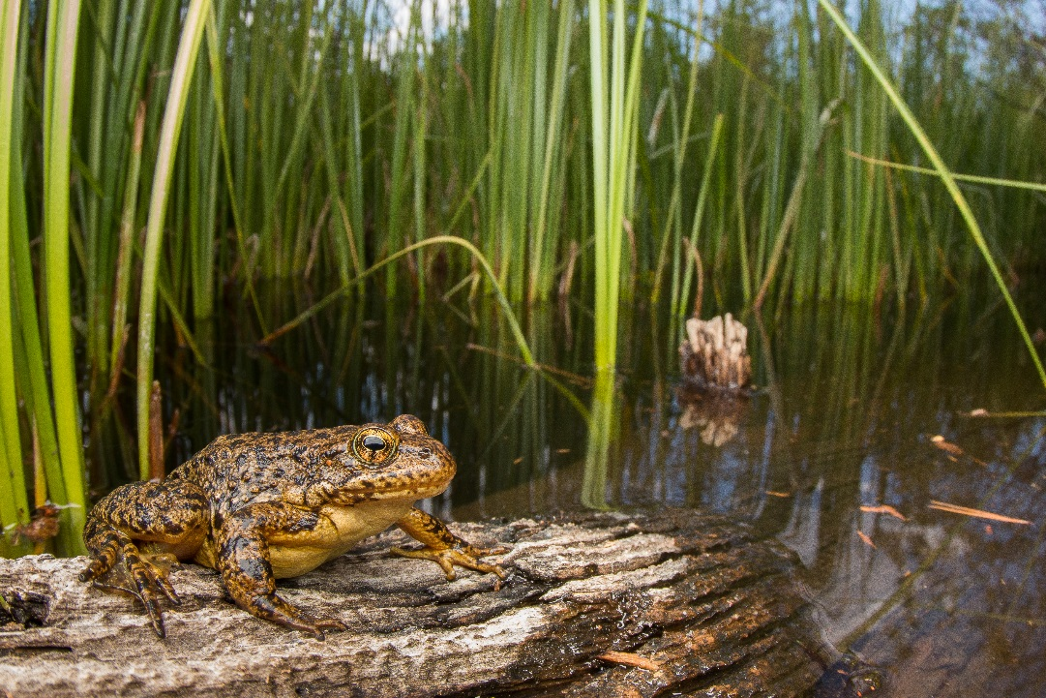
2b&c. Ability to access food, refuge, and sun
Can be a trade-off
Can be all in one

Slide 13
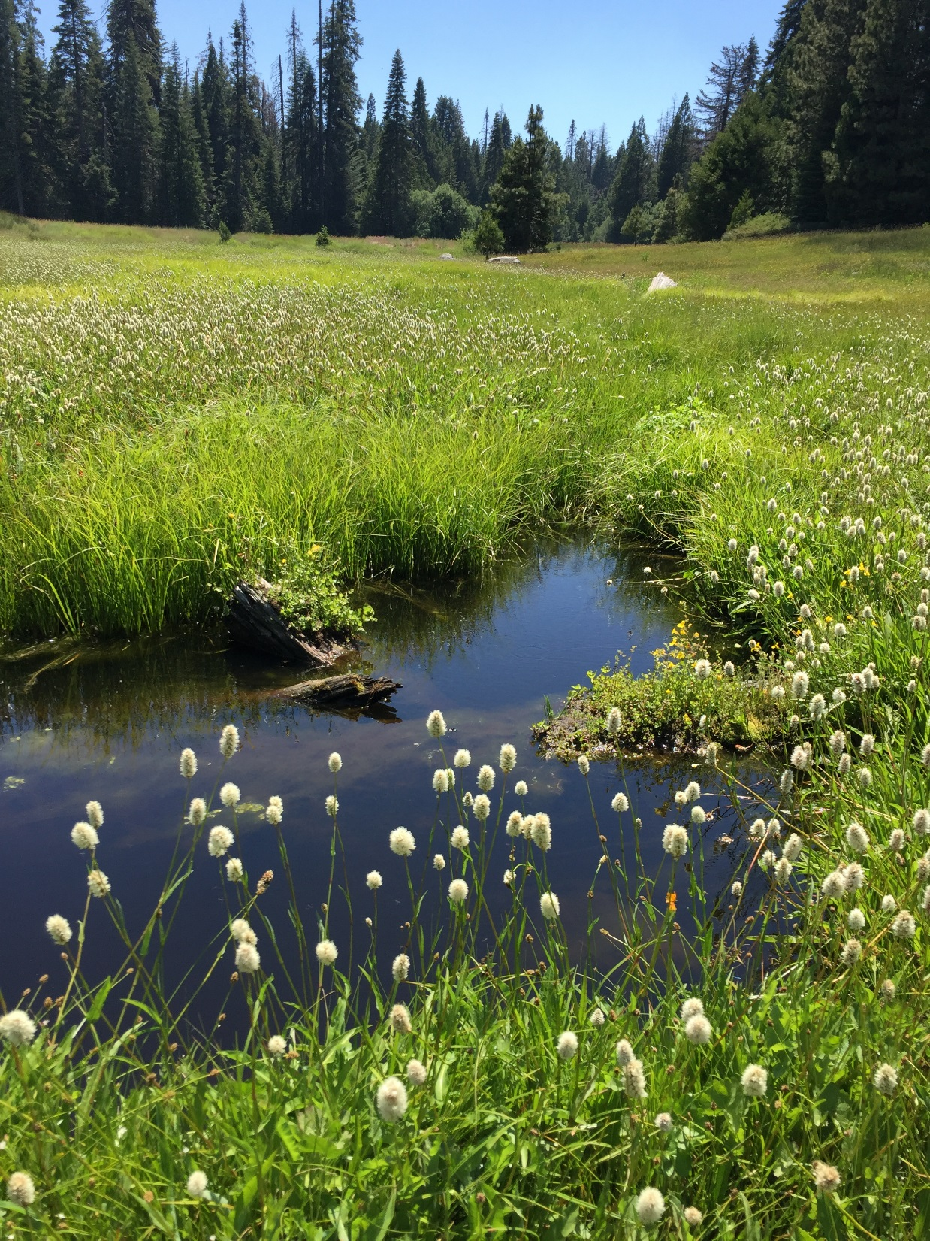

Slide 14
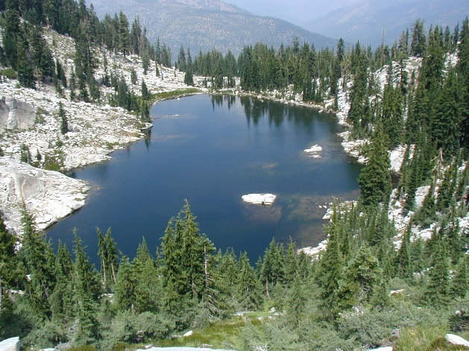
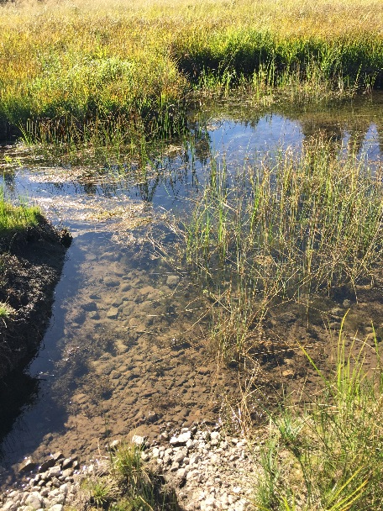
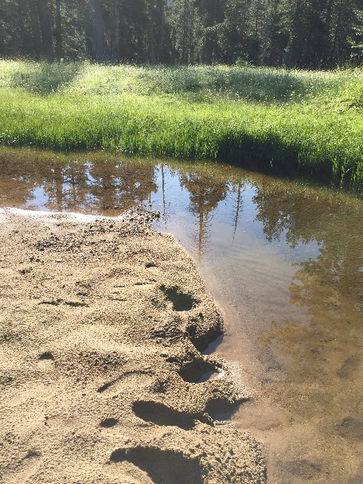
3. How are appropriate conditions created and maintained?
Different from mountain lakes
Local disturbances necessary
Hydrologic processes
  Sediment transport – deposition and scour
Biological processes
  Ecosystem engineers
  Vegetation change
Notes:
Wet meadows can provide the necessary habitat conditions to sustain amphibian populations through natural hydrological processes that result in local patchy disturbances and heterogeneity. Low gradients and shallow water tables make them relatively hydrologically stable, while the sudden reduction in stream power causes regular local disturbance patterns associated with sediment transport, deposition and scour.

Slide 15
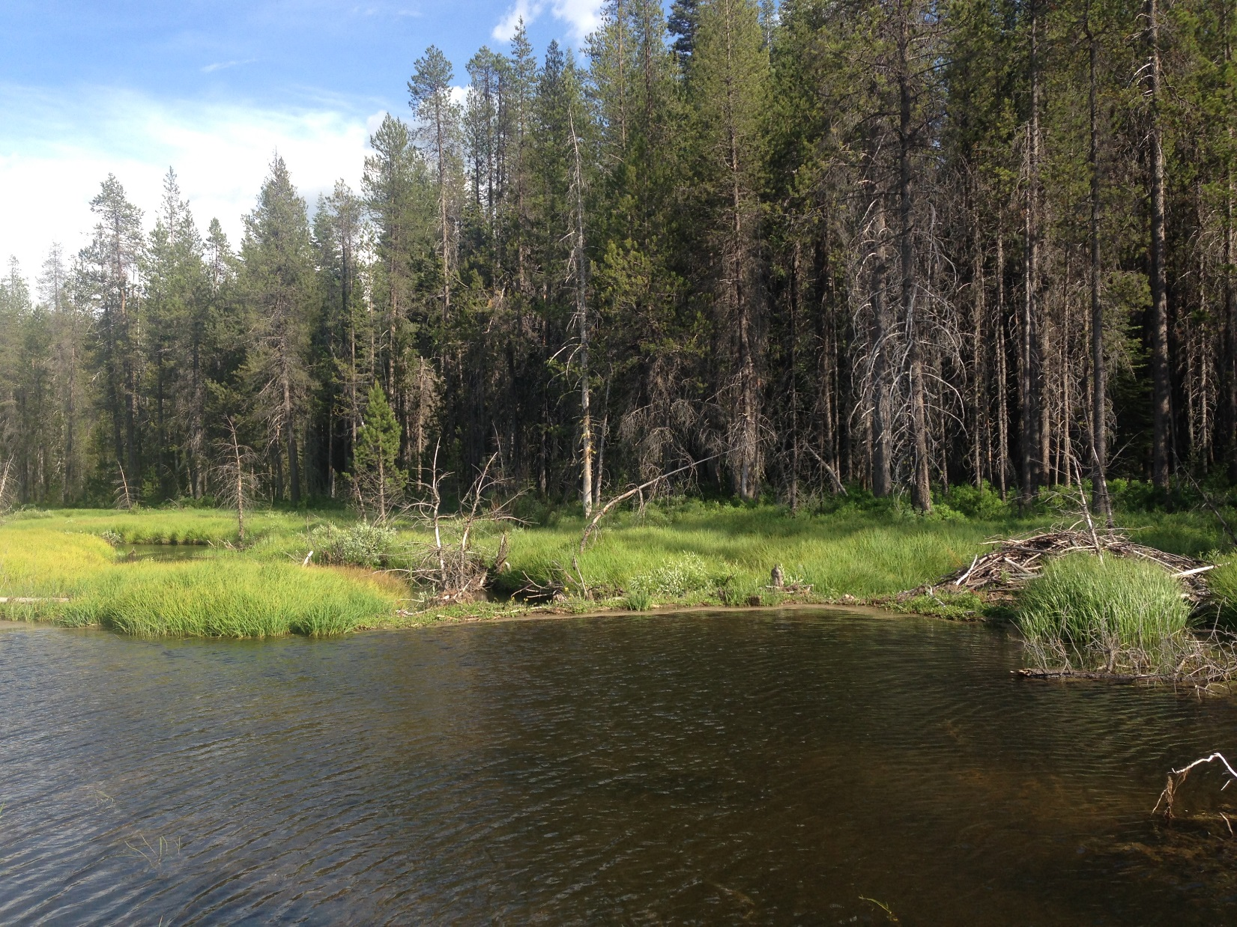
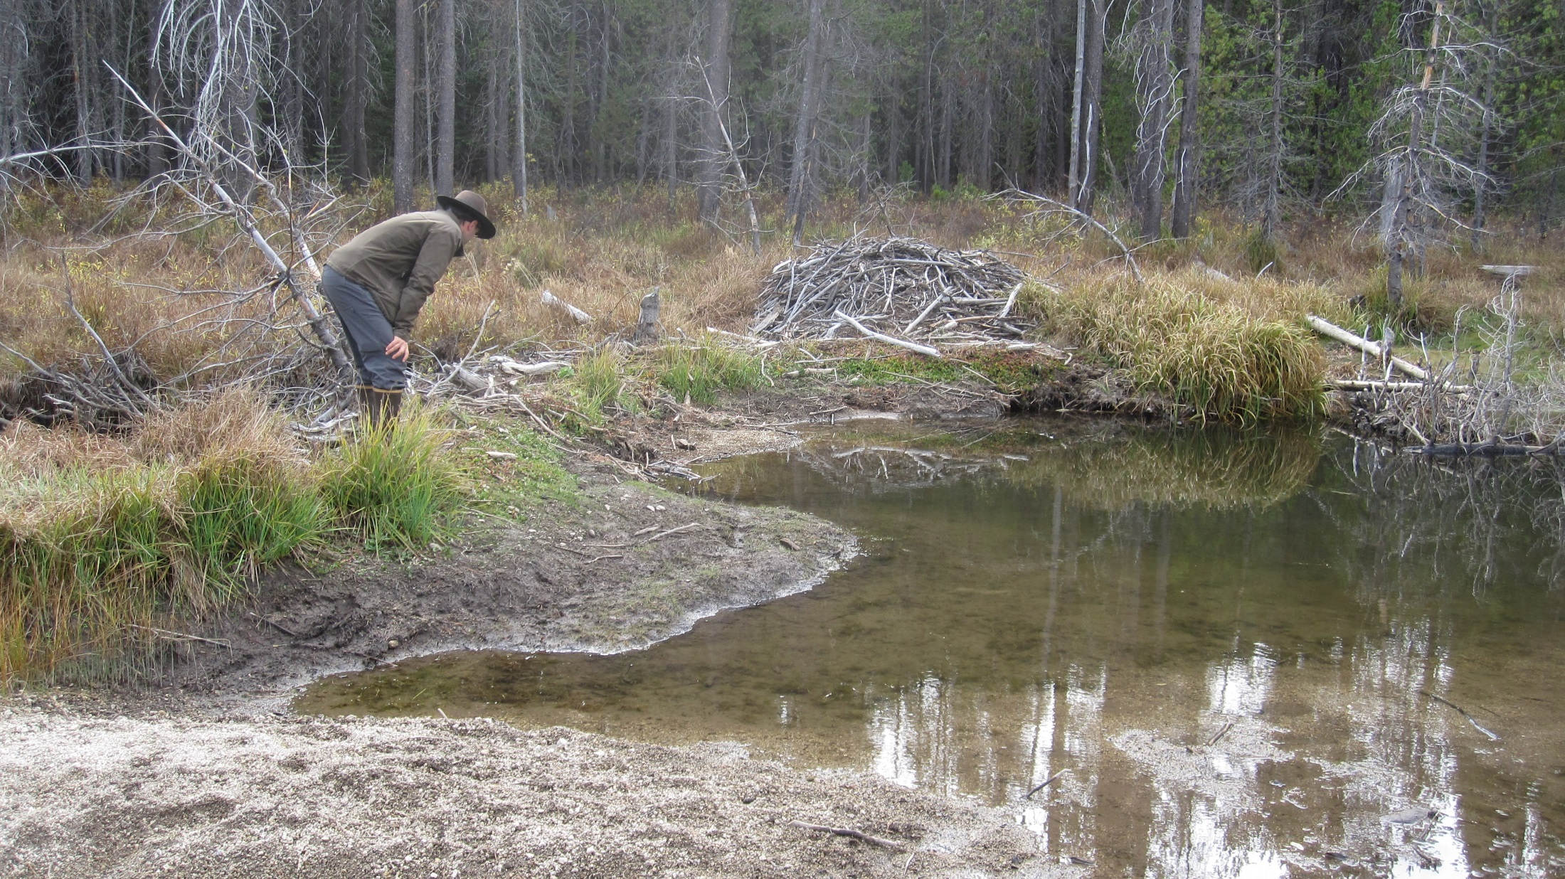

Slide 16
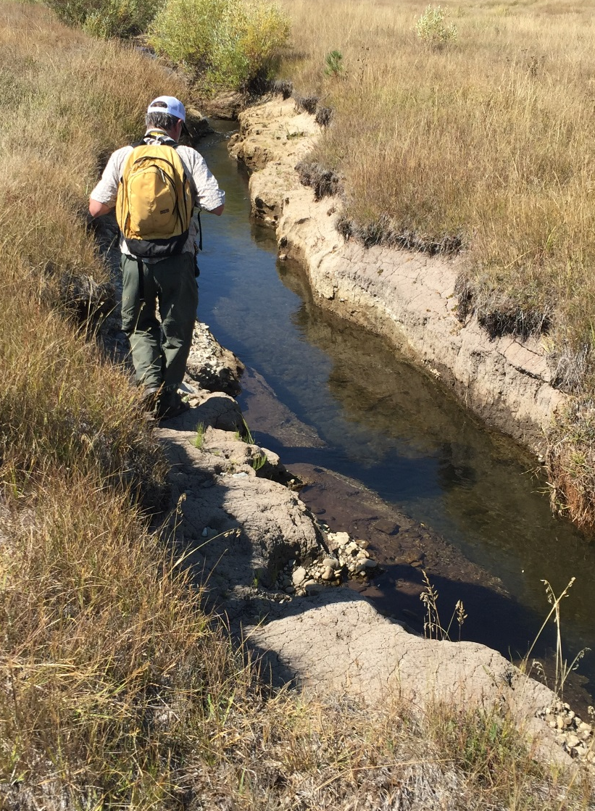
4. How do we conduct restoration so that the processes that create and maintain suitable conditions are sustained?

Slide 17
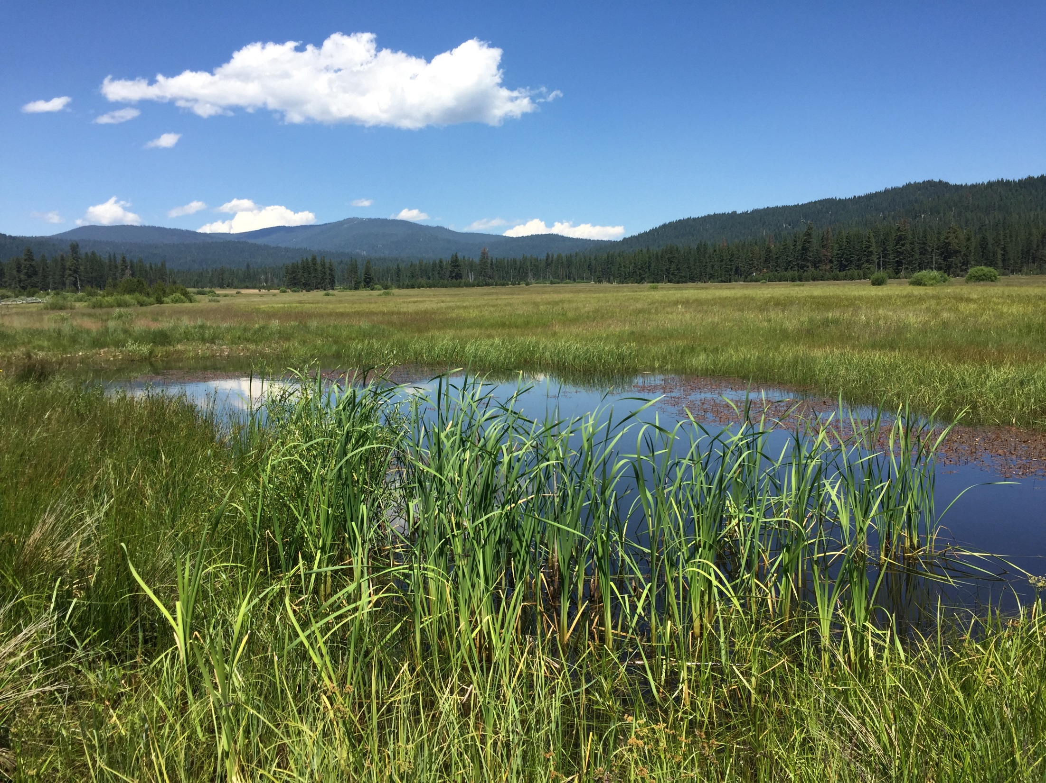

Slide 18
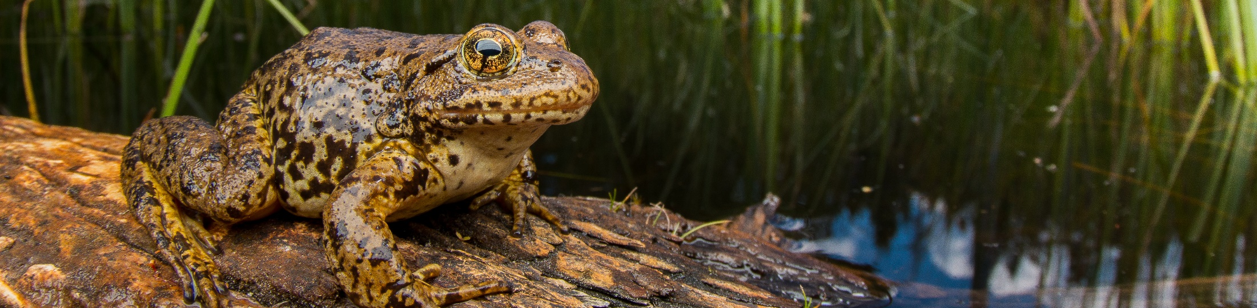
Restoration Objectives for Sierra Nevada Frogs
Retain surface water – increase hydroperiod
Provide a range of aquatic habitat conditions for different life stage needs
Protect and enhance habitat associated with groundwater springs
Retain/encourage local disturbance processes
Notes:
Goal is stage zero, multi-threaded channels. Not immediate gratification but process based and arguably provides habitat along the way. Timeline depends on sediment transport and collection. A perceived lack of sediment supply is an argument for not using this approach. But Brian Cluer said “sediment supply is typically assumed to be low and that is typically a fatal error. Without setting up a sediment trap (e.g. BDA or a channel expansion) we can't judge the sediment transported in incised channels”
Recent research prompts the consideration that the single-thread configuration taken to represent the initial, undisturbed morphology of an alluvial stream may have actually evolved from earlier, truly pre-disturbance, multi-channel morphologies that were not only more extensive and complex but also provided greater diversity and richer habitats and ecosystem functions.

Slide 19
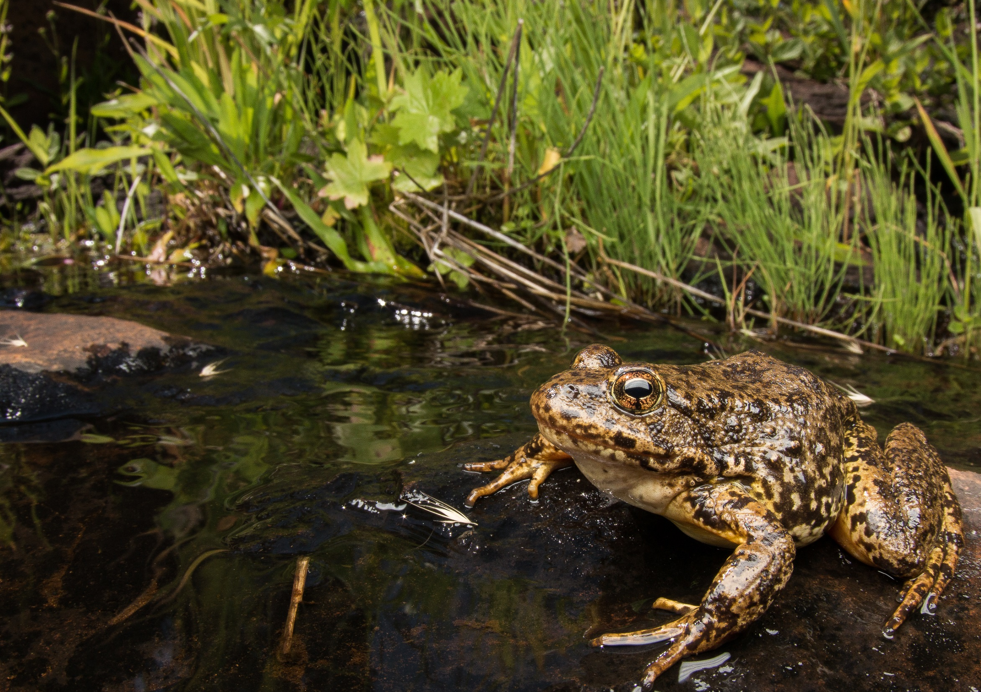
Conclusions
By considering the needs of amphibians, we are led to:
  Embrace and incorporate natural processes
  Remember the importance of local disturbance
  Target hydrogeomorphic complexity, which benefits biodiversity in general

Slide 20
Acknowledgements
Spencer Riffle and Andrew Bearer– field work and photography –https://www.flickr.com/photos/riffle_nature_photos/
Garth Hodgson – analysis
Lots of fabulous crew members

Slide 21
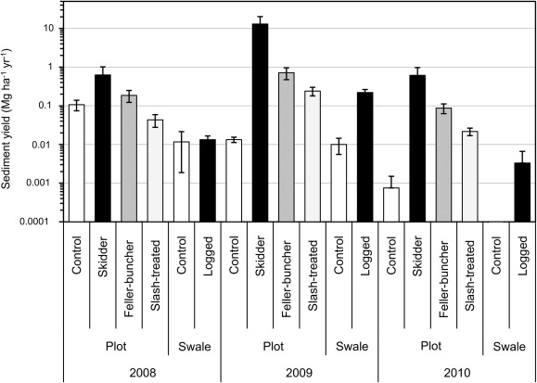
Partner restoration with forest management?
Waggenbrenner et al. 2015, Forest Ecology and Management
Notes:
We know that water and sediment yield from forested slopes increases with major disturbance such as timber harvest, wildfire and salvage logging. This graph shows a more than doubling of sediment yield for a few years following salvage logging. Why not strategically implement restoration of incised meadow channels with upslope management actions for a win-win flood and erosion control and faster restoration?

