Slide 1
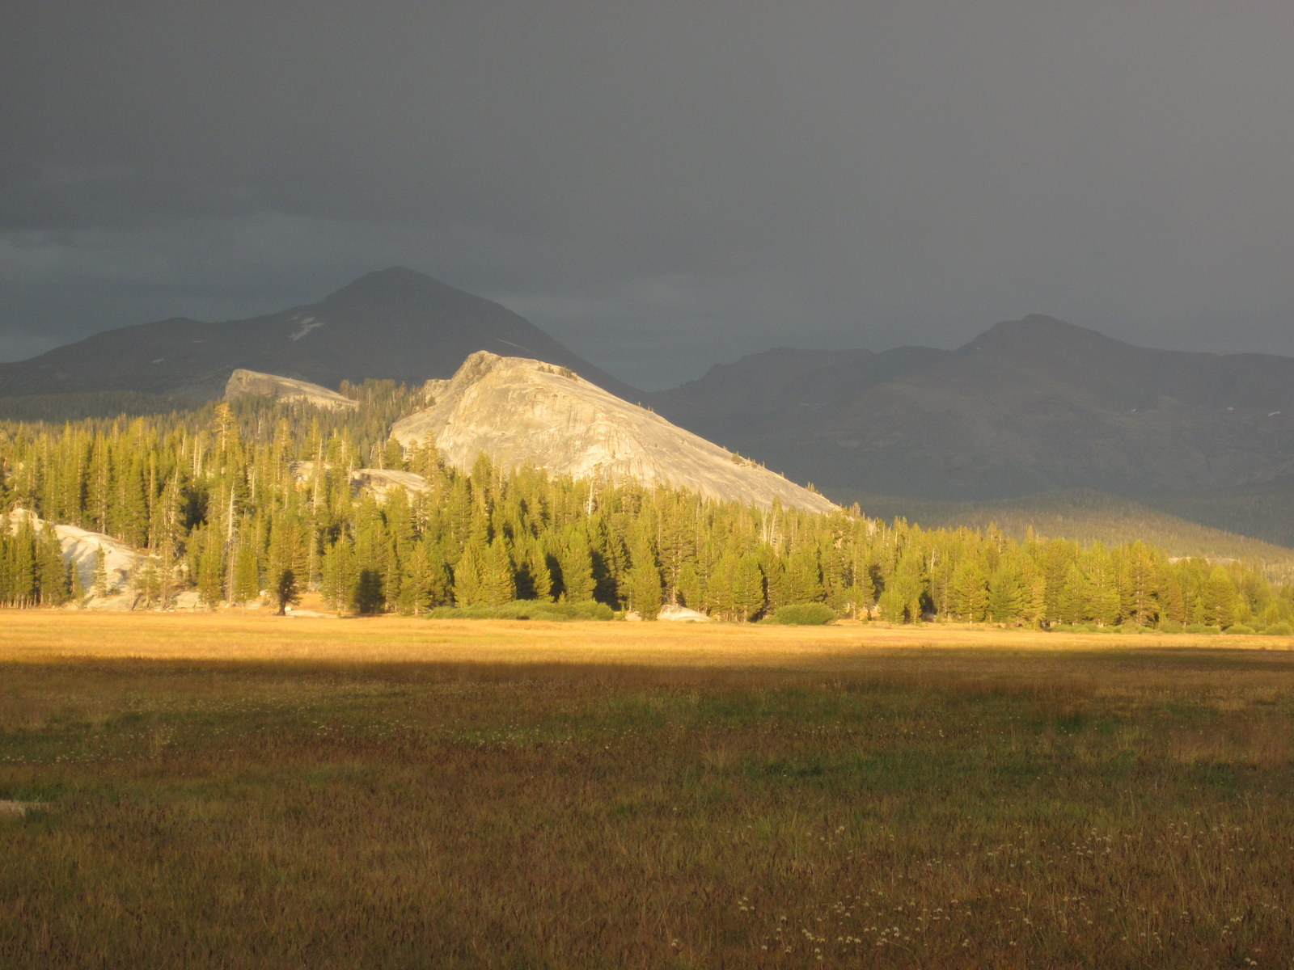
Herbivory, vegetation, and carbon storage in Tuolumne Meadows, Yosemite
David Cooper
Evan Wolf
Melissa Booher
Lydia Baldwin

Slide 2
Tuolumne Meadows soil stratigraphy
~16% soil C
1200 yrs BP ash layer found at 40-70 cm depth in well holes
Base of meadow sediments estimated @ 2300 yrs BP
(Wood 1975)

Slide 3
Organic matter sponge
(Ankenbauer and
Loheide 2016)

Slide 4
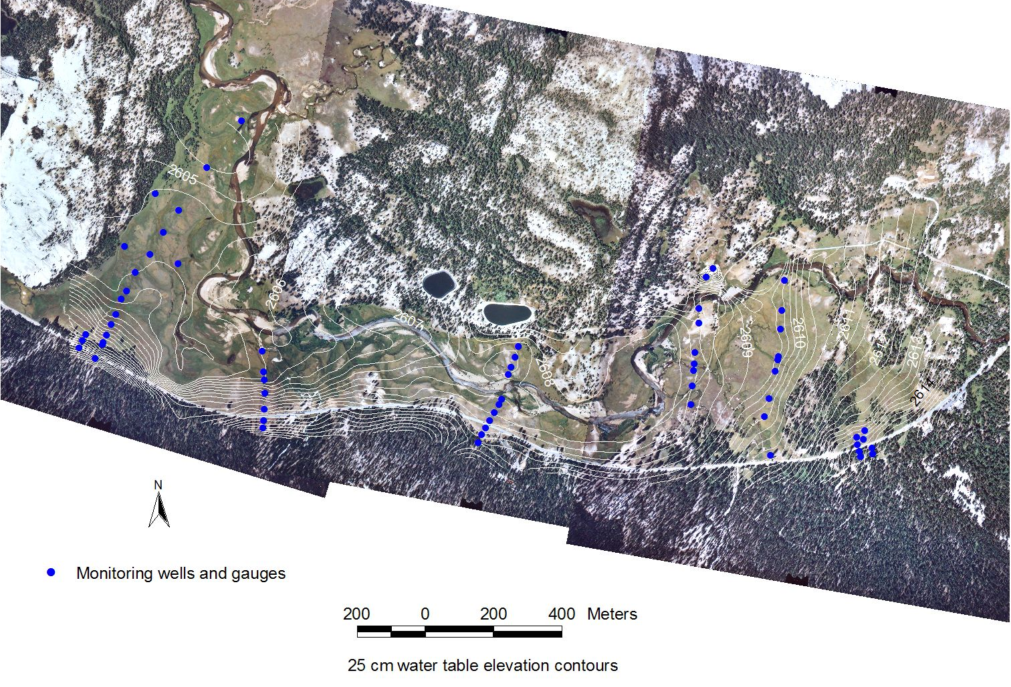
Tuolumne Meadows

Slide 5
Western Tuolumne is groundwater supported
(Loheide et al. 2009)

Slide 6
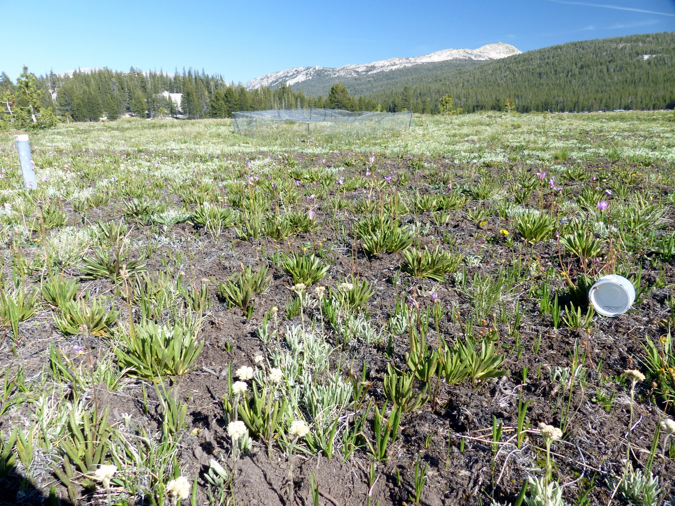
Wetland soil
80 cm (2.6 ft) thick.
High organic content (30%).
Formed over the past ~2,000 years.
Groundwater wetland hydrology
45 days/season high water + 35 days from OM
Little variation b/t wet and drought years.
Vegetation?
Soil and hydrology indicate productive wetland plant community.
What do we see?

Slide 7
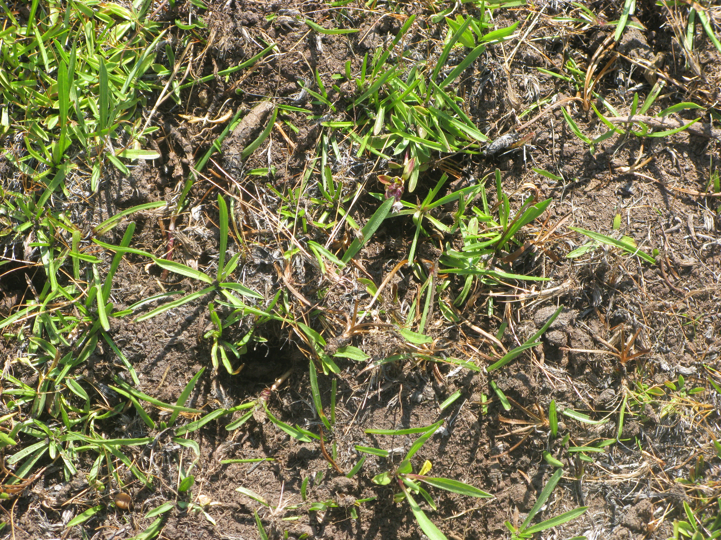

Slide 8
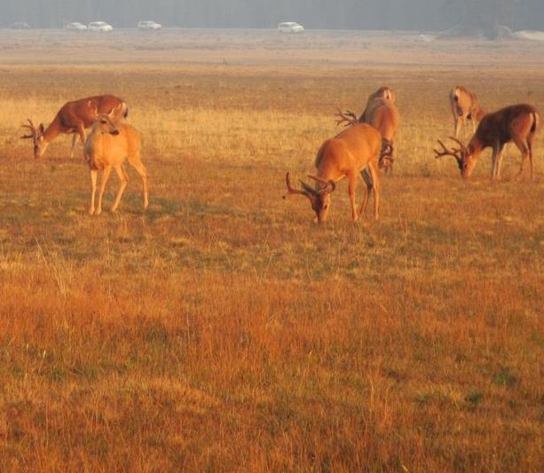
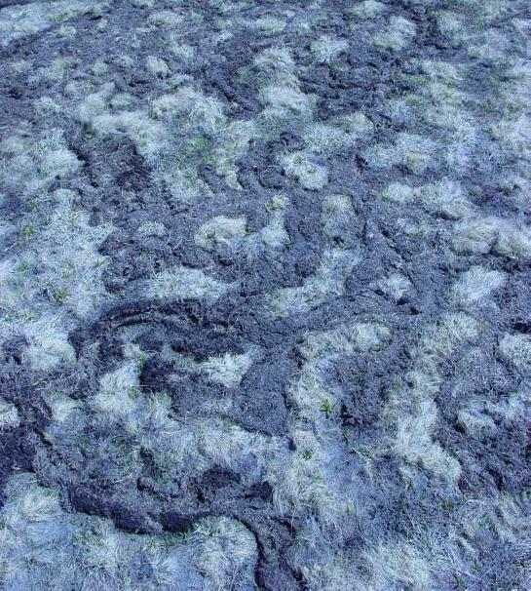
Primary research question 2011-14:
Is current (native) herbivory suppressing vegetation
and altering ecosystem processes?

Slide 9
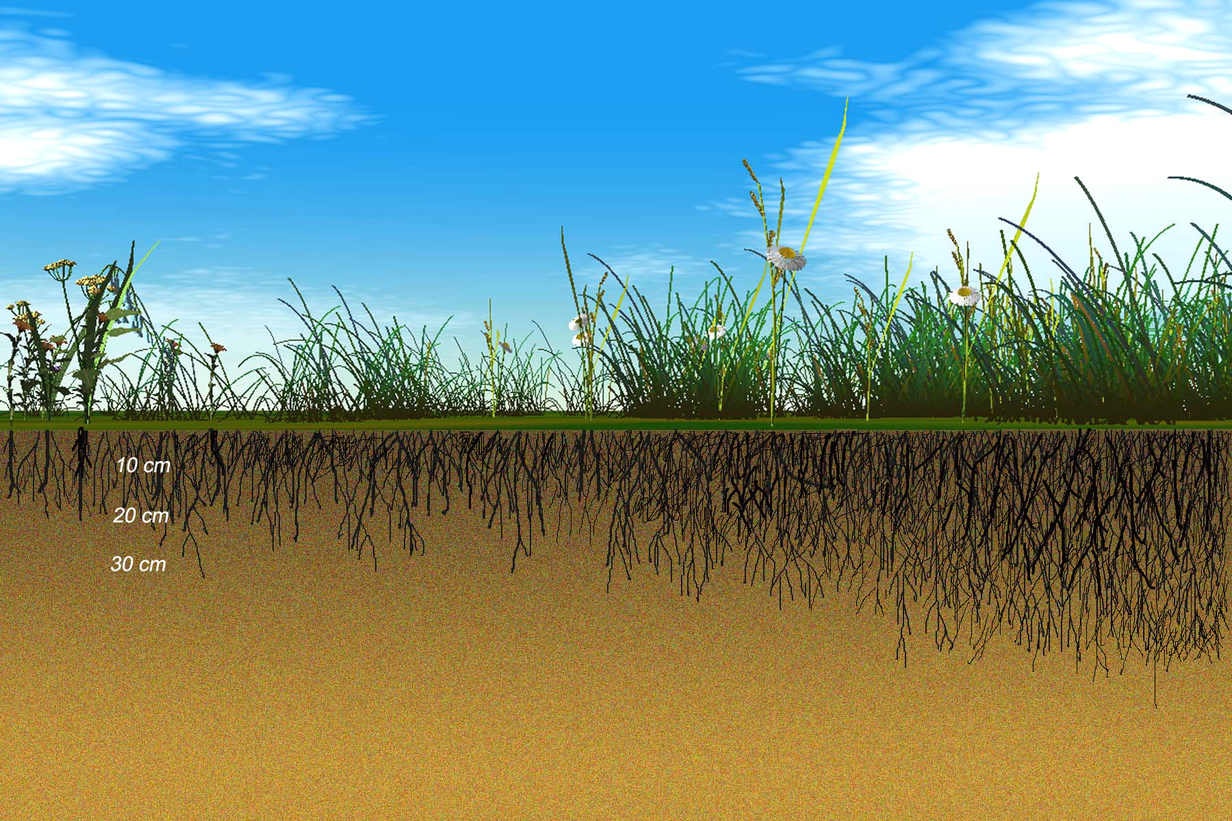
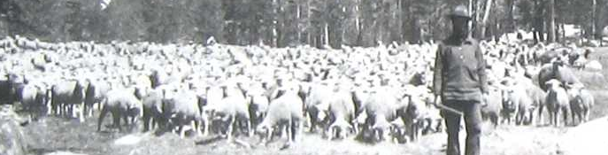
Soil + water + plants
Grazing
Dense perennial,
clonal sedges
Sparse annuals and
tap-rooted perennial
High water-
holding capacity
High belowground
productivity
Low water-
holding capacity
Low belowground
productivity
High soil
organic content
Low soil
organic content

Slide 10
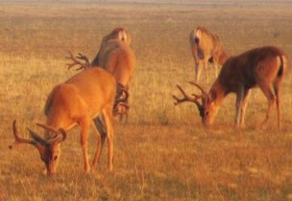

Soil + water + plants
Dense perennial,
clonal sedges
Sparse annuals and
tap-rooted perennial
High water-
holding capacity
High belowground
productivity
Low water-
holding capacity
Low belowground
productivity
High soil
organic content
Low soil
organic content

Slide 11
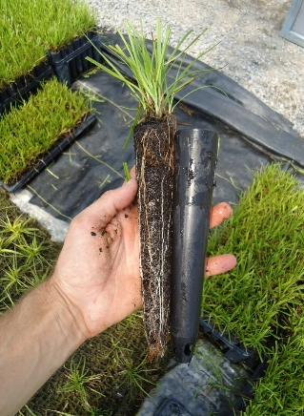
Soil + water + plants
Transplanting
Dense perennial,
clonal sedges
Sparse annuals and
tap-rooted perennial
High water-
holding capacity
High belowground
productivity
Low water-
holding capacity
Low belowground
productivity
High soil
organic content
Low soil
organic content

Slide 12
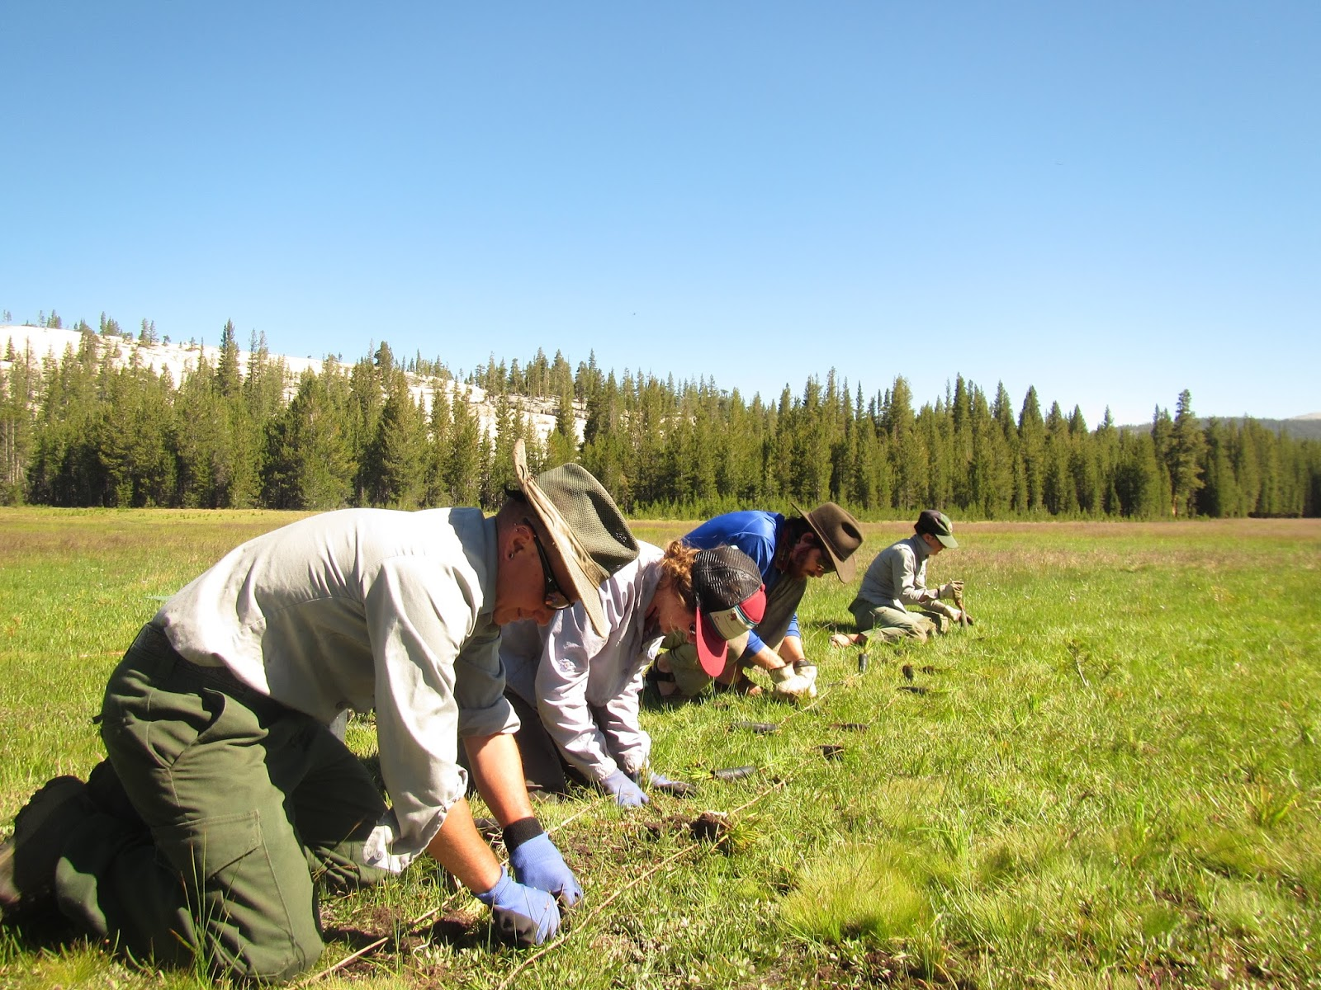
2016+ Primary research questions
Will planting Carex scopulorum change the carbon flux?
Will fencing allow the plantings to become established and resilient once exposed to herbivory?

Slide 13
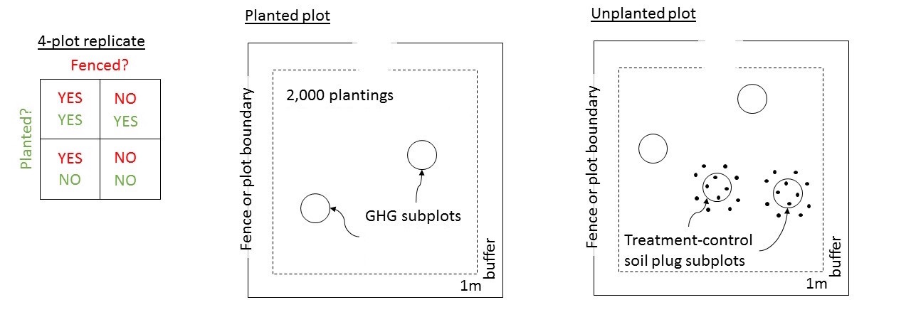
Experimental design
June 27: Received partial permit
June 29: Started planting nursery grown Carex scopulorum
July 1: Complete MRA signed
July 13: Finished planting 20,000 seedlings
July 14: Started fencing
July 22: Finished fencing
July 26: Started carbon flux and seedling survival measurements

Slide 14
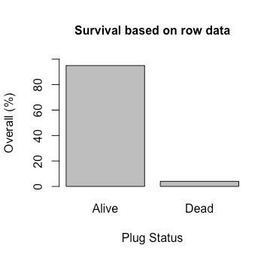
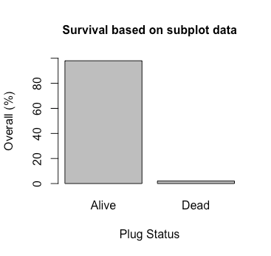
Planted Carex scopulorum seedling survival
1,009 observations from 8/15 in randomly selected rows in planted plots, survival rate = 95%
1,974 observations from 8/7-8/12 in randomly selected subplots in planted plots, survival rate = 98%

Slide 15
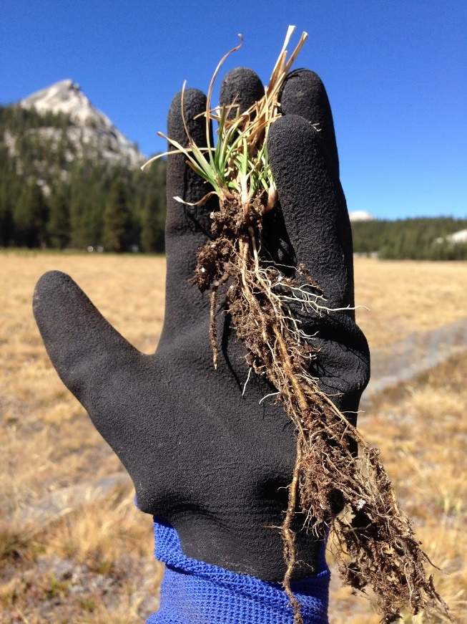
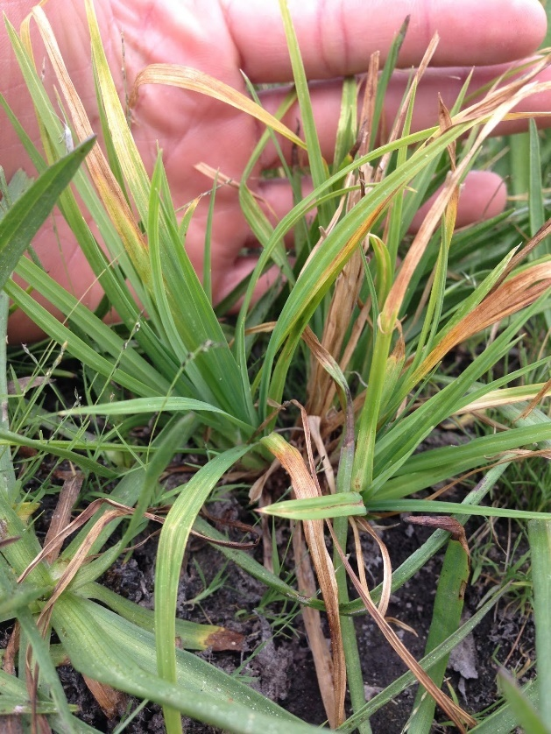
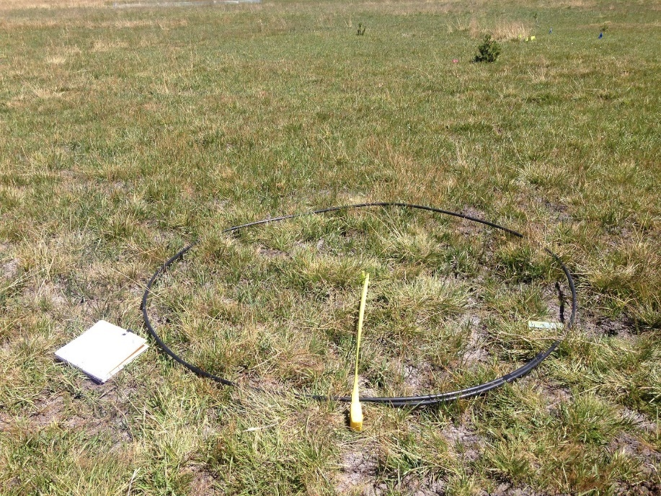
Planted Carex scopulorum seedling growth
Measured
Seedling area
Numbers of new shoots
Length of longest new leaves
Biomass

Slide 16
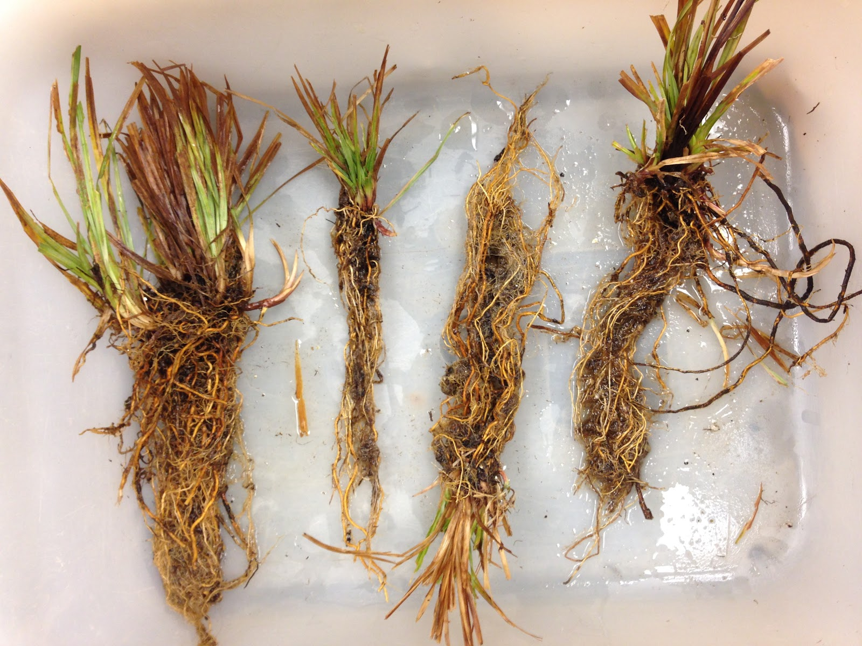
Nursery-grown, planted, field-collected Carex scopulorum washed in the lab

Slide 17
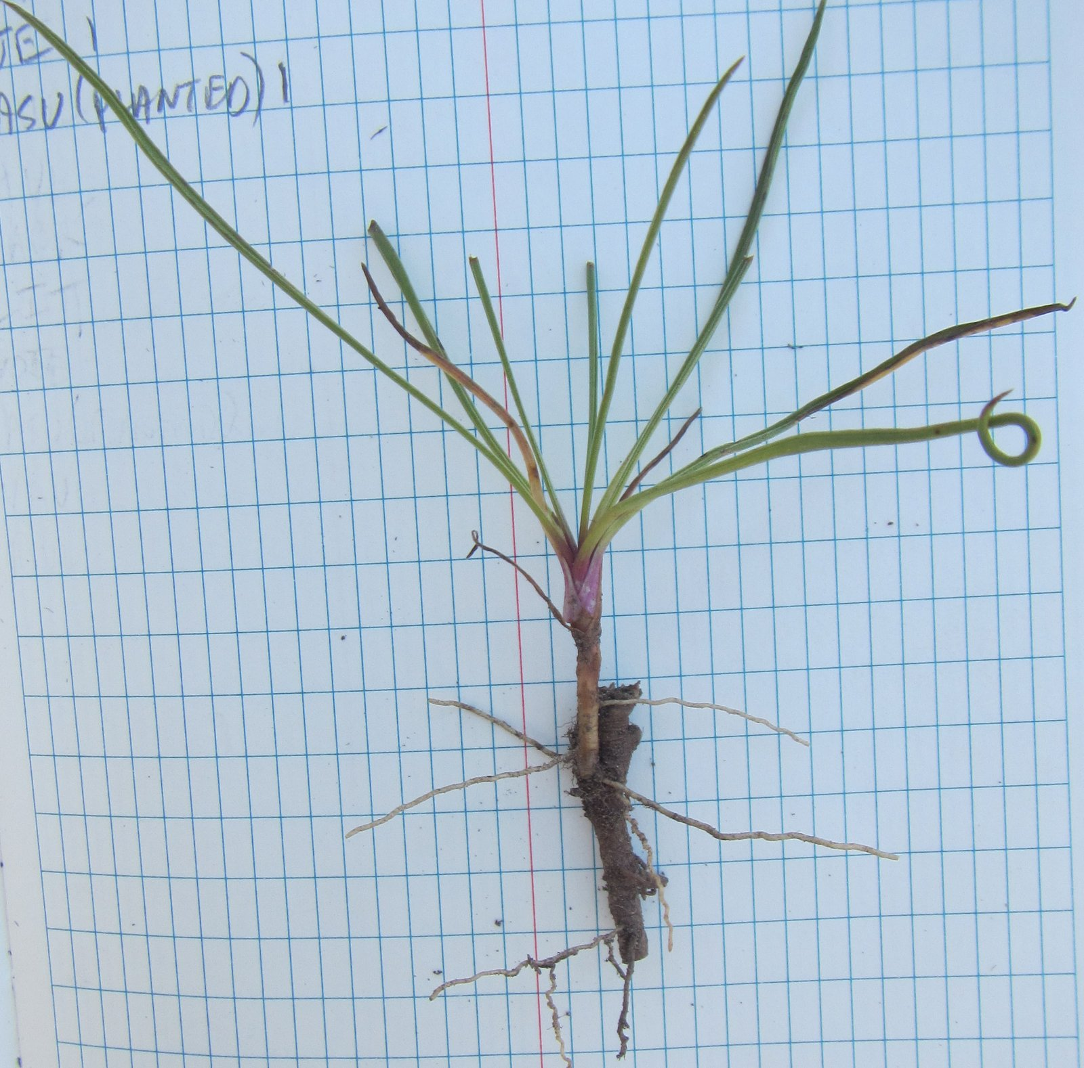
Natural field-collected Oreostemma alpigenum

Slide 18
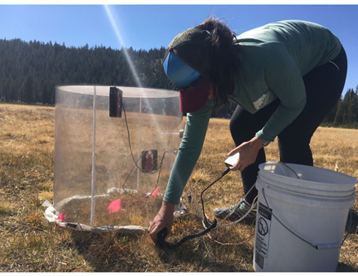
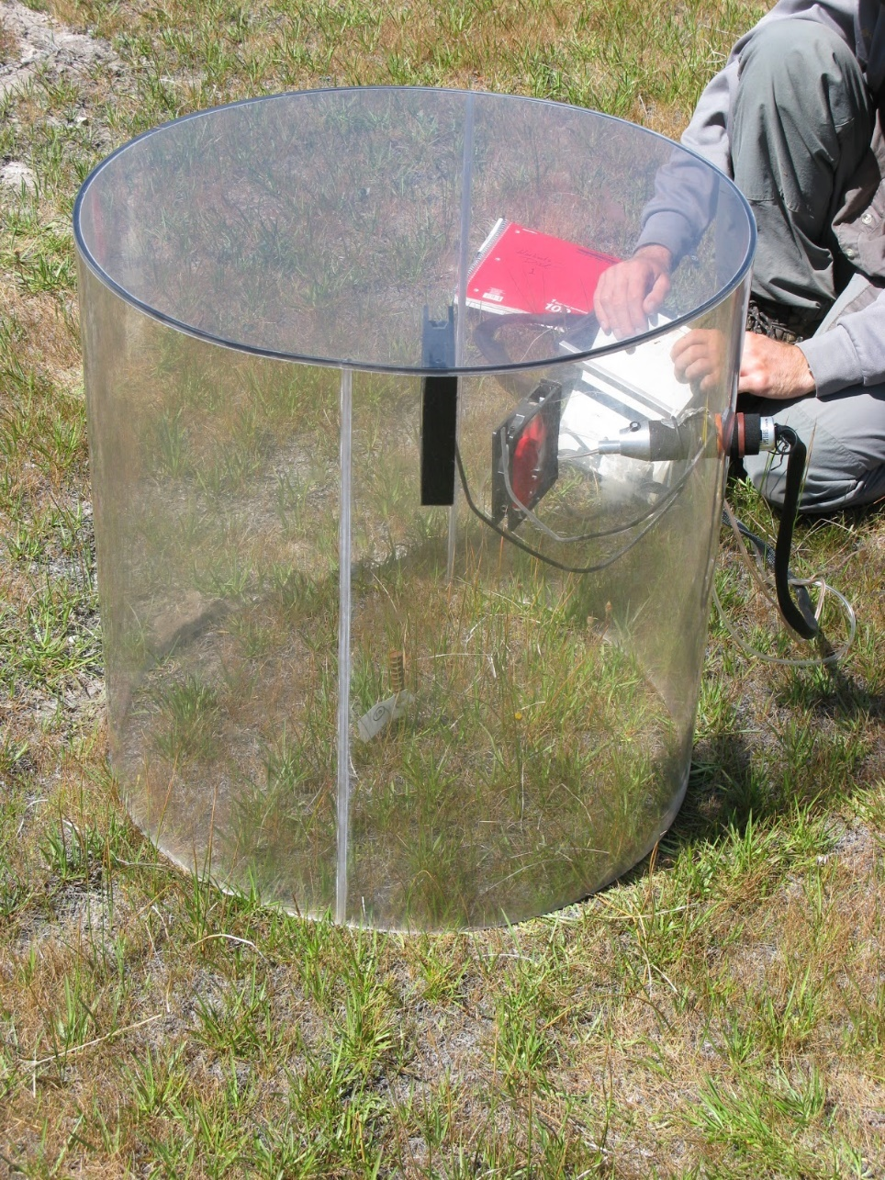
Carbon flux
Three rounds of measurements (105 plots, 210 measurements/round)
Measured soil moisture, soil temperature and CO₂ flux at all plots

Slide 19
Wet-block carbon flux

Slide 20
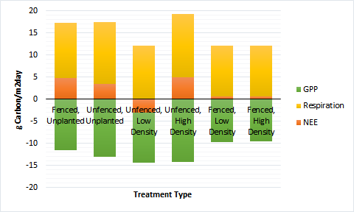
2016 peak-growing season carbon flux

Slide 21
2017 Requested Research Plan
Stratify Carex scopulorum seed for 60+ days (Started in early November)
Transfer seed to Cornflower Nursery to grow 60,000 seedlings
Hire professional crews to plant seedlings in late May or early June
Use existing plots with fences (2nd year seedlings)
Focus on data collection:
  Biweekly carbon flux measurements starting as soon as road opens, or earlier if possible
  Seedling survival and growth in height and area occupied
  Effects of herbivory, including quantifying rodent and deer activity
  Above and below ground biomass production

Slide 22
