Slide 1


Expected Changes in Flow Regime
Tuolumne River Flow
Shift from snow-dominated to rain-dominated flow regimes
Earlier timing of snowmelt
Larger winter floods
Longer dry season
Discharge (cms)
Oct
Jan
Mar
Jun
Sept
+ 0 ºC (baseline)
+ 4 ºC
+ 2 ºC
+ 6 ºC
Adapted from Young et al. 2009.; presented in Yarnell et al. 2010.
Notes:
Loss of snowpack and warming temps results in shifts in downstream river flows
Large shift from snow to rain at mid-elevations.
Larger winter floods that are more unpredictable (snowmelts slowly and predictably).
5-7 weeks earlier snowmelt/runoff (June to late April).
Longer dry season (start in June instead of August).

Slide 2
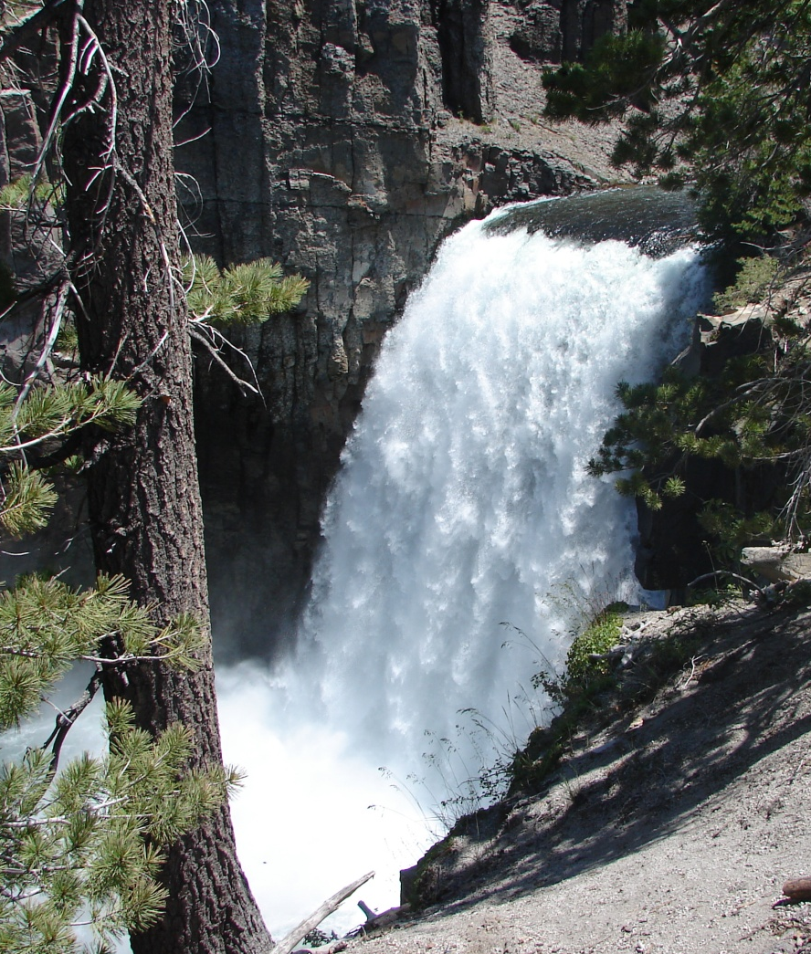
Spring Snowmelt Recession
Middle Fork San Joaquin
the physical, chemical and biological impact of this spring-time pulse of water is profound…
Yarnell, Viers, & Mount 2010 (BioScience)
a singular annual event where high resources are coupled with stable predictable flows, resulting in high biological productivity...
Yarnell, Viers, and Mount (2010) BioScience
Notes:
These shifts in the flow regime will be profound for native species.
In med-montane evnvirons with distinct annual wet and dry seasons, the spring snowmelt recession limb is a critically important part of the natural flow regime. Acting as a bridge between the abiotically stressful high flows of winter and the biologically stressful warm low flows of summer, the spring recession is the one time annually where flows are plentiful and predictable. Plays a large role in maintaining and creating stream diversity. Allows non-limiting habitat conditions to coincide with high resource availability, resulting in high reproductive success, growth rates, and survivorship.
Important to both geomorphic and ecological processes...
Montane ► bulk of the total annual discharge, often delivering more than 70% of annual streamflow
(Hauer et al. 1997).
Mediterranean-montane ► summer low flows dominate for up to six months of the year and at least 65% of annual precipitation falls in the three months of winter
(Gasith and Resh 1999).

Slide 3
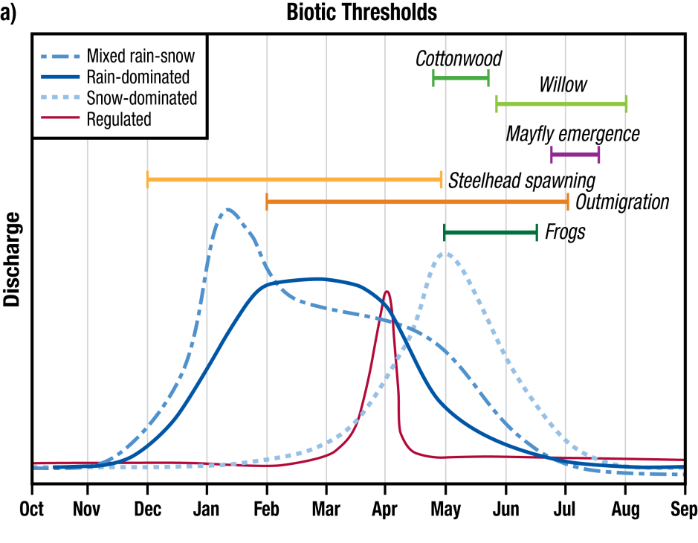

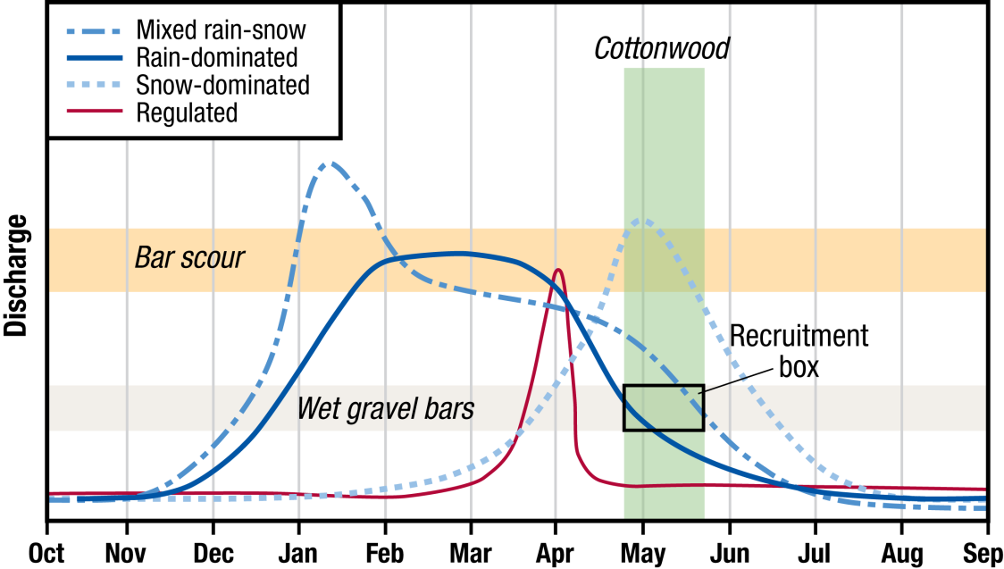
Yarnell, Viers, and Mount (2010) BioScience
Notes:
The flow regime provides ecological cues for native species adapted to the seasonal flood/drought cycles
Also provides disturbance and geomorphic work for the channel and habitat for native species
When considered in tandem through time, can see how the timing, magnitude and rate of change of flows create habitat and conditions necessary for native species success.

Slide 4
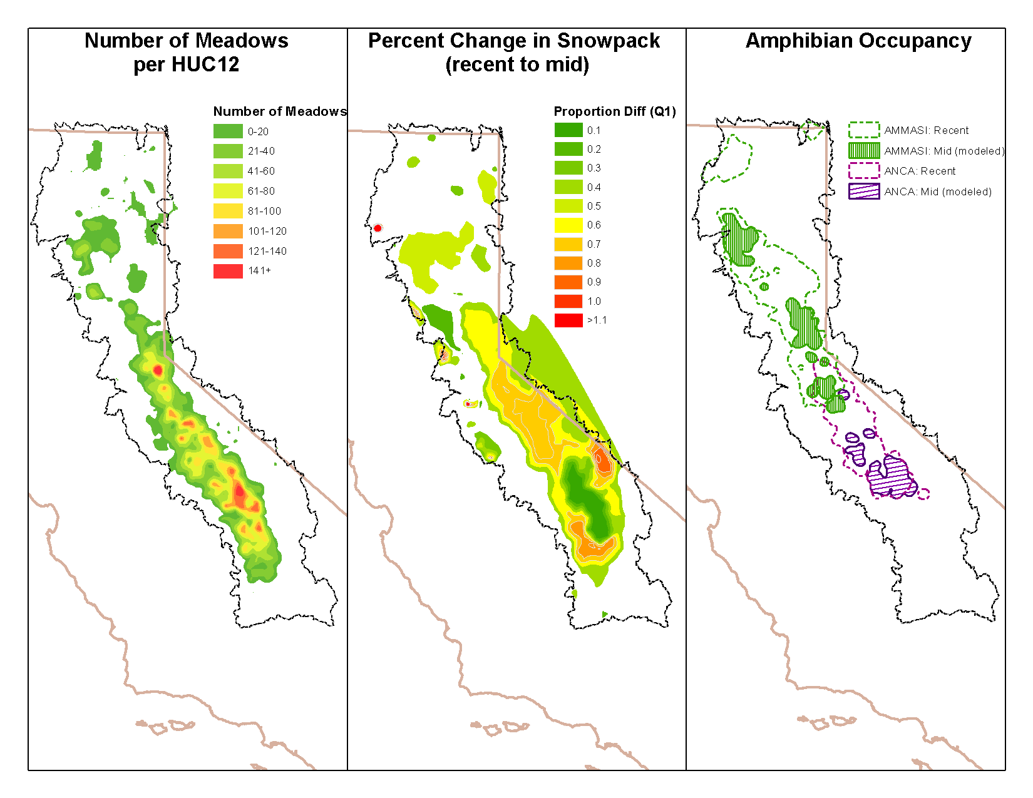
Examine climate warming on hydrology of meadows and amphibian spp distribution
Quantify changes in hydroclimate using BCM data
Spp distribution versus 60 hydroclimatic, 27 anthro/environmental variable
Final models used top 25 with highest relative influence on predictive outputs

Slide 5
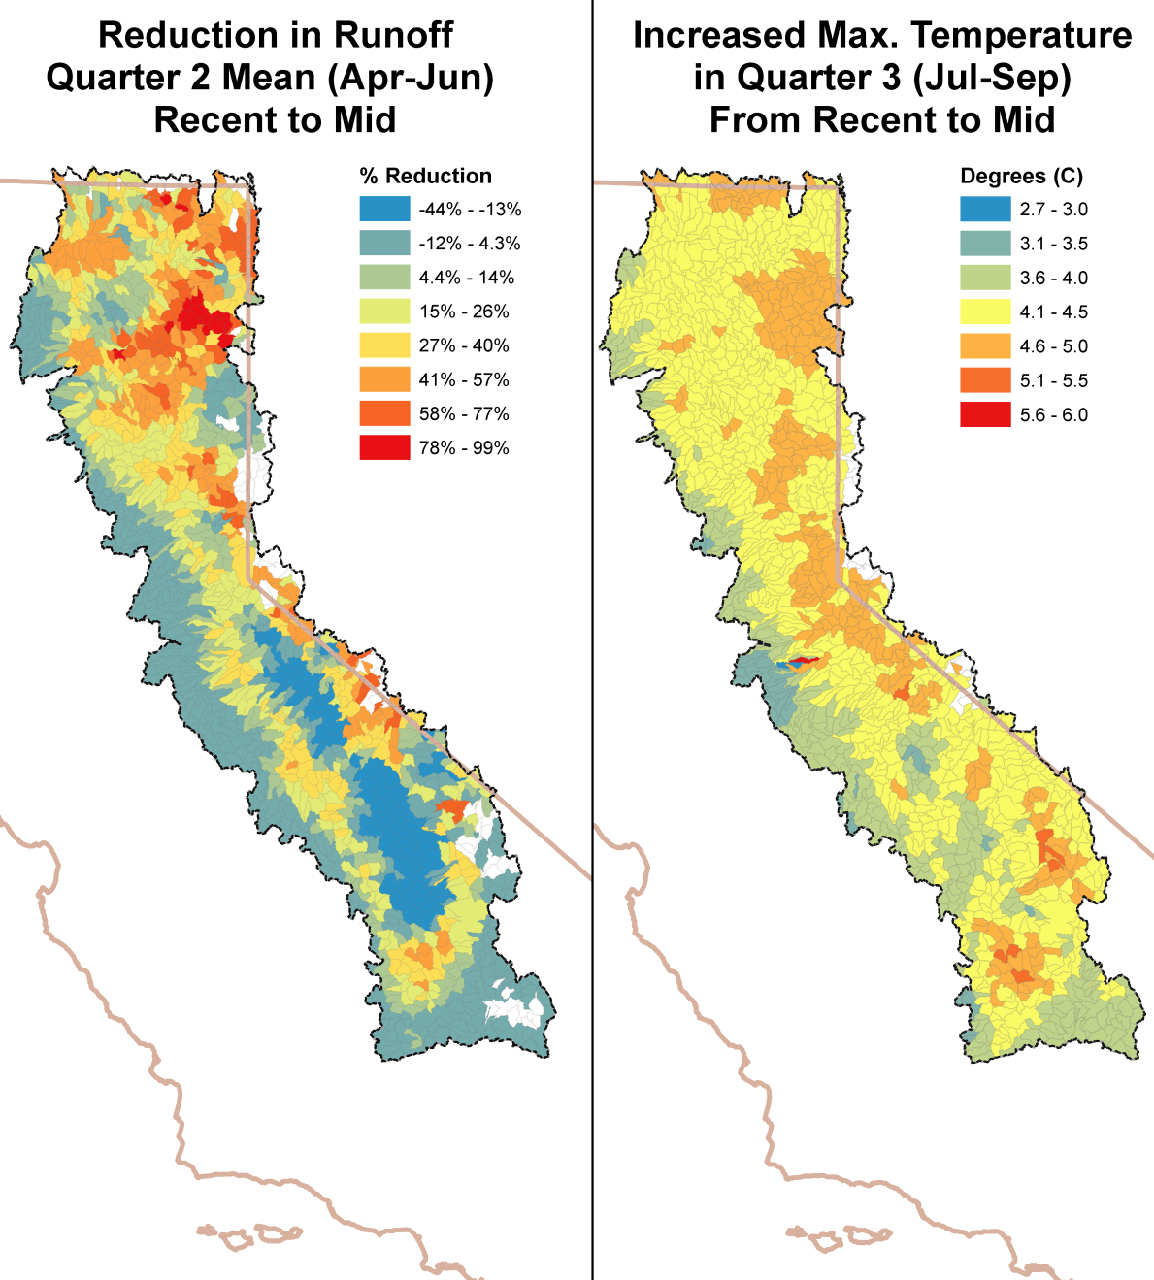
From Viers et al. 2013. Montane Meadows in the Sierra Nevada: Changing hydroclimatic conditions and concepts for vulunerability assessment.

Slide 6
Relative Influence on Amphibs
AMMASI | ANCA | RAMU | RASI | PSRE
pptQ2mean (11.1) | tmxQ3mean (20.9) | tmxQ1sd (31.2) | pckQ1mean (15.8) | domVegprcnt (9.3)
ElevMean (7.0) | pptQ2cv (10.9) | River Density (11.1) | pptQ2cv (10.1) | PrcntBrn100yr (8.9)
pckQ1mean (7.6) | runQ3mean (9.6) | pptQ2cv (9.2) | runQ2mean (9.7) | VegType (8.3)
River Density (5.8) | MdwCnt_H12 (4.5) | pckPrcntTotQ2 (3.7) | River Density (5.3) | MdwCnt_H12 (3.1)
runQ3mean (4.7) | River Density (1.1) | ElevMean (3.9) | ElevMean (4.9) | pckQ1mean (1.9)
MdwCnt_H12 (0.48) | ElevMean (1.1) | MdwCnt_H12 (0.6) | MdwCnt_H12 (1.5) | tmnQ3mean (1.7)

Slide 7
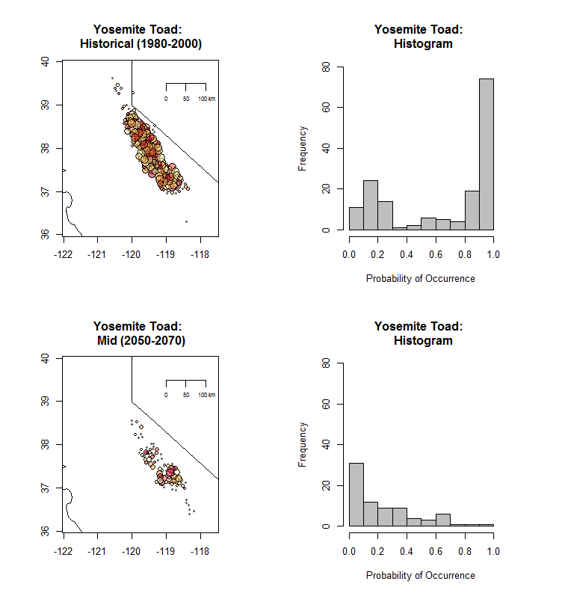
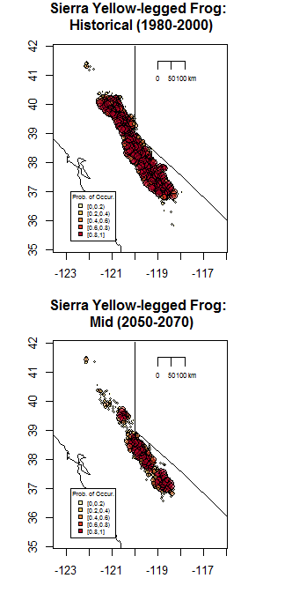

Slide 8
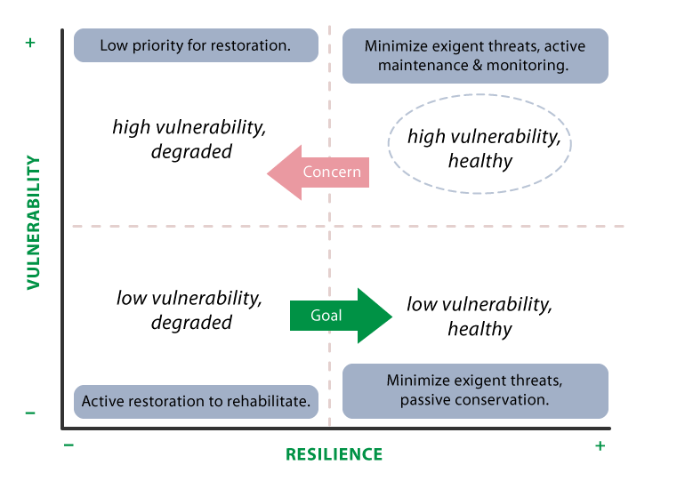
Viers et al. 2013.

