Slide 1
Sierra Meadows Partnership Prioritization Workgroup Update
Marian Vernon
SMP Annual Gathering
May 15, 2019

Slide 2
Purpose
Develop a tool that will provide a strategic, flexible approach for prioritizing meadows for restoration and protection
Point Blue secured funding from the SNC in 2018 to develop the tool by October 2019

Slide 3
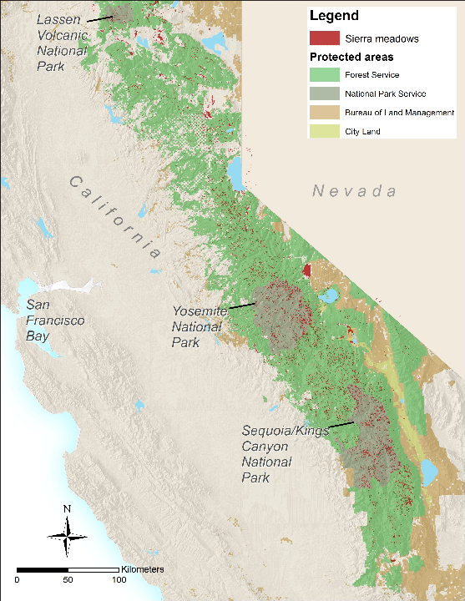
Tool Overview
Strategic, flexible approach for prioritizing meadows
Comprehensive database of the distribution of conservation values
Increase the pace, scale, and efficacy of meadow restoration to reach the SMP’s goal
Achieve multiple benefits: biodiversity, water, carbon storage, and climate resiliency
Notes:
No comprehensive database containing info about distribution of conservation values across SN meadows – roadblock

Slide 4
Prioritization Work Group Core Members
Marian Vernon, Point Blue Conservation Science
Rene Henery, Trout Unlimited
Jill-Marie Seymour, U.S. Fish and Wildlife Service
Kristen Wilson, The Nature Conservancy

Slide 5
Current Project Status
Prioritization tool database and draft user guide are COMPLETE!
Next step is to get it online
Working with UC Davis Center for Watershed Sciences to create tool interface through the Meadows Clearinghouse website
Target date for tool to go live is October 2019
Notes:
Seeking $10k in additional funding…may or may not mention this

Slide 6
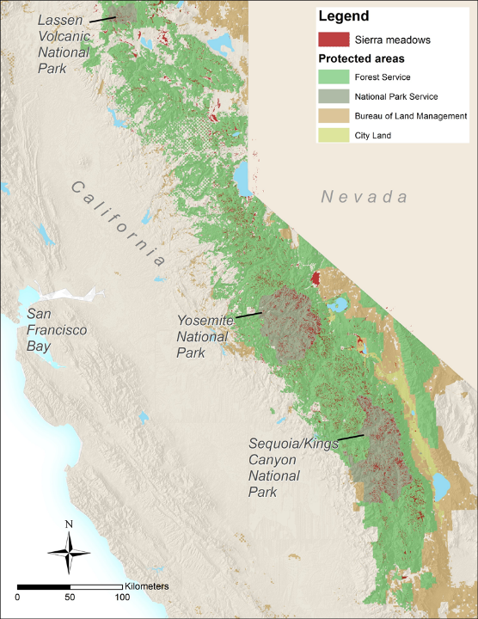
How it will work
User selects the desired scale/region of interest as well as their priority conservation targets
Tool will provide .csv spreadsheet for each conservation target with data for the meadows in selected region to inform decision-making
Consult user guide for information on data sources, suggested scoring, and how to use the data in decision-making

Slide 7
Tool Conceptual Model
Ecosystem Targets
Carbon Storage
Climate Vulnerability
Climate Refugia
Hydrological Importance
Landscape-Level Significance
Water Quality
Biodiversity Targets
Target amphibian, bird, and fish species
Meadow climate decision framework
Notes:
24 total targets
For climate vulnerability – going to include Shana’s DF tool instead

Slide 8
Preliminary Results
Used the tool and AR Scorecard meadow condition data to prioritize 90 meadows for restoration in Lassen National Forest
Used the tool to prioritize 70 privately owned meadows for a strategic conservation assessment with Feather River LT
Notes:
Working with Luke Hunt, Kristen Wilson and LNF staff
GC07

Slide 9
How to get involved
Assist with tool sensitivity and data validation
Pilot tool for meadow prioritization processes
Provide feedback on tool utility, sensitivity, validation
Notes:
24 total targets

Slide 10
Thank You and Q&A
Marian Vernon, mvernon@pointblue.org
Special thanks to the Sierra Nevada Conservancy for
funding this work.
Thank you and Questions
For more information:
Marian Vernon, mvernon@pointblue.org
Special thanks to the Sierra Nevada Conservancy for funding this project

