Slide 1
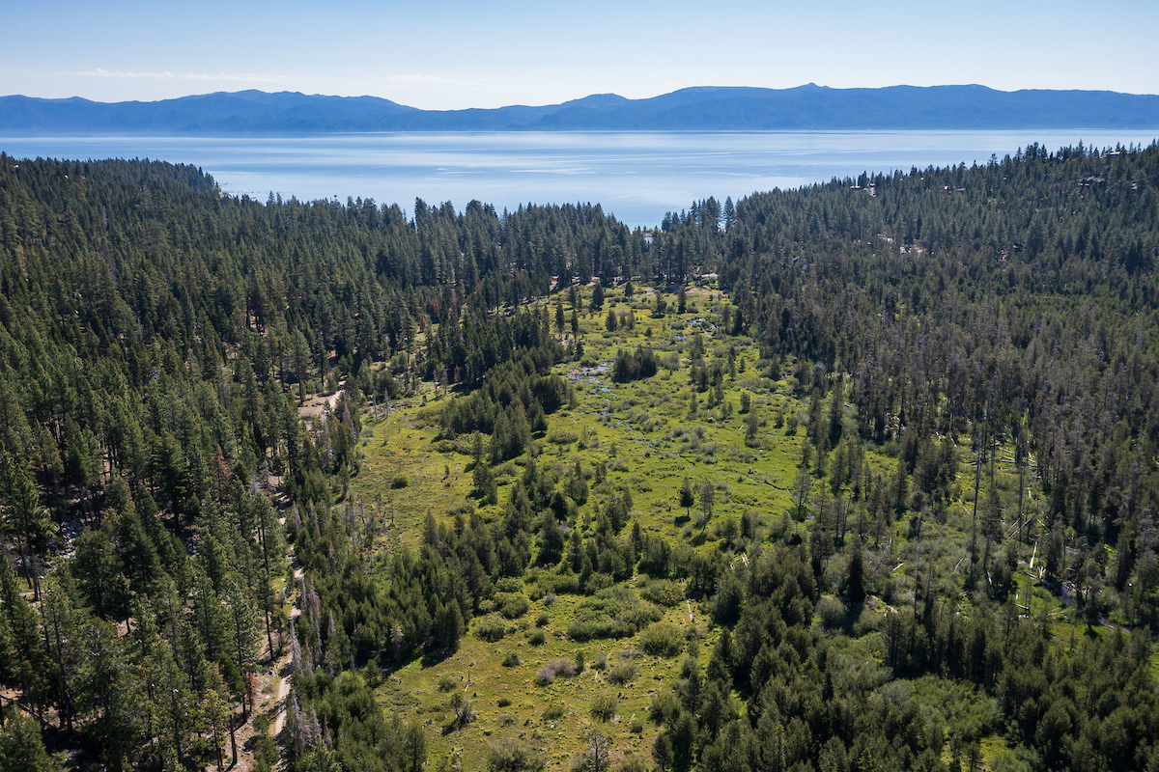
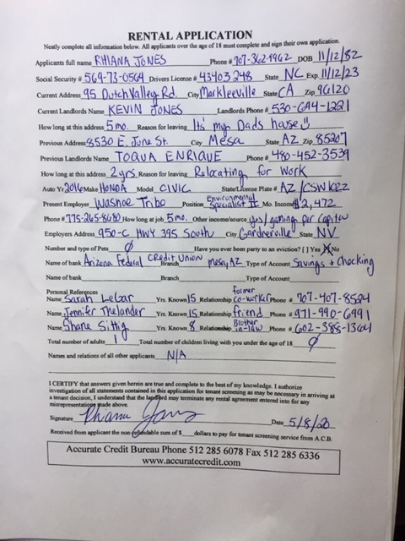
MaɁyála Wàťa Restoration Project
Washoe Tribe of Nevada and California
Washoe Environmental Protection Department
Rhiana Jones, Environmental Specialist II

Slide 2
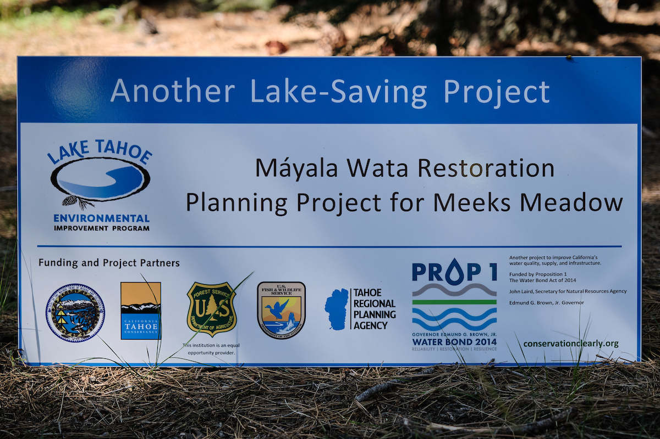

Slide 3
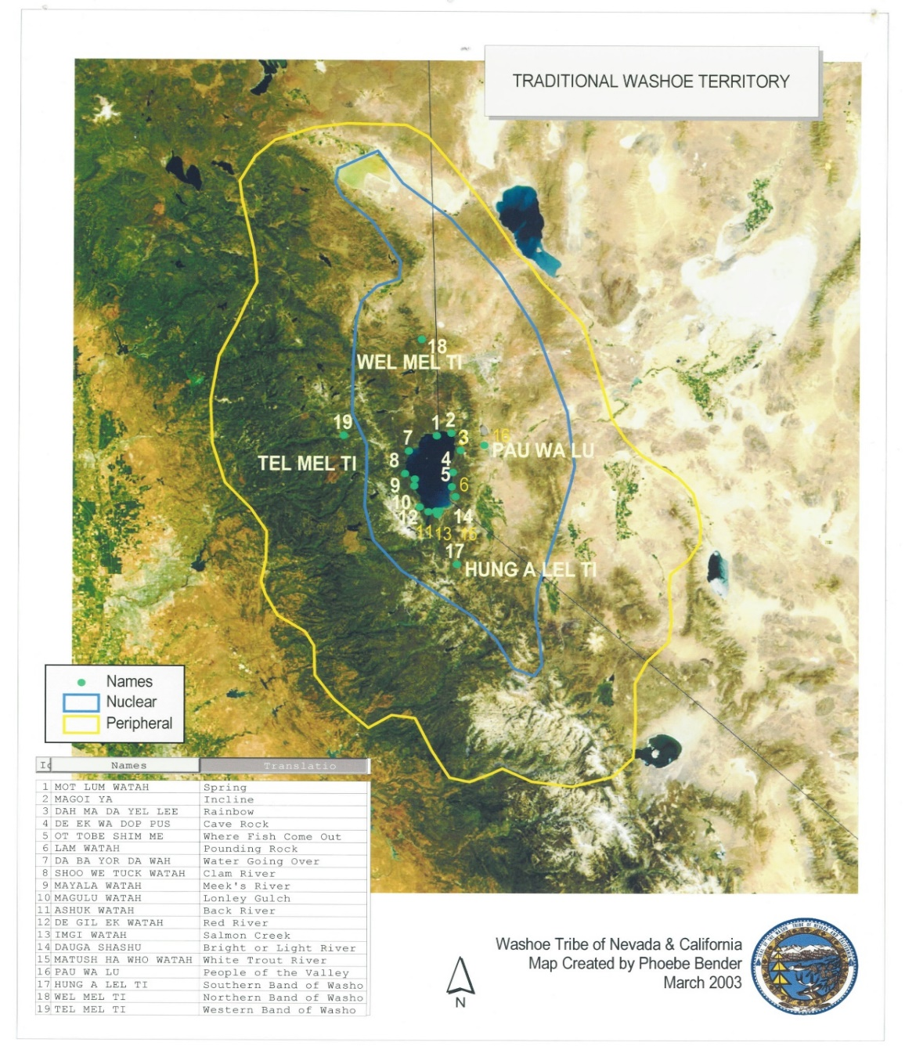
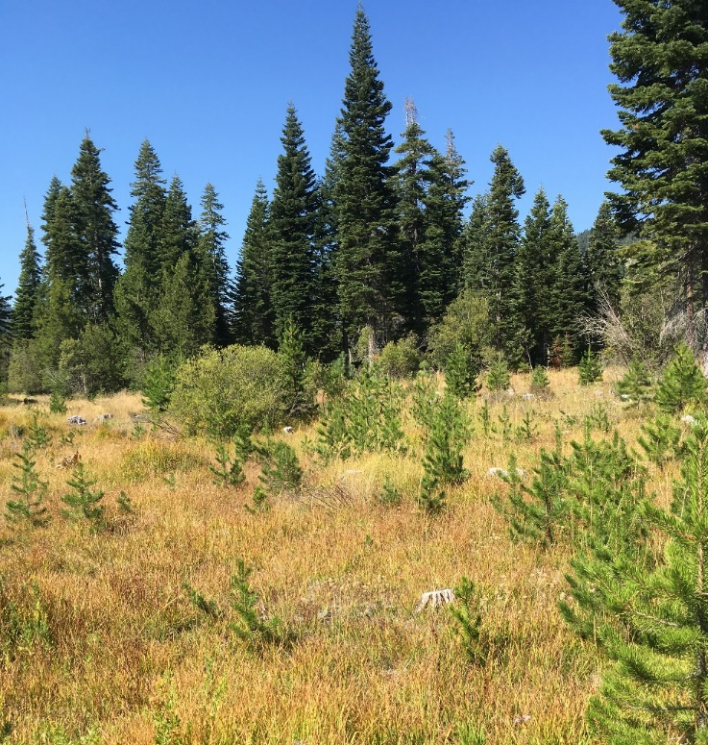
Where is Meeks Meadow?
Dáʔaw (Lake Tahoe) is the center of the wašíˑšiw ʔítde (Washoe homelands)

Slide 4
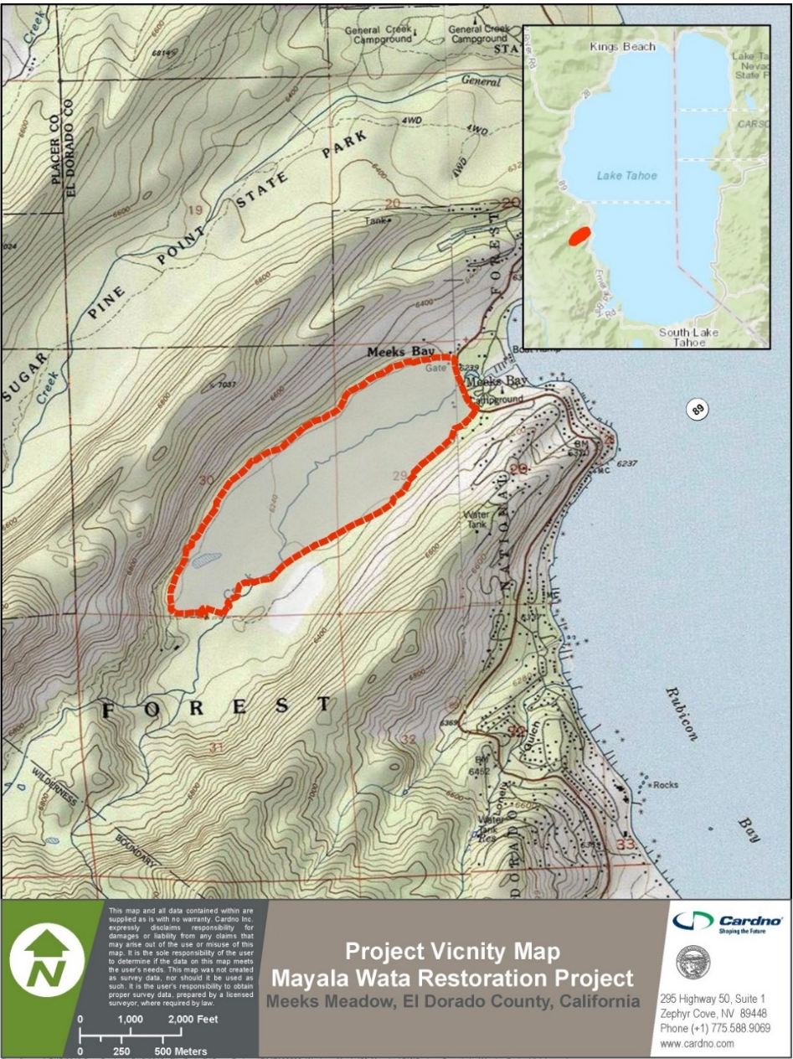
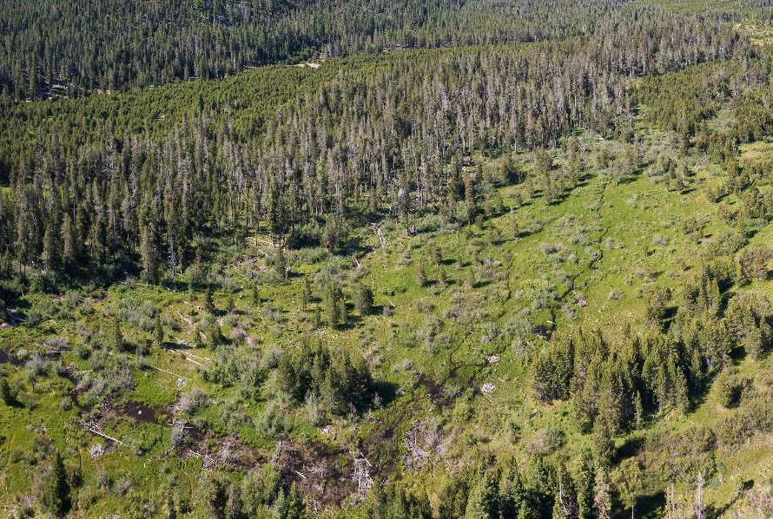
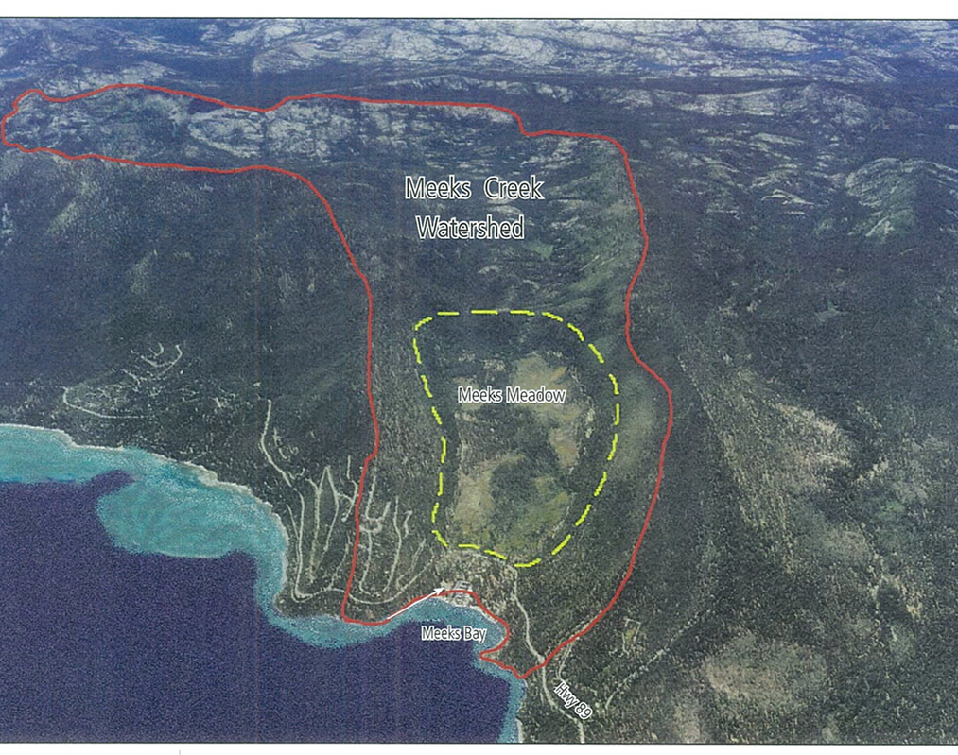
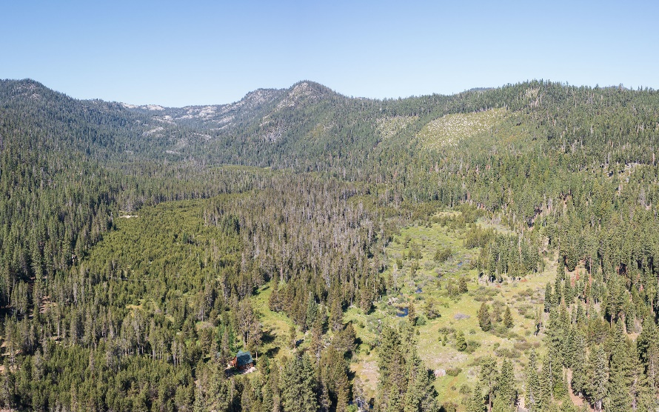
Where is Meeks Meadow?
MaɁyála Wàťa is the wá:šiw name for Meeks Creek and the surrounding area, the meadow and the bay

Slide 5
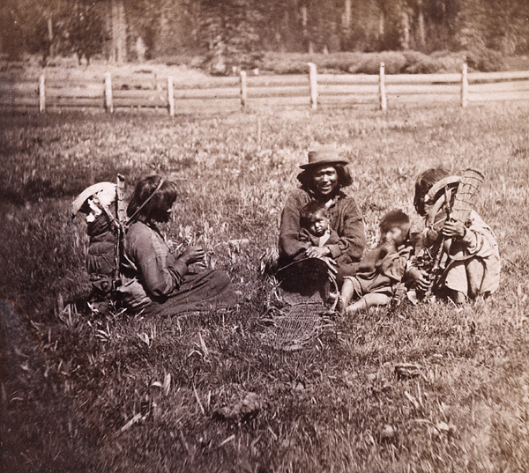
Importance of including Indigenous knowledge systems in land management
Allows for the Tribe to manage aboriginal lands in a historical and cultural manner
Including the Washoe community in restoration work days instills a sense of responsibility, belonging, and stewardship of the traditional Washoe Homelands
This project serves as template for increased Tribal involvement in the Lake Tahoe Basin, working collaboratively with federal, state, and local agencies

Slide 6
Washoe Presence in Meeks Meadow
Washoe management of Meeks Meadow included activities such as, pruning, thinning, and periodic burning to keep the meadow open and encourage desirable vegetation.
The Tahoe Basin is an extension of the Washoe people. Meeks Meadow provided the Washoe with food, medicine, and basketry material.
1850-1870’s: European-American arrived in the Tahoe Basin and began using Meeks Meadow for grazing. The Washoe population was displaced as there was less availability of land use and resources.
1880’s: Logging in the Basin began. Logging was followed by erosion, dense forest regrowth, and native meadow vegetation was displaced.
1928: Meeks Bay was developed as a resort. The present Highway 89 bridge was constructed.
1930’s: Washoe people were relocated to designated reservations, and denied access to traditional lands and practices at Lake Tahoe.
1930-1970’s: Without Washoe presence in the meadow, continued fire suppression, conifer invasion of the meadow increases, reducing native meadow vegetation, wildlife habitat, and changing meadow hydrology.
1960: The mouth of Meeks Creek was dredged to create a marina and wetlands were filled.
1980-1990’s: Conifer invasion of Meeks meadow continues, despite attempts by the USFS to remove trees. A slash pile burn burned a large part of the meadow in 1995, but conifer invasion continued.
1998: LTBMU and Washoe Tribe sign MOA regarding the operation of Meeks Bay and the co-management of Meeks Meadow.
2000’s: The Washoe Tribe’s continued involvement with the bay and meadow, has resulted in conifer removal test plots, plant surveys, and monitoring.
2010’s: LTBMU begins planning efforts for a major conifer removal and prescribed burn at Meeks Meadow (in line with Washoe traditional practices).
2016: The Washoe Tribe receives Federal and State funding to complete planning for the implementation of Meeks Meadow restoration project.
Present

Slide 7
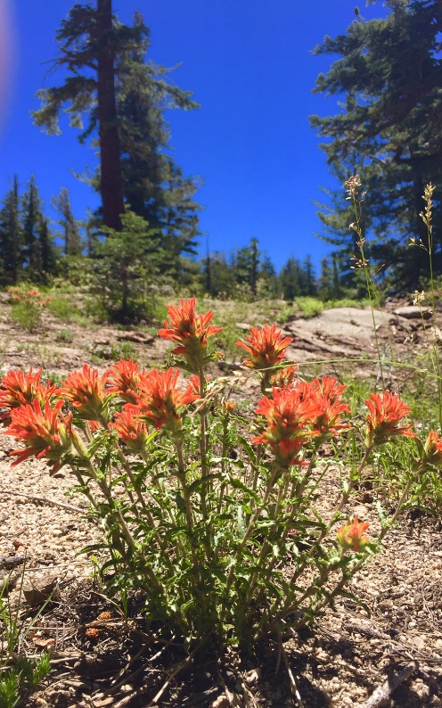
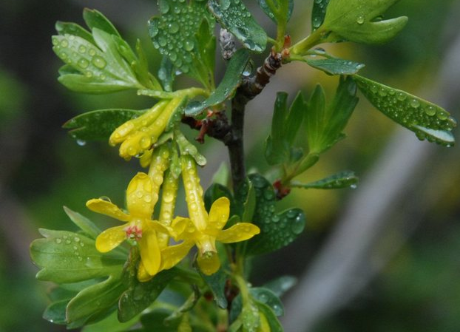
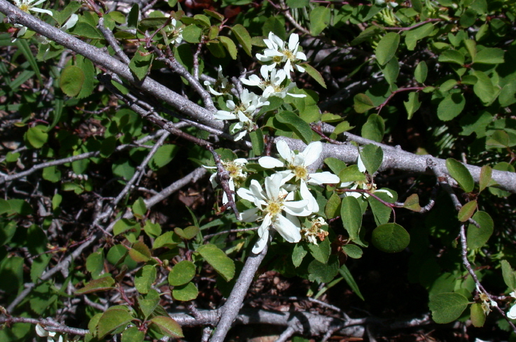
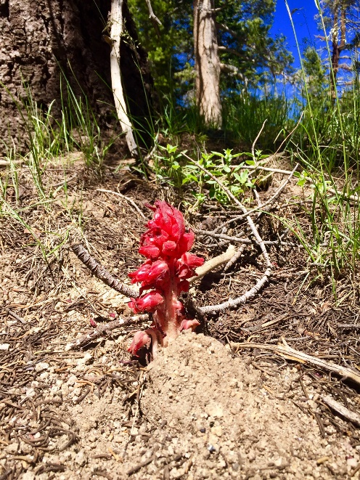
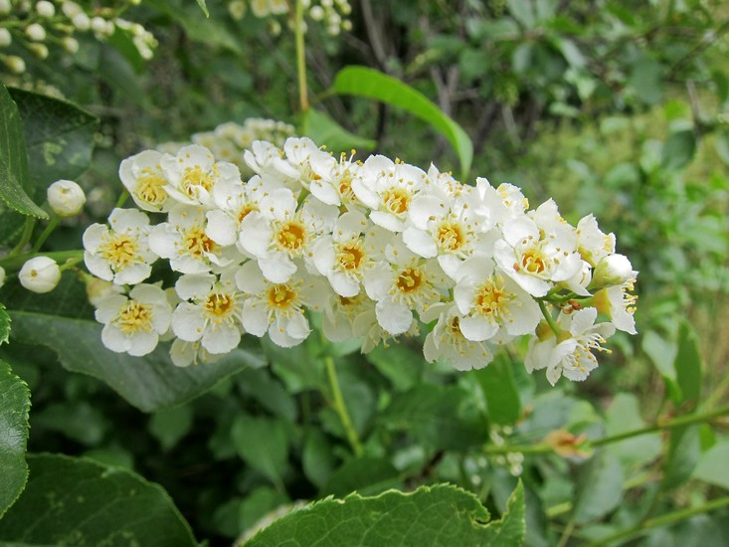
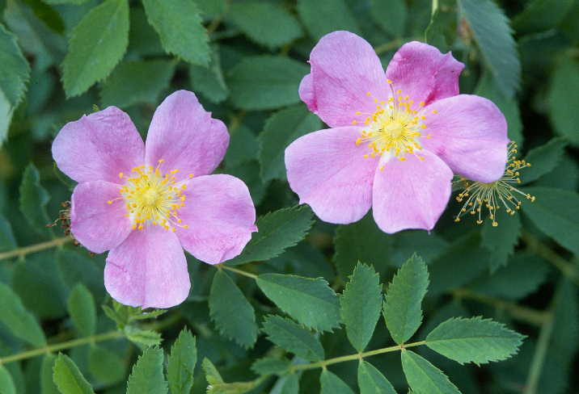
Washoe Native Plants
Nanolwaʔ (nan-hole-wah)
Golden current (Ribes aureum)
Šuwetɨk (shu-wet-uk)
Serviceberry (Amelanchier alnifolia)
Ćamdu (tz-ahm-do)
Chokecherry
(Prunus virginiana)
Ćamdu (tz-ahm-do)
Chokecherry (Prunus virginiana)
Pećumeliʔ (petz-umel-eeh)
Woods rose (Rosa woodsii)

Slide 8
10 Culturally Significant Plants of Focus
Scientific Name | Washoe Name | Common Name | Meeks Meadow Vegetation Community | Cultural Management Techniques
millefolium | wemšiɁ | yarrow | mixed conifer forest (dry meadow understory), wet meadow, dry meadow | Cultural burning, collection, planting, seeding
Allium sp. | bošdi | wild onion | mixed riparian scrub, wet meadow, dry meadow | Cultural burning, collection, planting, tilling, digging
Alnus incana | sidumim | mountain alder | mixed riparian scrub | Collection, trimming, planting
Fragaria virginiana | mu·Ɂaluŋi | mountain strawberry | wet meadow, dry meadow | Cultural burning, collection, planting, tilling, digging
Pteridium aquilinum | megi·geš | bracken fern | mixed conifer forest (dry meadow understory), mixed conifer forest (mixed conifer understory) | Cultural burning, collection, tilling, digging
Salix sp. | himu | willow | mixed riparian scrub, wet meadow | Collection, trimming, planting
Calocedrus decurrens | ɁitmahawaɁAchillea | incense cedar | mixed conifer forest (dry meadow understory), mixed conifer forest (mixed conifer understory) | Cultural burning, collection, seeding
Sambucus sp. | ba·duɁ | elderberry | mixed conifer forest (mixed conifer understory), mixed riparian scrub | Collection, trimming, planting
Sarcodes sanguinea | geweɁmukuš | snow plant | mixed conifer forest (dry meadow understory), mixed conifer forest (mixed conifer understory) | Cultural burning, collection, tilling, digging
Rosa woodsii | pećumeliɁ | Woods’ rose | mixed conifer forest (mixed conifer understory), mixed riparian scrub | Collection, trimming, planting

Slide 9
Keys to success and lessons learned
Communication and outreach with the public, community, and federal, state, and environmental agencies is crucial.
Intergenerational Knowledge and skill transfer, involvement of Elders in decision making and teaching youth about traditional practices
Incorporating language, education and culture to restore lands that are no longer functioning in a traditional capacity helps serve in cultural revitalization for the aboriginal inhabitants of the area.

Slide 10
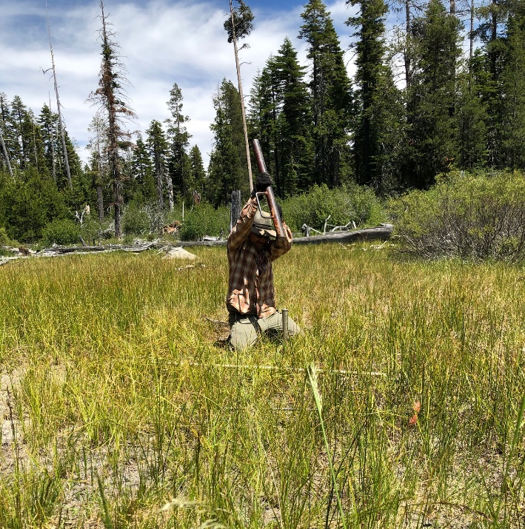
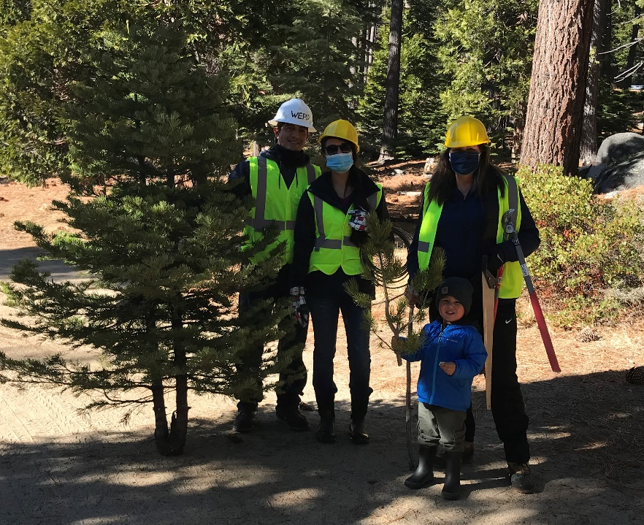
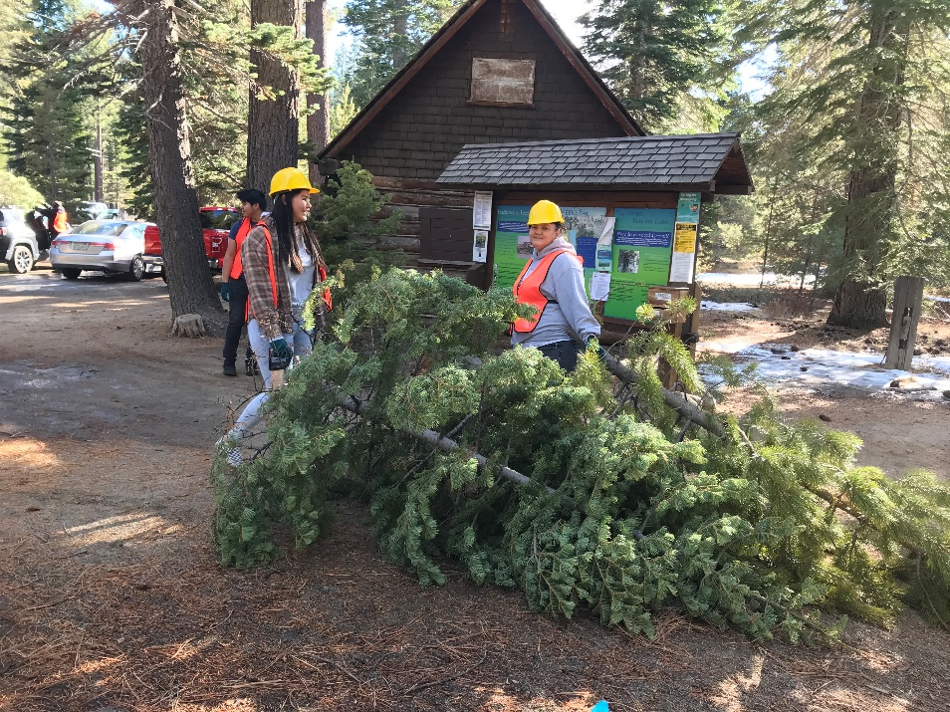
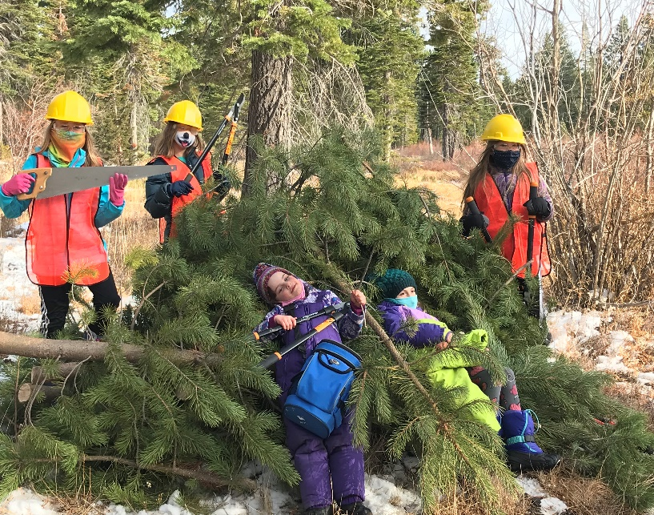
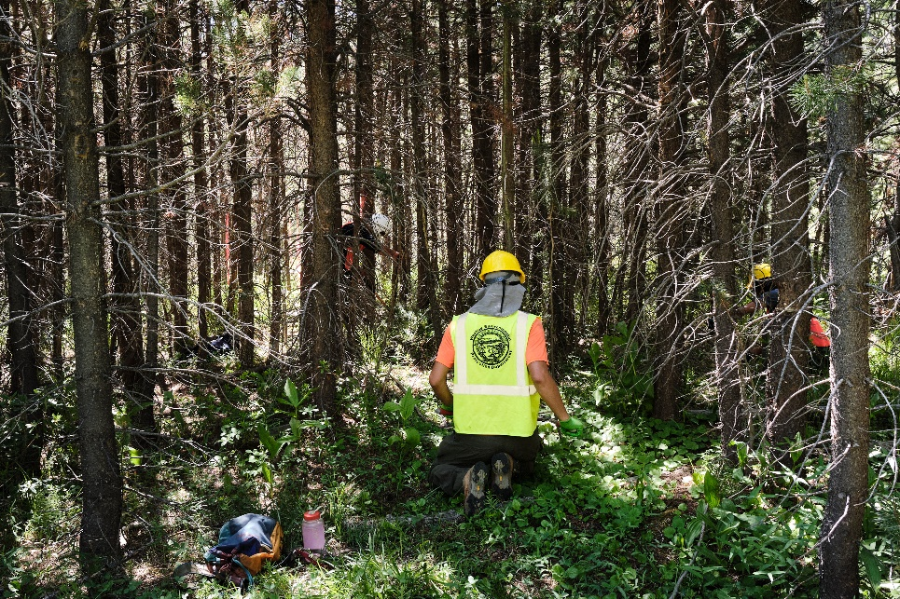
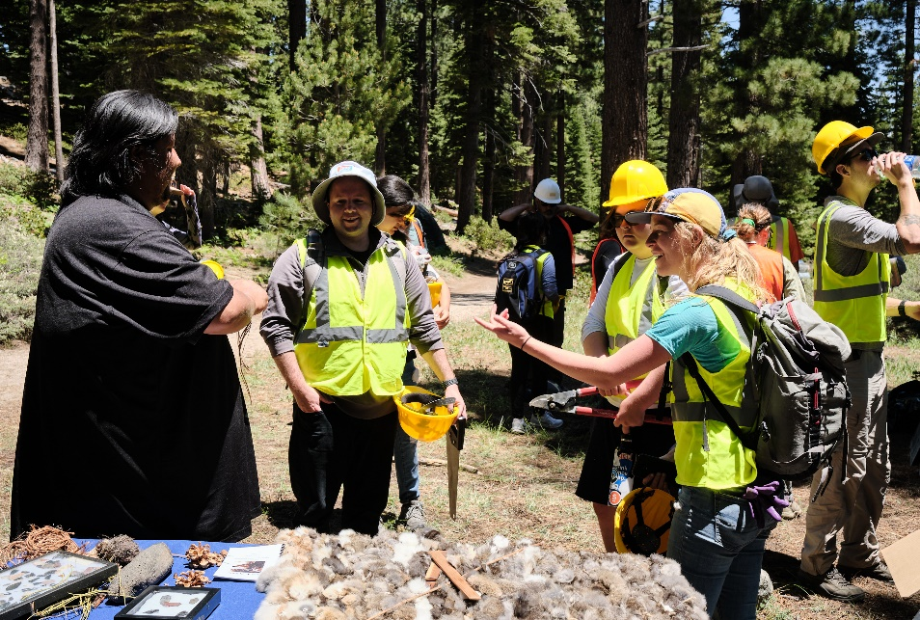

Slide 11
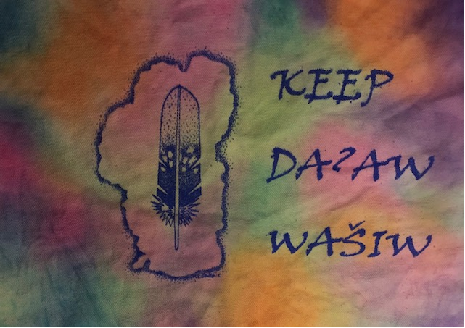
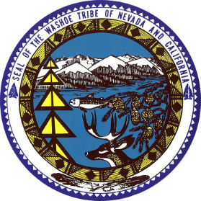


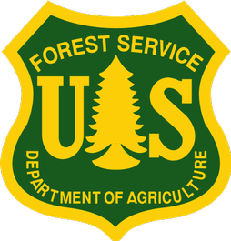




Acknowledgements
Photo credit to John Peliter Photography
Wes Kitlasten, PhD
Shana Gross, MS
Washoe Environmental Protection Department (WEPD)
Washoe Tribe of Nevada and California
United States Forest Service (USFS)
Lake Tahoe Basin Management Unit (LTBMU)
Tahoe Regional Planning Agency (TRPA)
CARDNO INC.
National Fish and Wildlife Foundation (NFWF)
California Tahoe Conservancy (CTC)
Calflora.com
Swanson Hydrology and Geomorphology
https://www.kunr.org/post/washoe-fishing-camps-lake-tahoe#stream/0
https://calisphere.org/item/ark:/13030/kt5s20178k/

Slide 12
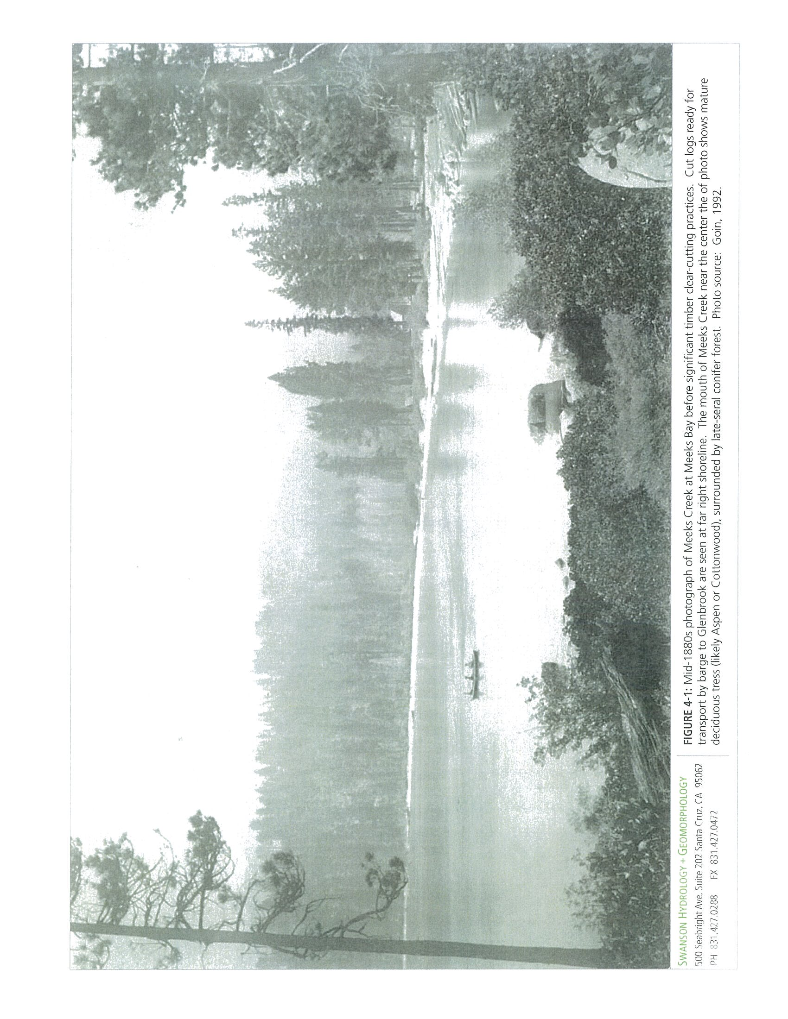
Questions?
Meeks Bay, 1880’s

