Slide 1
2017 Calistoga Sierra Meadows Workshop February, 2017
Mountain Meadows
Restoration Project
Jim Wilcox, Project Manager
Plumas Corporation
Website: www.plumascorporation.org
Email: jim@plumascorporation.org

Slide 3
Upper Goodrich Creek-
2 channels- East Fork & West Fork
5,990’ of gully fill (near complete fill)
72 acres of restored meadow function
Greenville Creek-
2 channels- Greenville Creek & Stroing Creek
7,967’ of gully (pond & plug)
181 acres of restored meadow function

Slide 5
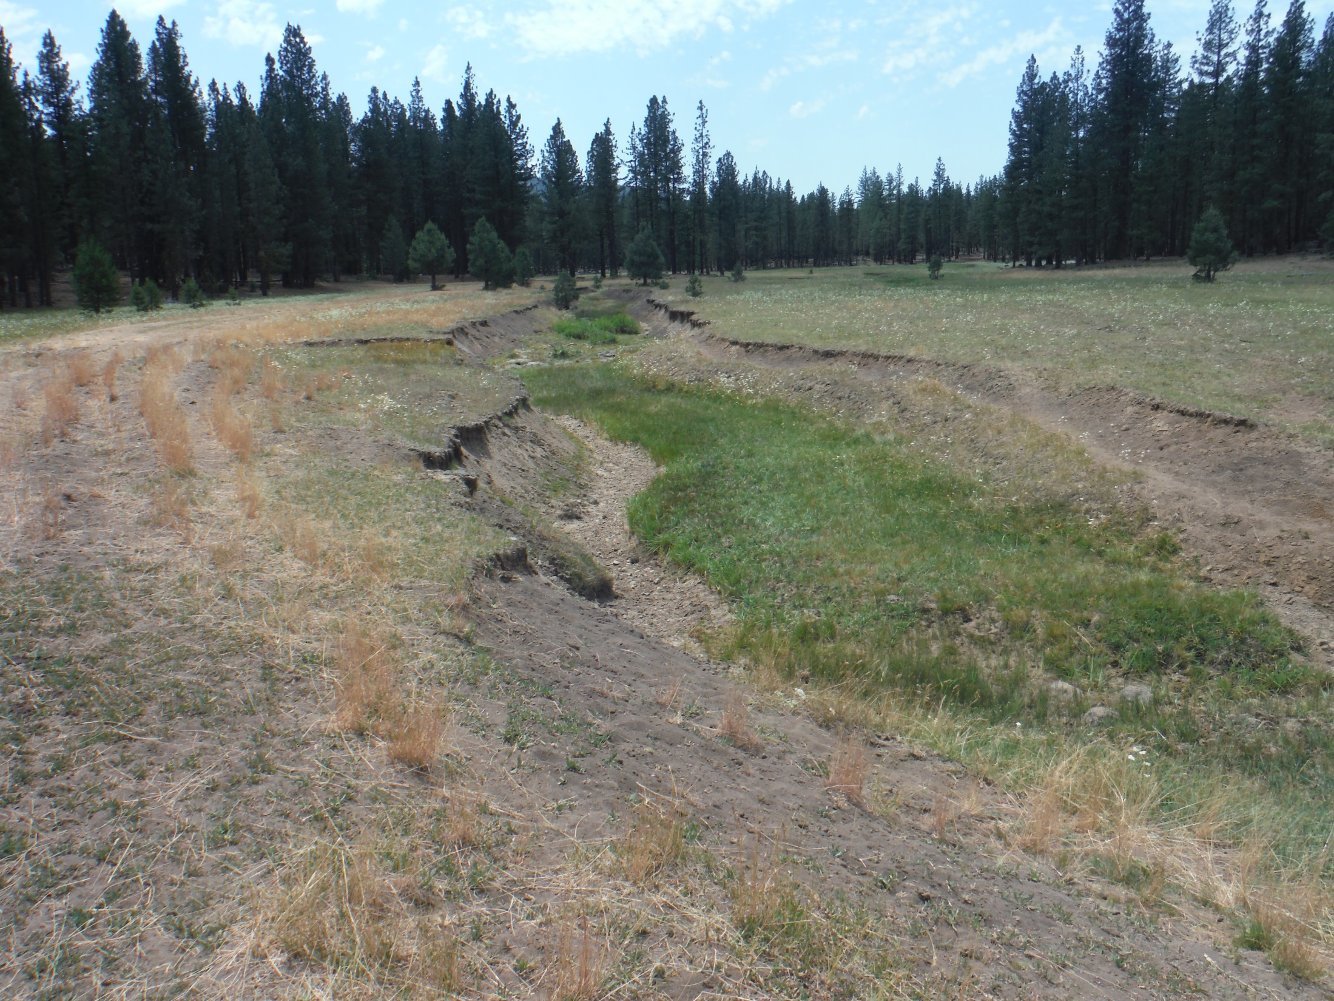
Upper Goodrich @ confluence, pre-project- 7/2015

Slide 6
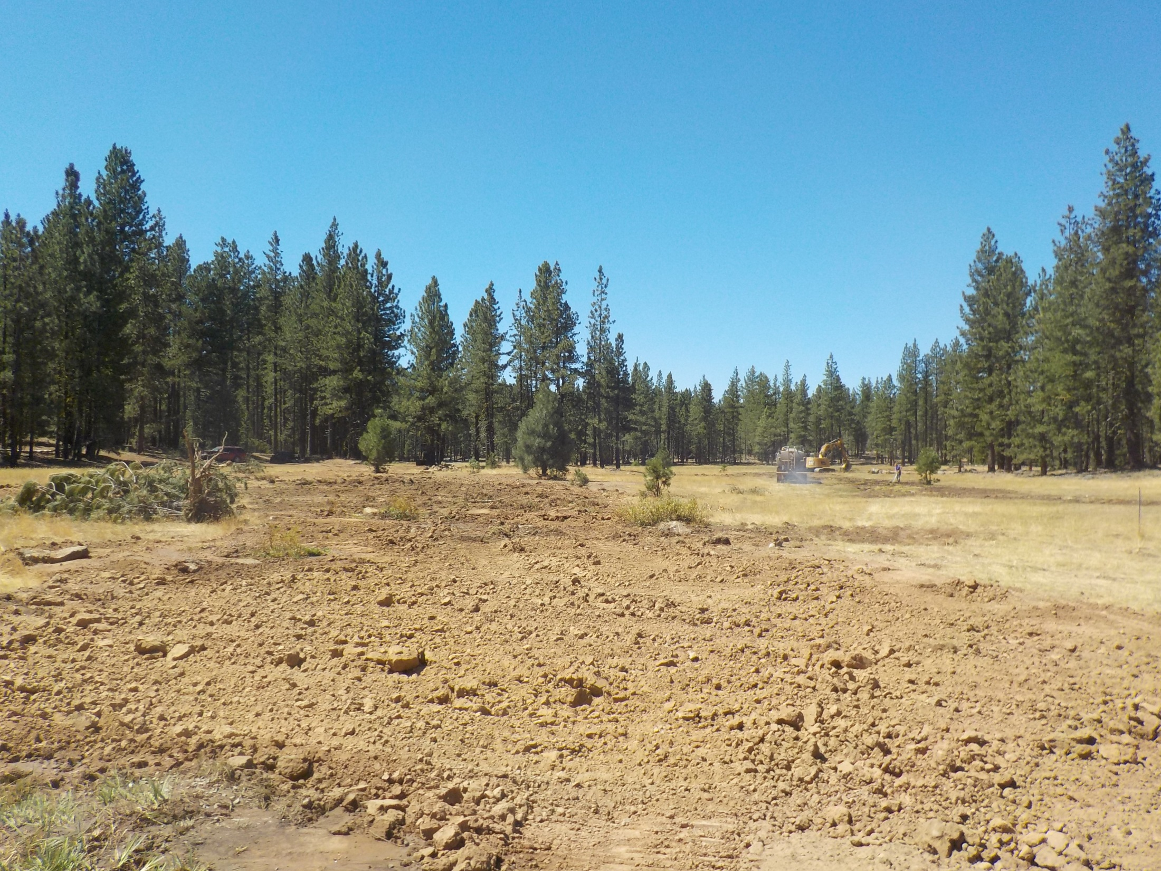
Upper Goodrich @ confluence, post project- 8/2016

Slide 7
Upper Goodrich @ confluence, post project- 12/2016

Slide 8
Upper Goodrich floodplain function, post project- 12/2016

Slide 10
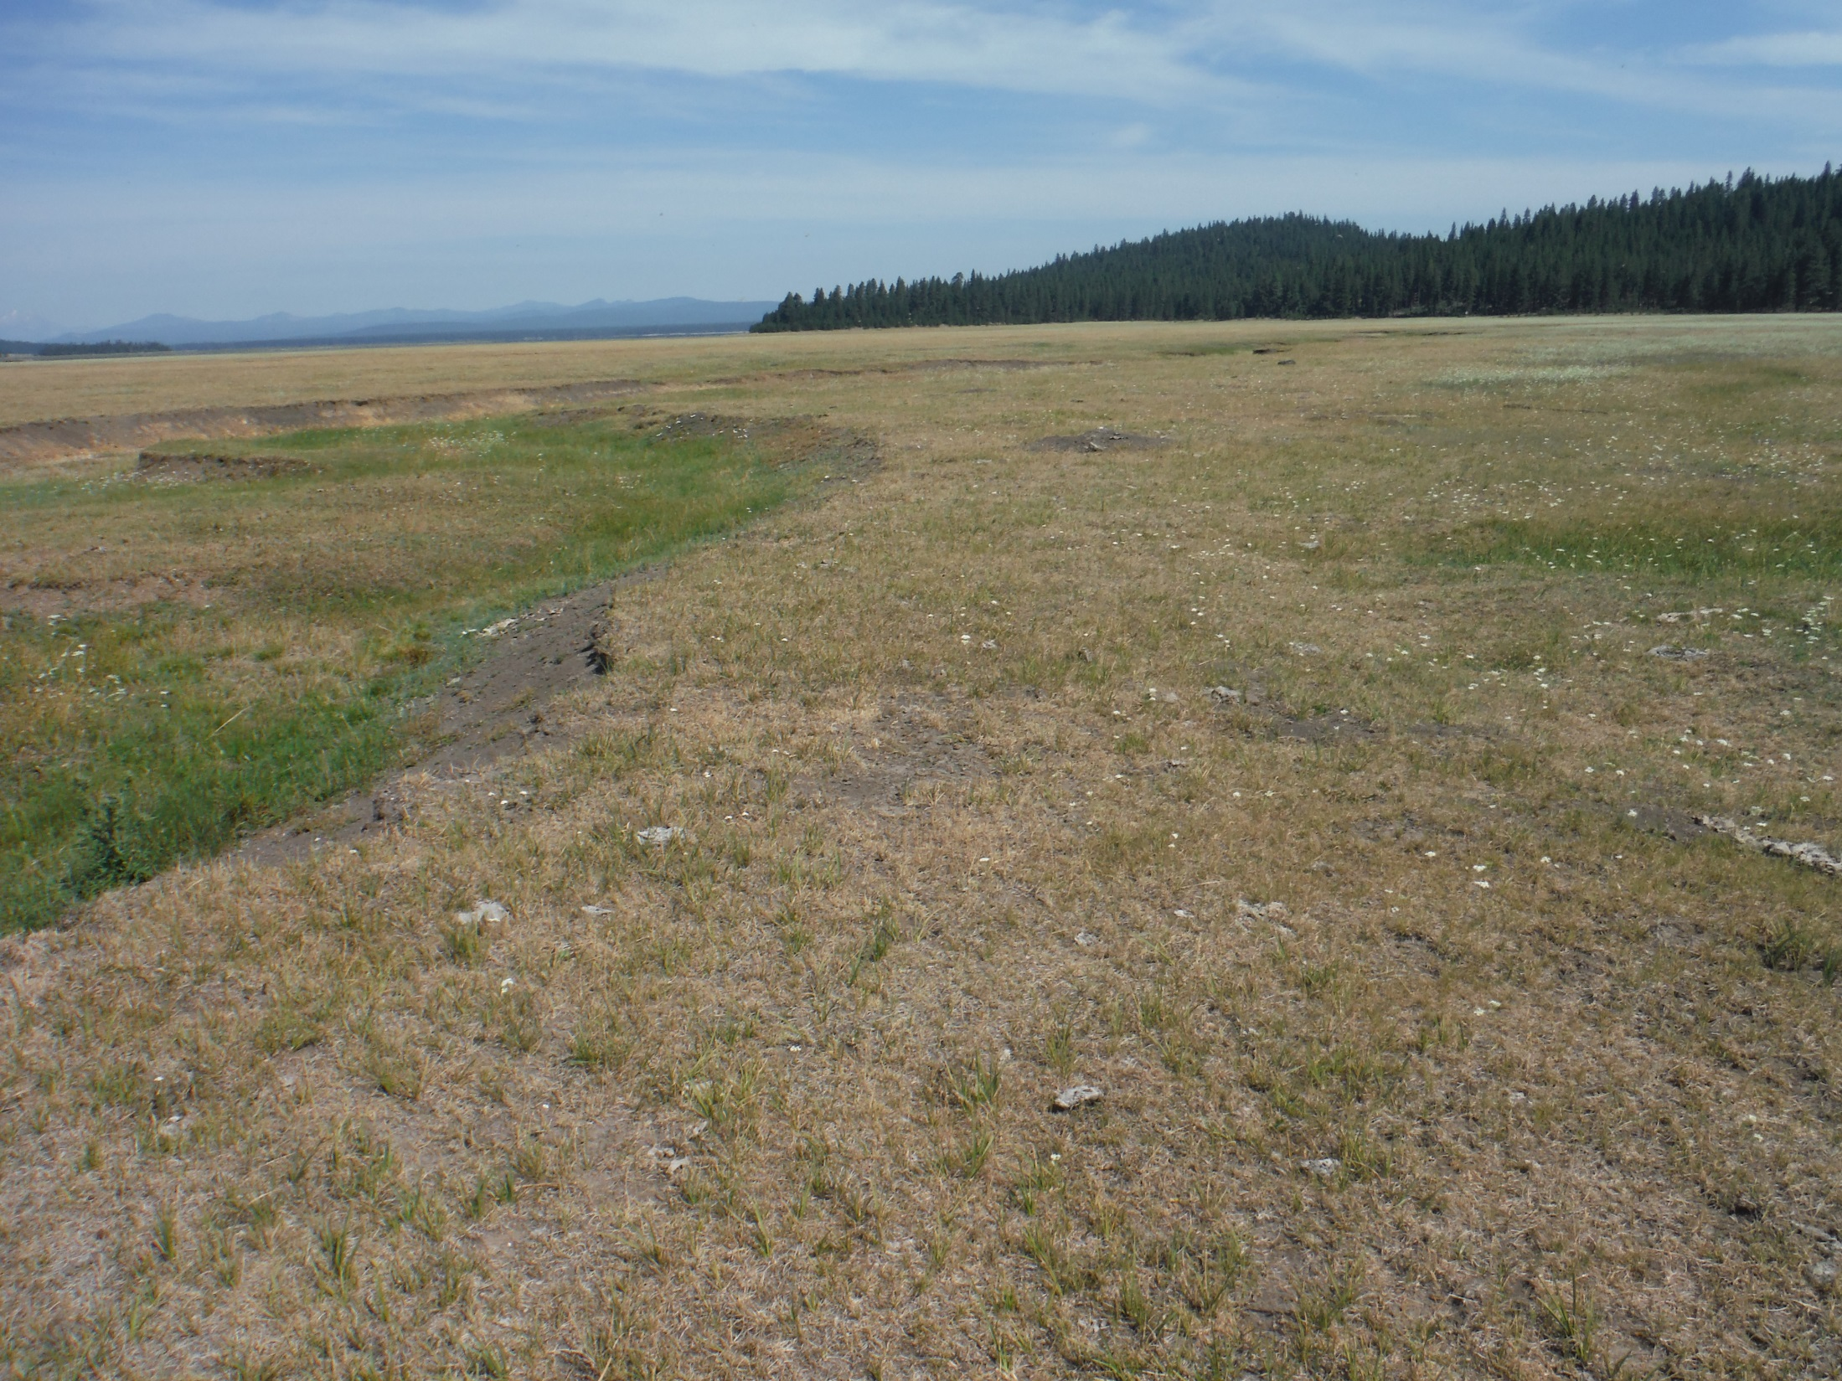
Greenville Creek Project, Stroing Creek remnant, pre-project- 7/2015

Slide 11
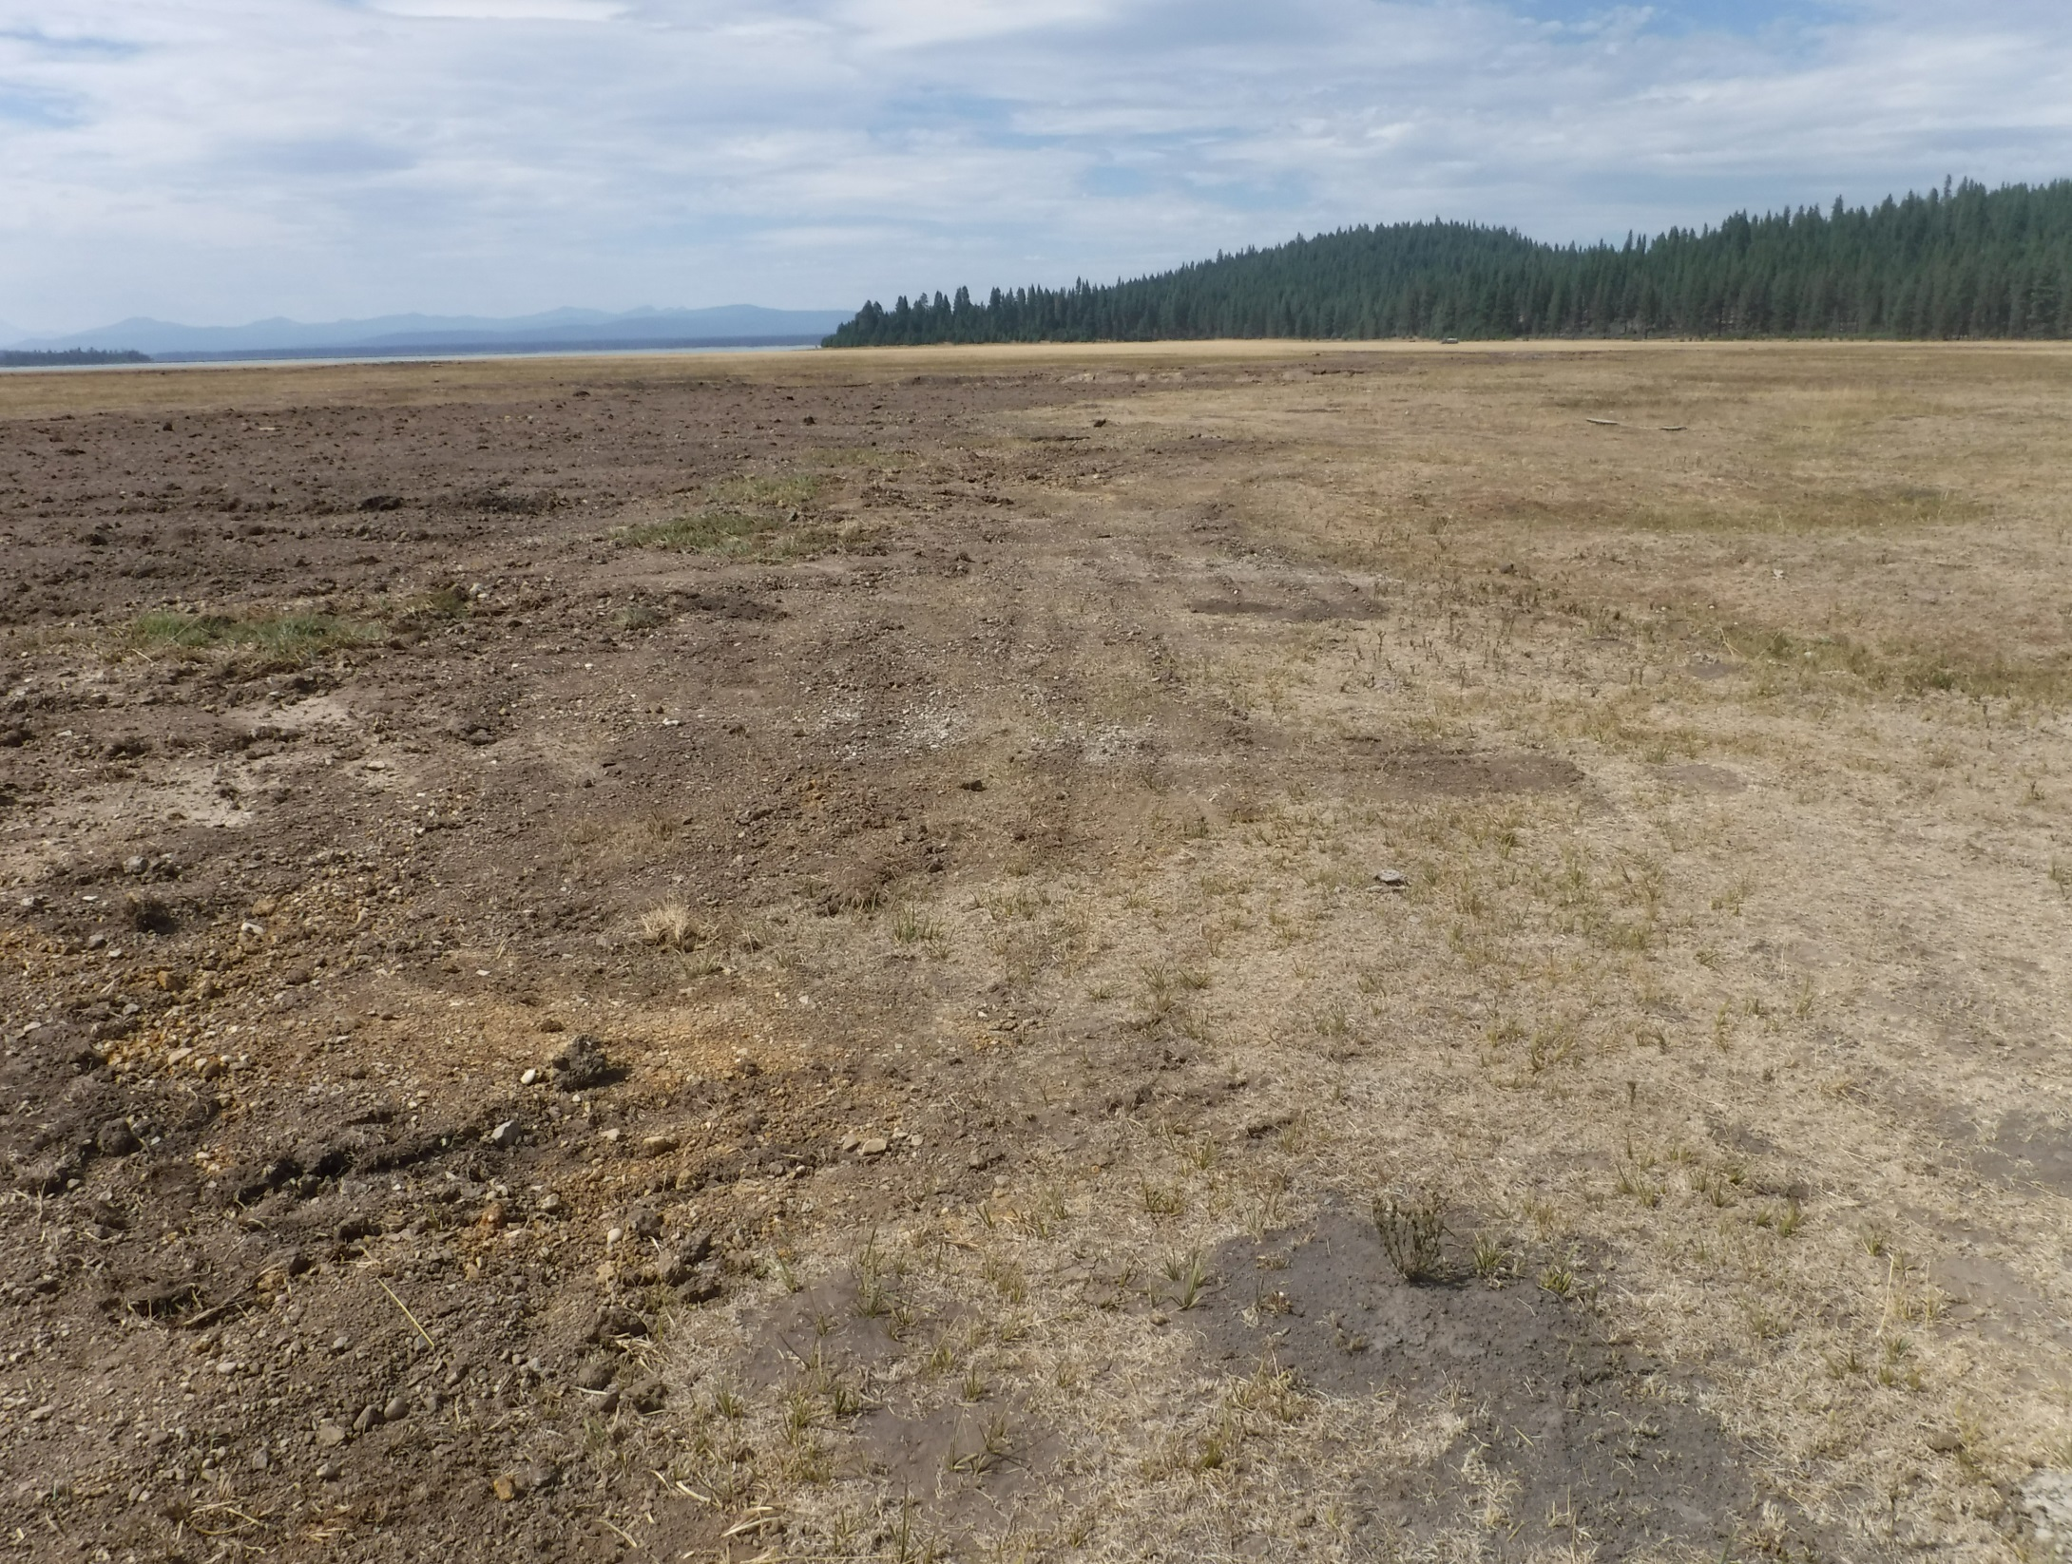
Greenville Creek Project, Stroing Creek remnant, post project- 8/2016

Slide 12
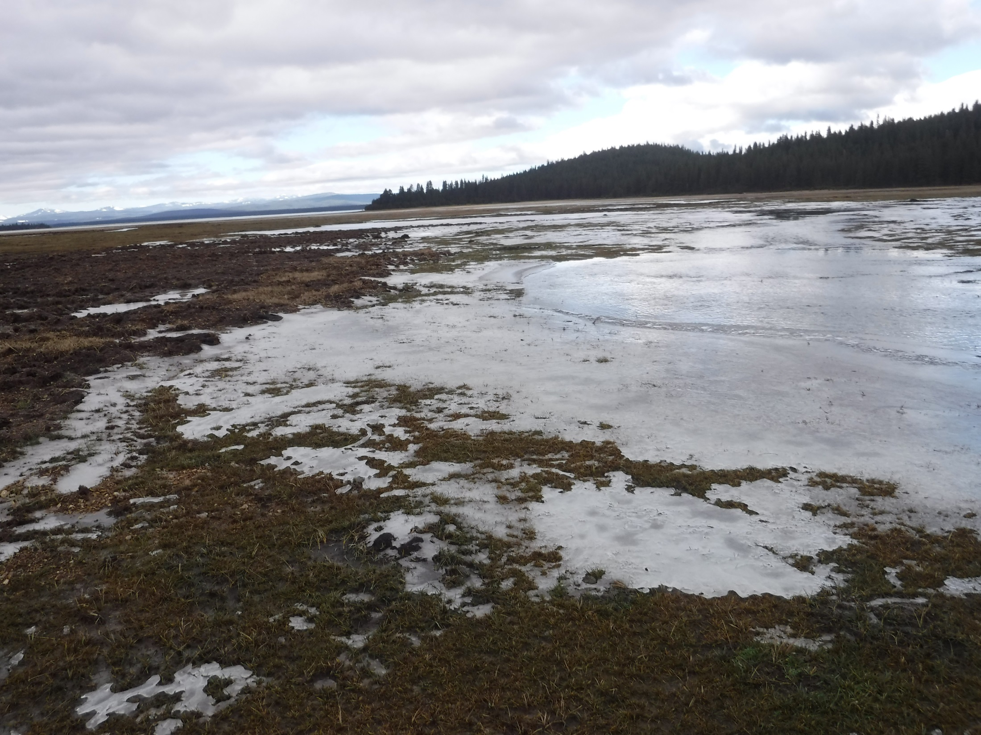
Greenville Creek Project, Stroing Creek remnant, post project- 12/2016

Slide 13
Greenville Creek Project, Greenville Creek, pre-project- 7/2015

Slide 14
Greenville Creek Project, Greenville Creek, post project- 8/2016

Slide 15
Greenville Creek Project, Greenville Creek, post project- 12/2016

Slide 16
Greenville Creek Project typical headcut structure, post project- 12/2016

Slide 17
Greenville Creek Project culvert replacement, post project- 12/2016

Slide 19
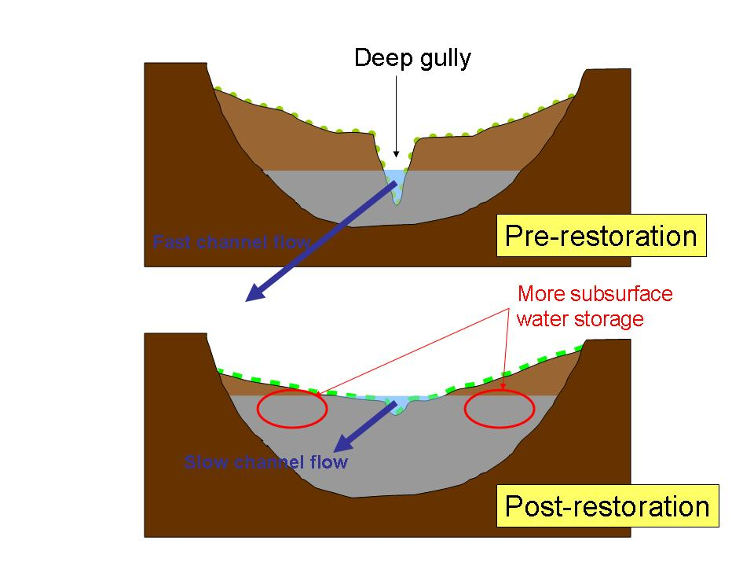

Slide 20
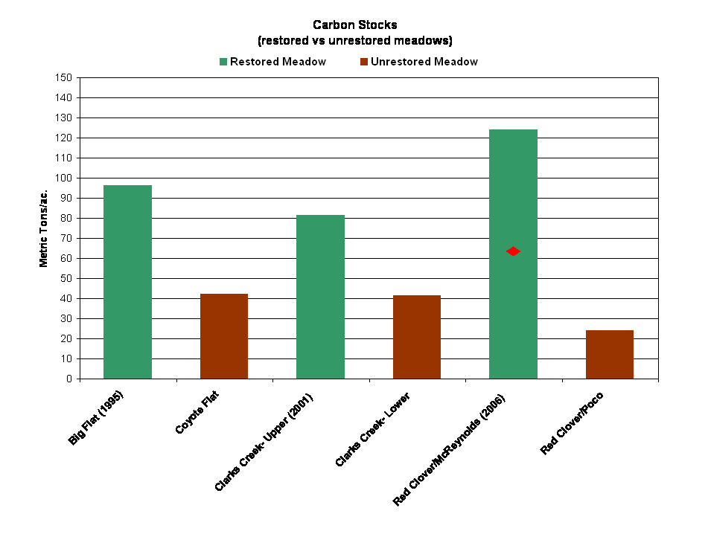

Slide 21
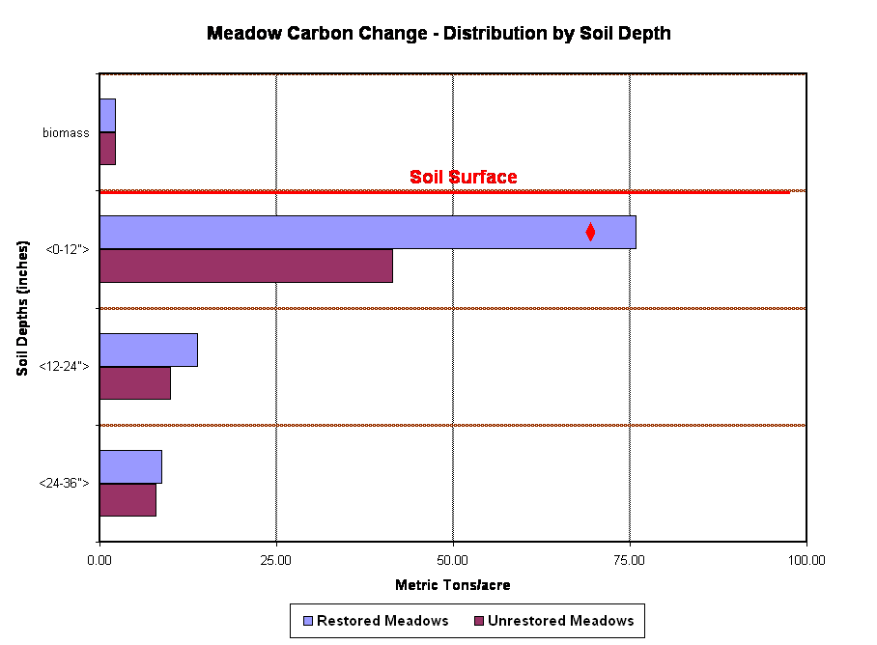

Slide 22
Research Partners Acknowledgement
University of California, Davis
Stanford University
University of Nevada, Desert Research Institute
CSU- San Francisco
CSU- Sacramento
CSU- Fresno
California Department of Water Resources
Ca. State Water Resources Control Board
USDA- Plumas National Forest

