Slide 1
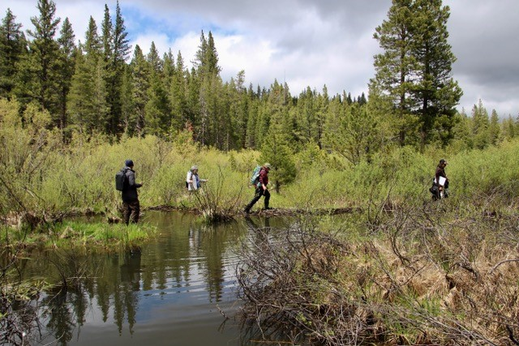
Restoration Planning for Beaver Based Solutions
The Nature Conservancy
U.S. Forest Service
NFWF Grant
1. Beaver Restoration Assessment Tool
Utah State University
2. Willow flycatcher Institute for Bird Populations
Point Blue Conservation Science
3. Stakeholder outreach
Occidental Arts and Ecology Center
Photo: Brock Dolman

Slide 2
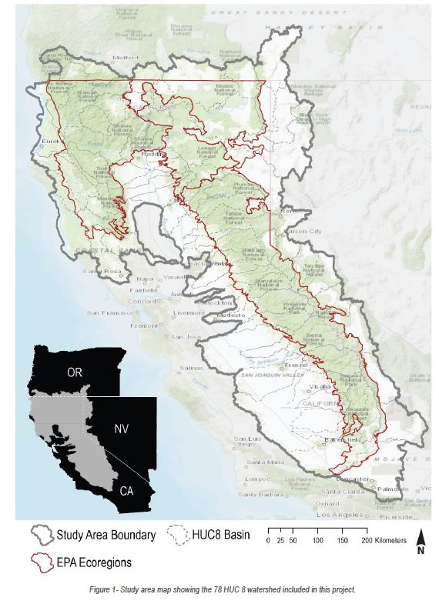
BRAT Model Area
4 EPA ecoregions
78 HUC 8s
261,063 km² area
77,377 km of perennial stream

Slide 3
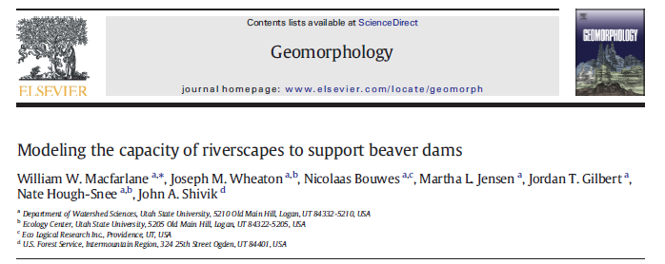
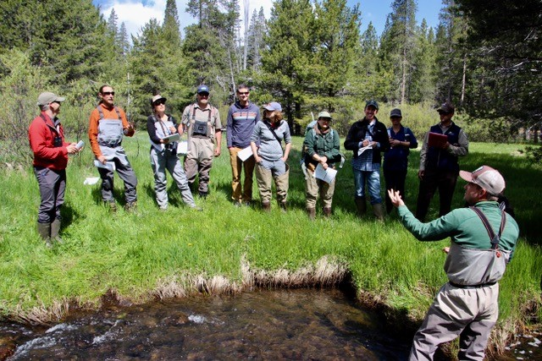
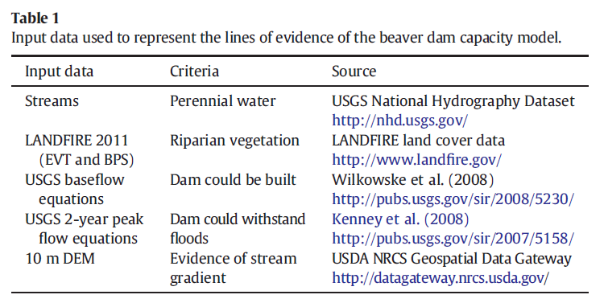
Photo: Brock Dolman

Slide 4
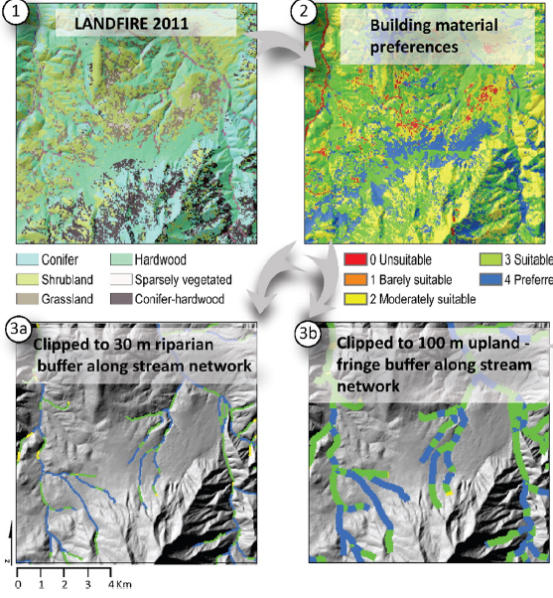

Slide 5
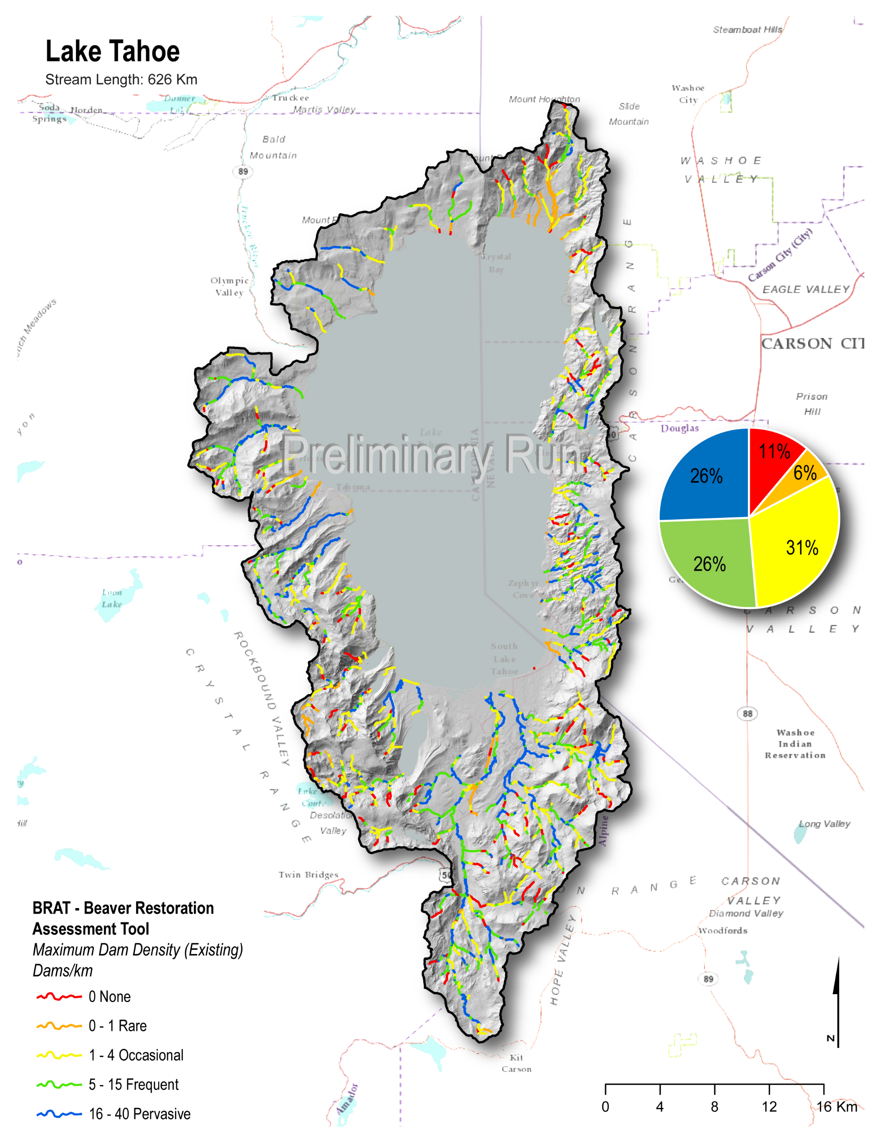

Slide 6
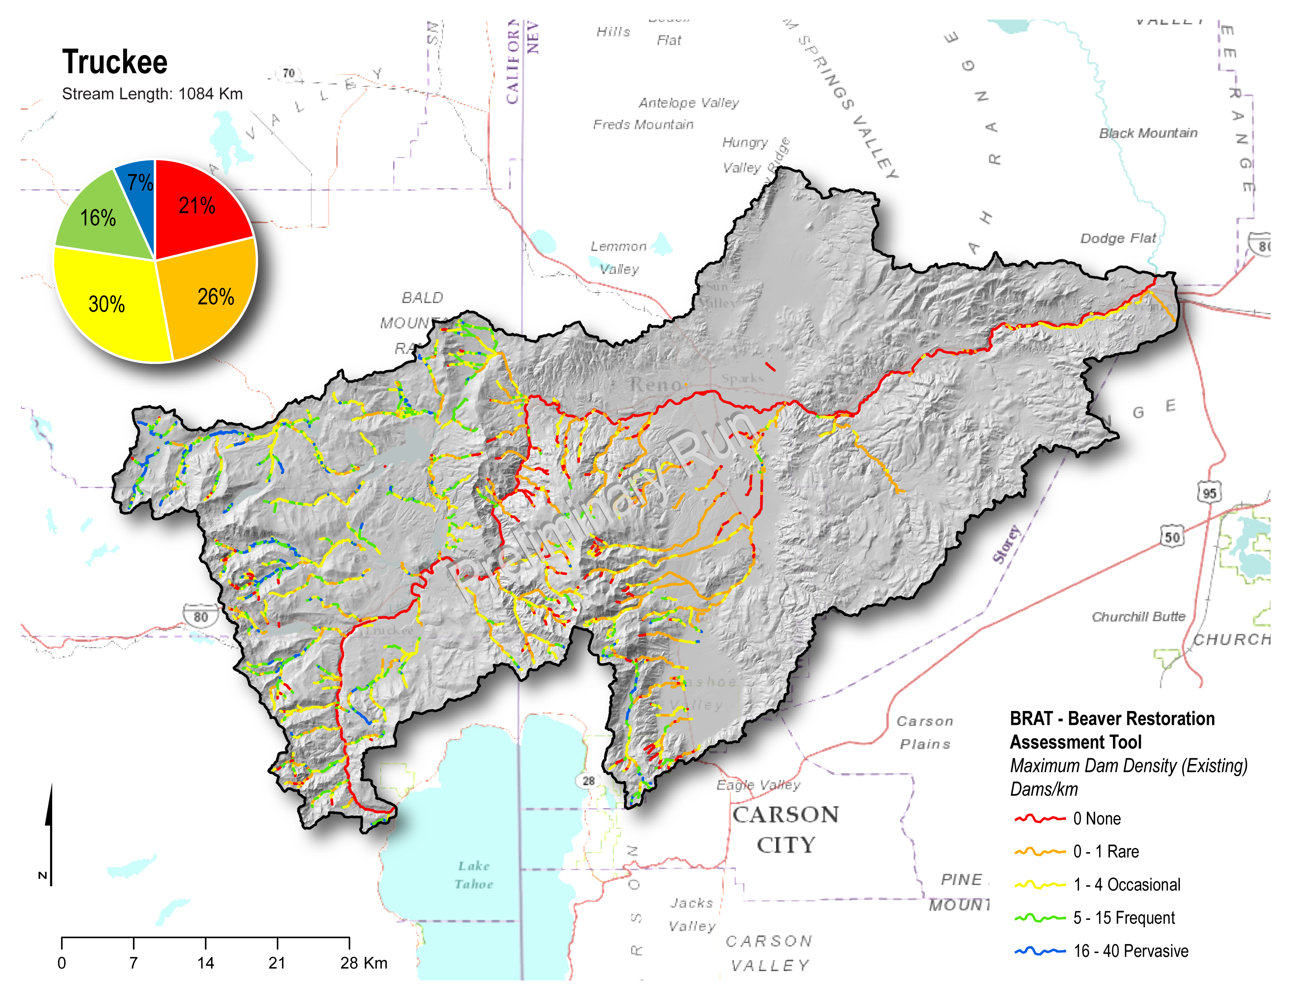

Slide 7
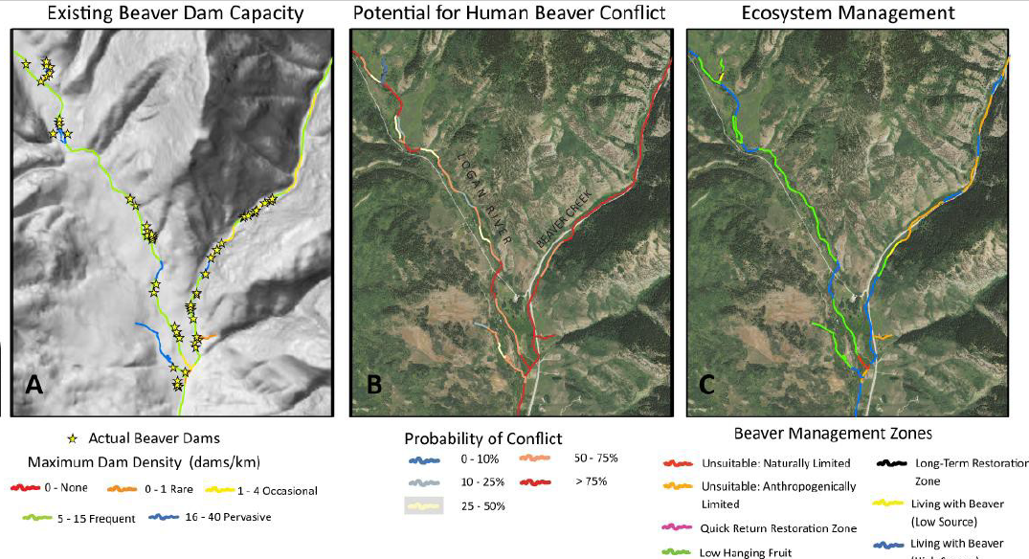

Slide 8
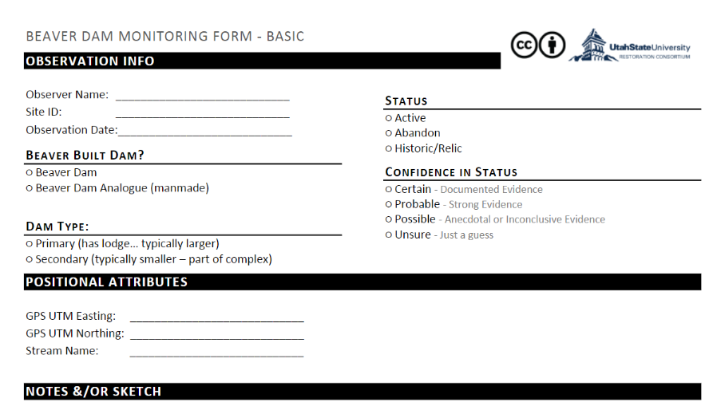
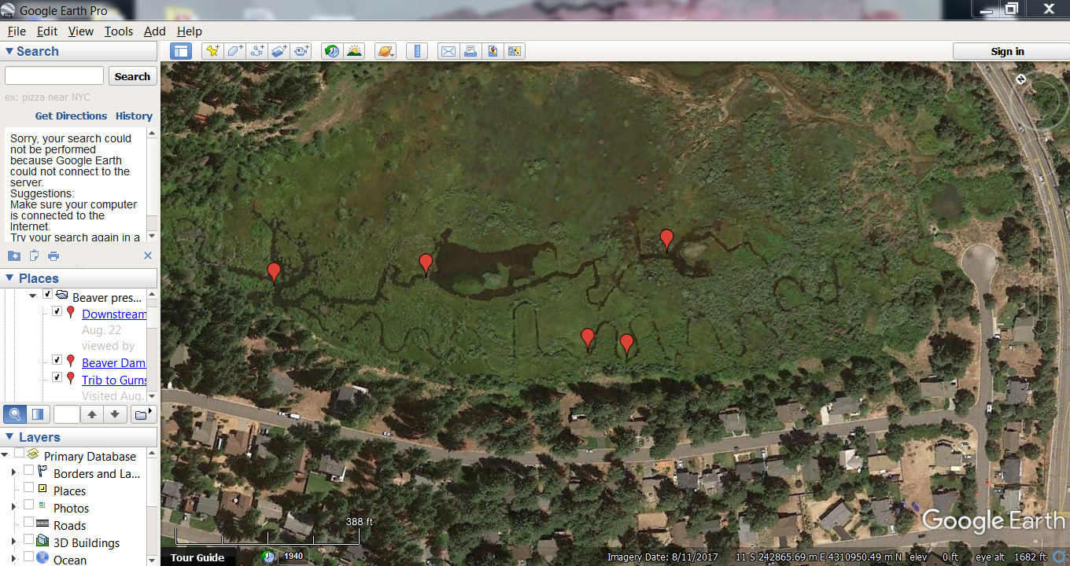
June-August 2018 Model Validation

