Slide 1
Establishing a Climate, Community & Biodiversity Verification Roadmap: What are the Necessary Steps and Requirements for Establishing a Meadows CCB Project
Dr. Letty B. Brown
SCS Global Services

Slide 2
GHG Standards
Notes:
Standards around now – rainforest standard, womens’ standard, social carbon, plan vivo also upcoming

Slide 3
Road Map for Mountain Meadows Restoration Payment for Ecosystem Services/ Carbon Offset Project
Step 1.
Define the Project (What are the activities that will generate carbon offsets?)
Step 2.
Compile and advance the science of mountain meadow restoration
Step 3.
Conduct a financial feasibility assessment of the potential carbon project
Step 4.
Develop relationships with potential offset buyers
Step 5.
Develop a PES/carbon offset methodology
Step 6.
Develop a carbon offset project
Step 7.
Verify the carbon offset project
Step 8.
Sell carbon offsets
Step 9.
Invest offset $ in additional mountain meadow restoration and research (?)
Notes:
Developing a Roadmap for Carbon Offsets for Sierra Mountain Meadows: Necessary Steps and Requirements

Slide 4
Road Map for Mountain Meadows Restoration Payment for Ecosystem Services/Carbon Offset Project
Step 5.
Develop a PES/carbon offset methodology
Determine the offset registry to house the methodology
Evaluate the pros and cons of each carbon offset registry
Seek answers to key project questions
Marry the science with the offset framework
Develop a scientifically rigorous methodology that will meet the requirements of the selected registry for a carbon offset project

Slide 5
Key Questions to the Registries
Land Ownership Eligibility- private, public or both
Aggregation Framework Available
Expected Revenue
Similar Methodologies Listed or Under Development
Process for Methodology Development
Existing Methodology in Place
Multi-benefit

Slide 6
Outline for Talk
CCB Standards- Background
CCB Standards- Project Development Overview
Key Requirements of CCB Standards
Climate
Community
Biodiversity
Case Study- Sequoia National Forest Meadows
Programmatic Approach

Slide 7
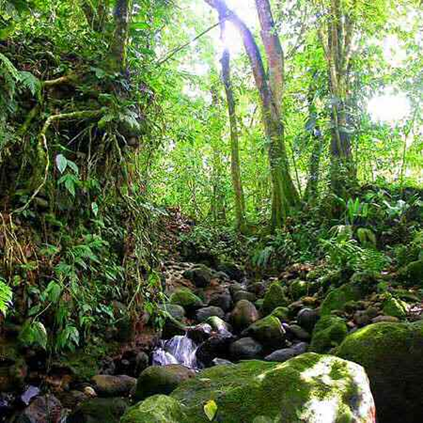
Climate Community and Biodiversity Alliance (CCB or CCBA)
Background: Partnership of leading NGO’s, founded in 2003
Identify multi-benefit land management projects that deliver net positive benefits for climate change mitigation, for local communities, and for biodiversity
Notes:
Note: CCBA Standard is most often coupled with REDD (mostly international) projects to make them more robust with regard to treatment of “cobenefits” of biodiversity and community values

Slide 8
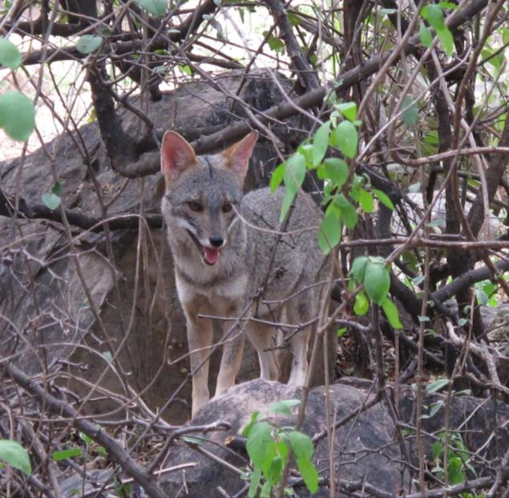
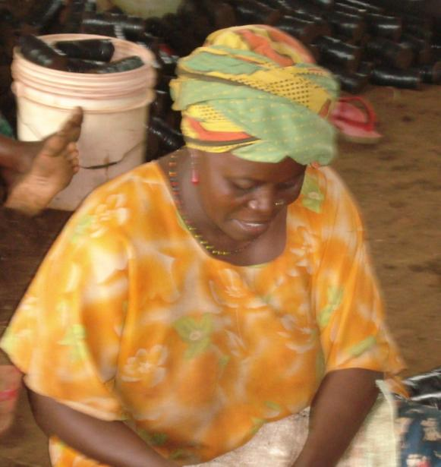
Climate, Community & Biodiversity Program
The CCB Program stimulates and promotes land management activities that credibly mitigate global climate change, improve the wellbeing and reduce the poverty of local communities, and conserve biodiversity.
Photos: J.Henman

Slide 9
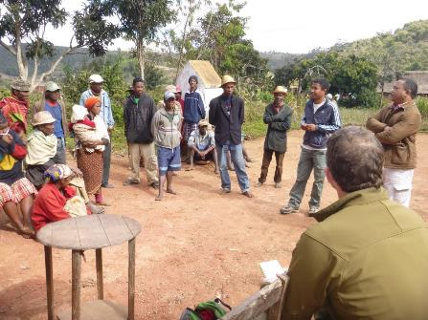
CCB Projects Worldwide
Notes:
Pie chart includes Projects Validated or in the Process of Validating to the CCB Standards as of 3 Feb 2017

Slide 10
CCB Validation Process
Validation
Verification
Project Design Document
Public Comment
Validation Audit
Notes:
It helps to first frame the process projects go through to become a CCB Project and verify the results of the project activities.
The first step is to develop a project design document that explains what the project will do and how those activities will produce net climate, community and biodiversity benefits.
That design document is submitted to VCS and goes through a 30 day public comment period in which stakeholders and the public may comment on the project design.
After the public comment the project and its design document go through a thorough audit by an independent auditor chosen by the project proponent.
If the auditor finds that the project design meets the requirements of the CCB Standards the project can be validated.

Slide 11
CCB Verification Process
Validation
Verification
Project Implementation & Monitoring
Project Implementation Report
Public Comment
Verification Audit
Label VCUs
(Optional)
Notes:
Only validated projects may verify their benefits.
The process starts with monitoring of the project impacts to demonstrate that net benefits have been obtained.
A project implementation report would then be written by the project to demonstrate how the project activities are responsible net climate, community and biodiversity benefits.
Again this document like the project design document must go through public comment
After public comment the project and its benefits will be audited to verify that the benefits claimed are a result of the project activities and that the project was carried out in accordance with the project design document.
At this point the project can label any VCUs issued from the same monitoring period with the CCB label.
The project then repeats this verification step for the life of the project

Slide 12
Net Positive Benefits: Climate
Achieved by: reducing expected emissions or removing existing greenhouse gases from the atmosphere
Issues to consider:
The projects methodological approach must be ‘approved’ or ‘defensible’.
Leakage
Gold Level – Community adaptation benefits
Notes:
Approved - Approved methodologies are those approved by GHG programs recognized by the CCBA.
Defensible - follows good practice guidance that includes procedures for delineating the conditions under which the methodological approach can be applied… There is a fuller definition in the CCB Standards – footnote 72 if you think necessary. The point to get across is that they can’t just make something up that sounds appropriate

Slide 13
Net Positive Benefits: Biodiversity
Achieved by: net positive biodiversity impacts within the project zone over the project lifetime.
Issues to consider:
Appropriate methodologies to estimate changes in biodiversity in the project zone
Protection and enhancement of High Conservation Values
Gold Level – biodiversity conservation at sites of global significance for biodiversity

Slide 14
Net Positive Benefits: Community
Achieved by: net positive impacts on the well-being of communities and community groups over the project lifetime.
Issues to consider:
How to identify stakeholders
A participatory process
Full and effective participation from all relevant stakeholders
Gold Level – smallholder-led or pro-poor projects

Slide 15
Sierra National Forest Meadows and CCB Standards

Slide 16
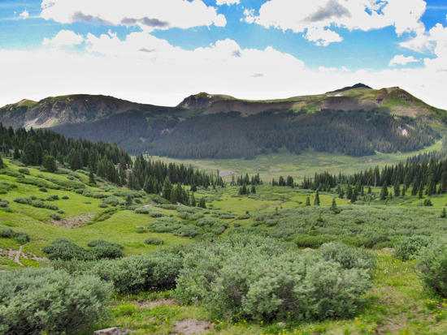
Potential Stakeholders (Sequoia National Forest Meadows)
Community groups (e.g. members of neighboring towns, groups who use project area)- who “derive income, livelihood or cultural values and other contributions to well-being” from project area
Hunters, anglers, birdwatchers, hikers, school groups
Landowner (e.g. USFS or another public entity, or a private entity)
Neighbors (e.g. property owners adjacent to projects)
Leaseholders or other entities who were using the land prior to its restoration
Project implementers (e.g. parties involved with site selection, restoration activities, biological monitoring, carbon monitoring, long-term management)
Any “Other Stakeholders” not identified

Slide 17
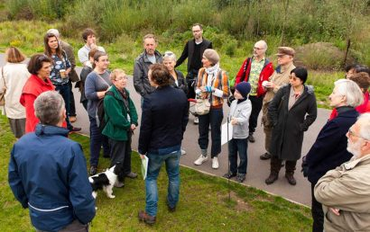
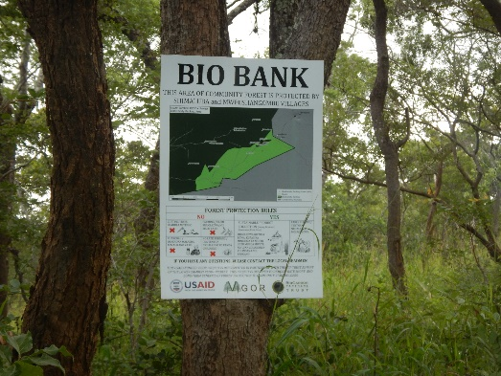
Stakeholder Engagement (Sequoia National Forest Meadows)
A participatory process “through full and effective participation, including access to information, consultation, participation in decision-making and implementation.” (applies to both design and implementation)
Access: Information about the projects will need to be made available via media outlets such as radio, newspapers, websites, and social media (e.g. Twitter and Facebook pages) as well as talks and signage
Project documentation, including PDD, and monitoring reports (as they become available), should be made readily accessible through the project lifetime
Consultation: describe the process, how stakeholders influenced design/implementation through effective consultation
NEPA/CEQA not enough, but can be used as an example
If there are any expected negative well-being impacts for any groups impacted by the project (e.g., stakeholders, communities, other communities), measures taken to mitigate these negative impacts must be described
Source: LDA Design

Slide 18
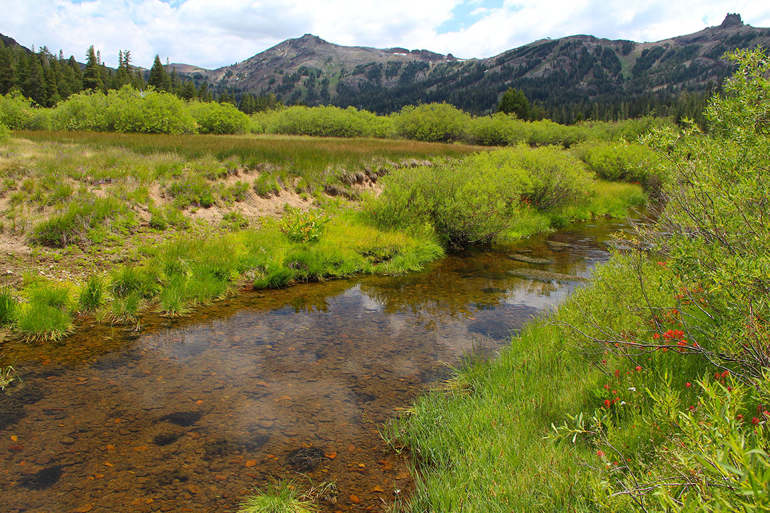
Positive Community Impacts (Sequoia National Forest Meadows)
Examples of potential positive community impacts :
Provision of educational resources- science/biology classes from local schools, researchers from local university;
Provision of opportunities to tour the carbon sequestration plots
Enhancement of recreational activities for locals via restored meadows, fishing, bird watching, wildlife viewing;
For the greater region of California and the US SW, the same, plus a greater number of rare and highly productive mountain meadow ecosystems;
Increased dollars associated with increased recreation in area (e.g. campgrounds, country stores, hotels/motels);
Disadvantages: Will there be any use restrictions associated for specific stakeholder groups? Reduced economic activity? Reduced access and recreation?

Slide 19
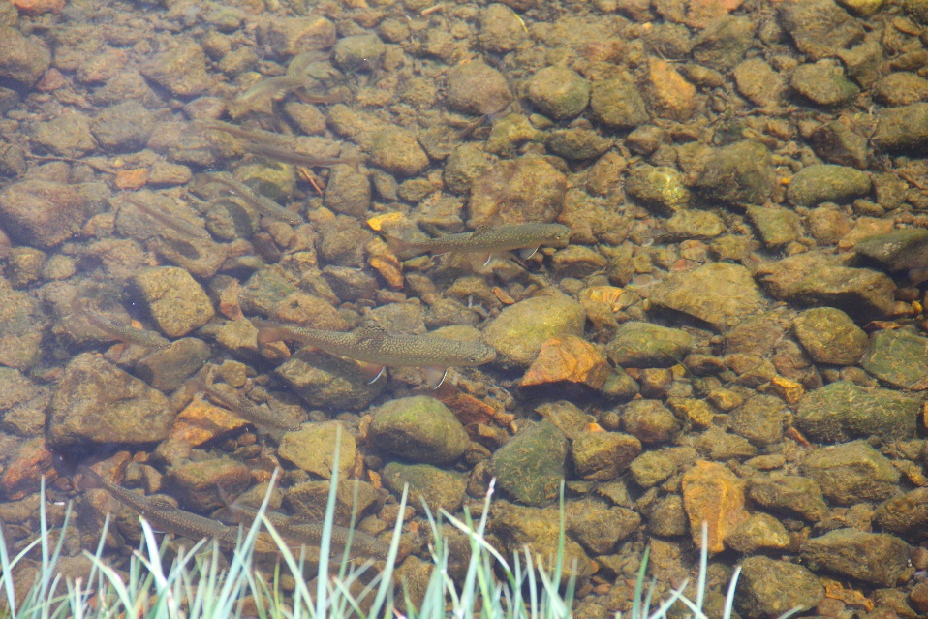
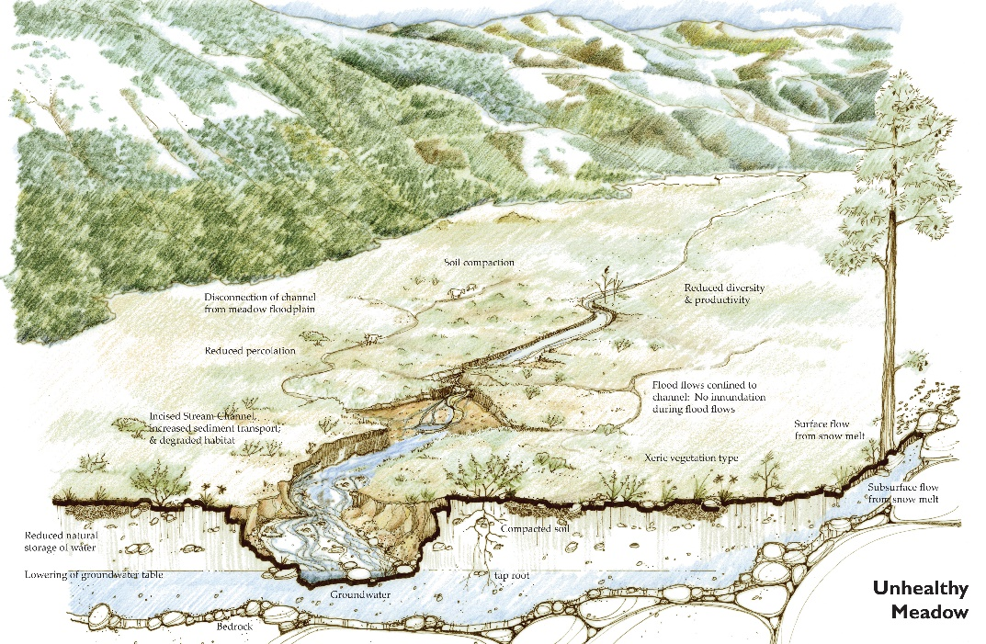
Positive Biodiversity Impacts (Sequoia National Forest
Meadows)
Examples of potential biodiversity benefits for Sierra Meadow Research and Restoration Partnership projects:
Enhanced Biodiversity
Critical Habitat for Threatened/Endangered Species
Improved Water Quality
Lowered Water Temperature
Natural Flood Storage and Improved Soil Protection
Disadvantages: Will there be increases in invasive species abundances? Are there anticipated decreases in special status native species?

Slide 20
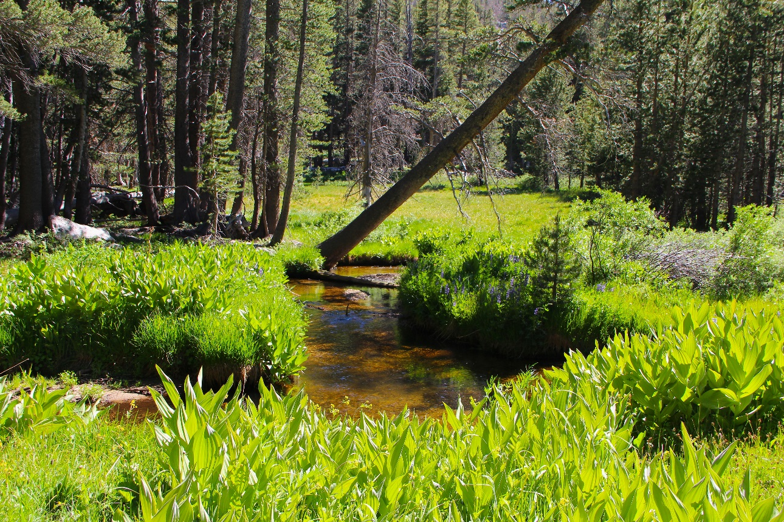
Project Monitoring (Sequoia National Forest Meadows)
A monitoring plan, and its effective execution, is necessary for projects to support the claims of benefits achieved through project activities
Considerations:
Appropriate indicators
Feasibility of monitoring
Frequency of monitoring
Notes:
Appropriate indicators- Are the indicators appropriate proxies for the desired progress or benefits? don’t just monitor the end benefits the project hopes to achieve, monitor indicators along the way that show the project is moving in that direction.
Feasibility is limited by physical parameters, costs, knowledge or certification of proper monitoring, etc.

Slide 21
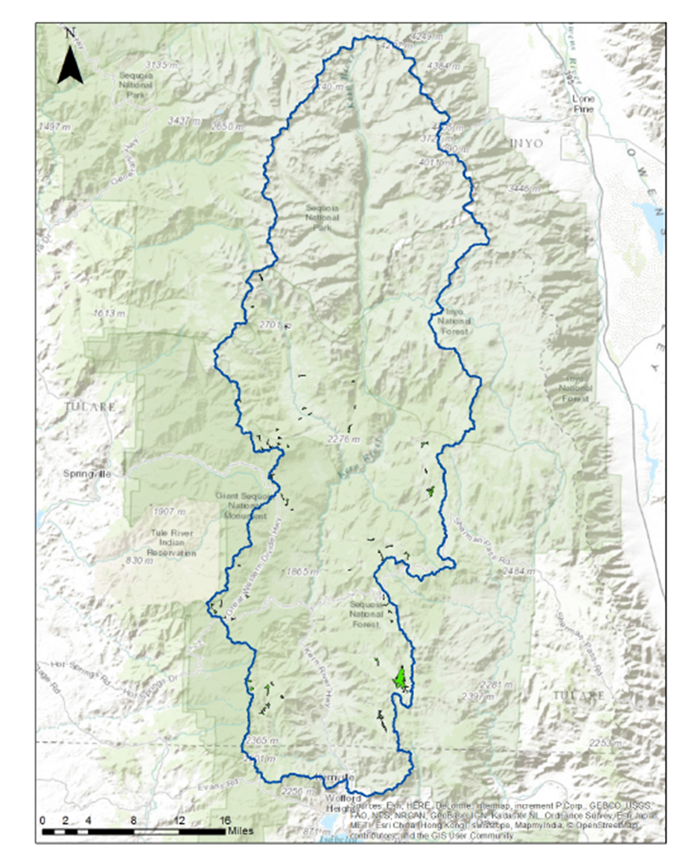
Programmatic Approach (Aggregation Framework)
A programmatic approach allows project proponents to expand their land areas
The project zone set out in the project design document must include all potential project areas
The project design document must set out eligibility criteria for the inclusion of new project areas, i.e., new project areas must be the same as the initial project areas in the following ways:
Activities
Without-project scenario
Additionality characteristics
Process for stakeholder engagement
Monitoring protocols & procedures
New project areas must be added to the project at verification events

Slide 22
Resources for Developing a CCB Project

Slide 23
CCB Program Documents
Climate, Community & Biodiversity Standards
Rules for the Use of the CCB Standards
Fee Schedule for the CCB Standards
All CCB Program documents are available on the VCS website (http://www.v-c-s.org/project/ccb-program/rules-requirements-and-guidance/)
Notes:
CCB Standards- Set out all specific requirements for developing and monitoring projects. Latest version is the third edition
Rules- sets out all rules and requirements governing the CCB Program including validation and verification against the CCB Standards, accreditation requirements for validation/verification bodies, communications related to the CCB Standards, including use of the CCB label, and project listing information.
Fee Schedule - The Fee Schedule for the CCB Standards sets out the fees applicable under the CCB Program.

Slide 24
Other Resources
Guidance section of the CCB webpages (http://www.v-c-s.org/project/ccb-program/guidance/)
Guidance for the Use of the CCB Standards
Social and Biodiversity Impact Assessment Manual for REDD+ Projects (SBIA)
Explore CCB projects via the VCS project database (http://vcsprojectdatabase.org/#/ccb)
Notes:
Guidance -provides explanations of key concepts and requirements that will be helpful for project proponents, auditors and any users of the CCB Standards Third Edition.
SBIA- The main objective of this manual is to help project proponents implement cost-effective social and biodiversity impact assessments to meet the CCB or other standards and, in so doing, make the projects more successful and sustainable. While the title indicates it is for REDD projects the guidance it gives can be used for any project.
VCS Project Database – Allows the public to view CCB projects, VCS projects, and project documentation for both. This allows anyone to find projects that are similar to those that they are interested in implementing and review their project documentation for examples.

Slide 25
Letty B. Brown
LBBrown@scsglobalservices.com

