Slide 1
Sierra Meadow Partnership Policy Potential
Notes:
Introduction:
Role and Title: Staff Attorney and Policy Lead. My role, on the policy side, is to coordinate with our regional offices and try to distill the lessons learned from our science based approaches in each region and turn it into funding opportunities and protections for our water based natural resources.
Why I am here: I have worked with Mark and now Janet to learn more about the SMP and even to do our best to steer funding in Prop 68 and through the GHG Reduction Fund towards meadows, but I am thrilled to finally be meeting you all with an eye towards coordinating our collective policy skills.
Outline of Talk: Today I plan on giving an update, as best I can, on the current Policy Climate; what we have done; on future opportunities; and on a proposal to set up a policy committee within the SMP with examples of similar partnerships which have gone this route.

Slide 2
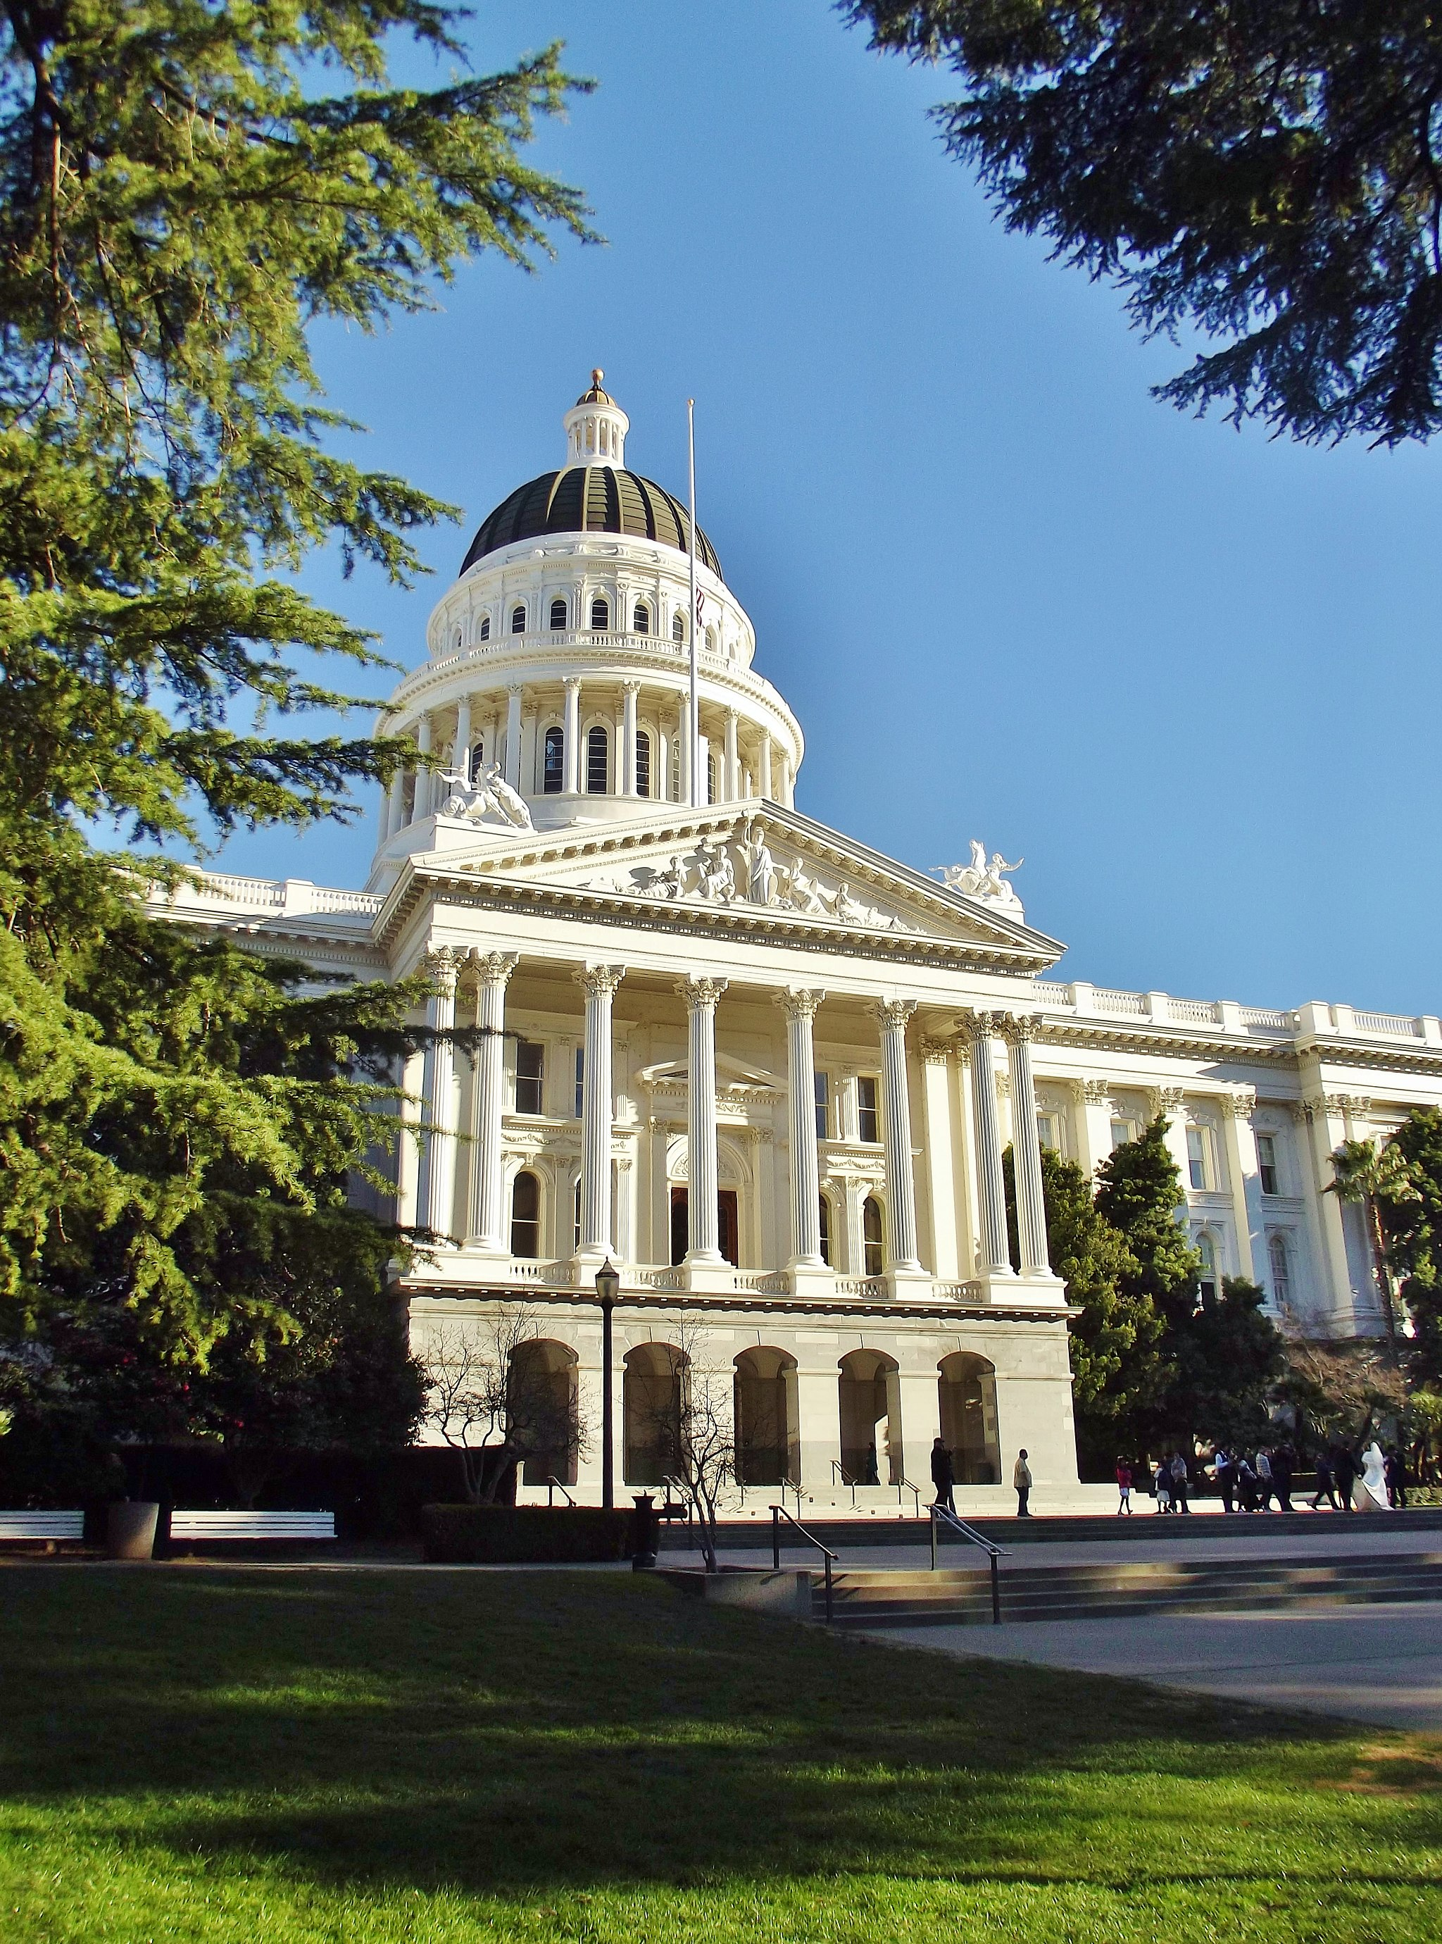
Current Policy Climate
CURRENT MEADOW POLICY CONVERSATIONS
The legislature and SMP partners are currently struggling with how to address the GHG, climate change, climate adaptation challenges.
PAST SUCCESSES
Prop 1
GGRF
SB 5 (Now Prop 68)
FUTURE OPPORTUNITIES
Prop 68 and Meral Bond passage and implementation
AB 2528 and Climate Adaptation legislation
GGRF Funding and budget conversation
Agency Per
Notes:
Background: I am sure that most of you are aware of the current policy conversations surrounding mountain meadows, but here’s a rundown of some of the most prominent mountain meadow funding sources, current legislative conversations, and on future opportunities.
Current Climate: The legislature and SMP partners are currently struggling with how to address the GHG, climate change, climate adaptation challenges. I’ve enjoyed listening to the various drivers of conversation today surrounding GHG, hydrologic function, and protection of specific species, because it mirrors the important conversations we’re having on the policy level.
Climate’s great: Bottom line: there’s an appetite in the legislature to fund GHG research and to address the climate adaptation question, and we need all of your voices at the table helping to shape this conversation.
Past Success: There are currently too many funding sources to list, but we’ve got a few major sources that we’ve been relying on for planning, implementation, and monitoring funds. Prop 1 is working its way though and GGRF remains a source of recurring funding. California has provided and hopefully will provide consistent funding, but we can’t take that for granted.
Future Opportunities:
SB 5, now Prop 68, provides funding sources for meadows. SNR spoke yesterday about the potential $310 million and there is more than that for natural resources. We worked from SB 5’s inception to include funding for natural resources that could be used for mountain meadow funding and worked through the budget process to help steer that money towards mountain meadows. Prop 68 comes in at over $4 billion, but plits the pot into parks, natural resource, and water funding and should likely be a yes vote for everyone in the room. If you’d like to learn more about how your organization can support the cause, please reach out to me, or to your TNC friends. We’re both involved in political campaigns to get this passed and can give your organizations social media and GOTV cues for the fast approaching June 5th election.
Meral Bond: Similarly, we worked language into the Meral Bond, which will be on the November ballot and comes in with a whopping $9 billion in water relation funding.
AB 2528: We’re working with Blooms office to build off of the Source Water bill (AB 2480), and include source water and mountain meadows in our focus. Our goal is to steer the Climate Adaptation Strategy to include research for these areas as we believe they deserve resources for research beyond our work.
Climate Adaptation Bill:
GGRF: We need to collectively advocate for continued GGRF funding. We’ve gotten funding over the last two years to the tune of $15 million, and the current projection this year is $20 million, but we need to conitnue to keep this pot in order to make this a regular source of funding.

Slide 3
SMP Policy Committee
SMP POLICY COMMITTEE PITCH
Our collective power as a group is stronger than any one advocating organization and a coherent clean message on the important of mountain meadows would go a long way in driving the policy conversation.
GOAL
Funnel the great work you all are doing and turn it into funding and protections for mountain meadows.
POTENTIAL MODEL
Joint Venture and CVSHP have established policy committees to help foster policy coordination
Agencies have participated with the understanding that they are technical advisors on the policy conversation
Charter and committee coordination
Notes:
SMP POLICY COMMITTEE PITCH: Our collective power as a group is stronger than any one advocating organization and a coherent clean message on the important of mountain meadows would go a long way in driving the policy conversation.
Past Models: Joint Venture and CVSHP have a large mixture of public, private, state, and federal partners working towards the same goal. They also have successfully established policy committees that include all of these partners working together.
Basic Structure: The idea would be to create a policy committee that works together to discuss policy drivers that will push the Sierra Meadows Partnership into a position where it can have a real policy impact. Each organization that has the capacity would offer up their time (or the person in their org that works on policy’s time) to meet, talk, and discuss policy opportunities. The group would then coordinate with the steering committee and all the partners to make sure that our efforts reflect the work we are doing collectively.
Buy In: We need people to take ownership and to step forward with their time and policy. I’ve spoken with leadership in the joint venture, specifically about policy engagement and they all have the same message: you have to make this a nimble and committed group.
Pitch: Taking a Page from the Ryan’s opening talk yesterday, I looked back at the Sierra Meadow Strategy and at the distilled three goals: the second really stands out for me: Enhance Coordination and Funding and establishing sufficient funding. I would quibble with sufficient and lean towards bottomless, but the point stands. We are all committed to helping to drive coordination and funding.

Slide 4
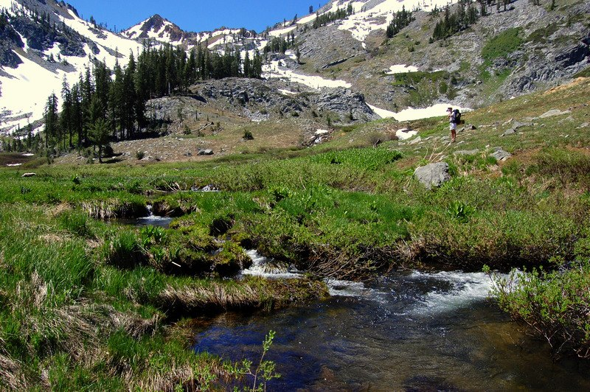
SMP POLICY COMMITTEE PITCH
Our collective power as a group is stronger than any one advocating organization and a coherent clean message on the important of mountain meadows would go a long way in driving the policy conversation.
Who
is
in?
GOAL
Funnel the great work you all are doing and turn it into funding and protections for mountain meadows.
POTENTIAL MODEL
Joint Venture and CVSHP have established policy committees to help foster policy coordination
Agencies have participated with the understanding that they are technical advisors on the policy conversation
Charter and committee coordination

