Slide 1

Proposition 1 DFW-Funded Cap and Trade Projects
South Yuba River Citizens League
Rachel Hutchinson

Slide 2
Yuba Headwater Meadows
Loney, Upper Loney, Deer Meadow, Freeman Meadow, Beartrap Meadow
South Yuba River Citizens League
Project lead, greenhouse gas field sampling, meadow monitoring
Tahoe National Forest
Landowner and restoration design
Stillwater Sciences
Grid set-up, Greenhouse gas lab sampling and data analysis
Earthwatch
Greenhouse gas, soil, biomass, and vegetation sampling
UNR
Soil carbon analysis
UC Davis
Amphibian surveys

Slide 3
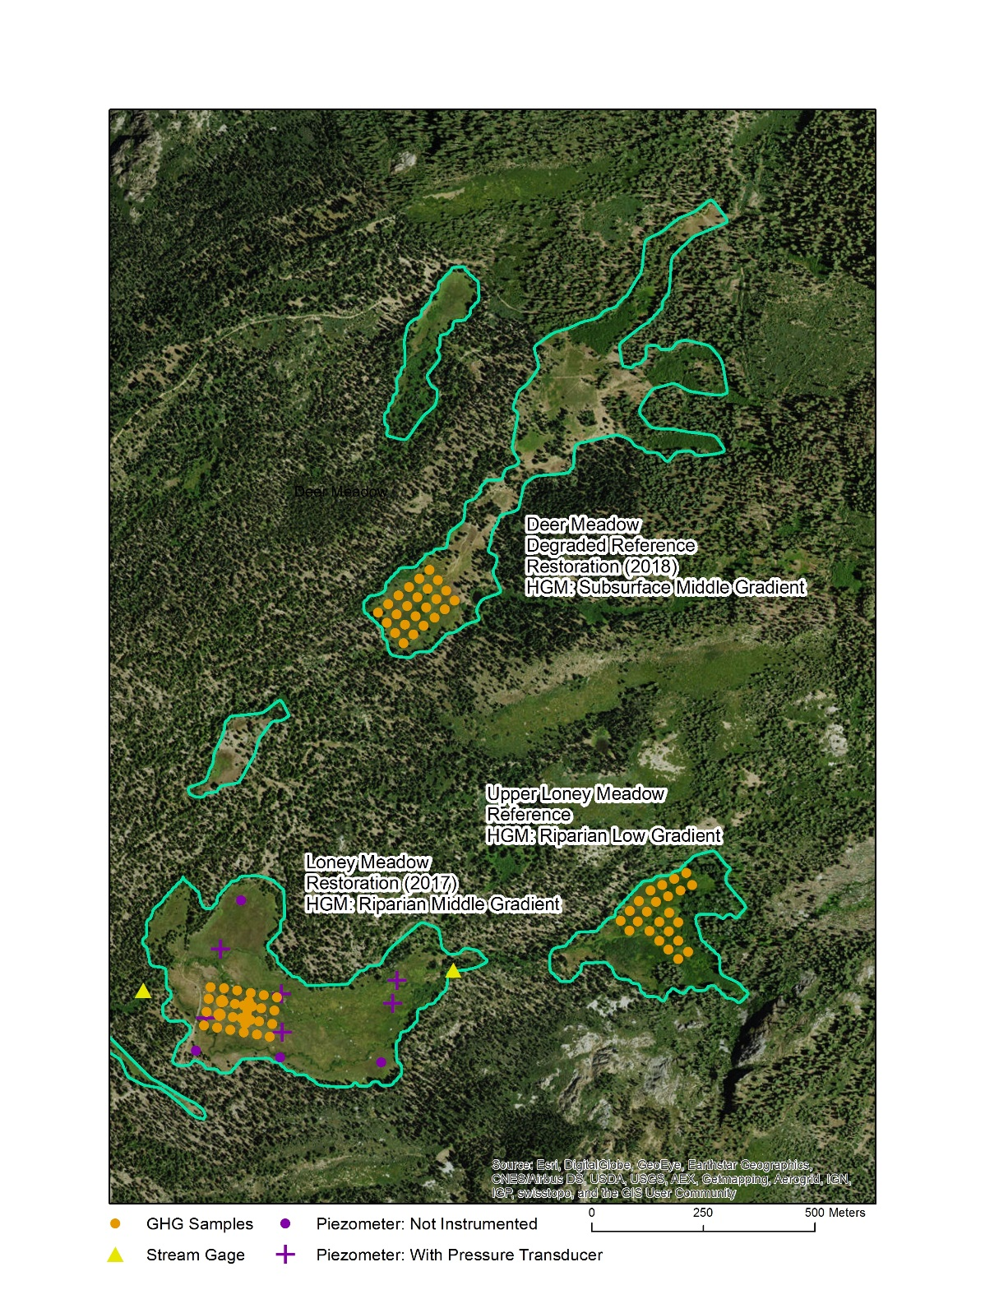
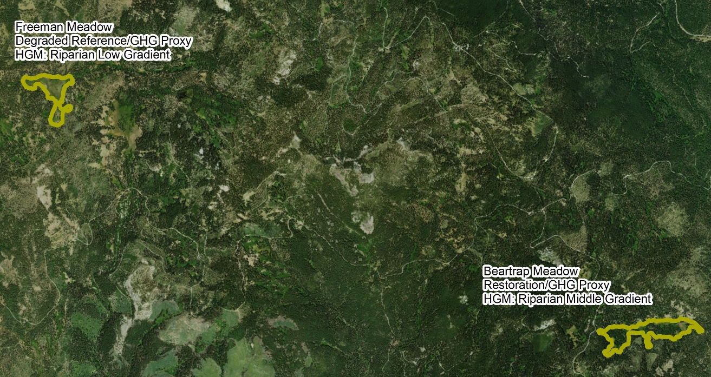
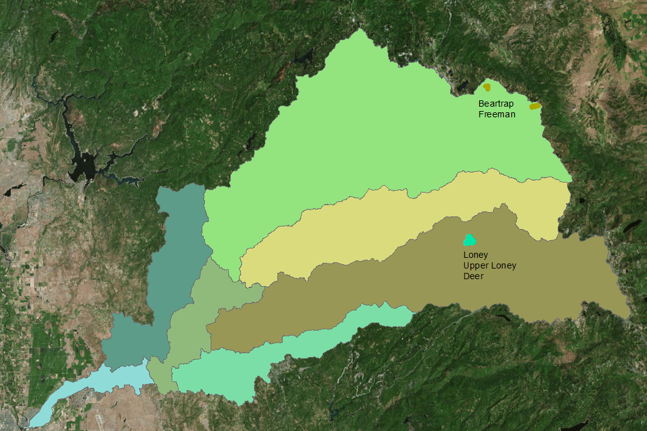
Location

Slide 4
Land-use History
Meadow | Project Status | Historical Degradation | Current Management
Loney | Restoration | Grazing, logging, fire suppression | Trails, Grazing
Upper Loney | Reference Control | Grazing, logging, fire suppression | Trails, Grazing
Deer | Degraded Control/Restoration | Grazing, logging, fire suppression | Grazing
Freeman | Degraded Control | Grazing, logging, fire suppression | Grazing
Beartrap | Restoration | Grazing, logging, fire suppression | Grazing

Slide 5
Pre-Restoration meadow conditions
Meadow | Hydrologic Status | AR Scorecard value | Critical Species
Loney | Fair, some head cutting and channel incision. | 2.7 | Willow Flycatcher
Deer | Upper meadow is dry, incision area between upper and lower meadow. Failing berm within the meadow where cattle pond exists. | n/a | Willow Flycatcher
Beartrap | Channel incision and head cutting. Issues with drainage from an above road. | 3.0 | Willow Flycatcher

Slide 6
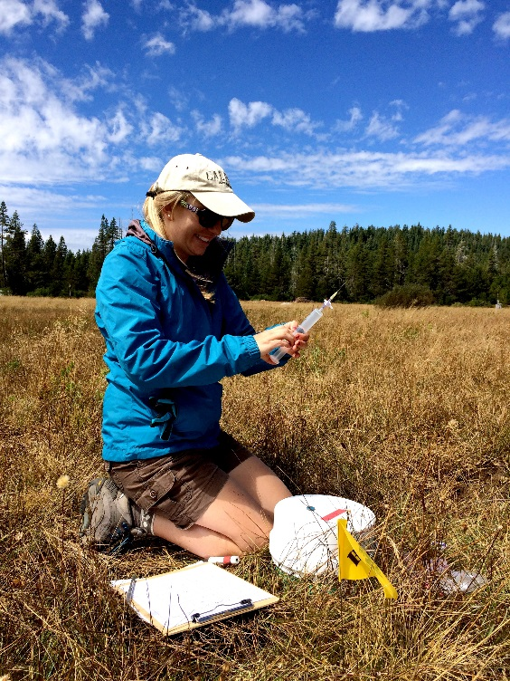
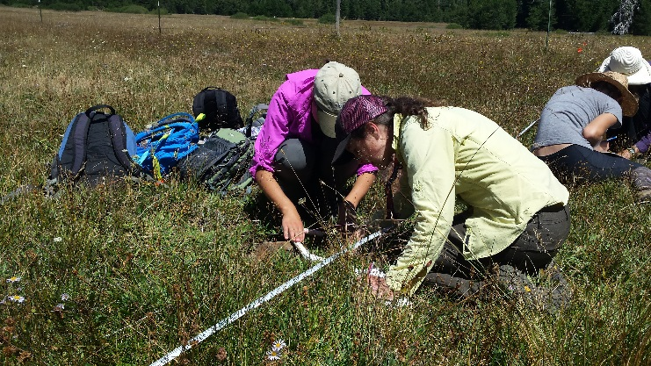
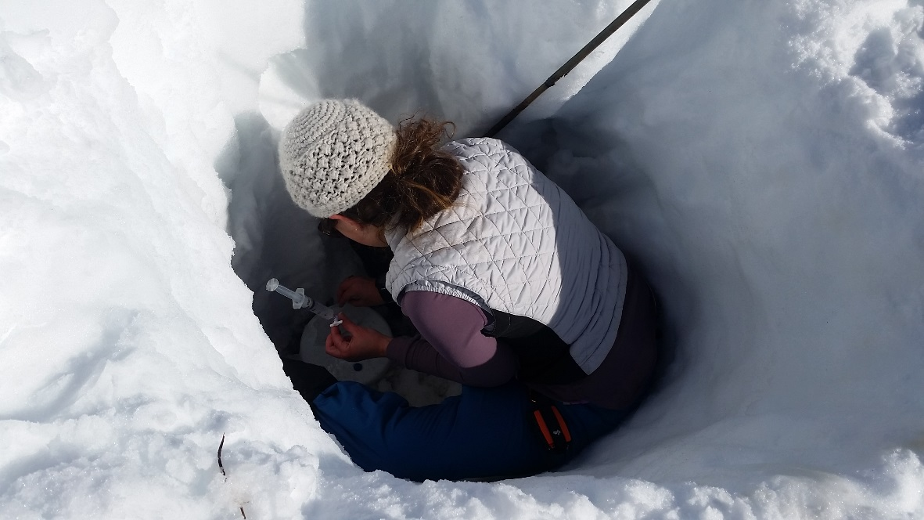
Data Collection

Slide 7
Pre-restoration Data Collection
GHG pre-restoration monitoring complete for Deer and Loney Meadows & will be complete for Upper Loney Meadow in by the end of June 2017
All soil samples have been collected at Deer, Loney, Upper Loney, and Bear Trap Meadows
All biomass samples and associated vegetation surveys (peak and senescent) have been collected at Loney, Upper Loney, and Deer
Monitoring of hydrologic regime continues in Loney; additional piezometers installed at Upper Loney, Deer, Bear Trap, and Freeman

Slide 8
Meadow | GHG | Vegetation | Soil | Biomass | Hydro
Loney Restoration 2017 | 1 year pre | Pre | Pre | Pre: P/S | 10 GW/stream gages
Upper Loney Reference | 6 months pre (June ‘17 end date) | Pre | Pre | Pre: P/S | 3 GW/stream gage
Deer Degraded | 1 year pre | Pre | Pre | Pre: P/S | 4 GW/no gages
Bear Trap Restoration 2018 | Not funded Grid installed | 2017 | Pre | 2017 | 6 GW/stream gage
Freeman Degraded | Not funded Grid installed | 2017 | 2017 | 2017 | 3 GW/ no stream gage

Slide 9
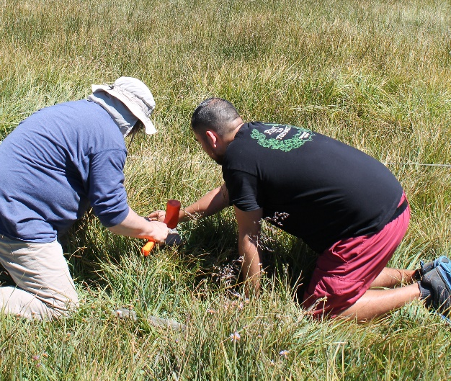
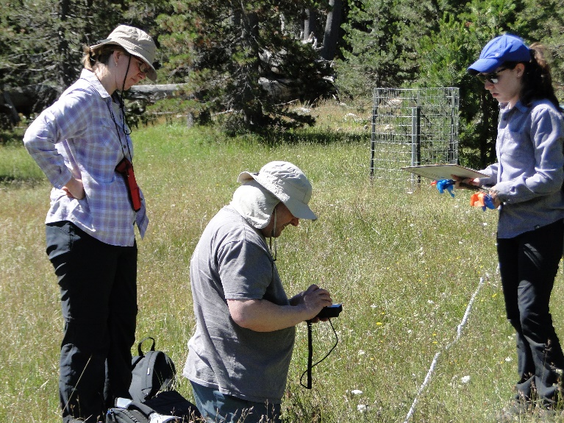
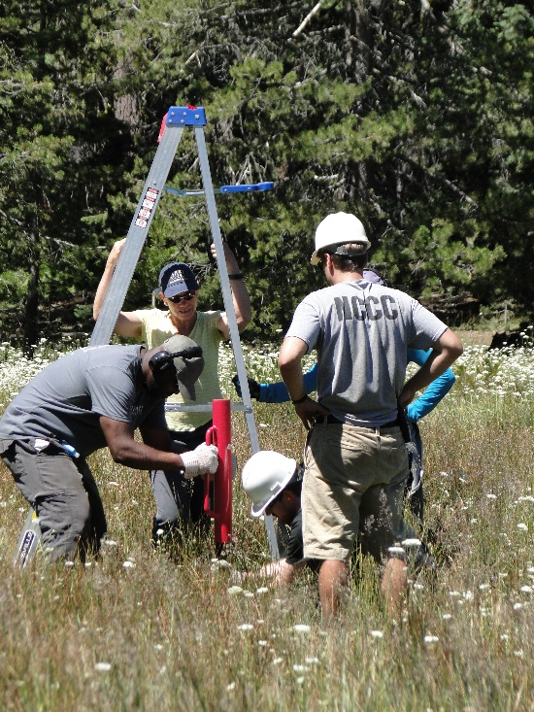
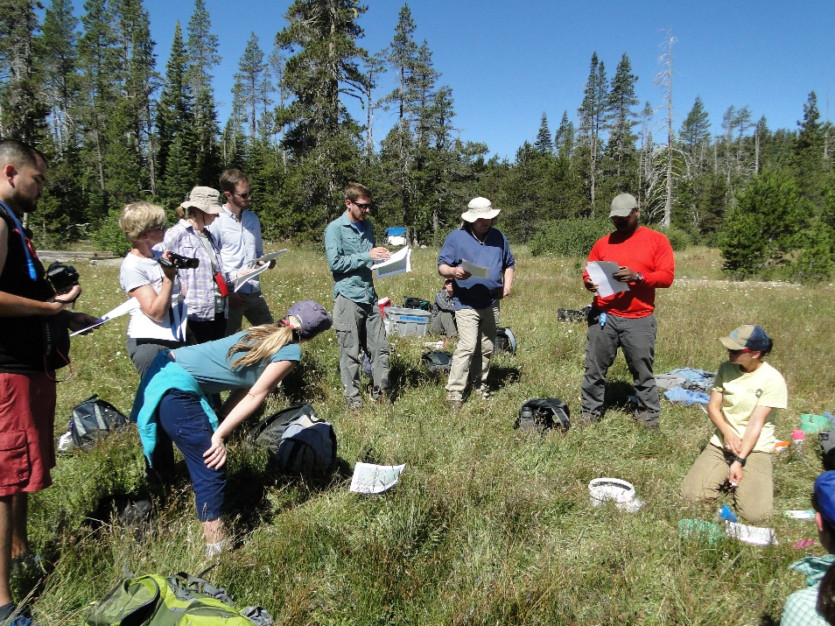
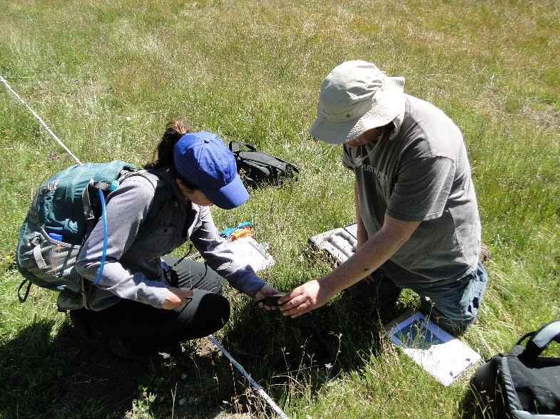
Volunteer Effort

Slide 11
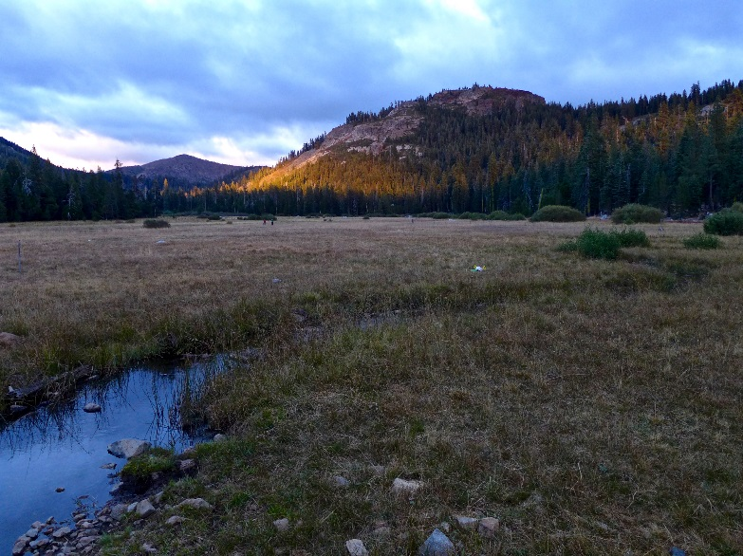
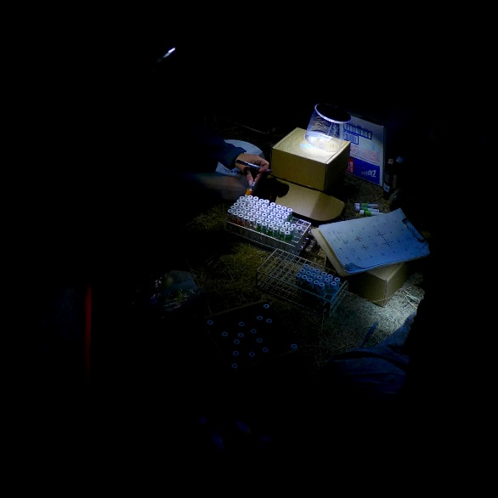
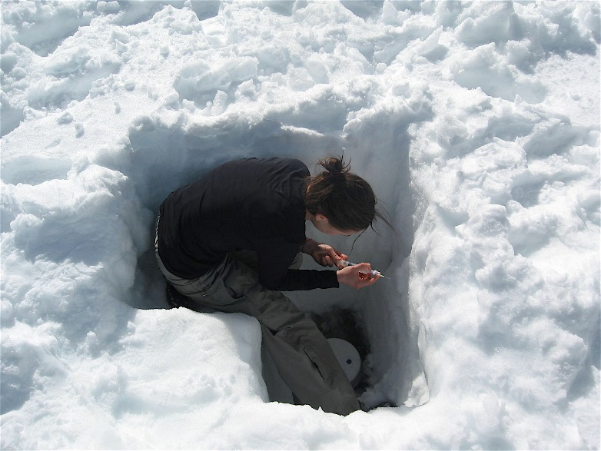
Restoration Status
Meadow | Restoration Year | Status
Loney | 2017 | NEPA by March/April 2017; Implementation Fall 2017
Deer | 2018 | NEPA in fall 2017
Beartrap | 2018 | NEPA in fall 2017

Slide 12
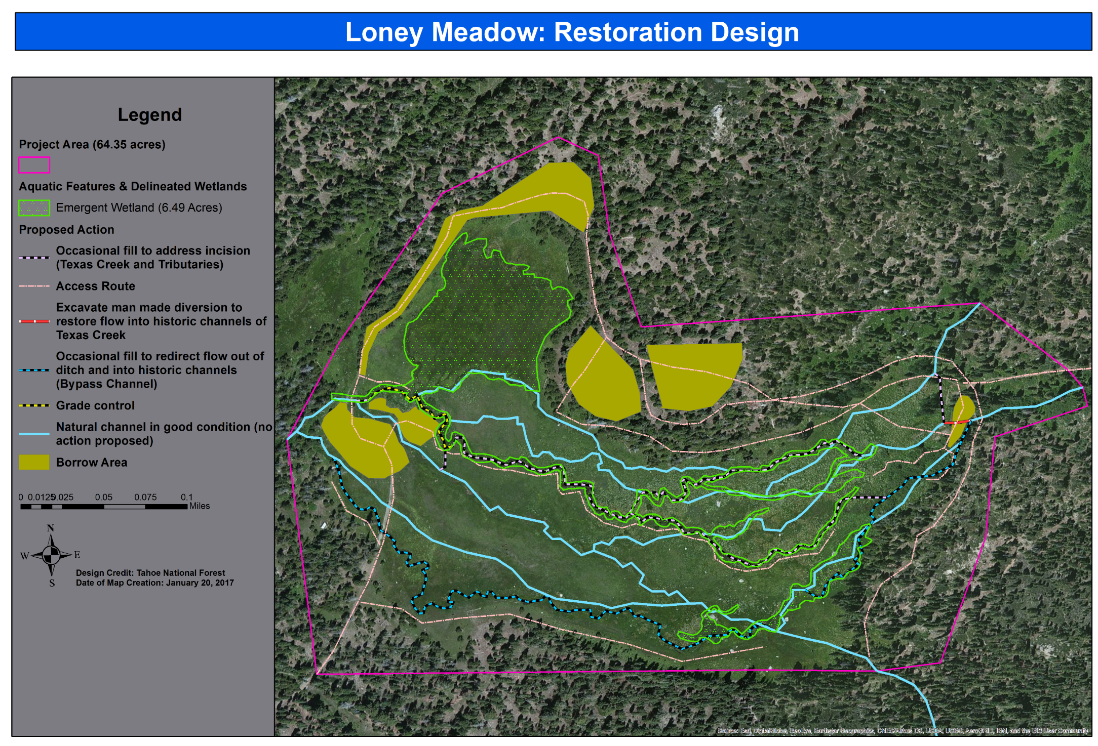
Restoration Plans

Slide 13
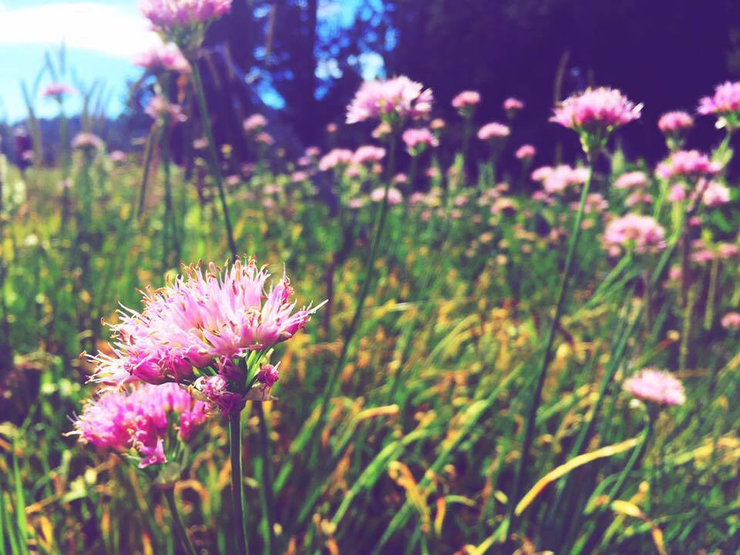
Questions?

