Slide 1
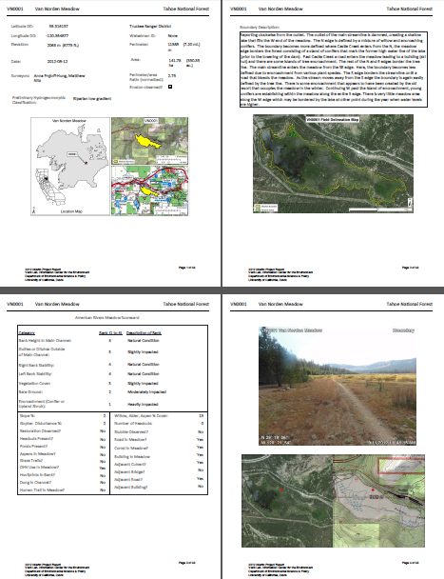
Bank height
Bank stability
Length of gullies/ditches
Vegetation composition
% Bare ground
Encroachment

Slide 2
Headcuts- map and measure
- area at risk
Loss ratio

Slide 3
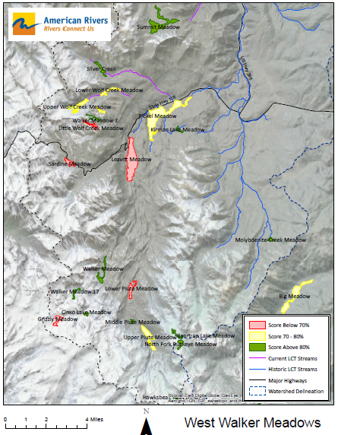

Slide 4
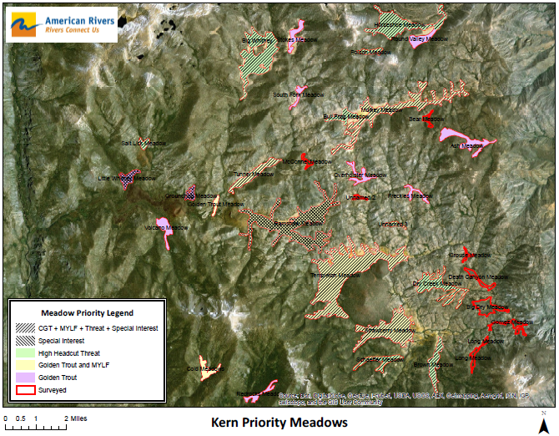
Notes:
Purpose of rapid assessment is to
Inventory

Slide 5
Assess to:
Inventory
Prioritize
Focus
Notes:
Purpose of rapid assessment is to
Inventory

Slide 6
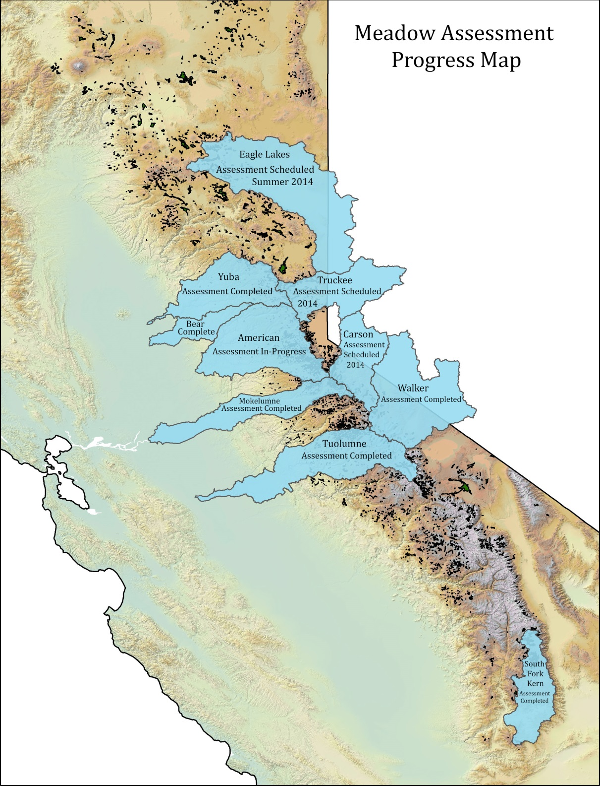
Notes:
UCD
Stillwater
Tuolumne River Trust
NRCS
AR

Slide 7
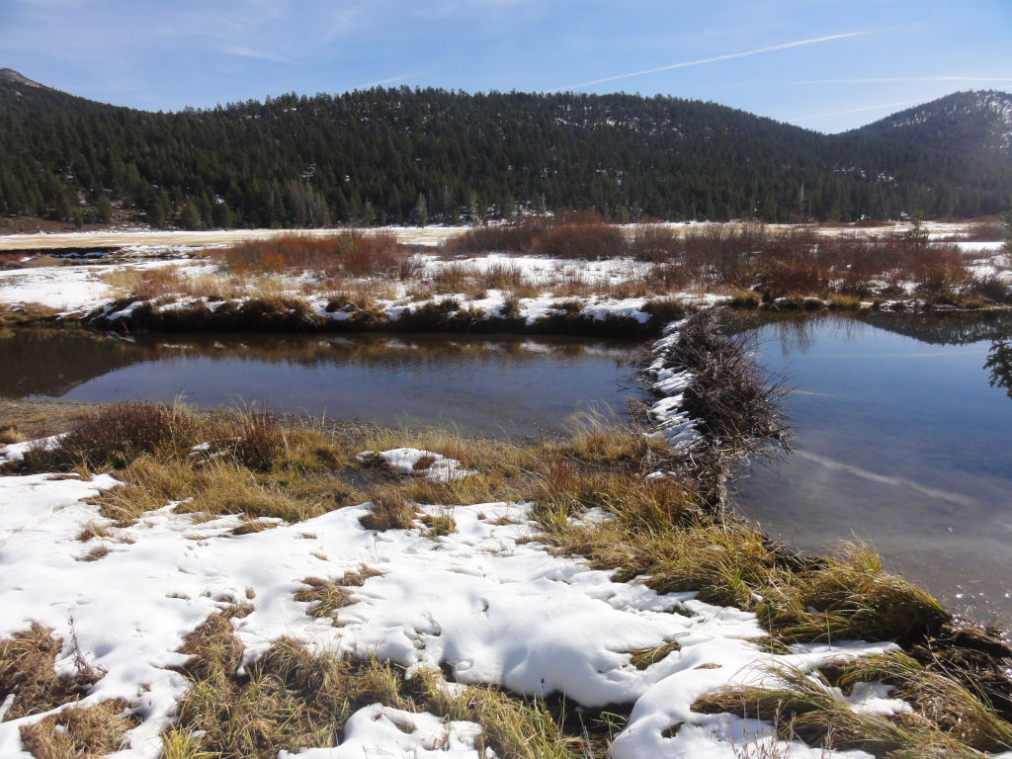
Project-specific monitoring and experiments:
Beaver Dams
Before-after and modeled streamflow and groundwater
Notes:
Nod to Rod for experiment

Slide 8
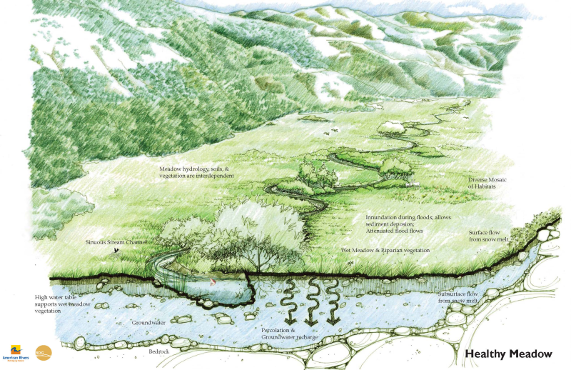
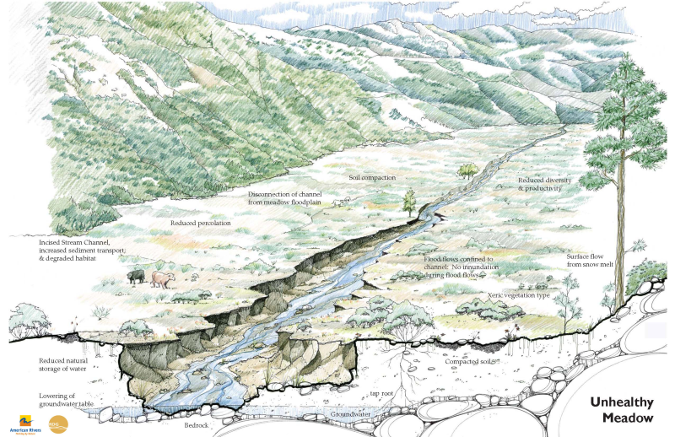
Why meadows?
Notes:
➢ Railroad Grades
➢ Road Building
➢ Livestock Grazing
➢ Logging
➢ Mining
➢ Channel/Drainage Manipulation
Water-
• Baseflow Augmentation
• Flood Attenuation
Improved Water Quality-
▪ Decreased Water Temperature
▪ Restored Nutrient Cycling
▪ Decreased Sediment
Biology-
• Aquatic Organisms
• Terrestrial Wildlife
• Vegetation Communities
➢Carbon-
• Biomass
• Soil

